Slide 1

Davis-Bacon “Mini - Camp”

Slide 2
New name & HUD web pages!!
The Office of Labor Relations is now called the Office of Davis-Bacon Labor Standards
OLSE web pages are in the process of being renamed and updated. So it’s best to start at HUD.gov and look under “Program Offices.”
Or type in: http://portal.hud.gov/hudportal/HUD?src=/program_offices/labor_standards_enforcement

Slide 3
Five Key Labor
Standards Objectives
(Local Agency Guide, Page 4)
Apply Davis-Bacon properly
Support contractor compliance
Monitor contractor performance
Investigate probable violations
Pursue appropriate sanctions when warranted

Slide 4
Local Agency Responsibilities (1)
(Local Agency Guide, Pages 5 & 6)
TEN ITEMS:
Designate appropriate staff
Establish construction management system (2 CFR Part 200)
Ensure contracts contain Federal labor standards (HUD 4010) and applicable wage determination

Slide 5
Local Agency Responsibilities (2)
Avoid debarred contractors
Conduct on-site inspections and interviews; and ensure wage determination and DOL Notice to Employees are posted
Review certified payrolls---ensure needed corrections are made

Slide 6
Local Agency Responsibilities (3)
Maintain full documentation of labor standards administration and enforcement
Refer complex matters to HUD
Prepare enforcement reports as required
Comply with all HUD Requirements

Slide 7
Labor Standards Administration
(Local Agency Guide, Pages 9 - 11)
1. Determine Davis-Bacon Applicability
2. Prepare Bid Documents & Contract
* D-B Wage Determination
* Labor Standards Clauses
3. Verify Contractor Eligibility
4. Assist w/ Contractor Compliance

Slide 8
CDBG: Factors of Applicability (1)
(Local Agency Guide, Page 23)
…construction work financed…
…in whole or in part…
…all laborers and mechanics employed by contractors or subcontractors…
…shall apply to the rehabilitation of residential property only if such property contains not less than 8 units.

Slide 9
CDBG: Factors of Applicability (2)
Construction contracts > $2,000
Soft costs generally do not trigger D-B
Force account construction work is generally exempt (not so for PHAs)
Volunteers are exempt (more later)

Slide 10
HOME: Factors of Applicability (1)
(Local Agency Guide, Page 26)
…affordable housing with 12 or more units assisted with funds made available under this subtitle…
…Any contract for the construction of affordable housing with 12 or more units…
…Sweat equity (is OK)
See also HOME Regulations: 24 CFR §92.354

Slide 11
HOME: Factors of Applicability (2)
Standard for applicability is construction assisted, not construction financed>>> this creates a broader application
Soft costs will trigger Davis-Bacon

Slide 12
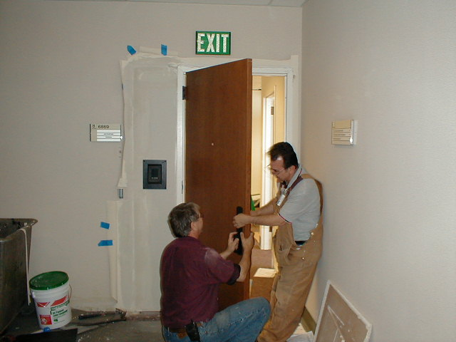
HOME: Factors of Applicability (3)
HOME applicability “taints” all units of a development
Volunteers are exempt

Slide 13
Contract Requirements

Slide 14
Labor Standards Provisions:
HUD Form 4010
Contracts must contain labor standards (LS) clauses & applicable wage determination
LS clauses describe contractor responsibilities
LS clauses have remedies for noncompliance

Slide 15

Wage Determinations

Slide 16
Wage Determination
“Lock-In” Rules (1)
Non-Competitive Bidding:
Modifications are effective if published before contract award, or start of construction, which ever occurs first

Slide 17
Wage Determination
“Lock-In” Rules (2)
Competitive bidding:
Modifications published <10 days before bid opening are not applicable if there is not sufficient time to notify bidders
Lock-in at bid opening provided contract is awarded within 90 days
Must update wage determination if contract award is >90 days

Slide 18
4 Types of Construction (1)
Building - sheltered enclosures for the purpose of housing persons, machinery, equipment, etc. Also apartment buildings greater than 4 stories
Residential - single family houses, townhouses, and apartment buildings up to four stories

Slide 19
Types of Construction (2)
Highway - roads, highways, sidewalks, parking areas, and other paving work not incidental to other construction

Slide 20
Types of Construction (3)
Heavy - projects which cannot be classified as Building, Residential or Highway
Often distinguished on basis of the characteristics of particular projects such as dredging, water and sewer lines, parks and playgrounds, dams, major bridges, and flood control.

Slide 21
Additional Classifications
Recent DOL All Agency Memorandum # 213 is a new wrinkle that must be taken into consideration when developing an additional classification request.
Use HUD Form 4230-A when requesting additional classifications.

Slide 22
Certified Payroll Basics
Optional Form WH-347 or equivalent
Compliance statement (w/ original signature of corporate official, or letter of delegation)
Identify first /final payroll; account for all wks.
Payrolls must be complete & legible
Payroll retention = three years

Slide 23

Labor Standards
Enforcement (1)
(Local Agency Guide, Pages 12 - 15)
1. Post Wage Det. & Davis-Bacon Poster
2. Conduct employee interviews on-site
3. Review Certified Payrolls (CPRs)
4. Require CPR discrepancies be fixed
5. Resolve probable violations and complaints

Slide 24
LS Enforcement (2)
6. Refer complex issues/falsification to HUD
7. Withhold money for back pay if nec.
8. Recommend debarment for repeat offenders
9 & 10. Prepare Enforcement Reports

Slide 25
Enforcement Concepts
Classification
Interviews
Posters

Slide 26

Classification
All laborers and mechanics must be:
Classified in accordance with the wage det. & paid for the work performed, not by level of skill or experience
Paid at rates not less than those on wage determination

Slide 27
On-Site Interviews…
Targeting highly encouraged
Interviewer must:
  Complete all info on HUD-11
  Note each Laborer’s / Mechanic’s:
    Duties performed
    Tools used
  Note discrepancies between observations and Laborer’s / Mechanic’s statements
  Sign and date HUD-11

Slide 28
HUD-11 Comparison to CPRs
Note results
Follow-up on discrepancies
  Notify contractor for corrections
  Target interviews
  Questionnaires
HUD-11

Slide 29
Posters
Two Posters:
      Wage determination
      DOL “Employee Rights”
      http://www.dol.gov/whd/regs/compliance/posters/fedprojc.pdf
      http://www.dol.gov/whd/regs/compliance/posters/davispan.pdf
  Posted in a conspicuous place, protected from the elements.

Slide 30
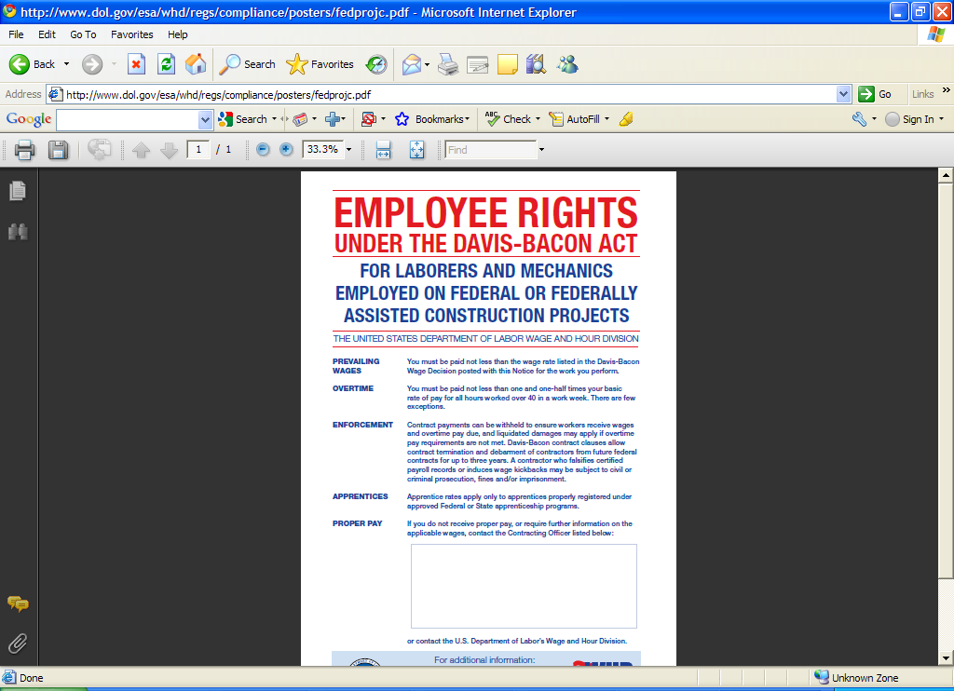

Slide 31

Home Stretch……

Slide 32
1. Get the CPRs
Without the CPRs, it is impossible to make any determinations regarding compliance

Slide 33
2. Check Payrolls
Review for major trades
Compare HUD-11s
Focus on falsification
Communicate results

Slide 34

Payroll Falsification Indicators
(Local Agency Guide, Page 44 - 46)
Ratio of laborers to mechanics (> 1:1)
Too few or irregular hours
Discrepancies in wage computations
Extraordinary deductions
        or…………..
Worker w/ a complaint

Slide 35
3. On-Site Interviews
Use on-site interviews to:
Validate / test payroll data
Develop complaints
Target interviews to substantiate suspected violations
      HUD-11 available at HUD Forms

Slide 36
4. Wage Restitution
Document restitution on corrected certified payroll report

Slide 37

5. Labor Standards
Records to be Kept (1)
Wage det’s and additional classifications
Verification of contractor eligibility (debarment)
Certified payrolls
Apprentice registrations
Documentation of all enforcement actions
Copy of executed contract

Slide 38
Labor Standards
Records to be Kept (2)
Documentation of bid opening /
contract award
Documentation of construction start date
Employee interviews & HUD-11s
Related correspondence / memoranda
Preserved no less than three years

Slide 39

Enforcement Reports
Semi-Annual (29 CFR §5.7(b))
Oct 1 → Mar 31 and Apr 1 → Sep 30
All covered contracts awarded w/in 6 mos.
Wage restitution found due
Complaints received
Investigations opened and closed
Employers found in violation
Findings of underpayment

Slide 40
Record of Employee Interview

Slide 41
Weekly Payroll Records Report

Slide 42

THANK YOU

