Slide 1

Affordable Homeownership NOFA
Applicant Information Session
Webinar
December 14, 2016
Updated December 28, 2017

Slide 2
Agenda
NOFA Description / Key Points
Proposal Parameters
Eligible Activities
Affordable Homeownership Property Standards
SHPO
Architectural and Technical Services (ATS) rqmnts
Utility Company Subsidies
SharePoint Application Submittal
ConApp / Homeownership Tabs
Rating and Ranking
Q and A

Slide 3
Affordable Homeownership
NOFA Key Points
The purpose of the NOFA is to create homeownership opportunities for eligible households throughout the State
Up to $10 million in State bond funds (FLEX or HTF)
DOH request not less than $500K, no more than $3MM
Electronic submissions mandatory (DOH/CHFA SharePoint)
Applications due Wednesday, March 21, 2018 at 4PM
Programs are NOT eligible

Slide 4
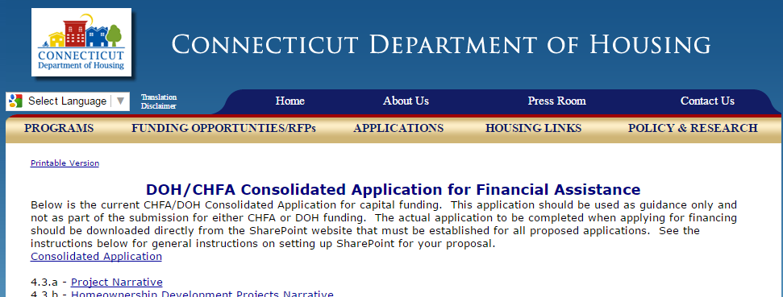
Affordable Homeownership
Proposal Parameters
NOFA, Q and A, Rating and Ranking
    Funding Opportunities/RFPs
Affordable Homeownership Property Standards
100% AMI Income Limits (FLEX)
120% AMI Income Limits (HTF)
Maximum Purchase Price/ After Rehab Value

Slide 5
Affordable Homeownership
Proposal Parameters-THRESHOLD
40% drawings and specs
Environmental Site Assessment required (within 6m of application deadline)
  Refer to NOFA for acceptable alternatives for certain circumstances
Projected housing payments (PITI) not <20% nor >30% gross annual income
  2-4 unit homes include 75% of projected rental income
Demonstrate marketability and absorption

Slide 6
Affordable Homeownership
Proposal Parameters
Soft commitments are threshold for all funding sources
Zoning- conditional approval is threshold
Sales proceeds must be used and included in sources and uses (cannot be kept as program income)

Slide 7
Eligible Activities
Assisted properties must comprise1-4 units (multiple buildings/condos OK)
New construction or rehab of uninhabitable homeownership units
Projects: Site control, one development budget, shared sources/uses to be developed in a single phase
Condominiums
  If proposing to rehab/convert existing rental units into condos CONTACT DOH ASAP

Slide 8
Affordable Homeownership
Property Standards
New Construction and Major Rehab
  All applicable state and local codes, rehab standards and ordinances and zoning ordinances prior to occupancy
  Housing must also meet Energy Star for Homes Certification with Energy Star Indoor Air Package

Slide 9
Affordable Homeownership
Application- SHPO
SHPO determination of effect required
Must consult with SHPO re: historic tax credits prior to application submittal
May be eligible under the Historic Homes Rehab Tax Credit Program or the Historic Rehab Tax Credit Program

Slide 10
DOH Architectural & Technical Services (ATS) Review

Slide 11
CEPA
(CT Environmental Policy Act)
Applicable to subdivisions if…
200 + BDRMS
200+ PARKING
Conservation Area
Includes all phases of work

Slide 12
SHPO
(State Historic Preservation Office)
Contact SHPO for a Determination
Submit SHPO Determination Response Letter
Historic Buildings, Site, Artifacts

Slide 13
Floodplain Management and Compliance
TRIGGER!
Buildings or any part of a site in
the
100 or 500 year
floodplain
*Submit FEMA floodplain map with site location identified

Slide 14
DEEP Floodplain Management and Compliance
Application materials must clearly demonstrate location of the project in relation to 100/500 yr
If located in 100/500 year, CONTACT DOH FOR PRE-APP meeting with DEEP. Must demonstrate:
  Incorporates safe evacuation
  does not involve the placement of utilities that will promote or encourage future development in floodplain
  does not increase the potential to cause or pose a hazard to human life, health or property if it is destroyed or damaged due to flooding; or
  does not involve the placement of fill within a watercourse or any water to create dry land to allow for the construction of a structure.

Slide 15
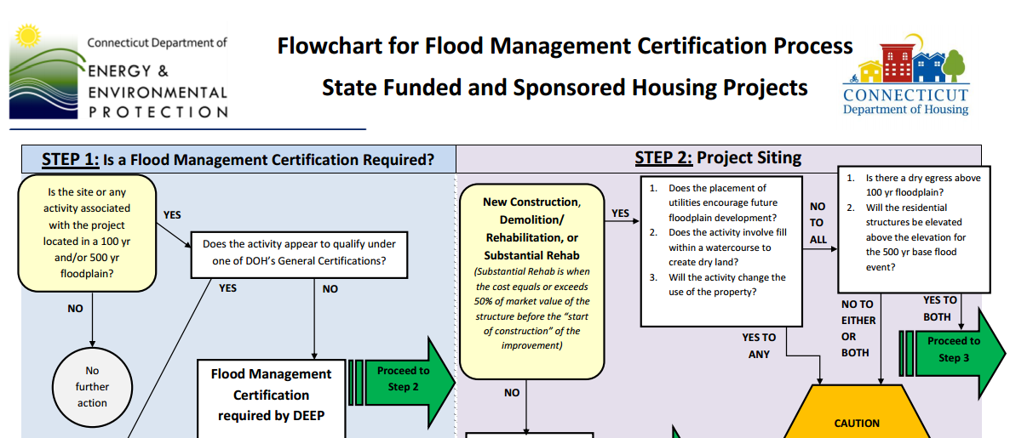
DEEP Floodplain Management and Compliance
Floodplain Management Certification
General Permit (DOH)
Exemption to the Statute

Slide 16

Environmental Building Conditions
HAZMATS
(Existing Buildings)
Inspections/Surveys
LBP, Radon, Asbestos, PCBs, Mold, etc.
Remedial Action Plans
Costs!!!
Report must be less than 6 months old

Slide 17
Environmental Site Conditions
Phase I/II ESA – Subdivisions (Phase II- if required)
Environmental Transaction Screen/Assessment (for EACH SITE)
  Scattered site (not subdivisions)
  new construction on vacant sites
  Vacant existing buildings(DEMO)
Environmental Site Inspection Letter Report (for EACH SITE)
  Scattered site (not subdivisions)
  substantial and/or moderate rehabilitation of vacant and occupied buildings
  Reports completed by an LEP or by someone supervised by an LEP.
  ** All reports must be less than 6 months old **

Slide 18
Local Approvals
  Variances
  Easements
  Right of Way
  Parking
  Special Permits

Slide 19
Building Assessments
(Existing Building)
  Capital Needs
  AND/OR
  Structural (gut or substantial rehab)
  Performed by an architect, engineer or qualified licensed professional

Slide 20
Procurement
Construction/Prof Services
Contracts over $100,000
  Must be publicly advertised
  Open/competitive
  Minimum 3 responses
Contracts under $100,000
  Obtain quotes
  Minimum 3 responses

Slide 21
Contractor Requirements
Contractor Qualification Statement A305 Open litigation will require a written update with a probable outcome statement for each case by the contractors attorney.
Bonding Performance/Payment Bonds 100%
Letter of Credit w/Completion Assurance Agreement < $250,000 10% >$250,000 25% Builders Risk (Owner or Contractor) Contractor’s Certificate of Insurance

Slide 22
CHRO
Commission of Human Rights & Opportunities
Contact CHRO for Contract Compliance Requirements for :
Set – Asides
Affirmative Action
Notification to Bidders
Monitoring and Reporting
Submit copy of contact letter to DOH.

Slide 23
Dwelling Design Requirements
CHFA/DOH
2016 Multifamily Design, Construction and Sustainability Standards
Section O: Dwelling Unit Design
Living, entrance, closet, dining, kitchen, bedrooms, bathrooms sizes etc
(Omit Secondary Storage)

Slide 24
Drawings and Specs
Drawings and specs must be submitted electronically via the SharePoint site, like all other application materials, by the deadline
40% drawings/specs are threshold
Must include Site plan & MEPs (Mechanical, Electrical and Plumbing)
Any energy efficient measures should be included in drawings/specs and construction costs
Specifications may be outline if they include material, product information sheets.

Slide 25
State Funding
Utility Company Energy Subsidies Overview
Presented by:
Enoch Lenge, Eversource
December 14, 2016

Slide 26
Who is Eligible?
Builders and homeowners building new homes or gutting an existing building to the studs in Eversource or UI territory
Building Eligibility Type:
  Single Family
  Single Family (Attached)
  Multi-Family (5+ Units)
Low income housing is eligible for additional 25% of incentives
Homes of all heating types are eligible
Notes:
NOTE: Applications will NOT be accepted for completed homes or once insulation has been installed in the home.

Slide 27
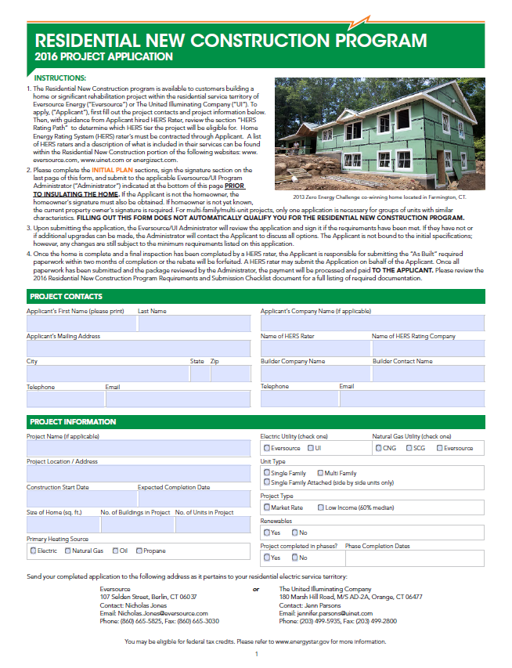
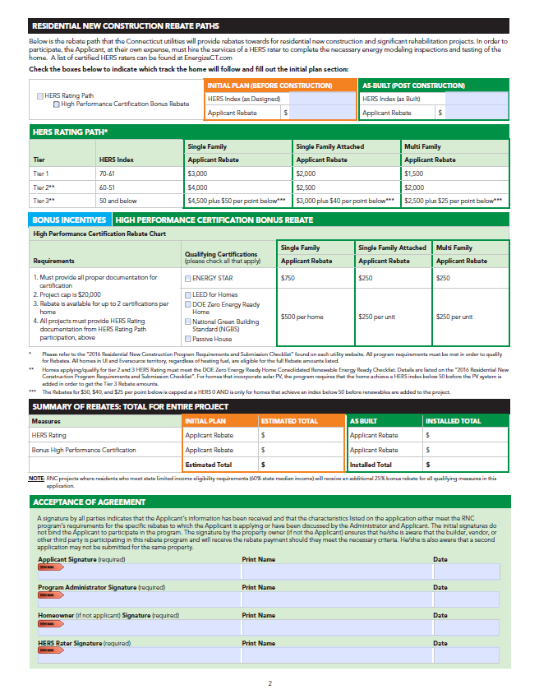
RNC Application Overview
Notes:
Touch on what the new fields are

Slide 28
HERS Incentive Structure
HERS Incentive Structure
HERS Index | Single Family | Single Family Attached | Multi Family
 | Applicant Incentive | Applicant Incentive | Applicant Incentive
70-61 | $3,000 (Per Home) | $2,000 (Per Unit) | $1,500 (Per Unit)
60-50 | $4,000 (Per Home) | $2,500 (Per Unit) | $2,000 (Per Unit)
Below 50 | $4,500 + $50* (Per Home) | $3,000 + $40* (Per Unit) | $2,500 + $25* (Per Unit)
*Additional incentive for every point below 50 HERS Index

Slide 29
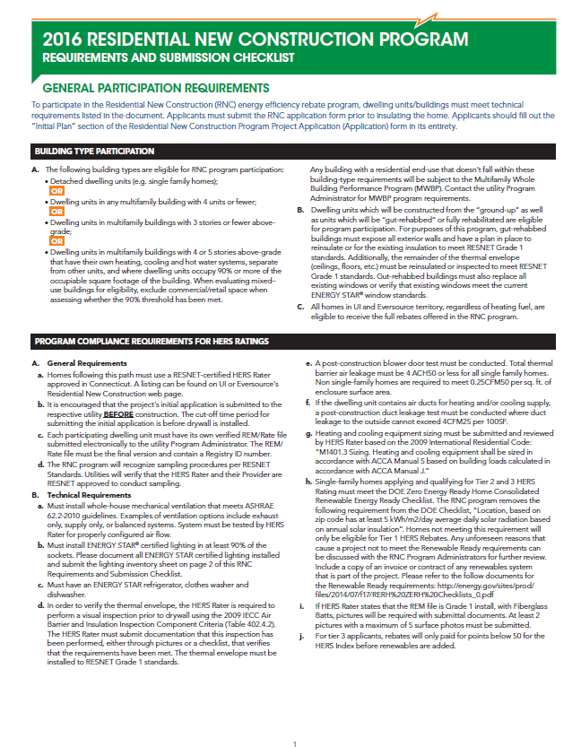
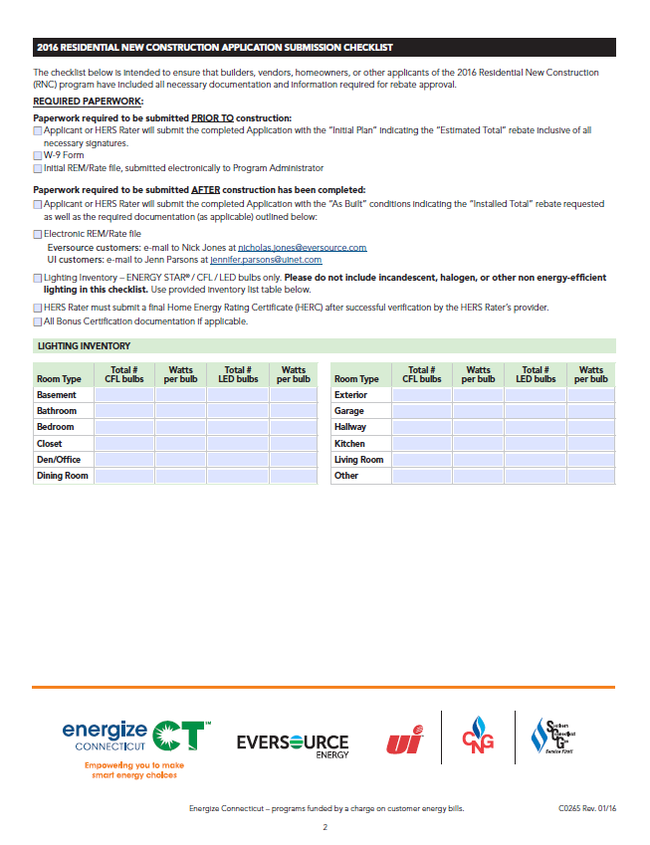
HERS Requirements Checklist

Slide 30
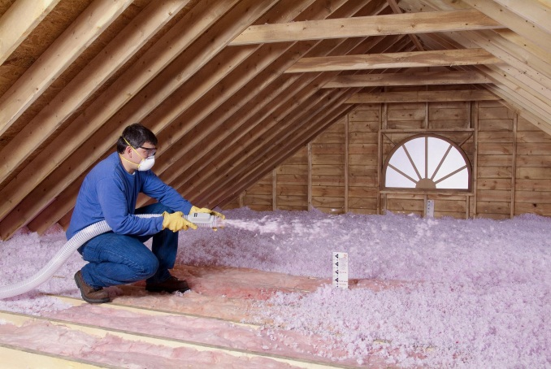

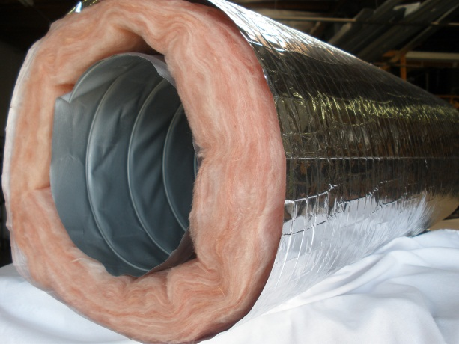

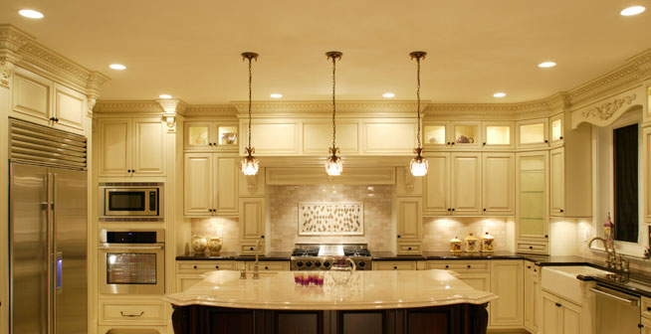

HERS Path:
Required Measures & Value
Thermal Envelope
Renewable Tech
Duct Tightness
HVAC Systems
Lighting & Appliances
3rd Party Verification
Notes:
30

Slide 31

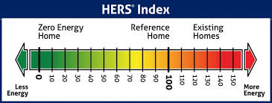
RNC HERS Path
Third-Party Verification
HERS Raters Add Value
Energy efficiency consultant working for you
Cost benefit analysis of energy measures
QA of energy measures
Blower door & duct blaster
Non-bias third party

Slide 32
List of HERS rating companies
www.EnergizeCT.com

Slide 33

Residential New Construction Program
RNC Project Process Flow
Hire a HERS rater
Kick-off meeting w/ HERS rater
HERS rater reviews energy performance of design
HERS rater works with you to recommend energy efficient design upgrades
Submit RNC Application which earmarks incentives to the project
Inspections done by HERS rater during construction
Incentives paid out upon completion

Slide 34
Questions?
Eversource: United Illuminating:
Nicholas Jones Jenn Parsons
107 Selden Street 180 Marsh Hill Road,
Berlin, CT 06037 Orange, CT 06477
Email: Email:
Nicholas.Jones@eversource.com Jennifer.Parsons@uinet.com
Phone: (860) 665-5825 Phone: 203-499-5935

Slide 35

Using SharePoint to Submit an Application

Slide 36

Contents
Requesting SharePoint website
Logging into SharePoint
  Sharing the application website with team
Utilizing the Consolidated Application (ConApp)

Slide 37

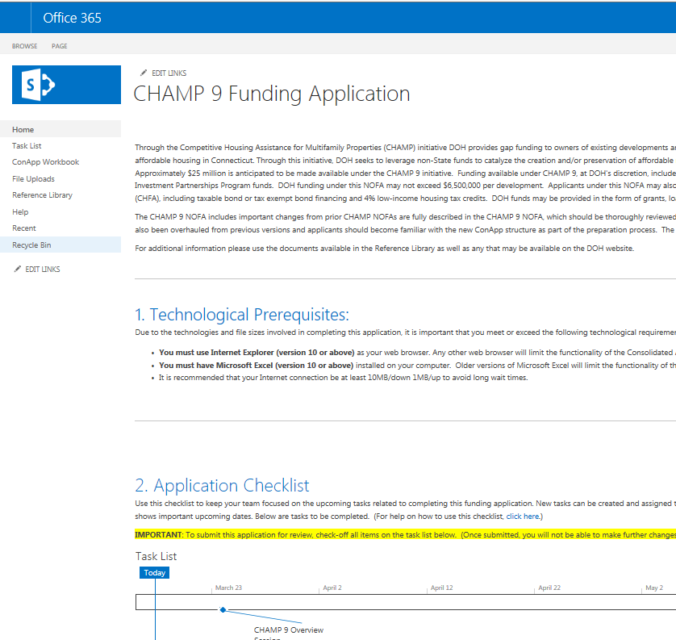
Electronic Submissions
Funding Round (i.e. 2018 Affordable Homeownership)
Project Name
Applicant Name
Primary Contact Name
Primary Contact Email
Primary Contact Phone
**Send requests to:
applicationrequest@chfa.org

Slide 38
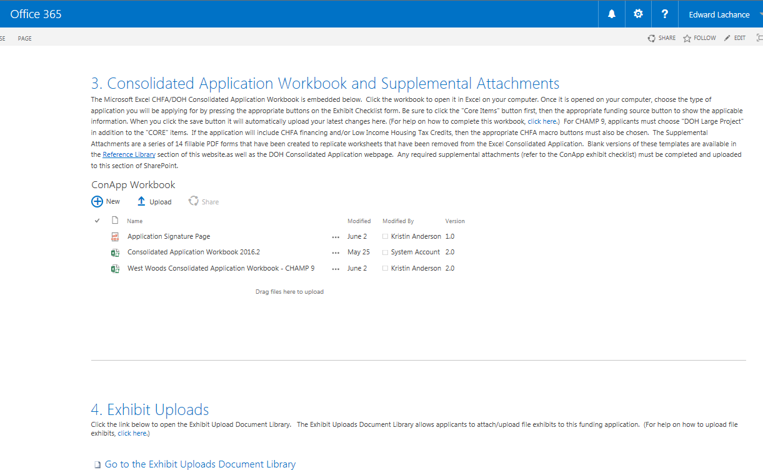
SharePoint

Slide 39
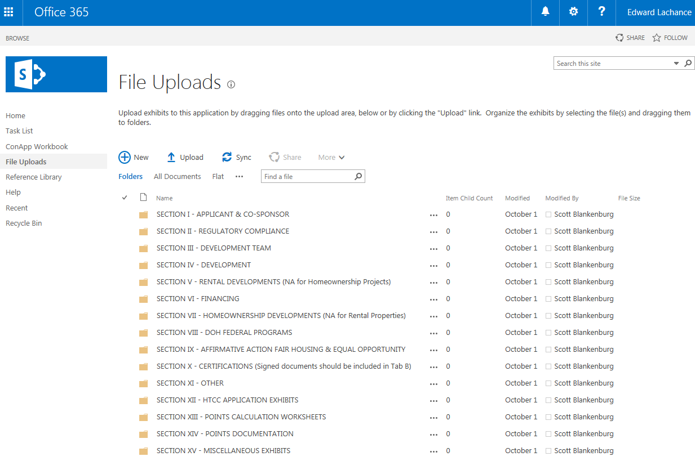
SharePoint

Slide 40
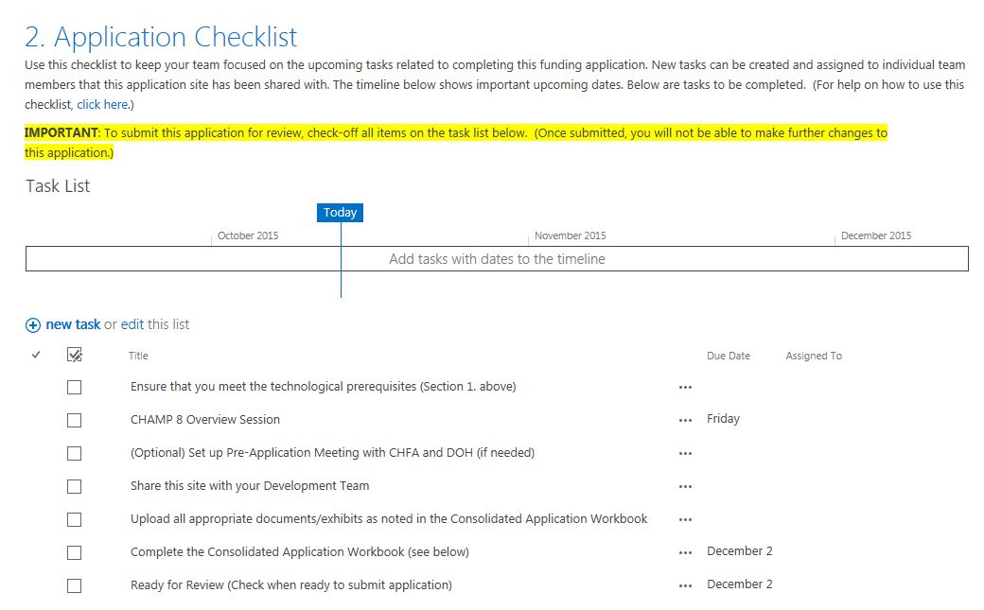
SharePoint
Check here to submit application

Slide 41
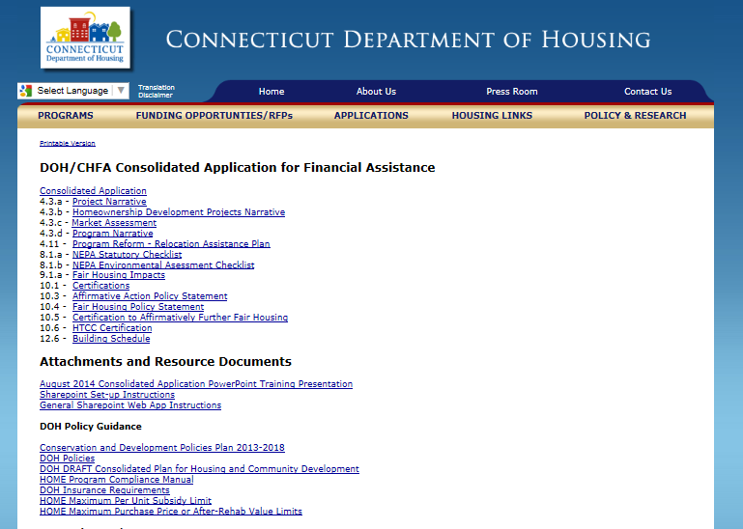
Latest version of the ConApp Required

Slide 42
ConApp Changes
Historic Preservation Requirements
Homeownership tabs
Development Budget

Slide 43
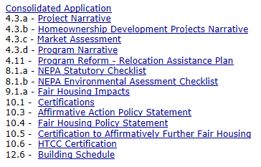
Now Fillable PDF Documents

Slide 44
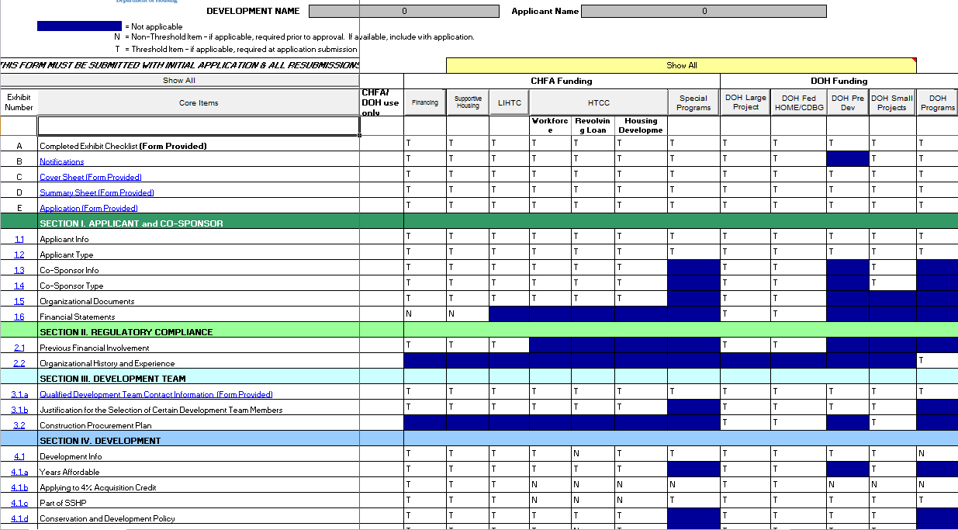
Macro Buttons
Select “DOH Large Project”

Slide 45
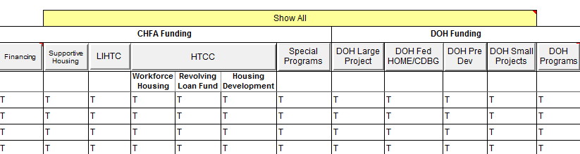
Program Type will appear in yellow box
(In this case no program type has been selected)

Slide 46
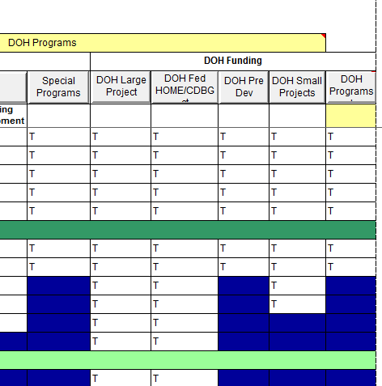
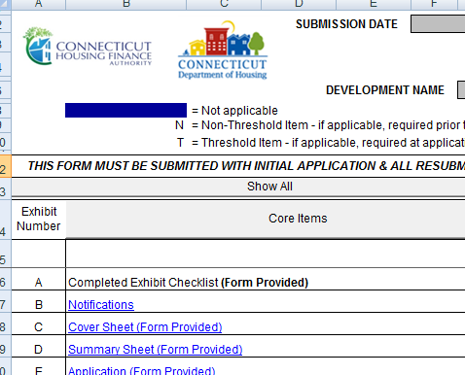
ConApp
Exhibit Checklist Tab
Exhibits marked as N/A, N (non-threshold), and T (threshold) for each “DOH Funding” selection

Slide 47
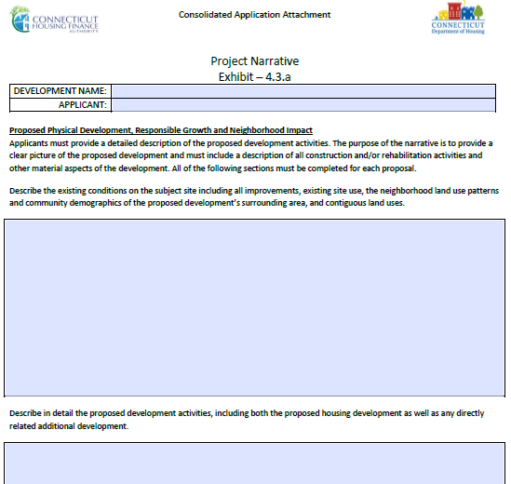
ConApp Review
Narrative Sections

Slide 48
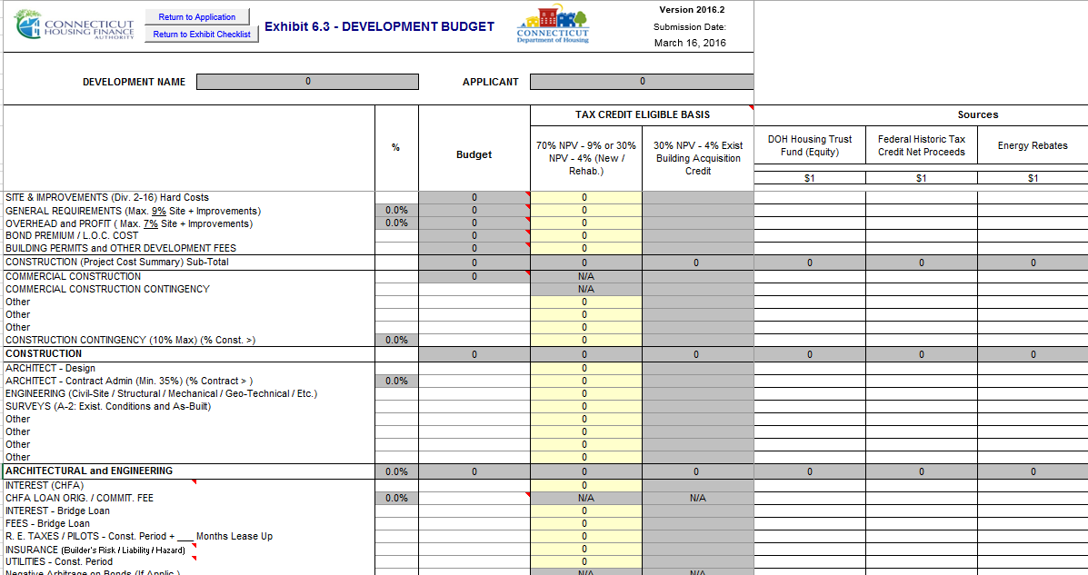
ConApp Review
Development Budget Form

Slide 49
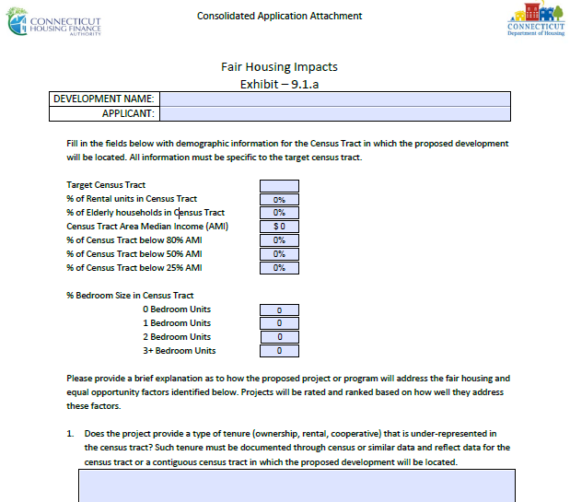
ConApp Review
Fair Housing Impacts

Slide 50
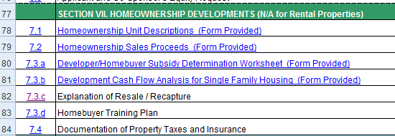
ConApp
Section VII. Homeownership Developments
Projects are required to complete all items in Section VII.

Slide 51
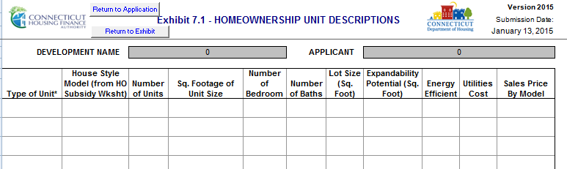
ConApp
Exhibit 7.1- Homeownership Unit Descriptions (PROJECTS)
Notes:
Definitions

Slide 52
ConApp
Exhibit 7.2- Homeownership Sales Proceeds (PROJECTS)
Preliminary homebuyer underwriting
Identify the resources that the homebuyer needs to purchase the home
  Estimated cash downpayment
  Identify other downpayment assistance
  Size of first mortgage and the interest rate
Incorporates rental income for 2-4 unit properties
Notes:
Definitions

Slide 53
ConApp
Exhibit 7.2- Homeownership Sales Proceeds
Since individual homebuyers may not be identified, it is based on research conducted by the applicant (mortgages, interest rates, other resources to assist with purchase)
DOH evaluates this to ensure that applicant can realistically sell the units based on the incomes of targeted households as well as the proposed purchase prices (Is it feasible?)
Notes:
Definitions

Slide 54
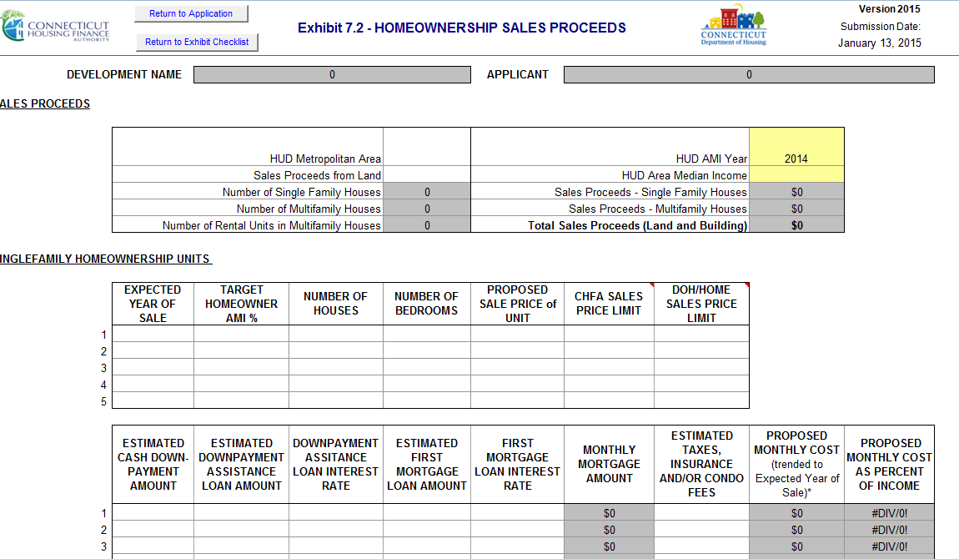
Notes:
Definitions

Slide 55
ConApp
Exhibit 7.2- Homeownership Sales Proceeds
CHFA has a number of mortgage products that may assist low-income households purchase a home
Work directly with CHFA participating lenders to obtain CHFA products
In homeownership development, mortgages are often used to “take-out” or repay construction loans
Notes:
Definitions

Slide 56
ConApp
Exhibit 7.3.a- Homeownership Subsidy Worksheet
Developer’s Subsidy: the difference between the cost to develop housing and the fair market value.
Homebuyer’s Subsidy: any investment that enables the buyer to purchase the unit (ex: dpa, closing costs)
Total Development Cost of Unit
-Fair Market Value
Developer’s Subsidy
Fair Market Value
-DPA, closing cost asst
Homebuyer’s Subsidy
Notes:
Definitions

Slide 57
ConApp
Exhibit 7.3.a - Homeownership Subsidy Worksheet
Developer Subsidy $20,000 | $280,000 | Total Development Cost of Unit
 | $260,000 | Fair Market Value
Homebuyer Subsidy $10,000 | $260,000 | Sales Price
 | $10,000 | Principal Buydown and/or downpayment assistance

Slide 58
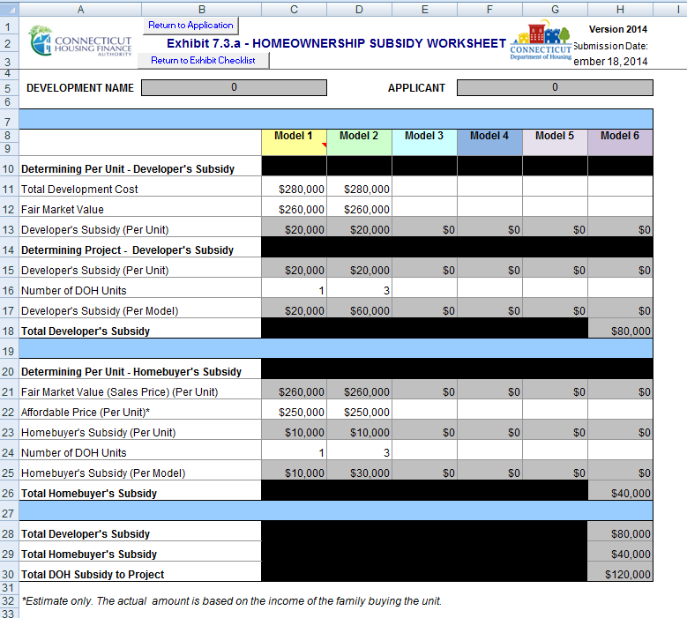

Slide 59
Resale/ Recapture
Exhibit 7.3.C -Application Tab
Applicant must submit explanation of terms and provisions
Homeowner required to occupy the property
Resale
  Ensures units remain affordable over time
  Unit must be sold to an eligible homeowner during period of affordability
Recapture
  Applicant can recover a portion of direct homebuyer subsidy.
  Homeowner is at liberty to sell to any buyer, at any price the market can bear

Slide 60
Resale
Pick ONE or the Other (resale or recapture)
Subsequent sales price must be affordable
Original homebuyer must receive fair return on their investment (downpayment, principal payments, capital improvements financed by homeowner)
If there is no direct homebuyer subsidy (development subsidy only) use resale
Secure interest with a deed restriction, covenant running with land.

Slide 61
Recapture
Pick ONE or the Other (resale or recapture)
Only secure the amount of direct homebuyer subsidy (not any portion of the development subsidy)
Use a Note and Deed to secure your interest
At time of sale/transfer, restrict repayment to an amount that is available from the net proceeds of the sale

Slide 62
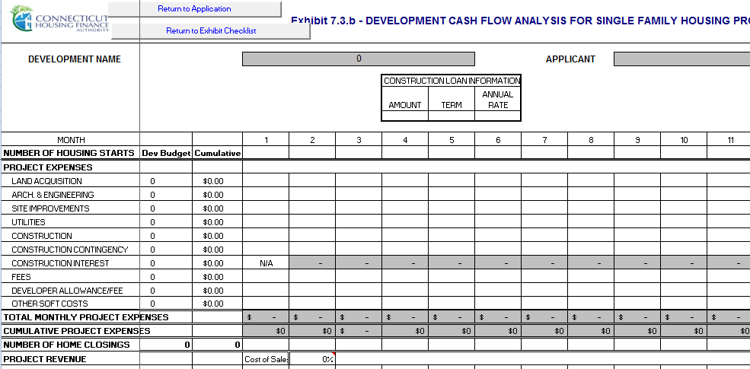
ConApp
Exhibit 7.3.b- Development Cash Flow Analysis
Notes:
Definitions

Slide 63
Affordable Homeownership
Rating and Ranking

Slide 64
Rating and Ranking
  Affordability and Marketability (30 pts)
  Applicant Experience and Capacity (30 pts)
  Project Feasibility and Readiness to Proceed (67 pts)
  Fair Housing (12 points)
  Responsible Growth and Livability Initiatives (16 pts)
  Other Towns and Cities OR
  Urban Cities (New Britain, New Haven, New London, Norwalk, Stamford, Bridgeport, Hartford, Waterbury, Danbury) (50 points)
Notes:
Major Categories

Slide 65
Affordable Homeownership
Rating and Ranking
Leverage DOH funds with other sources
Contact utility companies for energy subsidies- include in sources as permanent financing
Commitments for financing
  Firm commitments (points) or soft commitments (threshold)
  Sustainable development
  Any energy efficient measures should be included in drawings/specs and construction costs

Slide 66
Affordable Homeownership
Rating and Ranking
  4.3.d Long-term oversight
    Be sure to discuss how loans will be serviced
    Compliance monitoring
  4.3.a Homebuyer Training Program
  Homebuyer Counseling/ Training
  Landlord Education
  www.CHFA.org lists HUD approved counseling agencies

Slide 67
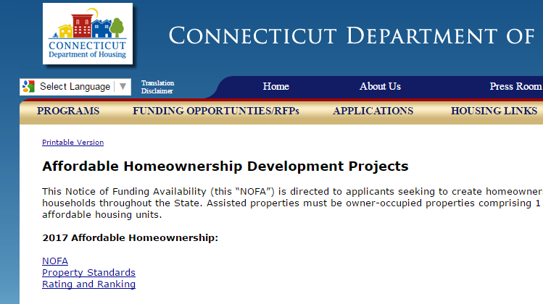

Questions and Answers
Questions and answers to be posted on DOH Affordable Homeownership Development webpage.
Send questions to:
Nick.Lundgren@ct.gov

