Slide 1
Intimate Partner Violence –
Family Assessment Intervention Response (IPV-FAIR)
Linda Madigan Runlett

Slide 2
Highlights
2012 Office of Intimate Partner Violence and Substance Use Treatment and Recovery established
2013 Request for Information-Domestic Violence Services, was distributed focusing on the Redesign of the Intensive Family Violence Services (IFVS) and Domestic Violence Training and Consultation
2013 Development of the Intimate Partner Violence Specialist position replacing the Domestic Violence Consultants & the Intimate Partner Violence Program Development and Oversight Coordinator position created
2014 Contract with the Connecticut Children’s Medical Center – Injury Prevention Center (IPC) for the Training, Consultation and Evaluation Services. Extensive research and literature review (DCF & IPC)
2014 Development of the IPV-FAIR clinical treatment model
2015 Request for Proposals - Initiated IPV-FAIR, four Providers to service 6 Regions
2016 Expansion of IPV-FAIR to 6 Providers each serving a separate Region
2018 Second Expansion increasing service capacity in Regions 2, 3, 4 (Currently hiring staff)

Slide 3
IPV-FAIR
Family Assessment Intervention Response
IPV-FAIR is a comprehensive treatment program designed to provide in-home and community based clinical and case management services to all members of a family involved with DCF and experiencing Intimate Partner Violence. Each family will work with a team of a clinician and family navigator to address identified needs
Population served - The target population is families involved with DCF Child Protective Services (CPS) & are impacted by intimate partner violence (IPV). It addresses families where the children remain in the home or are placed out of the home with a goal of reunification

Slide 4
IPV-FAIR Overview
Scope of the Program -
  Individualized assessment and treatment planning
  Individualized Safety Planning
  Fathers for Change & Mothers and More
  Psycho-education
  Dyadic work between caregivers and caregivers/child(ren)
  Trauma focused work
  Parenting education and skill building (Circle of Security Parenting)
  Linkages to appropriate supports including basic needs or community services/supports

Slide 5
IPV-FAIR Overview
    LOS: 4-6 months with possible extension – one o three sessions a week
    Areas /regions served – Statewide - Six (6) providers
    Referral process: Referred by DCF through Intimate Partner Violence Specialist after a IPV consultation
    Evaluation Process: Fathers for Change Fidelity case reviews by model developer, Bi-annual Periodic Review of Performance, and quarterly stoplight reports. Personal Service Agreement (PSA) with Connecticut Children's Medical Center – Injury Prevention Center for Training, Consultation and Evaluation.

Slide 6
IPV-FAIR Overview
  Total Funding = $2,609,000 /FY17 & FY18 (Expansion FY19 + $585,000)
    6 providers @ $390,000/Provider = $2,340,000
    Carla Stover Mental Health-Promising Practice Models = $29,000
    Injury Prevention Center-Training, Consultation & Evaluation = $240,000
  Total Capacity
    Statewide capacity 240-360 families
    Capacity 40-60 families/year/Provider
    Caseload size: 10 families/Clinician (Masters level) & Navigator Team (Bachelors level)
  Utilization Rate
    FY 2017: 227 families with 302 children
    FY 2018: 210 families with 459 children

Slide 7
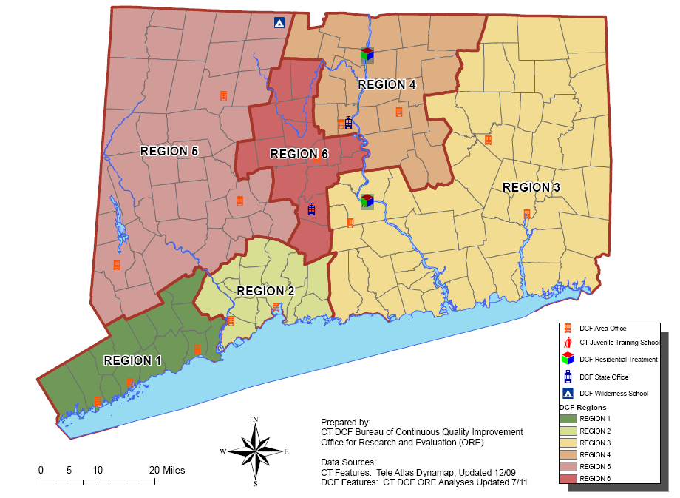
FAIR Providers
Region 1: Family Re-Entry: Bridgeport, Norwalk, 9 Mott Ave., Suite 104, Norwalk
Region 2: Family Centered Services of CT (FCT) New Haven, Milford 235 Nicoll Street, New Haven
Region 3: Child & Family Agency: Norwich, Middletown, Willimantic 7 Vauxhal St., New London
Region 4: CHR: Hartford, Manchester 999 Asylum Street, Hartford; 444 Center St, Manchester
Region 5: Wellmore: Waterbury, Danbury, Torrington 402 East Main Street, 2nd floor, Waterbury
Region 6: Child Guidance Clinic for Central CT: New Britain, Meriden - 384 Pratt St # 1, Meriden

Slide 8
IPV-FAIR Overview
    Staff Demographics: 32 staff
      Male 4/32 12.5%
      Female 28/32 87.5%
      Spanish Speaking 11/32 34%
      Hispanic Origin 10/32 31%
      Black/African Amer. 3/32 9%
      Asian 1/32 3%
      Multi 5/32 16%
      White 22/32 69%
      Not disclosed 1/32 3%

Slide 9
IPV FAIR - Admissions
Numbers of Admissions by Race:

Slide 10
IPV FAIR Discharges

Slide 11
IPV-FAIR Reason for Discharge &Race/Ethnicity – FY 17

Slide 12
IPV-FAIR Reason for Discharge &Race/Ethnicity – FY 18

Slide 13
Abusive Behavior Inventory
FY 2018
constitutes abusive relationship
*=sig. at .05; **=sig. at .01

Slide 14
Co-Parental Relationship: Exposure to Conflict
constitutes abusive relationship
*=sig. at .05; **=sig. at .01

Slide 15
IPV-FAIR – FY 18 Repeat Maltreatment
10 of 154 (6%) Families had a total of 22 children removed from their home within 3-12 months post discharge
              8 (5%) Families had 15 children removed for reasons not related to IPV
              2 (1%) Families had 7 children removed for IPV
21 of 154 (14%) families had new reports of maltreatment within 3-12 months post discharge
              12 (8%) Families had 17 reports that were not related to IPV
              9 (6%) Families had 12 reports that were related to IPV

Slide 16
IPV-FAIR
Satisfaction Survey Mom Comments
What I like the most was the way the staff treated me and my family and the change I see in my husband.
My workers were very reliable and stuck to every promise made, they really helped above and beyond.
The best part of the program for me was learning how to communicate in a healthier manner and to be able to voice injustice in a productive and non-violent way. I also loved when my partner got to sit down with our son and verbalized why we were a part of this program
The co-parenting sessions, and practicing communication skills with my co-parent
I like that I now have all these great skills to help me in life to have the best possible life for my family.
The one on one sessions helped a great deal with understanding why and how the way i feel. I also, liked the joint sessions with my partner. That has also helped me understand the way he feels and how he thinks.
I liked most the clinician came to our home and was flexible with scheduling. This made the program possible for us. I also feel that the program itself has a solid implementation that greatly impacted our outlook and impacted positively on communication skills. Our clinician was very kind, understanding, and upbeat which made our family feel comfortable with transition.

Slide 17
IPV-FAIR
Satisfaction Survey Dad Comments
I most like the level of comfort provided by clinician. I felt as if I actually had someone who cared about my well-being and wanted to help me move forward in my life.
Before the program I was not able to have a healthy relationship, now having completed the program I have learned to be a partner and parent.
I liked the fact the program touched very important aspects in my life that I once couldn't cope with.
I liked how informative the program is, I have learned a lot about my children and myself.
The one on one aspect of the program allowed me to get very personalized help. My counselor was extremely accommodating and flexible to my needs.
The program helped me to be a better human being. Also helped to create stronger bonding with my family.
It was very helpful with communicating with my co-parent and looking at things from my children’s and her point of view.
I liked the tools I was given to help me be a better co-parent and father.
I enjoyed being able to discuss the emotions I was going through and having someone to listen.

Slide 18
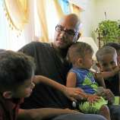
New Haven Register Article
Connecticut DCF finds success in domestic violence program for fathers
100 served so far, with aim to decrease domestic violence
By Esteban L. Hernandez/Hearst Connecticut Media
Published 3:07 pm EDT, Sunday, August 20, 2017

Slide 19
IPV-FAIR- Strengths and Challenges
Strengths
Challenges
Committed & dedicated provider network
Innovative Practice Model – Individually tailored/family focused
Fatherhood Engagement built into the model
Thorough assessment informs case planning
Ongoing weekly consultation calls with model developer provides support and guidance to providers.
Overwhelmingly positive satisfaction survey responses.
Strong collaborative partnership with CCMC-IPC
Robust fidelity and evaluation
Monthly hub meetings maintain a collaborative working relationship between DCF and Providers
Data collection
  Assessments in Qualtrics
  Additional data collection in PIE (start 10-1-18)
  Providers also have their own Electronic Health Record
  Repeat maltreatment captured manual review
Need exceeds capacity
Maintaining Engagement with families through completion
Staffing
  Staff turnover
  Difficulty hiring and retaining Spanish speaking clinicians

Slide 20
IPV-FAIR – Next Steps
Integrate PIE & Qualtrics
Continue with fidelity monitoring and bi-annual reviews
Data development to capture repeat maltreatment
Introduce Assertive Engagement model and monthly coaching calls
Continued exploration of expansion

Slide 21

THANK YOU
Linda Madigan Runlett linda.madigan@ct.gov

Slide 22

Additional Data from Assessments

Slide 23
Anger Inventory (Dad)

Slide 24
Difficulties in Emotional Regulation (Dad)
*=sig. at .05; **=sig. at .01

Slide 25
Reflective Functioning (Dads)
*=sig. at .05; **=sig. at .01

