Slide 1
Family First Prevention Services Act - Fiscal and Revenue Enhancement Workgroup
February 10, 2020
Conference Call

Slide 2
Agenda
Welcome
Charter document
Candidacy Workgroup Update
Program Workgroup Update
Maintenance Of Effort
Ethics Issues regarding future procurements
Potential use of the federal seed funding

Slide 3
Candidacy workgroup update

Slide 4
Candidacy workgroup update
6. Families with certain characteristics who are identified through a community or neighborhood Pathway:
  Children who are chronically absent from preschool/school or are truant from school
  Children of incarcerated parents
  Trafficked youth
  Unstably housed/homeless youth
  Families experiencing interpersonal violence
  Youth who have been referred to the juvenile review board or who have been arrested
  Caregivers who have, or have a child with, a substance use disorder, mental health condition or disability that impacts parenting
  Infants born substance-exposed (as defined by the state CAPTA notification protocol)

Slide 5
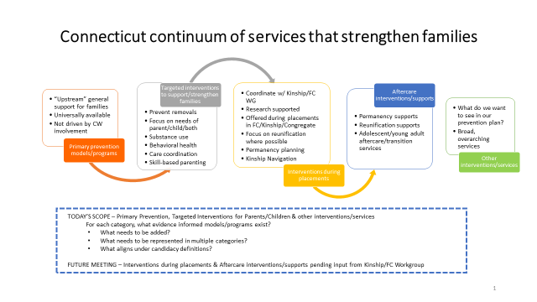
Program Workgroup Update

Slide 6
Maintenance of effort
DCF is contracting with a national expert to receive consultation
Reasoning on 2014 Base year
Sets the minimum to be spent on prevention activities
Determining Statewide the Clearinghouse Services in effect in FY2014
Opportunities / Risks Discussion

Slide 7
Potential Use of Federal Seed Funding
Purpose / potential use of funding
Bridging States for loss of revenue when switching to prevention model
Investment funding to implement plans
The commissioner and Executive Team have yet to determine the use of funding

Slide 8
Ethics Issues Related to Potential Procurements
State contracting procurement rules
Insider information vs. Information that is openly available
Planning vs. implementation
RFP creation
Requesting an opinion

Slide 9
Questions / New Items
Preparation for the next meeting
Questions
Comments
Homework
Meeting Schedule – in person and remote

