Slide 1
Family First Prevention Services Act - Fiscal and Revenue Enhancement Workgroup
January 8, 2020
Conference Call

Slide 2
Agenda
Welcome
Timelines
Scope of the Plan
Candidacy Workgroup Update
Program Workgroup Update
Crafting of the Fiscal and Revenue enhancement Workgroup Charter

Slide 3
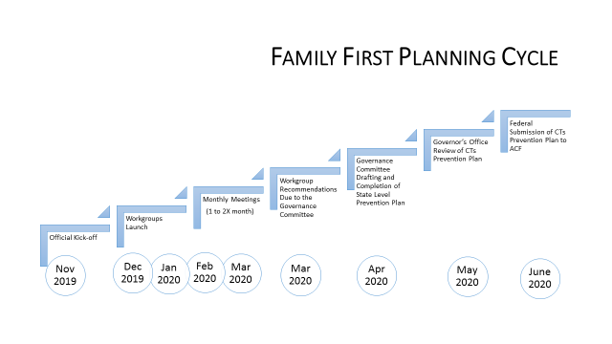
Timeline For October 2020 Target Start Date

Slide 4
Candidacy workgroup update
As an engagement tool; during the presentations, workgroup members actively engaged in an exercise where they placed categories of youth in one of three buckets:
  Definite Candidate for Family First
  Possible Candidate for Family First
  Candidate for Broader Prevention Plan
A summary of the activity (as compiled immediately following) is captured here:
Definite Family First Candidate
Children w/ substantiated maltreatment report Parents with mental health/substance use issues Youth exiting foster care (to varying degrees—all, within 30 days, etc.) FAR cases (with varying risk levels, or FAR with subsequent report) Pregnant/parenting youth in foster care Each of these got one post-it each: juvenile justice-involved youth, families with unstable housing, and non-accepted calls to DCF
Possible Family First Candidate
Substance-exposed youth/caregivers Accepted/non-accepted Careline calls Upstream, community-involved, non-DCF youth ID within the school system (special ed, school refusal) Each of these received one post-it each: juvenile justice-involved youth, homeless families, informal kin

Slide 5
Program Workgroup Update
Program Workgroup is awaiting the defined Candidacy pool
Evaluating the current service array with a focus on EBP
Preparing their Charter

Slide 6
Workgroup Charter
Scope
The workgroup should focus on production of the plan only
Try to avoid scope creep
Plan acceptance is the primary overall goal

Slide 7
Fiscal and Revenue Enhancement Charter - Goals
Development of workgroup recommendations for planning and implementing CT Prevention Plan
Identification of opportunities and barriers within Family First implementation so that they be acted on in support of increased family support
Collaboration with other Family First working groups and Governance committee towards creation of an integrated plan for implementation

Slide 8
F & RE Workgroup Charter – goals Continued
To determine the State’s Maintenance of Effort budget from the FFY2014 designated point in time.
Create financial models based the Candidacy workgroup’s proposals.
Pair the Candidacy workgroup’s proposals with the Program workgroup’s proposals to develop a scope and budget.

Slide 9
Deliverables/Key Tasks
Determine the MOE from 2014 spent on prevention activities.
Develop financial models based on the proposed candidacy population to assist the Governance Team to determine the scope of this work.
Apply the outcomes from the Program Workgroup to the proposed candidacy pool to size the scope of what is being proposed

Slide 10
Deliverables/Key Tasks- continued
Determine a financing plan to implement the program expansion/shift for both short and long term conversion.
Work with stakeholders to determine the revenue enhancement impact and options for new revenue streams.

Slide 11
Questions / New Items
Preparation for the next meeting
Preparation - Determining MOE
Other items

Slide 12
Maintenance of Effort
PREVENTION OF FOSTER CARE PLACEMENT
Base year: FFY 2014
Prevention service Expenditures: defined as state expenditures and federal matching funds proved to the state for title IV-B, Temporary Assistance for Needy Families (TANF) and Social Services Block Grant (SSBG), and state expenditures for foster care prevention and activities under any other state program.
MOE
TANF Expenditures
SSBG Expenditures
Expenditures FCP services and activities under any other state program.
State us use Title IV-E prevention services to supplement, and not supplant, FY 2014 state foster care prevention expenditures as defined in 471(e) (7) of FFPSA

