Slide 1

Community Partnership and Youth and Family Engagement Workgroup
February 25, 2020
Family First

Slide 2
Agenda
  Welcome
  Workgroup Updates – Since February 4
  Follow-up to Community Ask since February
  Open Discussion

Slide 3
Candidacy
Meeting dates: February 20
Next Meeting: February 28
Update:
  Solicited Greater Parent Involvement
  Launched Phase 2 Work – Candidacy 2.0
      Develop or Identify Screening and Assessment Tools
      Articulate a Process for Serving Families
      Further Articulate the Broader Prevention System
      Identifying Metrics and Outcomes
  Reviewed Federal Requirements Relevant for Candidacy
  Introduced a visual containing CTs anticipated Family First Pathways to Service
  Partnered with Chapin Hall to Refine Data Specific to Candidate Population
Discussion:
Family First

Slide 4
Program and Service Array
Meeting dates: February 6 and February 20
Next Meeting: February 27
Update:
  Received Updates on Each of the CT Family First Workgroups
  Finalized Workgroup Charter
  Reviewed the Candidacy Target Populations in Detail
  Initiated Process of Mapping Evidence-based Interventions to Approved Candidacy Definition
  Reviewed Implementation Science with Workgroup to Ground Members in Development Processes
  Utilized Model Inventory Template to Began Cataloguing Known Service Interventions in Connecticut
Discussion:
Family First

Slide 5
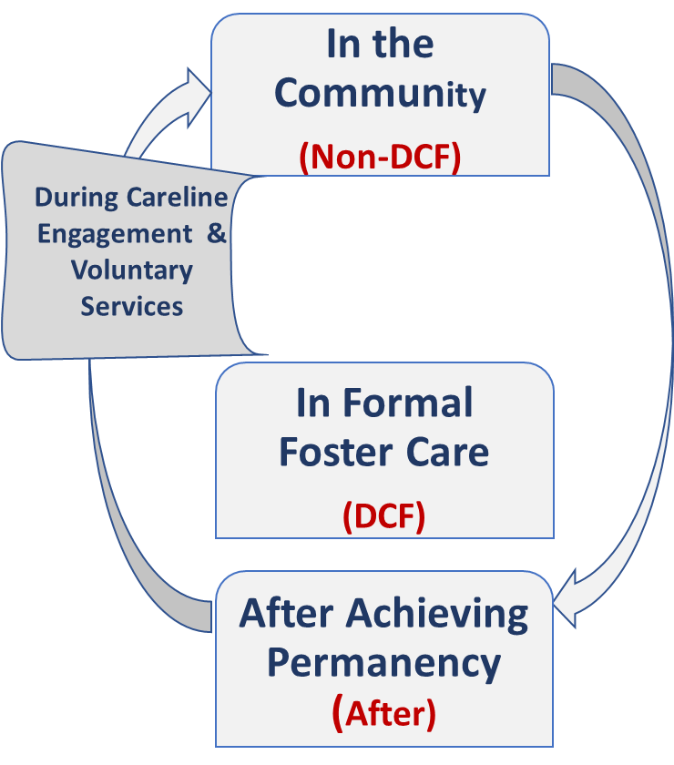
Kinship and Foster Care
Meeting dates: February 14
Next Meeting: February 28
Update:
  Conducted Policy Exploration exercise by identify barriers
  from Data Exploration Exercise
  Context Used to Frame
      In the Community (No DCF Involvement)
      During Careline Engagement & Voluntary Services
      In Foster Care
      After Achieving Permanency
  Group Surprised Probate Studies Completed by DCF (for Non-DCF Involved Families)
Family First

Slide 6
Kinship and Foster Care (con’t)
  Greatest needs: Financial, Legal and Housing Supports
  Services Available Prior to DCF Involvement Exist; However Fragmented
  211, Probate and Support Groups are Primary Source of Information
  Caregiver Support Teams and CAFAF are Available to DCF Involved Families
  After DCF, DCF Subsidy & Adoption Assistance Program are Available in Addition to Other Community Services
  Language matters Kinship vs. Guardian
  Policy /Legislation Expansion Needed
  Data Management Needed to Track the Number of Kin Care Relationships and/or Disruptions
  Discussion:

Slide 7
Fiscal and Revenue Enhancement
Meeting dates: February 10
Next Meeting: March 20
Update:
  Finalized Workgroup Charter
  Received Updates for the Candidacy and Programs and Services Array Workgroups
  Provided comments on the Candidacy Definition
  Discussed TANF Maintenance of Effort
  Acknowledge Ethics Concerns from Providers
  Explained Use of Family Transition Act Funding
  Cancelled previously scheduled meetings: Feb 21 & 28
Discussion:
Family First

Slide 8
Governance
Meeting dates: None
Next Meeting: March 19
Update:
  Next Meeting, anticipate presenting Programs and Service Array Recommendations
Discussion:
Family First

Slide 9
Community Updates
Update:
  State Index published per groups request: State Prevention Plan
  Shared Broader Prevention Definition with Candidacy Group
  CT Family First Website Updated to Reflect Revised Meeting Dates
  Question Review: https://www.plan4children.org/ct-family-first/
Discussion:
  Next meeting: March 3 @ Beacon, in-person, 2-4pm
Family First

Slide 10
Discussion
  Established a Sixth Workgroup – Intensive 24/7 Treatment (QRTP)
    Co-leads: Dr. Linda Dixon, DCF and Alyssa Goduti, Adelbrook
    Invite when out to all workgroup members Friday, February 21
    24 Expressed to date
    First Meeting March 3 @ 9am, Location: The Alliance, 35 Cold Spring Rd, Building 500, Rocky Hill, CT
  Technology Review
Family First

