Slide 1
Family First Prevention and Services Act:
CT Candidacy Sub-Committee
DCF Presentation
January 2, 2020

Slide 2






There are 817,015 children residing in the state of CT…
34,613 (4.2%) Alleged Victims not already in DCF placement
8,177 (1%) Substantiated Victims not already in DCF placement
1,412 (0.2%) Substantiated Victims Entered DCF Placement 40% likely to go home
16% like to go to kin
= 10,000 Children
What Happened to Children Reported to DCF in SFY2019?

Slide 3
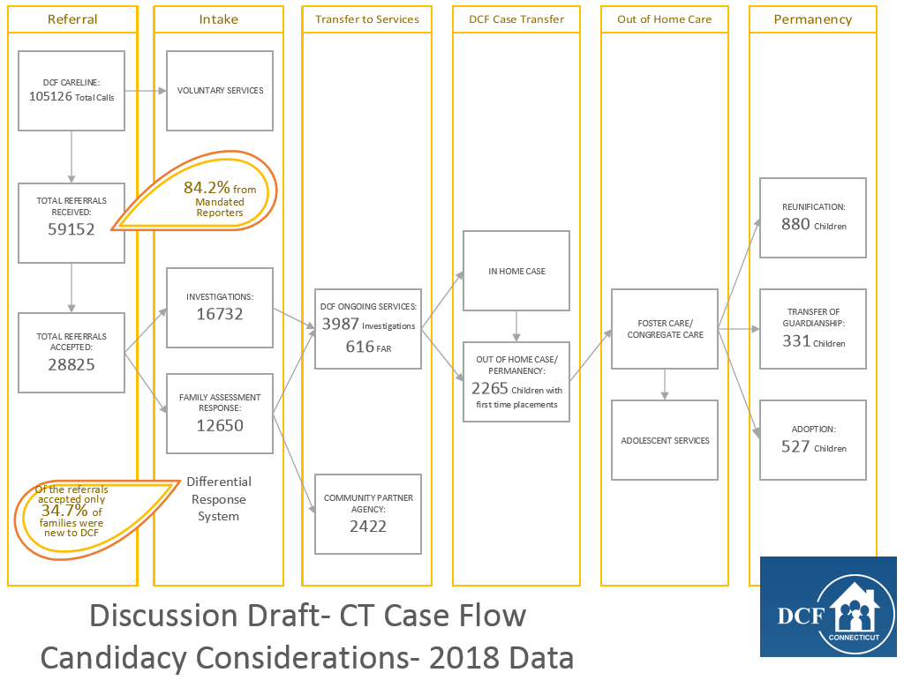

Slide 4
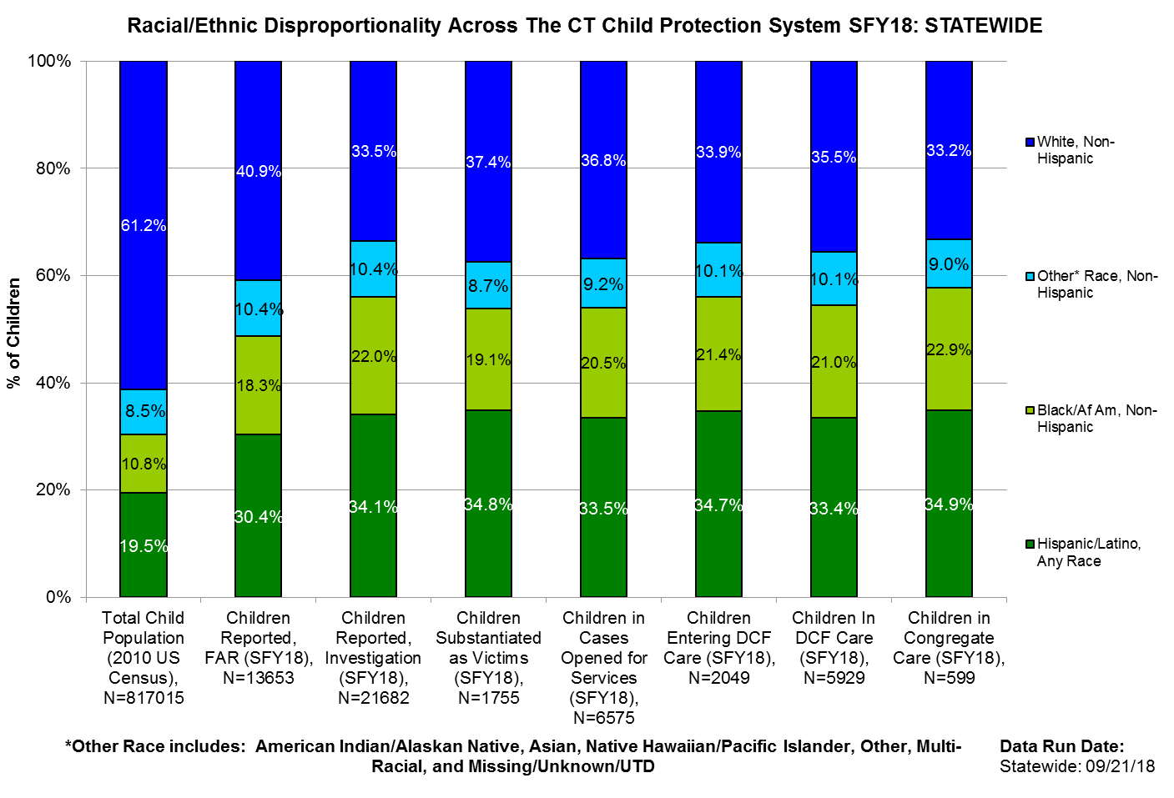


Note: Lesser levels of disproportionality in FAR vs. Investigations is likely indicative of disparity in case practice given the population served in FAR; hence not a desirable outcome.
Notes:
Disparity Index trends show consistent increases for Children Reported with both FAR and Investigation responses since SFY14
Disparity Index trends show previously mixed/decreasing trends, but with an increase in SFY18 compared to SFY17, for Entries, In-Care and In Congregate Care

Slide 5
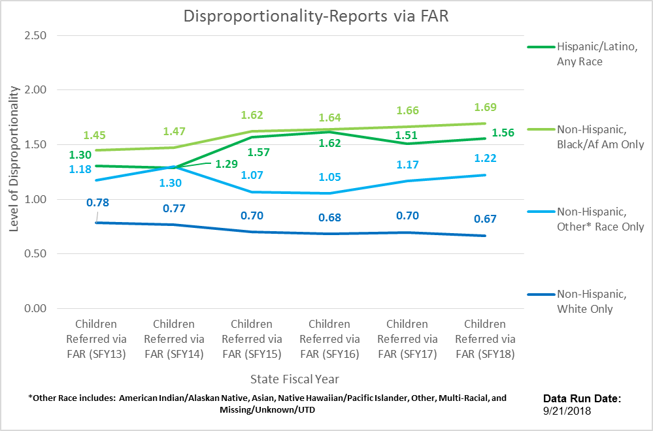
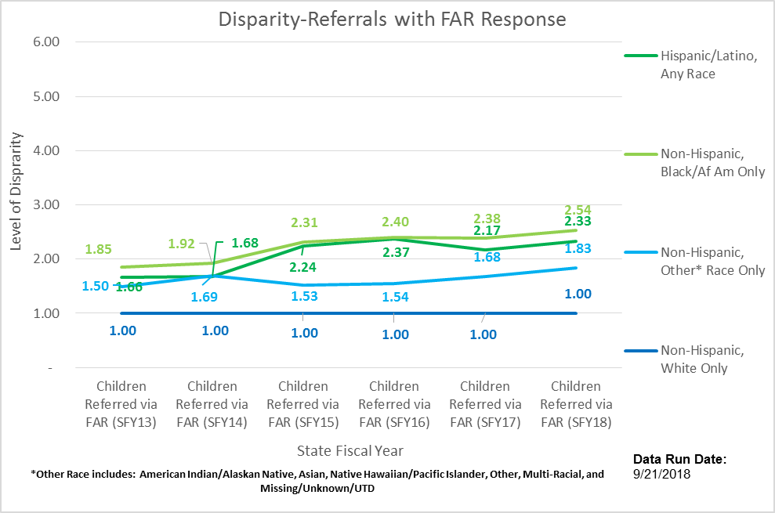

Slide 6
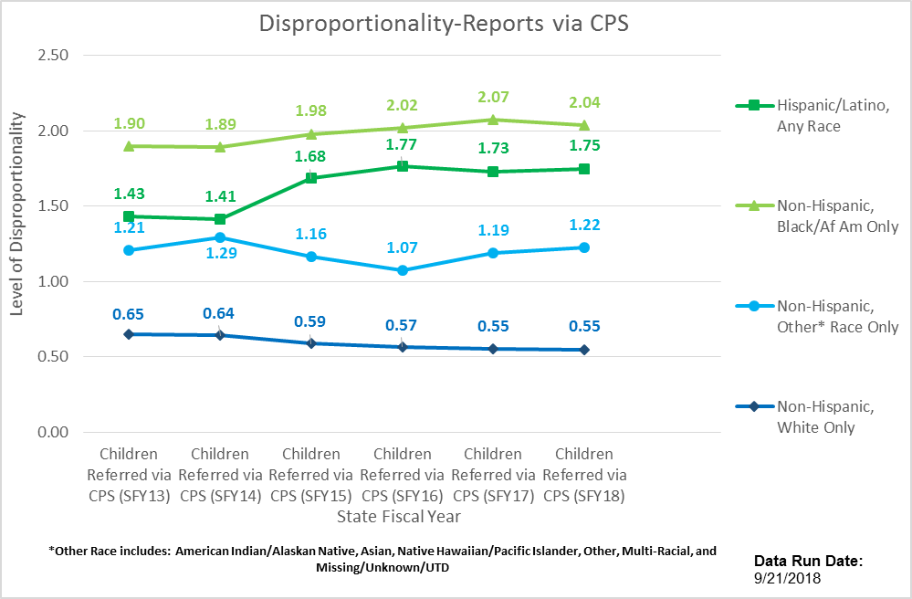
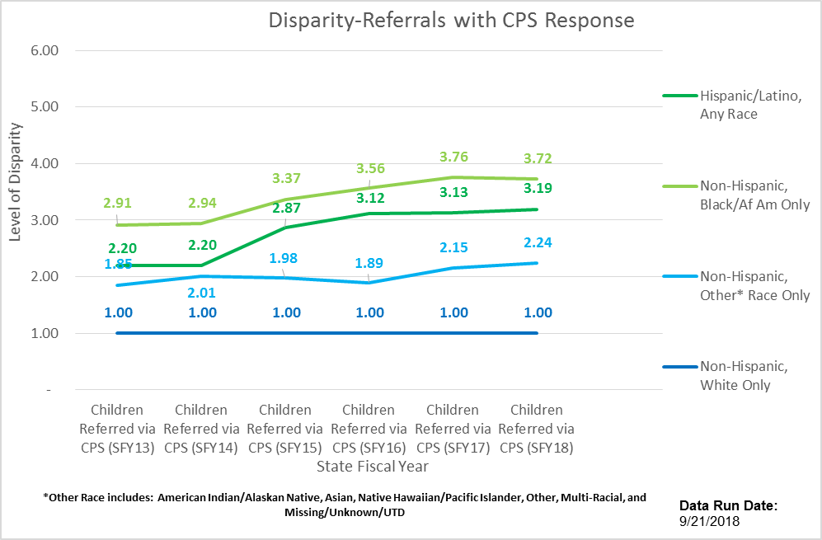

Slide 7
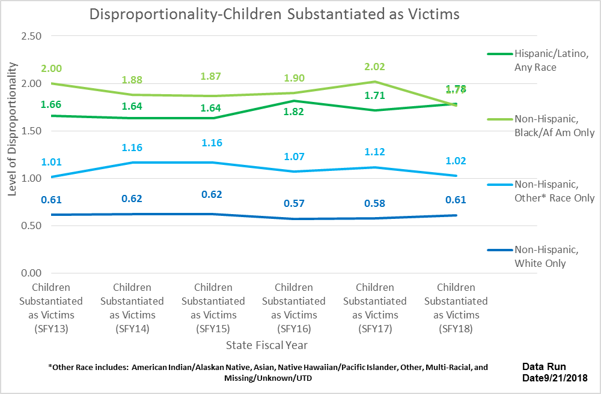
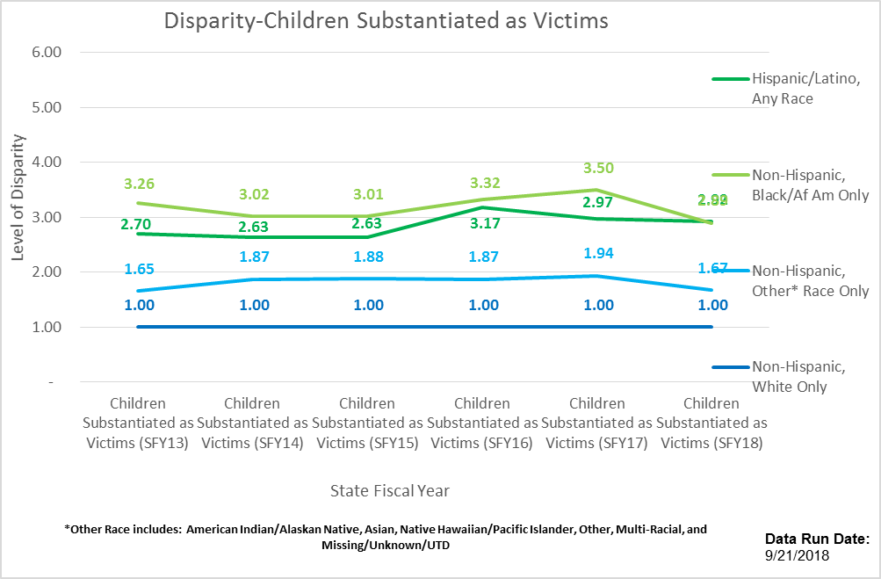

Slide 8
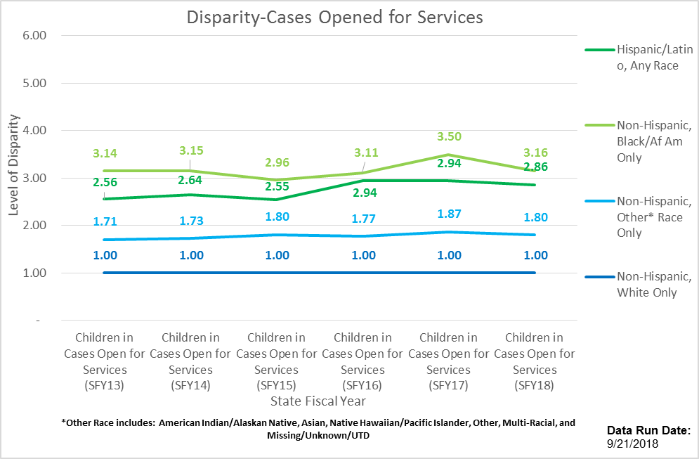
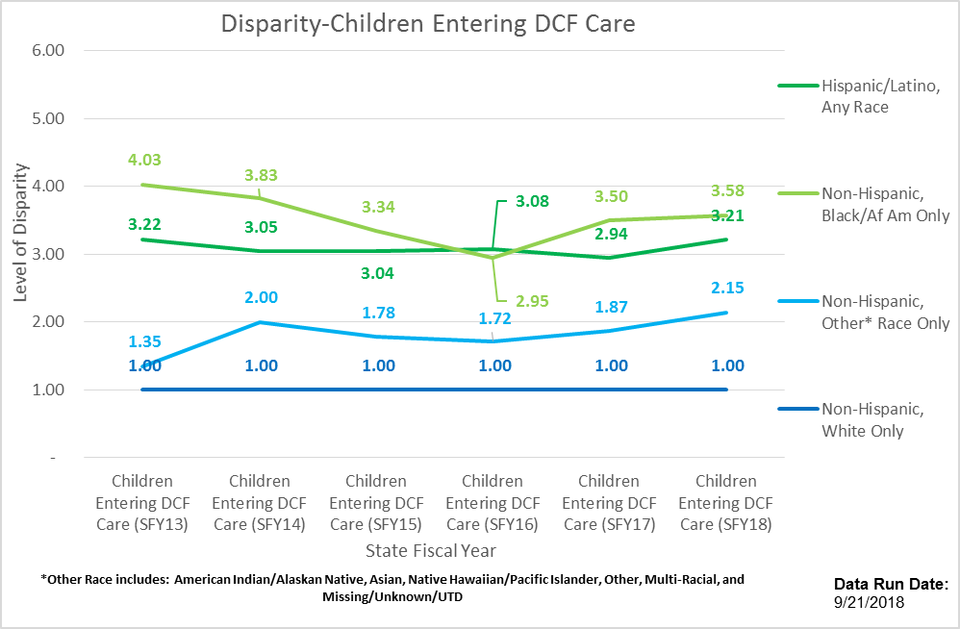

Slide 9
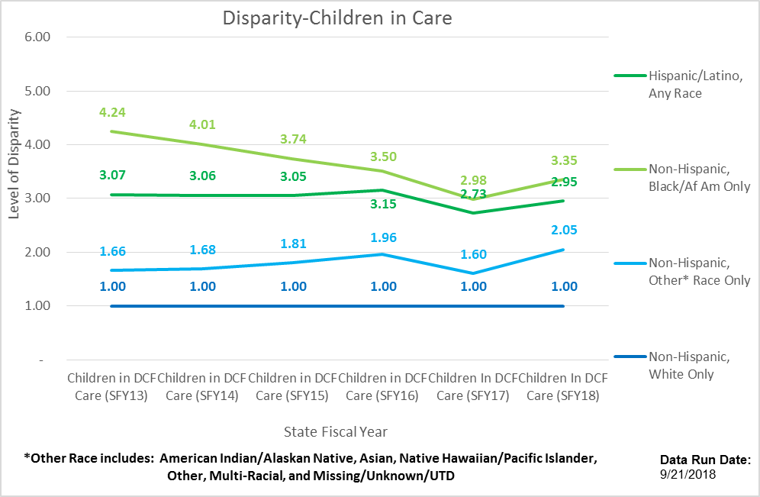
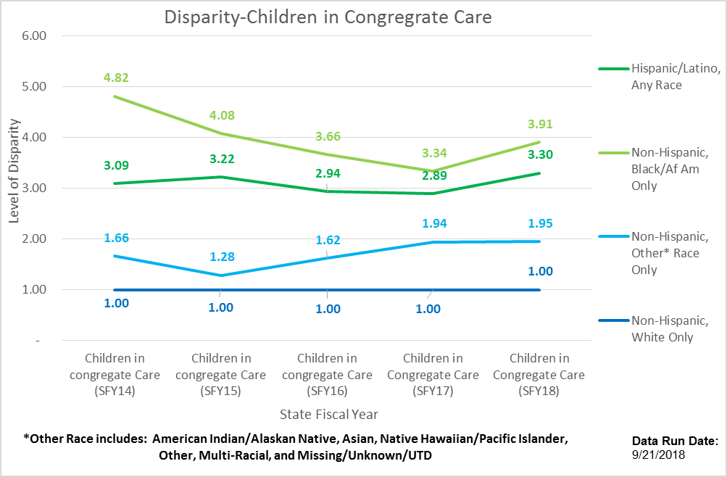

Slide 10
CAPTA Portal Data
Launch through 11.30.2019

Slide 11
CT’s CAPTA system of notification triages and diverts CPS involvement.
Blind notification allows families without CPS risk factors to remain unknown to DCF while accessing community services
1206
836
550
Number of total blind CAPTA notifications made since portal launch thru 11.30.2019
69.3% of mothers had a Plan of Safe Care developed by or verified at the hospital
45.6% of blind notifications resulted in a Careline Report

Slide 12
Most CAPTA notifications involve young, white, non-Hispanic mothers.
Mother’s mean age is 27.8 years
More than half are white
Just over 1 in 5 are Hispanic

Slide 13
Among the notifications-turned-Careline-report 33% had a Plan of Safe Care.
Among all CAPTA notifications 69% had a Plan of Safe Care.

Slide 14


Marijuana is the most common substance identified in notifications.
84.3% of notifications involved only one substance
Marijuana was identified in 77.2% of notifications – with or without other substances
185 newborns (15.4%) were identified as having exposure to any MAT (buprenorphine +/or Methadone)
1.7% of newborns were reportedly born with cocaine and any MAT exposure

Slide 15
“5 Connecticuts” is a methodology to group similar communities
Individual towns are classified into one of five categories:
Wealthy
Suburban
Rural
Urban Periphery
Urban Core
Designations are based on the median household income, population density, and poverty rate of each town, based on census data.
The original classification system was developed by the CT State Data Center to disaggregate Connecticut’s census data in a meaningful way. This analysis used birth mother’s home town as the basis for assignment to one of the five categories.
These designations were described in in: Levy, Don, Orlando Rodriguez, and Wayne Villemez. 2004. The Changing Demographics of Connecticut - 1990 to 2000. Part 2: The Five Connecticuts. Storrs, Connecticut: University of Connecticut, The Connecticut State Data Center, Series, no. OP 2004-01.

Slide 16
Early data suggest an uneven practice of notification by hospitals based on mother’s community type.
899 (74.5%) of the 1206 CAPTA notifications involved a birth mother residing in an Urban Core or Urban Periphery community
1 report in 1206 involved a birth mother residing in a Wealthy community

Slide 17
Mothers were referred to a variety of services (up to 18) at different frequencies.
*Birth to Three was not among the most commonly referred services, but it is included since it is a priority service for this population

Slide 18
DCF Child Protective Services Reports Data

Slide 19
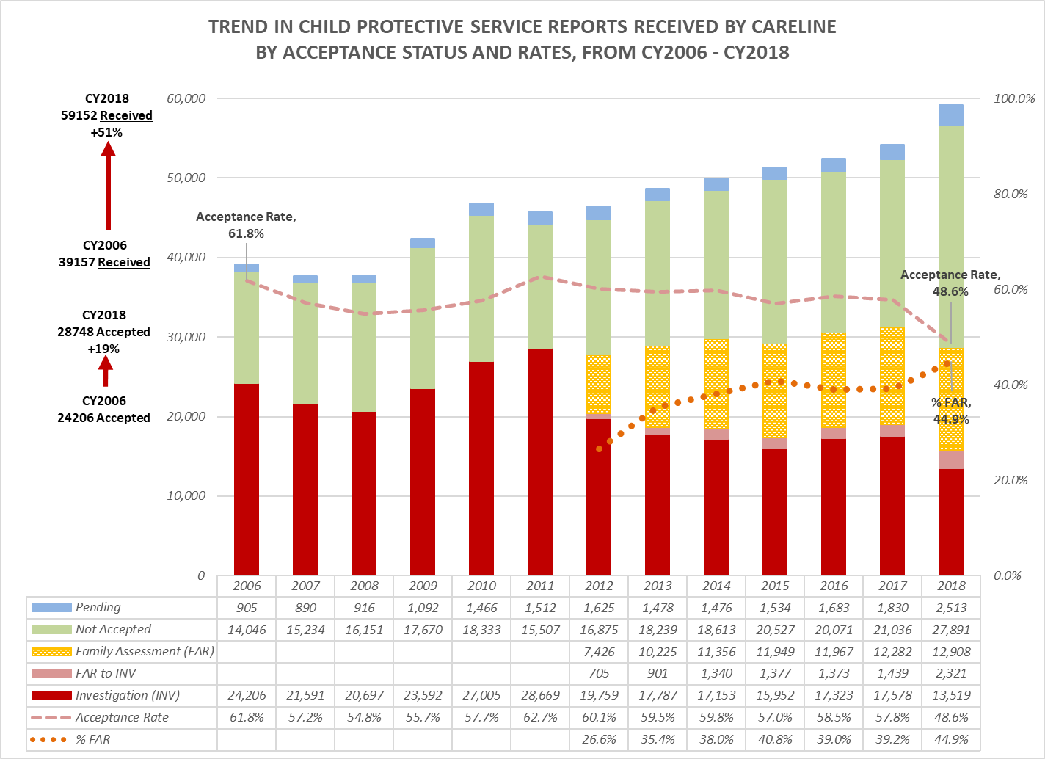
Notes:
FRED
Largest difference in Race/Ethnicity between child population and DCF is with Children Reported (front door)
Largest single group of Reporters are School personnel (about 34% of all reports; next largest are Healthcare and Law Enforcement each about 22%)
Volume of School reports are increasing
Outreach & collaboration with schools to help reduce disproportionality and disparity
Total number of calls to Careline steadily increasing since CY13; in CY18 about 104k
Total number of CPS Reports received by Careline has been steadily increasing (up 51% from CY06 – CY18), with relatively large increase in 2018 compared to prior annual increases – partly due to high profile cases of failure to report, and changes to Mandated Reporting statute effective 2017
Small but consistent decreases in our Acceptance Rate from 2011 to 2017
Strengthening statute re: mandated reporting, Enhanced Careline QA and revised SDM Screening instrument significantly impacted acceptance rates from Fall ‘17 forward
Volume of CPS Reports Accepted increased by 19% from CY06 – CY18
Percentage of reports accepted with a Substance Abuse indicator steady about 33% SFY15 – SFY19; IPV indic steady around 18% SFY17-19

Slide 20
Comparison of Accepted vs. Screened-Out Reports Received During SFY19
Screen-out Rate = 54.7%
  DCF Regional variation <2%
  5CT Regions vary from 51% in Urban Core to 60% in Wealthy
  72% Not Abuse/Neglect, 11% Ongoing Issues, 10% Duplicate Info
Accepted Reports
  Reporters
    36% School/Daycare
    23% Legal/Law Enforcement
    22% Health/Behavioral Health
Alleged Victims
  Higher % of Children Ages <=5
  Higher % of Black and Hispanic
Screened Out Reports
  Reporters
    41% School/Daycare
    13% Legal/Law Enforcement
    23% Health/Behavioral Health
Alleged Victims
  Higher % of Children Ages 13 – 17
  Higher % of Other Race

Slide 21
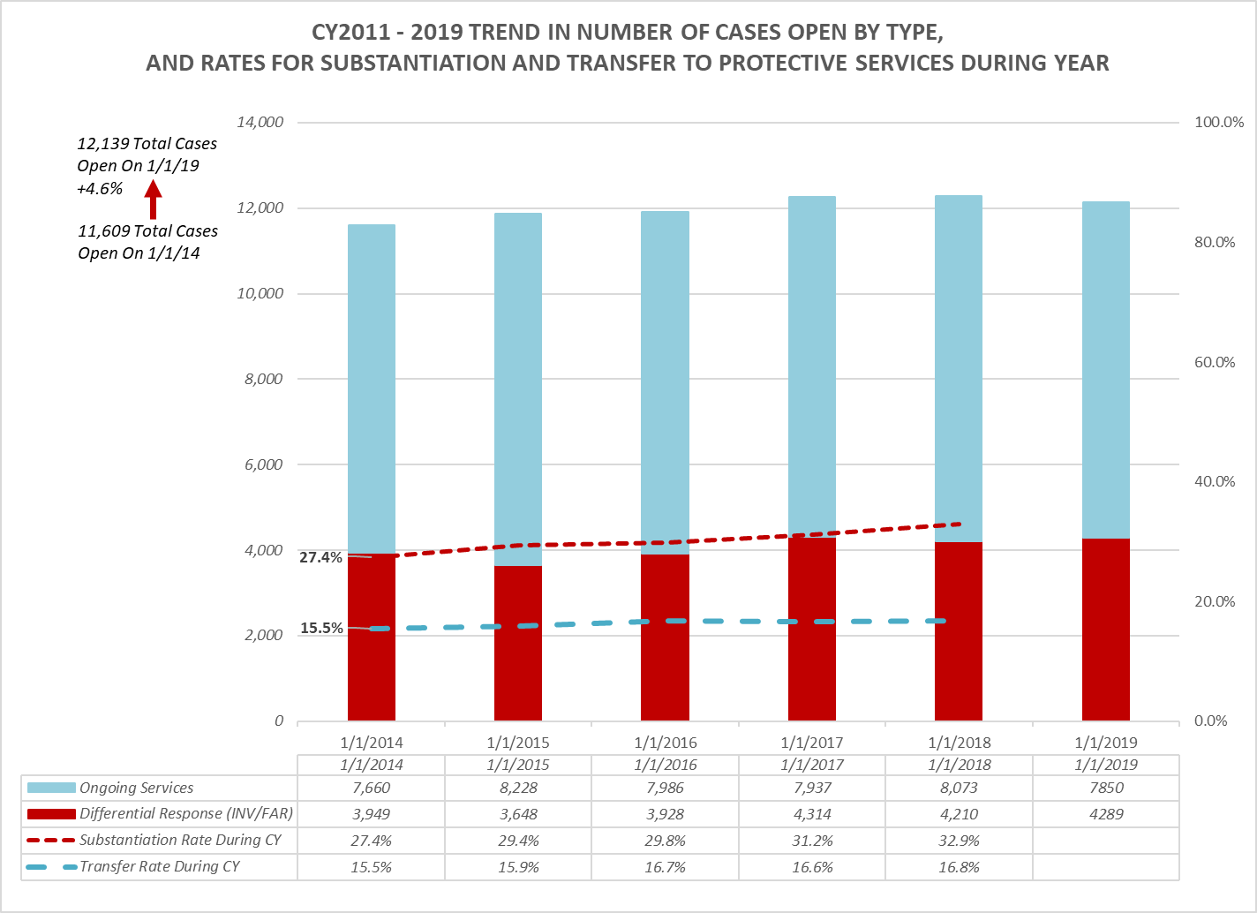
Notes:
FRED
Slow/modest but consistent increases in total caseload (about 6% increase) from CY13 to CY18 may be leveling off
Physical/Sexual Abuse Reports down from 31.5% of all accepted reports in CY11 to 25.7% in CY18; Very little change in Substantiated Abuse Reports (16.9% to 15.6%)
While DRS responses have been increasing, and the Substantiation rate has showed increase of 5.5% points from CY14 to CY18, the Transfer Rate has held very steady across the same time period, especially the last 3 years
In-Home Monitoring increasingly important to effectively manage caseloads and improve engagement of and service provision and delivery to families and children\; specific focus on:
Quality Supervision
Quality Visitation (also important for PIP and Juan F)
Risk and Safety Assessment/Management
Child and Family involvement in case planning

Slide 22
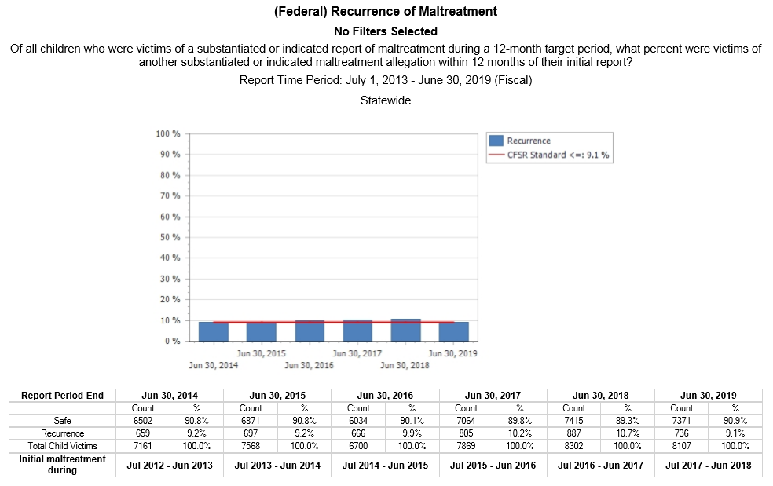

Slide 23
Predictors of Maltreatment Recurrence
Based on logistic regression of children with initial substantiated reports between 1/1/11 and 12/31/16 (conducted March 2018)
  Increased Odds:
    Child with physical/developmental disability +22%
    Child/youth with delinquency history +46%
    Caregiver with alcohol misuse +30%
    Caregiver with drug misuse +16%
    Caregiver with mental health issues +25%
    Family lacking support +23%
    Prior neglect investigation in the family
      One or two +63%
      Three or more +100%
    Child under age 2 in the family +11%
    Compared to Region 4 (largest volume)
      Region 1 +19%; Region 6 +23%
      Region 2, 3 & 5 +50% to 55%
  Decreased Odds:
    Compared to Children Age <= 5
      13 – 17 years old -20%
    Allegations of physical/sexual abuse –20% to –24%
    Family with unsafe housing -54%
  No significant difference for variation by:
    Race
    Gender

Slide 24
DCF Children Entering DCF Care Data

Slide 25
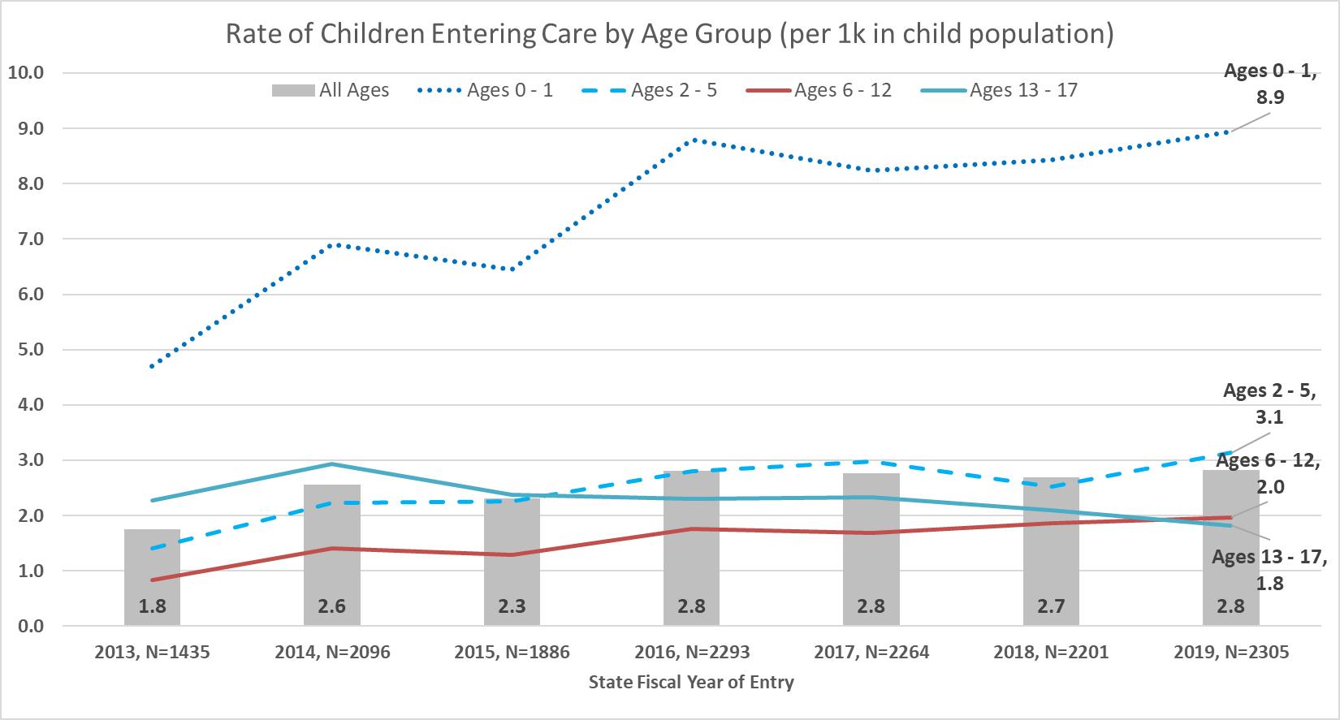

Slide 26
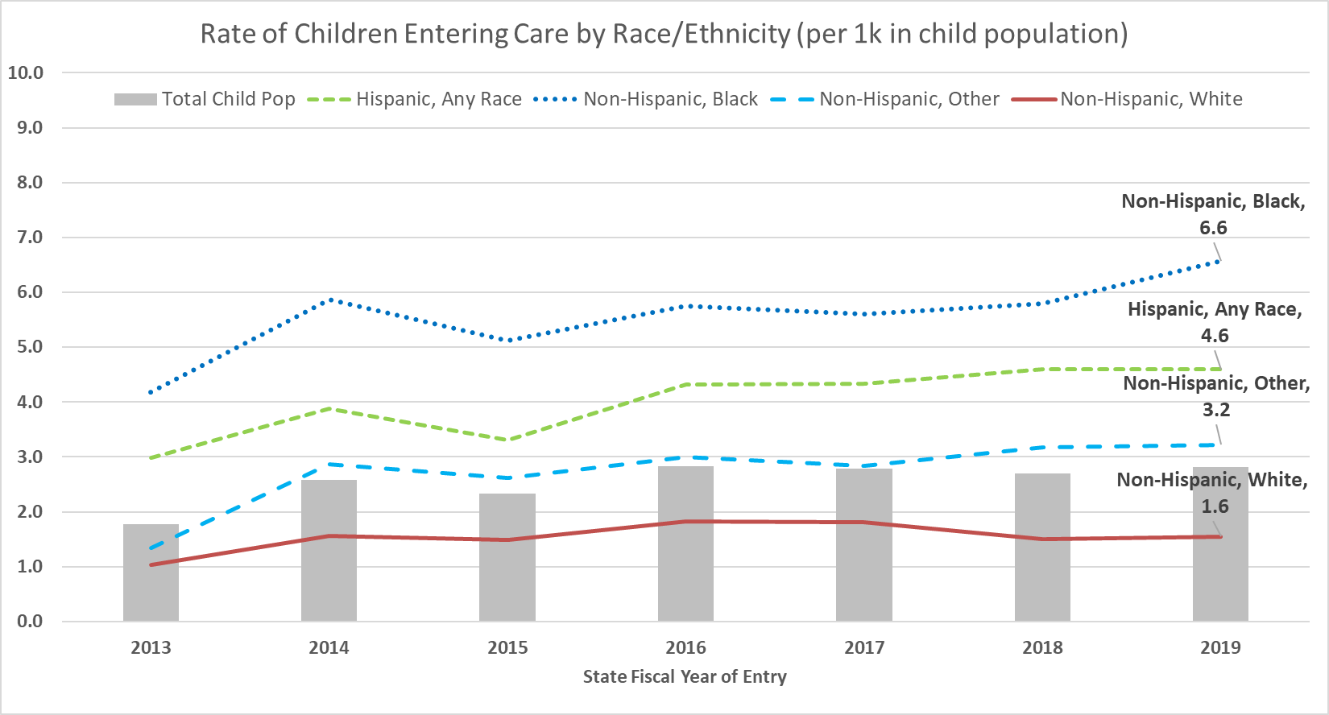

Slide 27
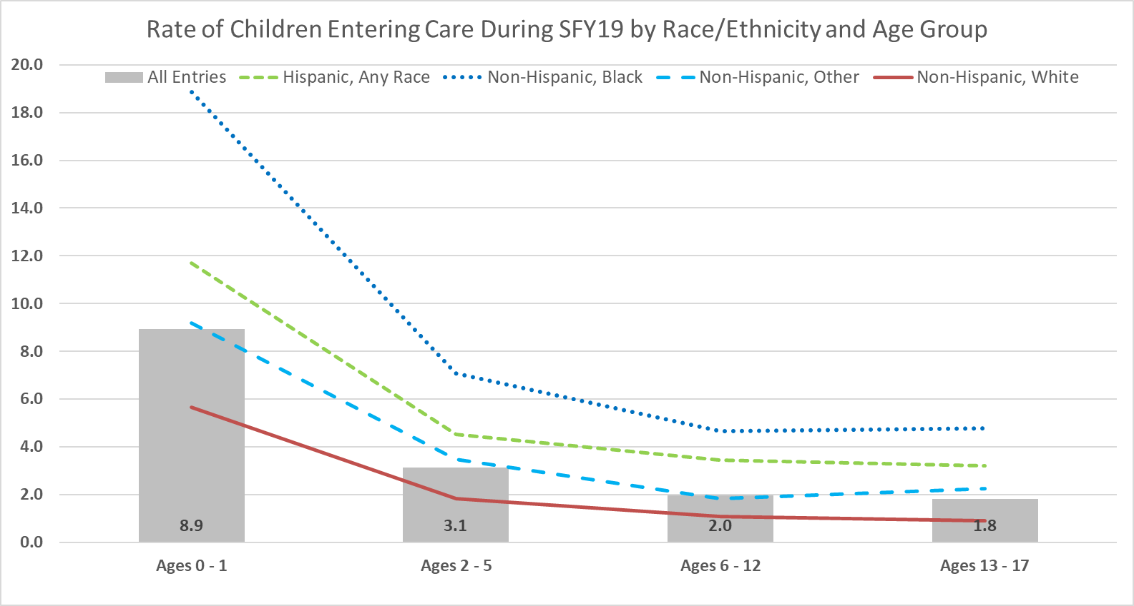

Slide 28
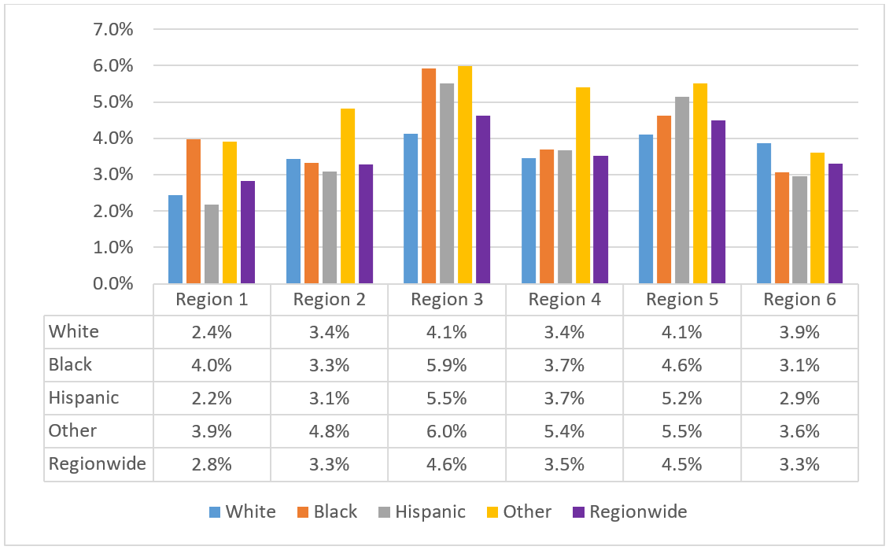
Percent of Removal For Children with Allegations by Race/Ethnicity and Region
(for children with >=1 allegation between 4/1/15 and 3/31/17)

Slide 29
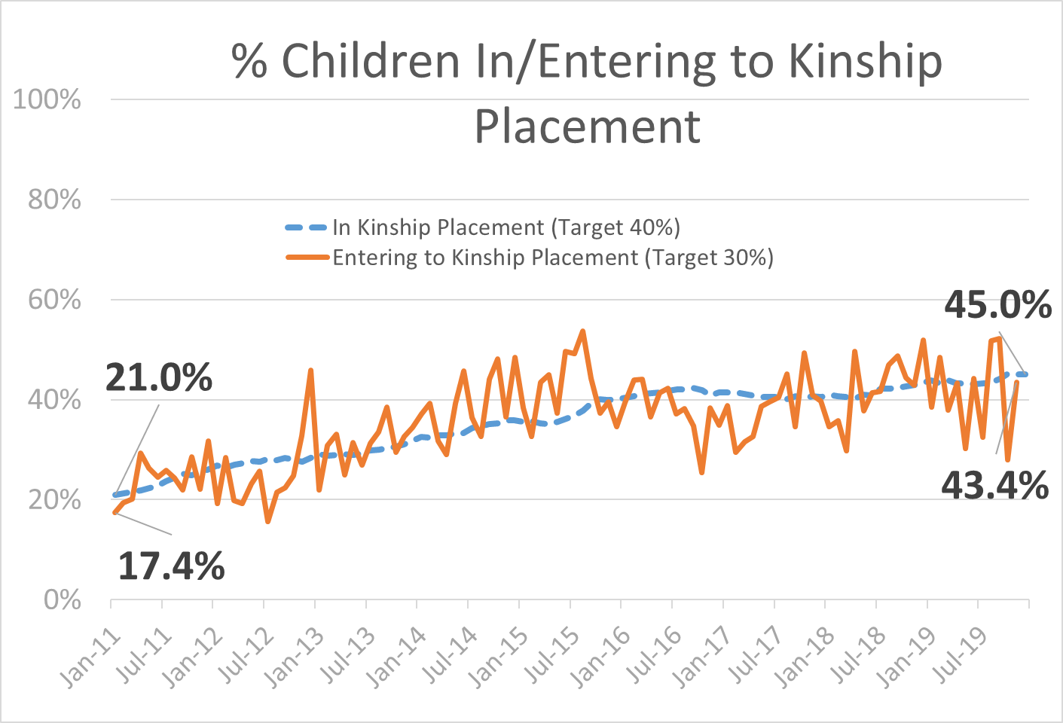

Slide 31
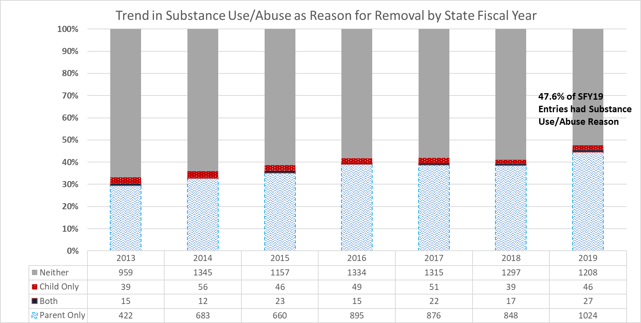

Slide 32
Key Results for Entries to DCF Care
Highest Entry Rates in Region 3, especially New London County
Lowest Entry Rates in Region 1, especially Fairfield County
Age – infants/toddlers enter DCF care at much higher rates than older children
Race/ethnicity – children of color enter DCF care at much higher rates than white children
Substance use/abuse issues both increasing, and largest single reason for entry to DCF care
Neglect and Inadequate Housing also important reasons for entry
Future Consideration
  Plan to conduct more robust statistical analysis to better inform characteristics of Entry populations soon!

Slide 33
Predictors of Permanency in 12 Months
Based on logistic regression of children that entered DCF care between 4/1/15 and 3/31/17 (conducted March 2018)
  Increased Odds:
    Compared to Children Age <= 5
      6 – 12 years old +31%
      13 – 17 years old +55%
    Removal Reason: Physical Abuse +59%
    Number of Siblings in DCF Care +27%
    Decreased Odds:
    Compared to Region 3
      Region 1 -18%
      Region 2 -29%
      Region 4 -58%
      Region 5 -26%
      Region 6 -41%
    Compared to Children Age <= 5
      13 – 17 years old -20%
    Non-Hispanic, Other Race -40% (all others NS)
  Decreased Odds (continued):
    Child Eligible for Special Education -73%
    Increasing Number of Social Workers -30%
    Increasing % Average Utilization -4%
    Predominant Placement with Kin -40%
    Increasing Number of Placements -31%
    Increasing Number of Prior Episodes -24%
    Removal Reasons included:
      Housing Issue – 53%
      Abandonment – 38%
      Parental Incapacity -26%
      Parental Drug Use – 19%
    **34.2% of all children entering had parents with both substance abuse and mental health issues – 12 month permanency -34% compared to those whose parents had only one, or neither issue

Slide 34
Predictors of Permanency in 18 Months
Based on logistic regression of children that entered DCF care between 4/1/15 and 3/31/17 (conducted March 2018)
  Increased Odds:
    Compared to Children Age <= 5
      Ages 6 – 12 +29%
      Ages 13 – 17 +47%
    Removal Reason:
      Physical Abuse +109%
      Parent in Jail +89%
    Number of Siblings in DCF Care +45%
    Compared to Region 3
      Region 2, 4 & 6 no significant differences
      Region 1 +162%
    Decreased Odds:
    Compared to Region 3
      Region 5 -61%
  Decreased Odds (continued):
    Compared to White Children:
      No significant differences
    Child Eligible for Special Education -73%
    Increasing Number of Social Workers -22%
    Increasing % Average Utilization -3%
    Predominant Placement with Kin – no significant diff.
    Increasing Number of Placements -28%
    Increasing Number of Prior Episodes -33%
    Removal Reasons included:
      Housing Issue – 63%
      Abandonment – no significant differences
      Parental Incapacity - no significant differences
      Parental Drug Use – no significant differences

Slide 35
Predictors of Permanency in 24 Months
Based on logistic regression of children that entered DCF care between 4/1/15 and 3/31/17 (conducted March 2018)
  Increased Odds:
    Compared to Children Age <= 5
      No significant differences
    Removal Reason:
      Physical Abuse +109%
      Parent in Jail +89%
    Number of Siblings in DCF Care +45%
    Compared to Region 3
      Region 2, 4 & 6 no significant differences
      Region 1 +162%
    Decreased Odds:
    Compared to Region 3
      Region 5 -61%
    Compared to Children Age <= 5
      No significant differences
  Decreased Odds (continued):
    Compared to White Children
      Non-Hispanic, Black Race -11%
      Non-Hispanic, Other Race -64%
    Child Eligible for Special Education -75%
    Increasing Number of Social Workers -29%
    Increasing % Average Utilization -3%
    Predominant Placement with Kin – no significant diff.
    Increasing Number of Placements -35%
    Increasing Number of Prior Episodes -33%
    Removal Reasons included:
      Housing Issue – no significant differences
      Abandonment – no significant differences
      Parental Incapacity - no significant differences
      Parental Drug Use – no significant differences

Slide 36
Youth In/Discharging From DCF Care
31% of youth in foster care in the US are parenting by age 21, vs 22% in CT (Casey Family Programs: figures based on 2015 NYTD and 2016 AFCARS)
SFY19: DCF served 61 expectant or parenting youth in care
  26 in CHAP/CHEER settings
  23 in Therapeutic Foster Care
  12 in Core Foster Care
SFY19: Received 44 requests for Re-Entry services (from 41 youth)
  9 (22%) of youth were expectant or parenting at time of request
  7 of these were female, and 2 male
  4 were accepted into Re-entry and began services (2 female, 2 male)
SFY19: Discharged 270 Youth Ages 18 and Older from Care
  29 (11%) were Parenting at time of discharge
  72% were Secondary Education Graduates
  43% of graduates received a Vocational Certificate or License
  79% were Female, 21% Male
  Females: 39% Black, 30% Hispanic, 13% White, 5% Other
  Males: 100% Hispanic

Slide 37
Youth In/Discharging From DCF Care
SFY19: Discharged 270 Youth Ages 18 and Older from Care (continued)
Reason for Discharge
  52 (19%) Refused services at age 18
  99 (37%) Later refused services or non-compliant with program requirements
  67 (25%) Case goals achieved
  47 (17%) Transitioned to DDS/DMHAS
  7 (3%) Incarcerated
Living Situation
  100 (37%) Living with Family
  70 (26%) Living Independently
  44 (16%) in DDS/DMHAS Placement
  25 (9%) Living in Unstable Housing
  5 (3%) Incarcerated
  4 (2%) Military/Job Corps
  20 (7%) Unknown
Employment Situation
  45 (17%) Full-Time Employed
  37 (14%) Part-Time Employed
  179 (66%) Not Employed
  9 (3%) Unknown
Other Characteristics
  189 (70) with Mental Health Diagnoses
  112 (42%) with Substance Abuse Issue
  86 (32%) with Arrest(s) and/or Dual Commitment

