Slide 1
Family Assessment Response and
Community Supports for Families:
Overview and Outcomes
January 2, 2020
Presented By:
Patricia Carlson, PhD, Meg Feely, PhD, and Brenda Kurz, PhD
UConn School of Social Work,
Performance Improvement Center

Slide 2
Family Assessment Response (FAR)

Slide 3
Differential Response (DRS) Implementation in CT
DRS is a system reform that enables child protective services (CPS) to differentiate its response to reports of child abuse and neglect
Allows a customized response that:
  Better ensures child safety
  Promotes child and family well-being
  Better meets the needs of families
Is expected to:
  Decrease rate of repeat maltreatment
  Reduce likelihood of families becoming re-involved with DCF
  Reduce the number of children entering care
Notes:
Connecticut’s Differential Response System, Family Assessment Response (FAR), connects low to moderate risk families with no safety factors to community supports and services. FAR is strength‐based, family‐centered approach to partnering with families and their supports to protect children and enhance parental capacity.

Slide 4
CT DCF’s Two-Track System
Intake
Family Assessment Response
Investigations
Accepted Reports

Slide 5
Family Assessment Response (FAR)
Implemented DRS in March 2012
Accepted CPS Report – meets statutory definition of abuse/neglect
72 hour response (lowest response time available)
Rule-out criteria established
Track change from FAR to Investigations based on safety and risk concerns

Slide 6
Family Assessment Response (FAR)
Use of Structured Decision Making (SDM) to help inform critical decisions
  Screening and Response Priority Tools at Careline
  Safety and Risk Assessments at Intake
Assessment of family’s protective factors
No formal determination/finding (i.e. no victim/perpetrator)
Assess level of need and willingness to engage in services

Slide 7
In 2019, almost half of all accepted maltreatment reports assigned to FAR

Slide 8
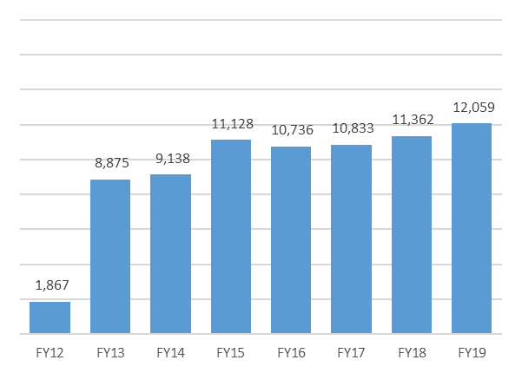
Families Served by FAR
There has been a total of 59,667 unduplicated families admitted to FAR since its implementation in March 2012.
The number of FAR families with approved report(s) has increased since FY17, with the largest number admitted (12,059) in FY19.
Notes:
The largest number of families were admitted to FAR in FY 19 since program implementation

Slide 9
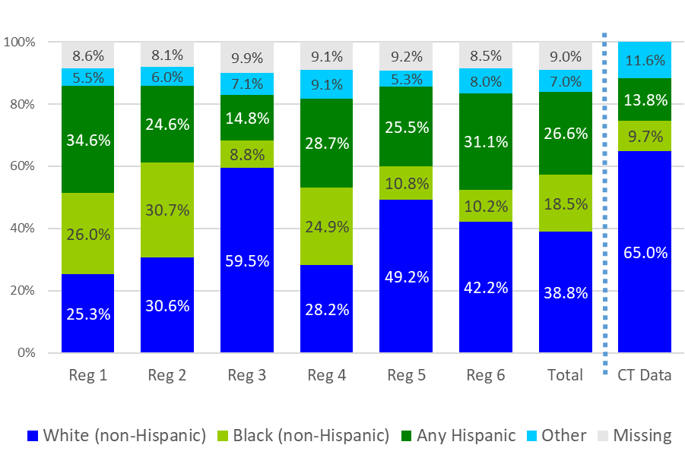
Demographics – FAR FY19
Race/Ethnicity by Region
Family Composition:
Single parent families - 42.4%
Two parent families - 33.7%
Age of children:
Children under five - 30.6%
CPS History
Prior reports – 15.7%
Prior substantiated reports – 2.1%
Reporter:
School personnel - 40.9%
Police - 16.3%
Mandated reporters: 86.5%
Notes:
Race Ethnicity
The overall racial breakdown of the race/ethnicity of the primary caregiver of FAR families is 38.8% White, 18.5% Black, 26.6% Hispanic, and 7.0% other.
It is important to note that there is a large proportion of cases (9%) that do not have race data for the primary caregiver.
This breakdown differs from the adult population of Connecticut. A larger proportion of families with caregivers of color are admitted to FAR in FY19 than are present in the general adult population of Connecticut.

Slide 10
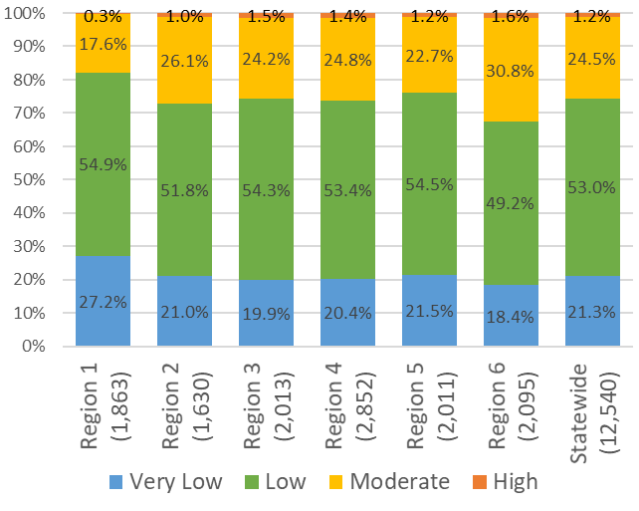
Risk & Safety – FAR FY19
For FY19 most (74.3%) of FAR families were scored as low or very low risk.
99.9% of FAR families had a safety assessment that was scored as safe or conditionally safe.
Notes:
Consistent with prior years’ data, for FY19 most (74.3%) of FAR families were scored as low or very low risk.
As expected, 99.9% of FAR families had a safety assessment that was scored as safe or conditionally safe.

Slide 11
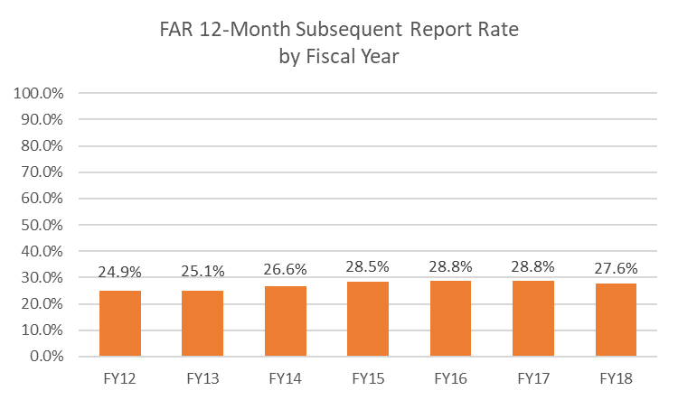
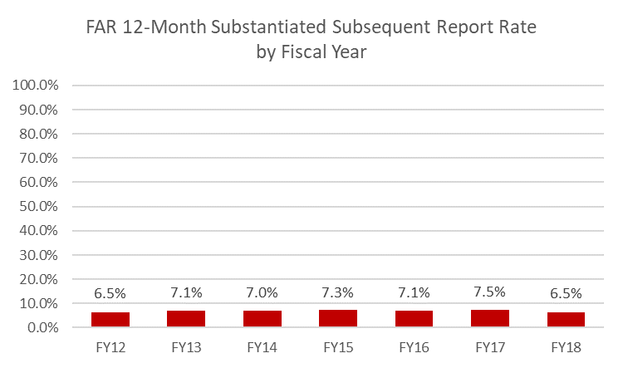
FAR 12-Month Subsequent & Substantiated Report Rates

Slide 12
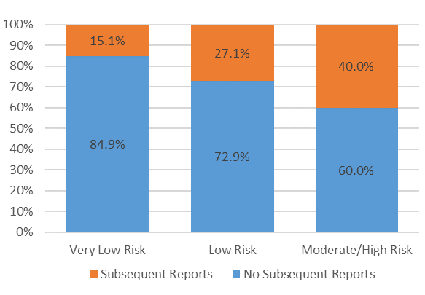
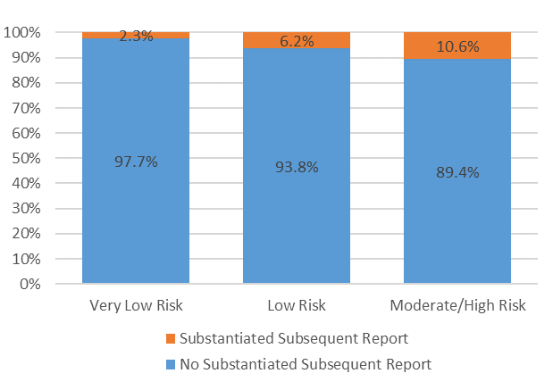
FAR 12-Month Subsequent & Substantiated Report Rates by Risk Assessment Score

Slide 13
FAR & INV Key Differences
 | FAR | INV
CPS History
Prior Reports | 15.7% | 23.6%
Prior Substantiated Reports | 2.1% | 4.2%
Risk Assessment Scores
Very Low Risk | 21.3% | 10.9%
Low Risk | 53.0% | 36.3%
Moderate Risk | 24.5% | 43.1%
High Risk | 1.2% | 9.7%
Subsequent Report Rate | 27.6% | 28.2%
Substantiated Subsequent Report Rate | 6.5% | 9.2%

Slide 14
Community Supports for Families (CSF)

Slide 15
Overview of CSF
DCF offers a voluntary, family-driven, individualized program, Community Support for Families (CSF) administered by seven community partner agencies throughout the state.
CSF is for families that are discharged from FAR but are still in need of additional support.
CSF utilizes a Wraparound philosophy and approach designed to;
      Promote child and family well-being,
      Build and strengthen natural and community-based supports,
      Connect families to resources and services in their community,
      Place the family in the lead role of its own service delivery.
    CSF is a time limited program (3-6 months) with an average length of service of 132 days.

Slide 16
Community Support for Families
Utilizes Evidence-based tools to assess strengths and needs of families to help inform service delivery
  NCFAS-G (formal assessment)
  Protective Factors Survey (family perspective)
Family Satisfaction Survey to gather critical feedback
Access to wrap funding to meet basic, concrete needs
  80% of funding is used to meet basic needs

Slide 17
CSF Families
CSF families are a subset of the FAR families in Connecticut and differ from this general differential response population in several important ways.
More CSF families had at least one prior CPS report
(20.5% compared with 15.7% of FAR families)
A higher proportion of CSF families were single parent families
(60.8% compared with 36.7% of FAR families)
  Fewer CSF families were scored as low or very low risk
  (72.1% compared with 74.3% of FAR families)
  More CSF families were scored as moderate or high risk
  (27.9% compared with 25.7% of FAR families)

Slide 18
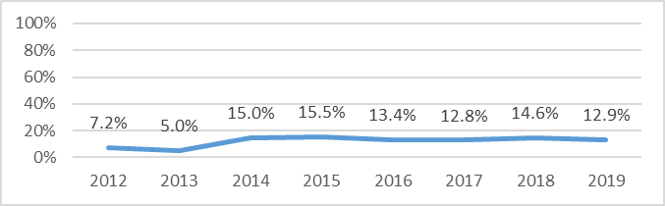
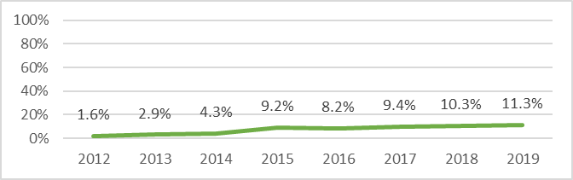
Engagement
Evaluation Only
Referral Only
Following referral from DCF, if the family decides they no longer wish to participate in the program, the case is categorized as Referral Only. In these cases, no face-to-face contact with the family has been made by CSF.
If within 45 days of opening, the episode closed and/or there was no Family Team Meeting, and the Plan of Care was not established.
75% of families fully engage in services
Notes:
75% of the families referred fully engage with the program

Slide 19
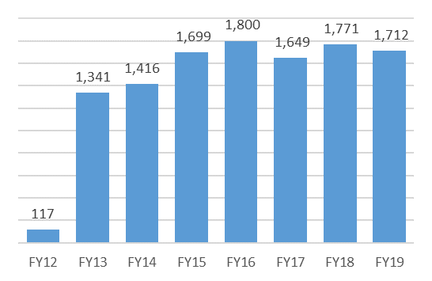
Families Admitted by CSF
There has been a total of 10,432 families served through Community Support for Families (CSF) since its implementation in March 2012.
A total of 2,628 families were active in FY19.
Notes:
The largest number of families were admitted to FAR in FY 19 since program implementation

Slide 20
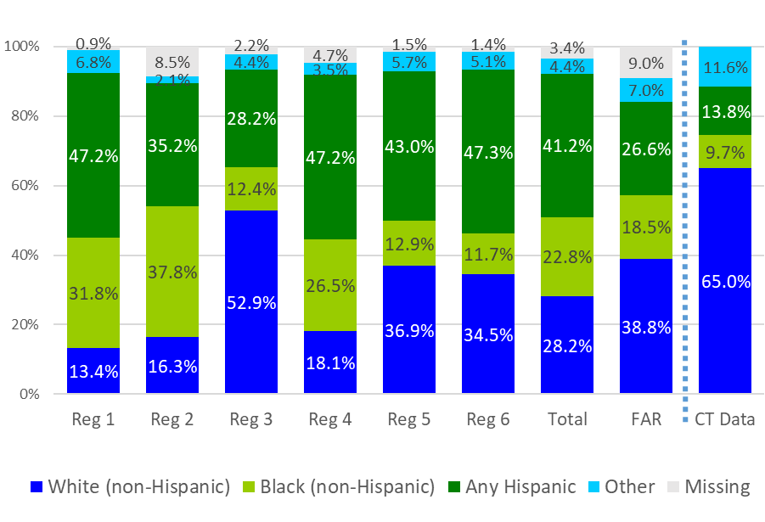
Demographics – CSF FY19
Race/Ethnicity by Region
Family Composition:
Single parent families – 60.8%
Two parent families – 24.8%
Age of children:
Children under five - 31.6%
CPS History
Prior reports – 20.5%
Prior substantiated reports – 2.05%
Reporter:
School personnel – 39.1%
Police – 15.4%
Mandated reporters: 85.9%
Notes:
Race Ethnicity
The overall racial breakdown of the race/ethnicity of the primary caregiver of CSF families is 28.2% White, 22.8% Black, 41.2% Hispanic, and 4.4% other.
This breakdown differs from the adult population of Connecticut, the population of FAR families, and also varies by region.

Slide 21
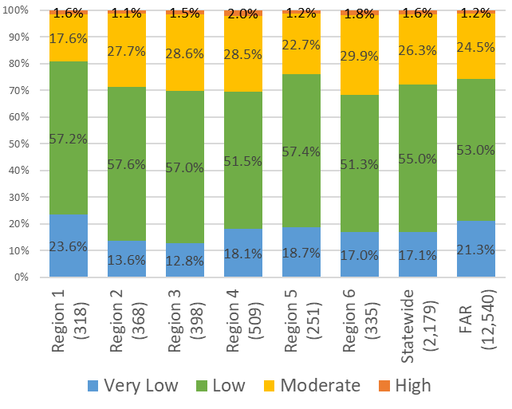
Risk & Safety – CSF FY19
CSF families had a slightly higher risk assessment scores than FAR Families.
  Fewer CSF families (72.1% compared with 74.3% of FAR families) were scored as low or very low risk.
  27.9% of CSF families were scored as moderate or high risk compared with 25.7% of FAR families.
Statewide, 99.8% had a safety assessment that was scored as safe or conditionally safe.
Notes:
In general, CSF families had slightly higher risk assessment scores than FAR Families.
Fewer CSF families were scored as low or very low risk.
For FY19, 27.9% of CSF families were scored as moderate or high risk compared with 25.7% of FAR families.
Statewide, 94.9% had a safety assessment that was scored as safe or conditionally safe.

Slide 22
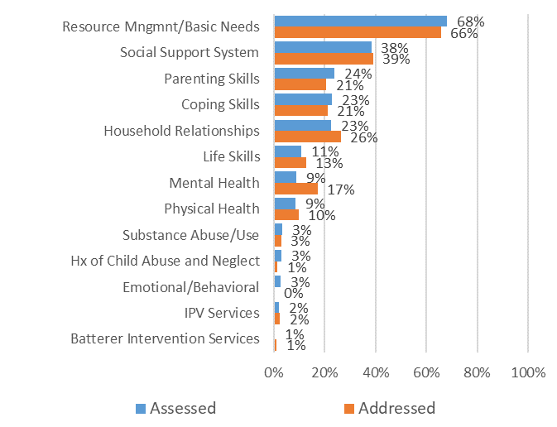
Needs Assessed/Needs Addressed
Top three needs assessed:
Basic needs
Social supports
Parenting skills
Top three needs addressed/received:
Basic needs
Social supports
Household relationships
Top three needs unavailable:
Housing
Employment
Mental Health Child

Slide 23
Performance Indicators
NCFAS-G
There is a statistically significant improvement in the overall subscale rating at intake when compared to closure on all domains (environment, parental capabilities, family interactions, family safety, child well-being, social/community life, self-sufficiency, and family health).
The largest proportion of families experiencing positive change occurred in the following three domains: Self-Sufficiency (38.0%); Child Well-Being (33.7%); and Family Interactions (34.6%).
Protective Factors Survey
Overall, domains show statistically significant improvement from intake to discharge on all domains (social emotional support, concrete support, nurturing and attachment, family functioning/resiliency, and knowledge of parent and child development).
The PFS domain “concrete services” has the highest rate of improvement.

Slide 24
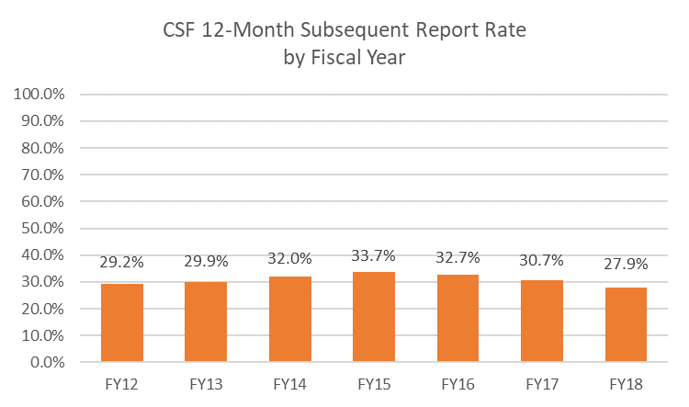
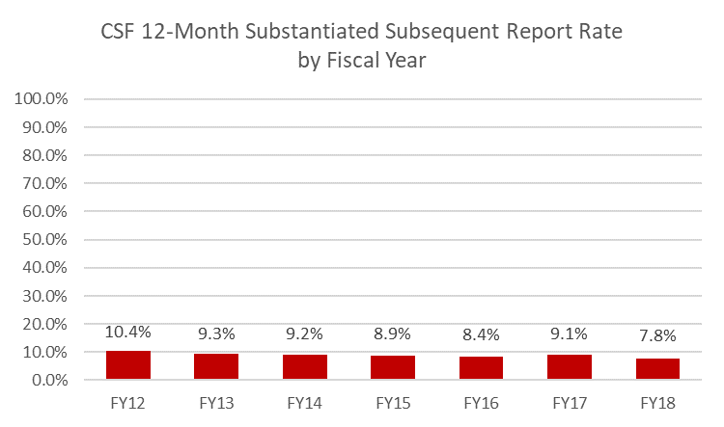
CSF 12-Month Subsequent & Substantiated Report Rates

Slide 25
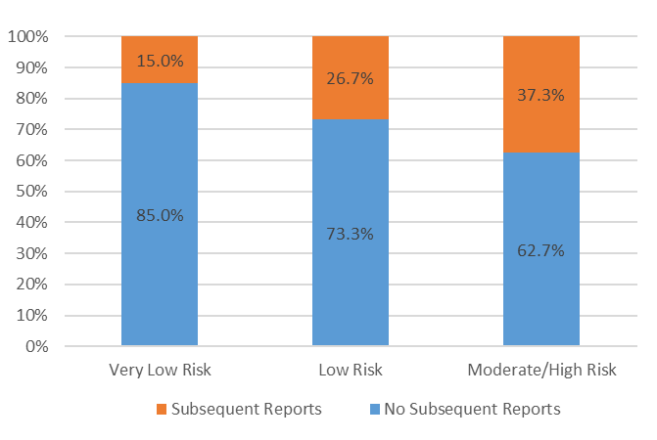
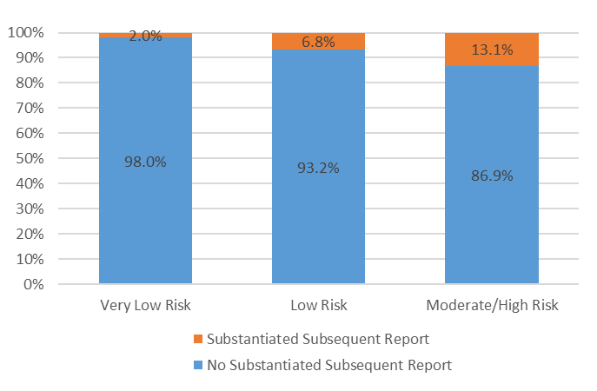
CSF 12-Month Subsequent & Substantiated Report Rates By Risk Assessment Scores

Slide 26
Key Takeaways
Since 2012, FAR and CSF have grown and evolved while always keeping the safety of children as its main focus and evaluation results have been positive.
Both programs are serving appropriate families.
Of the FAR/CSF families that have subsequent reports,
most are not substantiated.
Substantiated subsequent report rates are lower than the national standard for recurrence of maltreatment.

