Slide 1
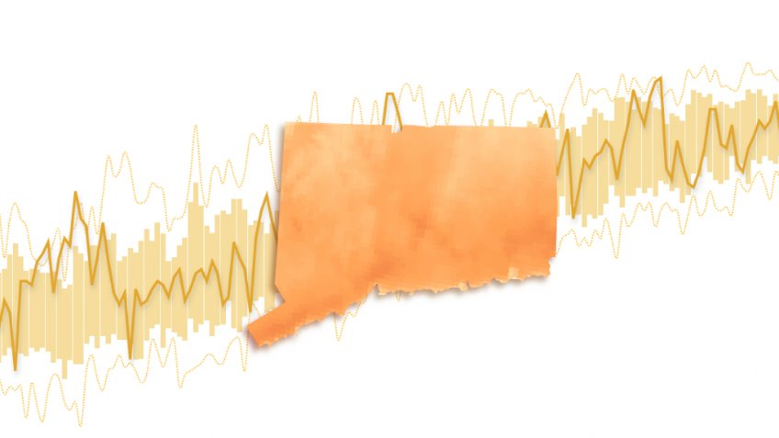
Group members (all)
Introduction (2 slides) - Reece
  Purpose and background
  Our approach
revisions (5 slides) - Yanjia
  Overview
  Pm 2.5
  EJ
  Indoor air quality
  Relevant resources
Toolkit + infographics (5 slides) - Reece
  Overview
  4 samples
Dissemination (4 slides) - Sena
  Website
  Webinar
  Additional methods
  Small groups
Questions (1 slide) - Sena
^ Potential change in picture, just so it can relate to the work we are doing.
Source: CT Insider, What is the temperature in CT today? And How does the weather compare to climate normals

Slide 2
CT Extreme Heat & Air Quality Plan
Yanjia Li, Reece Pauling, and Sena Wazer
Weiss, A., Haseman, J., Huang, L., & Zhao, Y. (2024). How does Connecticut’s weather compare to “normal”? check the charts.
Notes:
Sena

Slide 3

Group Members
Yanjia Li
(she/her)
2nd year, Master of Public Health, Health Policy Track
From China
Reece Pauling
(she/her)
1st year Master of Environmental Management
From D.C
Sena Wazer
(she/her)
1st year, Master of Environmental Management
From Mansfield, CT
Notes:
All

Slide 4

Purpose & Background
Our Purpose
Provide CT municipal public health departments with a preparedness template and toolkit for addressing extreme heat, ozone pollution, and PM 2.5
Our Partners
  CT Dept. Of Public Health
  Yale Center on Climate Change and Health
  CT Municipal Public Health Departments
Notes:
Sena

Slide 5

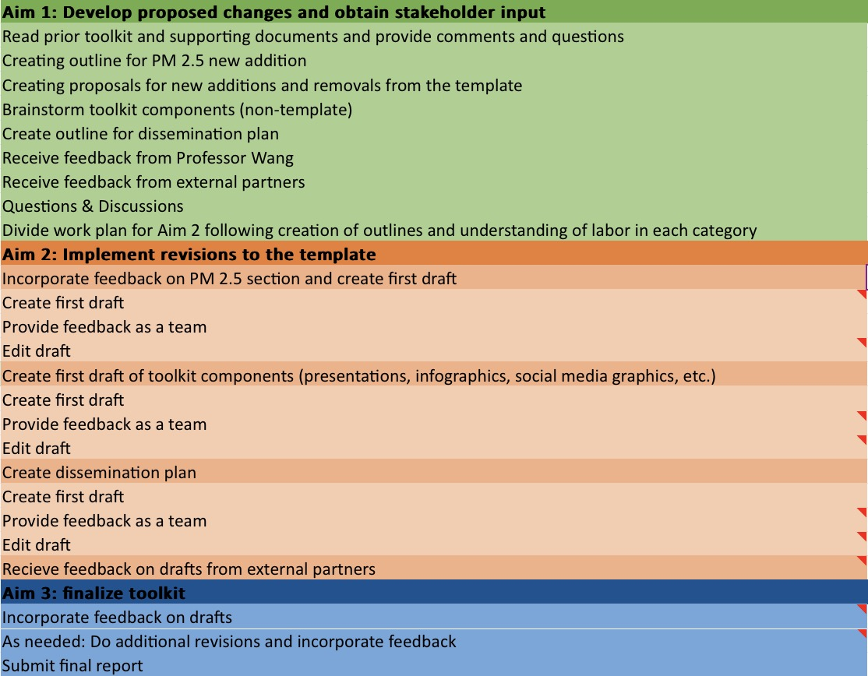
Our Approach + Workplan
Aim 1: Develop proposed changes and obtain stakeholder input
Aim 2: Implement revisions to the template
Aim 3: Finalize toolkit
Sep.-Oct.
Oct.-Nov.
Nov.-Dec.
Where we are now!

Slide 6
Part One
Template Revisions
Speaker: Yanjia Li

Slide 7

Existing template + Revisions includes:
Original Version
Executive summary
Purpose
Scope
Background
Assumptions
General stakeholder roles & responsibilities
Activation phases & activities
Plan maintenance
Climate change resilience
Communication strategies
Big additions:
PM 2.5
Environmental justice and the effects of these issues on specific populations (ex. those experiencing homelessness)
Indoor air quality and its interactions with outdoor air quality
Year-round preventative actions that municipalities can take
Revise for actionability
Update data & add new or additional tools
(ex. DEEP EJ screening tool)
Notes:
Based on the original template , we mainly made five additions : PM2.5, eNVIRONMENTAL jUSTICE , iNDOOR AND Outdoor air quality , Year-round preventative actions and the revision for actionabiltiy

Slide 8

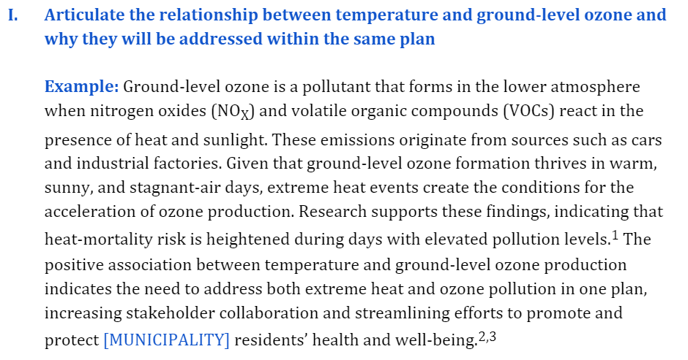
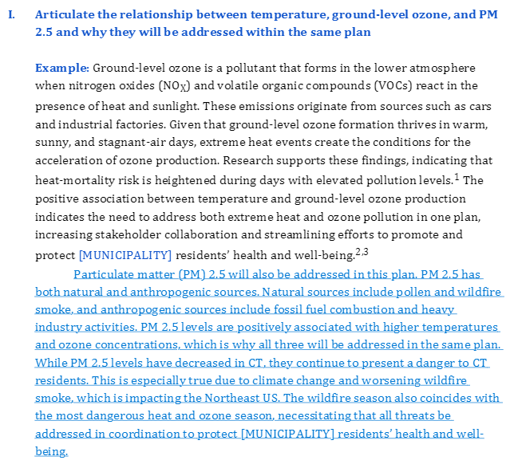
Revision one: PM2.5
Original Version
Revised Version
Notes:
Sena has incorporated several modifications across the template, particularly with PM 2.5 one of the examples is presented below. Higher temperatures and ozone concentrations are positively connected with PM 2.5 levels, so it's critical to address all three concerns in the same strategy. Even though PM 2.5 levels have decreased in Connecticut, residents are still at risk because of climate change and an increase in wildfire smoke. This is especially evident in the northeastern U.S., where burning fossil fuels produces dangerously high levels of PM 2.5 during wildfire smoke events.

Slide 9

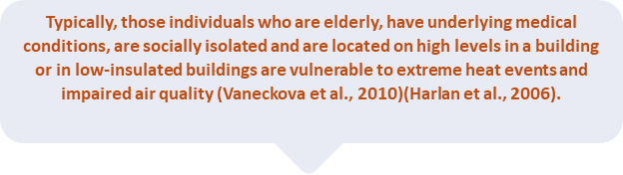
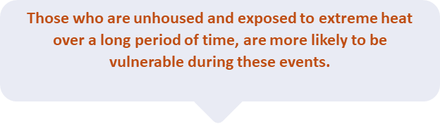
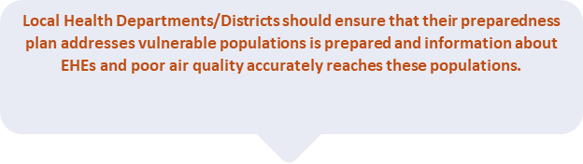
Revision Two: Local health departments should ensure that their plan addresses EJ through...
Notes:
Reece has concentrated on the environmental justice aspect of extreme heat occurrences, which we believe should be integrated into heat action strategies.
It is essential for response strategies regarding extreme heat and air pollution to have an equity-focused perspective to mitigate the disproportionate effects on vulnerable people. These groups experience high heat more frequently than others and are particularly susceptible to deterioration in air quality. Individuals who are elderly, possess underlying medical issues, experience social isolation, and reside in structures with high ceilings or inadequate insulation are particularly susceptible to intense heat events and compromised air quality. Another marginalized and at-risk demographic is the homeless population.

Slide 10

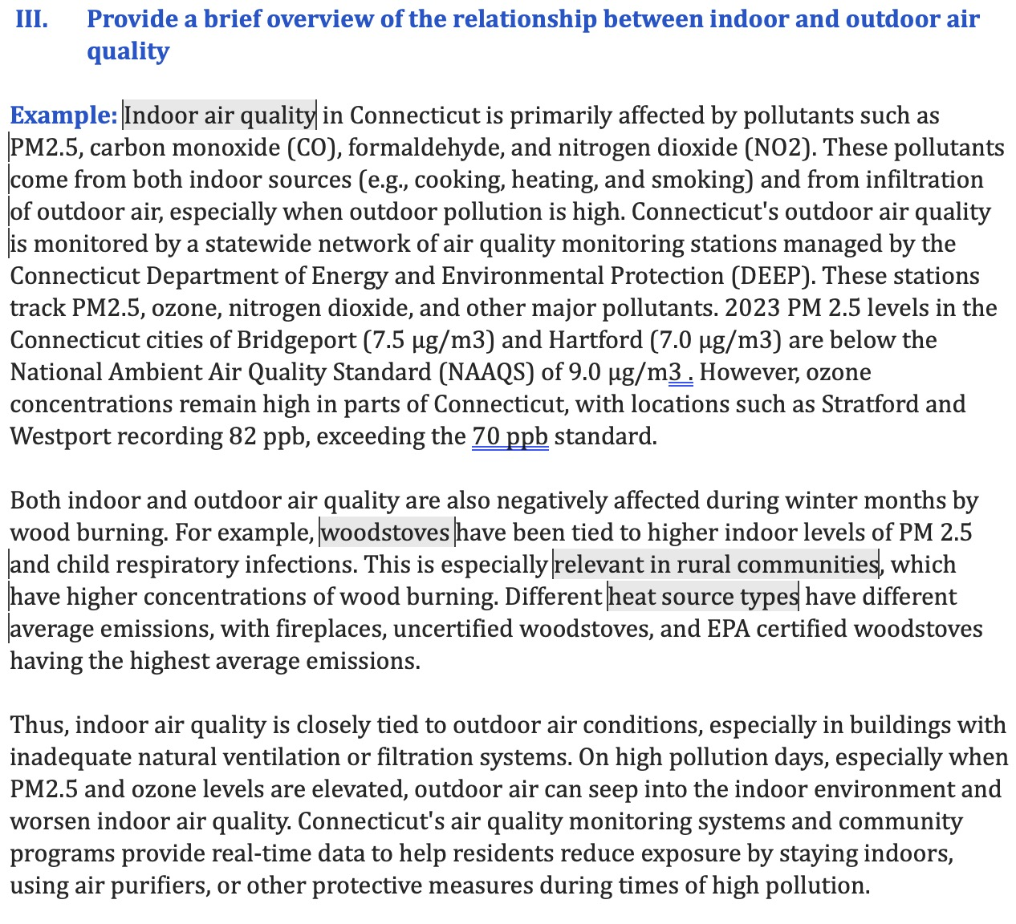
Revision Three: Indoor Air Quality
Different IAQ in different Counties
The impacts of woodstoves on IAQ
General relationship between Indoor and Outdoor air quality
Notes:
This discussion is followed by a further evaluation in the form of a template regarding the relationship between the quality of indoor and outdoor air, both of which are harmed by wood burning. The DEEP tracks outdoor air quality in Connecticut, disclosing variability in PM2.5 concentrations statewide. Locations like Stratford and Westport have recorded ozone levels of 82 ppb, surpassing the standard of 70 ppb. Additionally, during wintertime, wood burning in rural areas contributes to increased PM2.5 levels, which have been associated with respiratory infections in children.
During periods of higher pollution, particularly with increased PM2.5 and ozone levels, outdoor air may reach the inside environment, decreasing indoor air quality. During this period, the government should assist citizens in minimizing exposure by keeping indoors, utilizing air purifiers, or implementing other preventive measures.

Slide 11

Relevant Resources
Examples of resources included in the plan are:
Report: Connecticut 2024 Annual Air Monitoring Network Plan by the Connecticut Department of Energy and Environmental Protection Bureau of Air Management(DEEP)
Article: Heat and air pollution exposure among people experiencing homelessness
Tool: CT DEEP Environmental Justice screening tool
Report Card: ALA State of Air CT
Issue Briefs: Yale Center on Climate Change and Health briefs on issues such as The Air Quality Health Benefits of Climate Action in CT
Notes:
Here are lists of our relevant resources that will be included in the plan

Slide 12
Part Two
Toolkit & Infographics
Speaker: Reece Pauling

Slide 13

Toolkit + Infographics
Researching and include existing infographics addressing extreme heat and impaired air quality
External toolkit references that can be used by municipalities for public use
Notes:
Reece

Slide 14


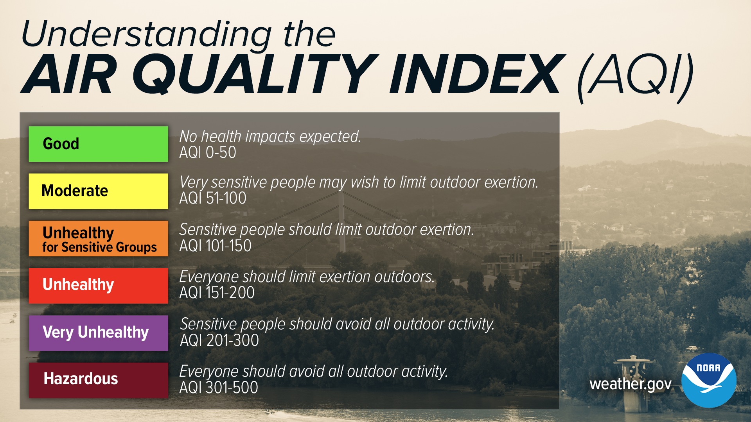
Reference Infographics
Additions: Infographics should contain information about public health factors. "At the moderate level, pay attention to symptoms like coughing, throat irritation, or chest tightness"

Slide 15
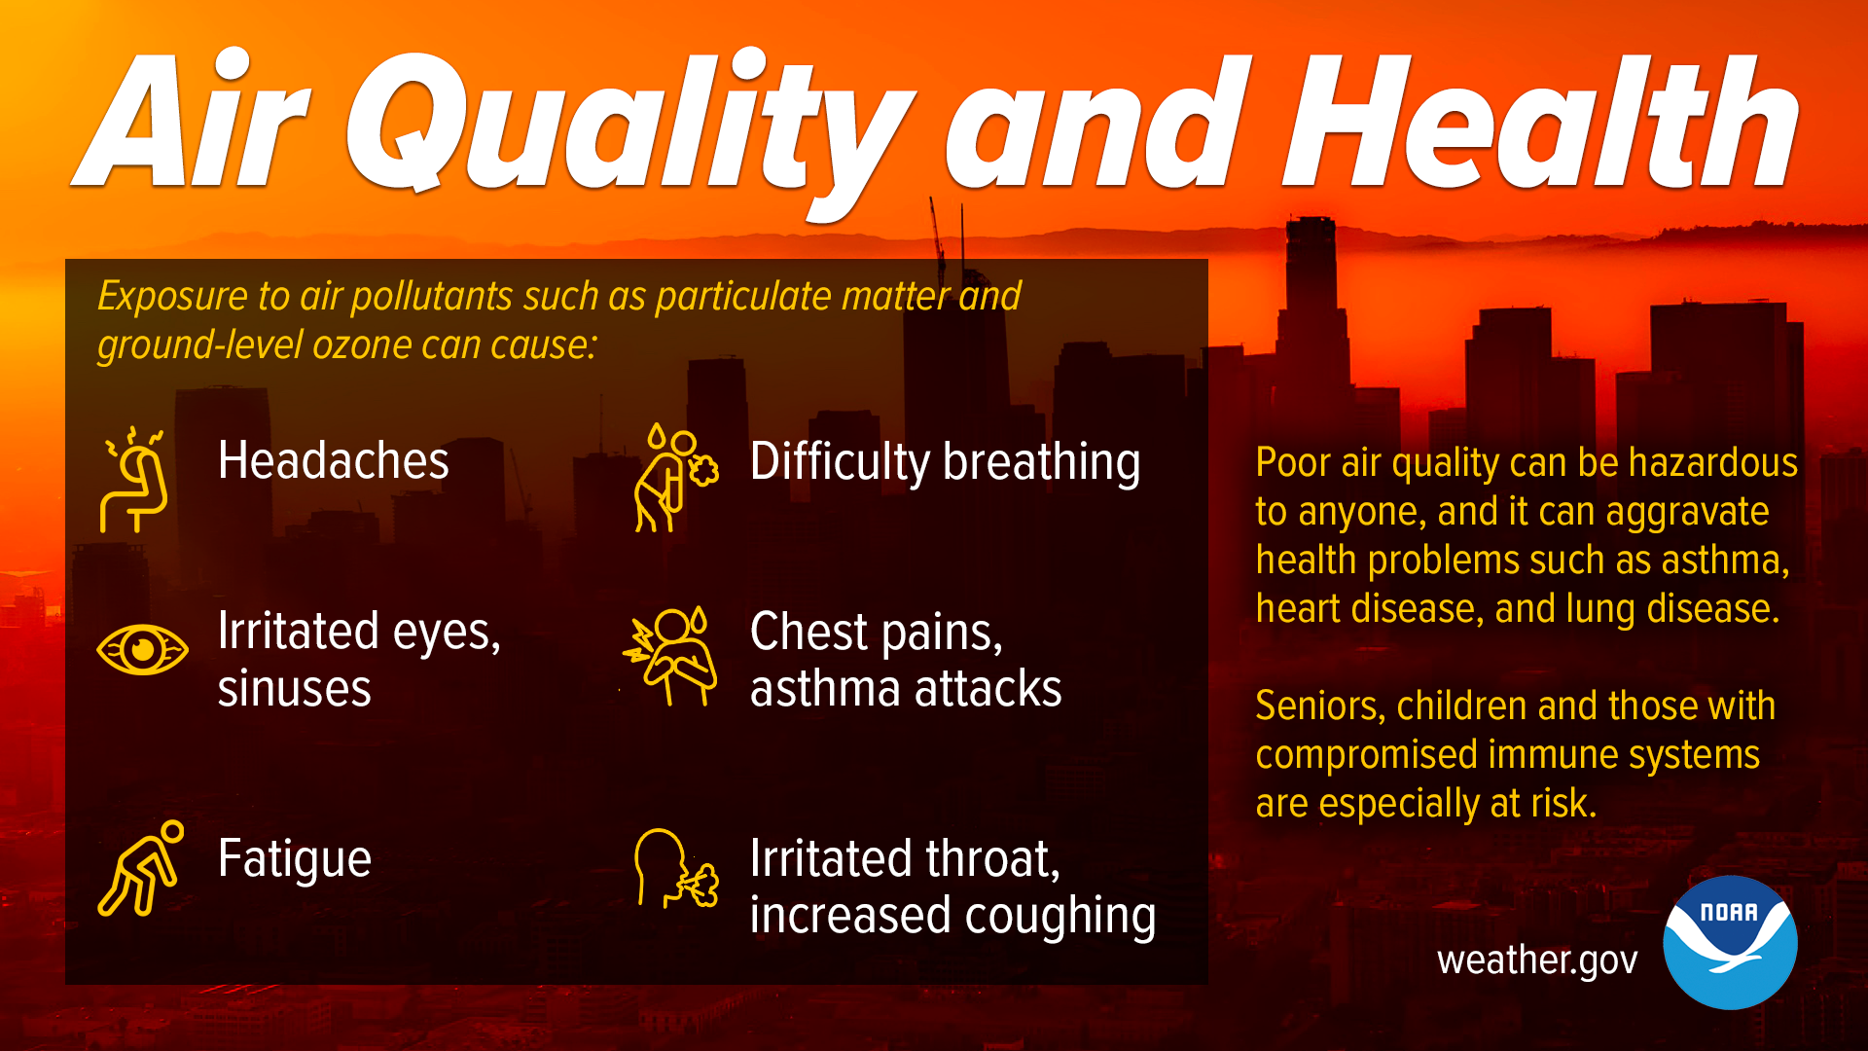

Reference Infographics
Symptoms to look out for
Impacts of Poor Air quality
Addressing groups at risks

Slide 16
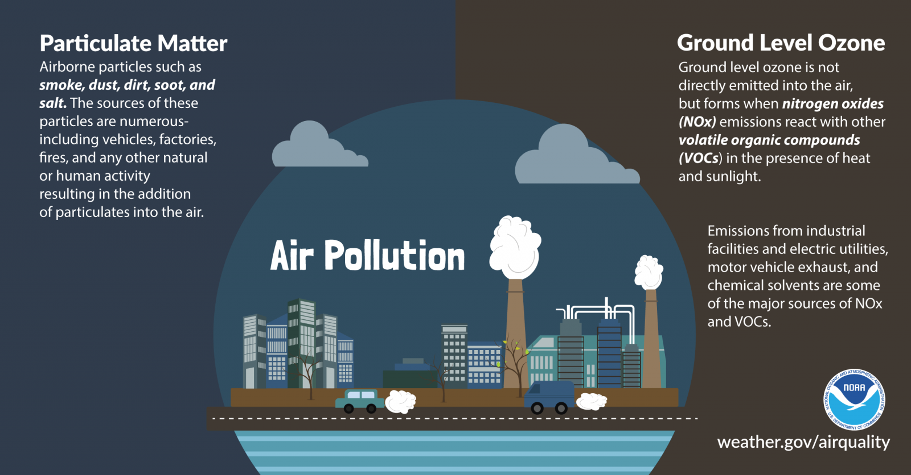
Reference Infographics
Additions: What actions can the public take before or during extreme heat events to reduce the impacts of PM2.5 & Ground Level Ozone?
During EHE's
Stay Hydrated
Wear light weight Clothing
Check on vulnerable neighbors
Thermostats at Moderate temp.
Before EHE's
Transportation adjustments
Identify your nearby cooling centers
Limit use of gas-powered equipment

Slide 17
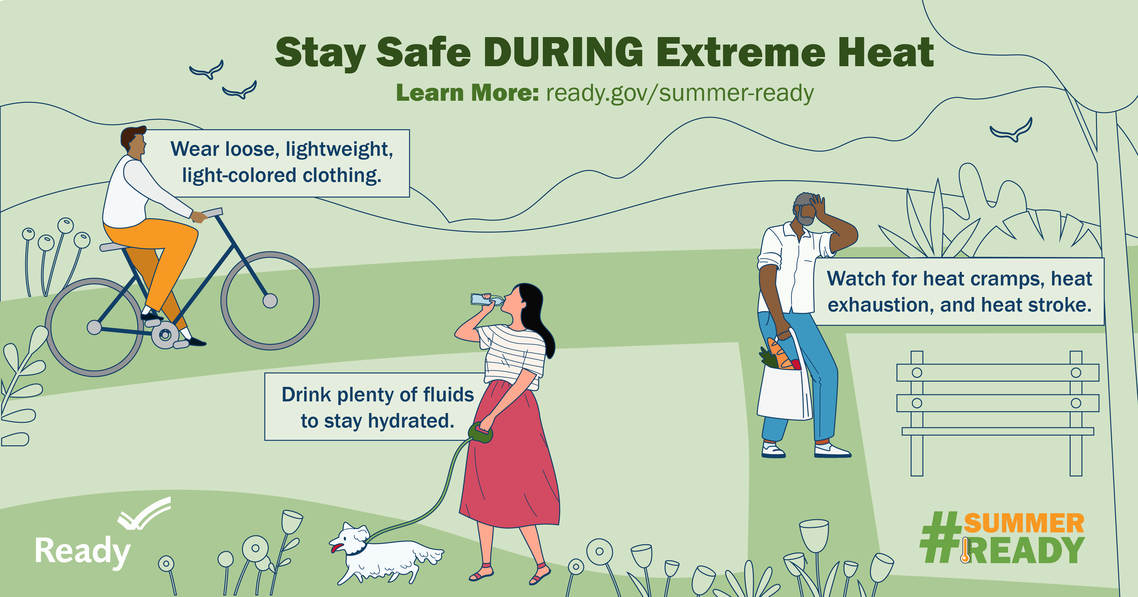
Reference Infographics
Actionable Steps for the Public DURING EHE's

Slide 18
Part Three
Dissemination Plans
Speaker: Sena Wazer

Slide 19

Dissemination Strategy One: Website
Central landing page for resources including:
The template
The toolkit & associated resources
Links to example plans from municipalities
Links to resources we want to highlight
Contact information and websites for relevant State Departments
Information for who they can reach out to for assistance (Yale Program on Climate Change and Health, CT DPH)

Slide 20

Dissemination Strategy Two: Webinar
Live session with local Departments of Public Health and other relevant stakeholders to rollout the template and answer questions:
When: December 6th from 12pm-1pm (possible)
Where: Zoom
Length and Format: 40mins presentations + 20mins Q&A
Content:
Introduction to the template
Introduction to the toolkit and its components
Introduction the website and additional resources
Q&A

Slide 21

Additional dissemination methods: Newsletter, social & traditional media
Additional dissemination methods:
Newsletter write up and graphic that can be included in publications from relevant partners
Social media graphics announcing the template that can be shared on partner social media accounts
Press release rolling out the template & webinar

Slide 22

Small group session with volunteer departments
When: Mid-November (12, 13 or 14)
What: A 1-hour session with a few volunteer local Departments of Public Health to share the plan and receive feedback.
Our ask: If you know a local department who may be interested, please send them our way!

Slide 23

Questions
What big issues related to air-pollution, extreme heat, ozone and PM 2.5 do you think should be included in a toolkit for municipalities?
Are there additional stakeholders we should be in conversation with?
What are key strategies or tools that should be included to make the template and toolkit as actionable as possible?
Notes:
Reece

Slide 24
Thank you

