Slide 1

Climate and Health Equity Coalition:
2nd Convening
Office of Climate and Health
Yale Center on Climate Change and Health
April 17, 2024

Slide 2
Agenda
Introductions and Ice Breaker
  DPH Staff and Project Partners
  Coalition Members
BRACE Overview
BRACE Grant Objectives and Updates
Role of Coalition Members
Subcommittee Selection
Survey Results
Compendium Guidance
Next steps

Slide 3
BRACE Team
CT Department of Health
Office of Climate and Health (OCH)
  Director: Hannah Beath Hannah.Beath@ct.gov
Yale University
Yale Center on Climate Change and Health (YCCCH)
  Executive Director: Jennifer Wang jen.wang@yale.edu
  Faculty Director: Robert Dubrow
  Robert.Dubrow@yale.edu

Slide 4
Ice Breaker
Name
Organization
Introductions
Role in Climate Change
Something you've found exciting recently

Slide 5
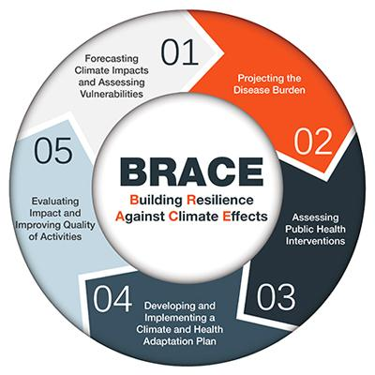
What is BRACE?
The Building Resilience Against Climate Effects (BRACE) framework is a five-step process that allows health officials to develop strategies and programs to help communities prepare for the health effects of climate change.
Feature of note:
  Incorporates atmospheric data and climate projections into planning and response activities
NOTE: Brace framework is undergoing an update by CDC to integrate mitigation best practices

Slide 6
Grant Funding and Objectives
CDC BRACE
$300k/5 years (Y3)
"Building Resilience Against Climate Effects"
Yale Center on Climate Change and Health (YCCCH) is partner
Enhance Program Management & Leadership
Enhance & Expand Partnerships
Compile Evidence & Best Practices to Develop & Implement Adaptation Plans
Identify, Use & Disseminate Lessons Learned on Effective Adaptation

Slide 7
BRACE Grant Objectives
Adaptation Action 1:
  Develop and implement an educational program for local health departments in socially vulnerable communities to reduce resident exposure to the health effects of climate change.
Adaptation Action 2:
  Develop guidance for local heat and air quality response plans (including alerts and communication strategies) and support local implementation through trainings and capacity building.

Slide 8
Recent BRACE Updates
CDC BRACE
  LHD Director survey results being analyzed
  Climate and Health Equity Coalition convened 1/30
  DPH + YCCCH Symposium occurred 3/6
  Interviews for AA2 scheduled for end of week (4/18-4/19)

Slide 9
Climate and Health Equity Coalition
Purpose
Share resources and expand the network of people engaged in climate work
Support health adaptation activities and provide oversight
Advise the monitoring, evaluation, implementation, and dissemination of the BRACE activities
Build the community’s capacity to address climate-related health equity
Commitment:
  Quarterly meetings:
    1 – 1.5 hrs
    Two more meetings in 2024: July and October
  Activity Review: Approx. 2 – 2.5 hrs between meetings
    Aiming for total of 4 hrs quarterly

Slide 10
Climate and Health Equity Coalition
Subcommittee Descriptions:
Monitoring and Evaluation:
  Provide input and guidance regarding the efficiency, equitability and effectiveness of the adaptation actions.
Implementation and Dissemination:
Subcommittee:
Membership: issue collecting names on survey form
  Only have 6 (out of 12) entries with name and selection
  Collect preferences live
Notes:
Hannah to add row to attendance list that can be used to capture subcommittee preference

Slide 11
Preliminary LHD Survey Results:
Responses from 25 local health departments/districts (LHDs)
  (42% response rate)
92% agree that climate change is impacting the health of their communities
80% believe LHDs should play a role in addressing the impacts of climate change (20% were neutral)
28% believe their LHD has the expertise required
  (4% report they have the capacity)
Reported the following climate impacts as the most concerning:
  Extreme precipitation (84%)
  Increase in vector-borne disease (80%)
  Extreme heat (76%)
Reported the following training topics as most pertinent:
  "Health Impacts of Climate Change"
  "Public Health Programs & Climate Change"
Reported the following training topics as least pertinent:
  Agriculture and Food Security

Slide 12
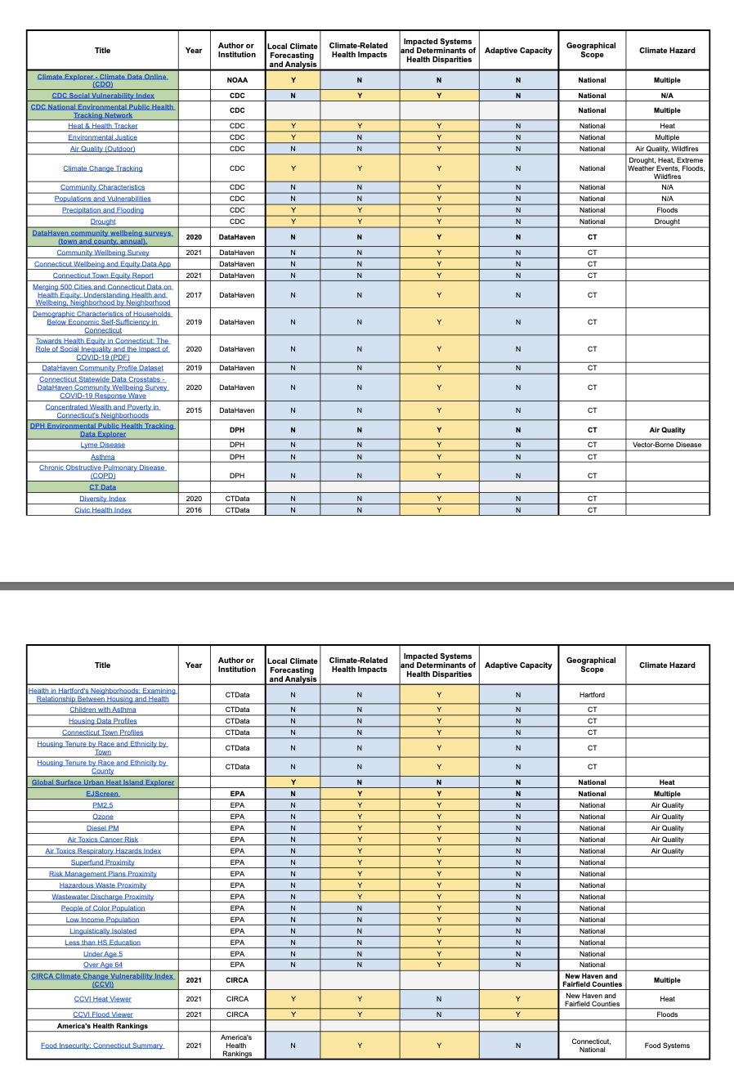
Connecticut Climate Impact Compendium
We are seeking coalition's feedback to:
Add additional resources – what’s missing that is readily available?
Identify resource gaps – what’s missing that is not readily available?
  Previously identified: adaptive capacity; interventions
  Others?
Improve formatting for usability and accessibility
  Add introductory page to orient reader on purpose and structure; add date
  Formatting/remediating PDF for accessibility, OR, adapting it to a webpage?
  Other ideas to make it more usable and accessible?
Please email Jen with your feedback on any of the above! jen.wang@yale.edu

Slide 13
Next Steps:
Selecting LHDs for preparedness planning (AA2)
Confirming budget (changes to contract/hiring
    Possible changes to contracts
    Hopefully hiring an EA2 position
YCCCH interns starting with DPH in June

