Slide 1
Climate and Health Equity Coalition
7/17/2024

Slide 2
Introductions + Icebreaker (10 minutes)
Symposium (5 minutes)
Compendium Updates (10 minutes)
Curriculum Update (40 minutes)
Evaluation Update (15 mins)
Wrap up (5 mins)

Slide 3
Intros + Icebreaker
What was the environment like where you grew up? OR What is your happy place?

Slide 4
Symposium Brainstorming
Reframing the Coalition to think big picture
  Creating visibility for Public Health + Climate Change
  How can we reconceptualize the Symposium to achieve that aim?

Slide 5
Compendium 2024 Update
Link to current version:
  Available from Office of Climate and Health homepage:
  https://portal.ct.gov/dph/environmental-health/climate-and-health
Feedback:
  Resources to include:
    Additional reports from Governor’s Council on Climate Change (GC3)
      Health & Safety Working Group report
      “Centering Equity in Climate Change Resilience Planning in Connecticut” report from Yale Center for Environmental Justice and GC3 Equity and Environmental Justice Working Group
    Other more current work, various articles, podcasts, etc.
  Reformat as an excel or alternative to create interactive tool; formatting suggestions
  Add explanation for use and statement of purpose to make document more accessible to broad audience
    Ex. Why and for whom was this created?
    Ex. What is the purpose?
    Ex. Tip: Sort by geographic area or hazard
Last minute feedback?
Next steps

Slide 6
Curriculum Progress
Content creation will be presented by YSPH Graduate Interns
Next steps
  Digital curriculum
  Evaluation
Feedback and discussion following Anne and Cooper's presentation

Slide 7
Data Collection

Slide 8
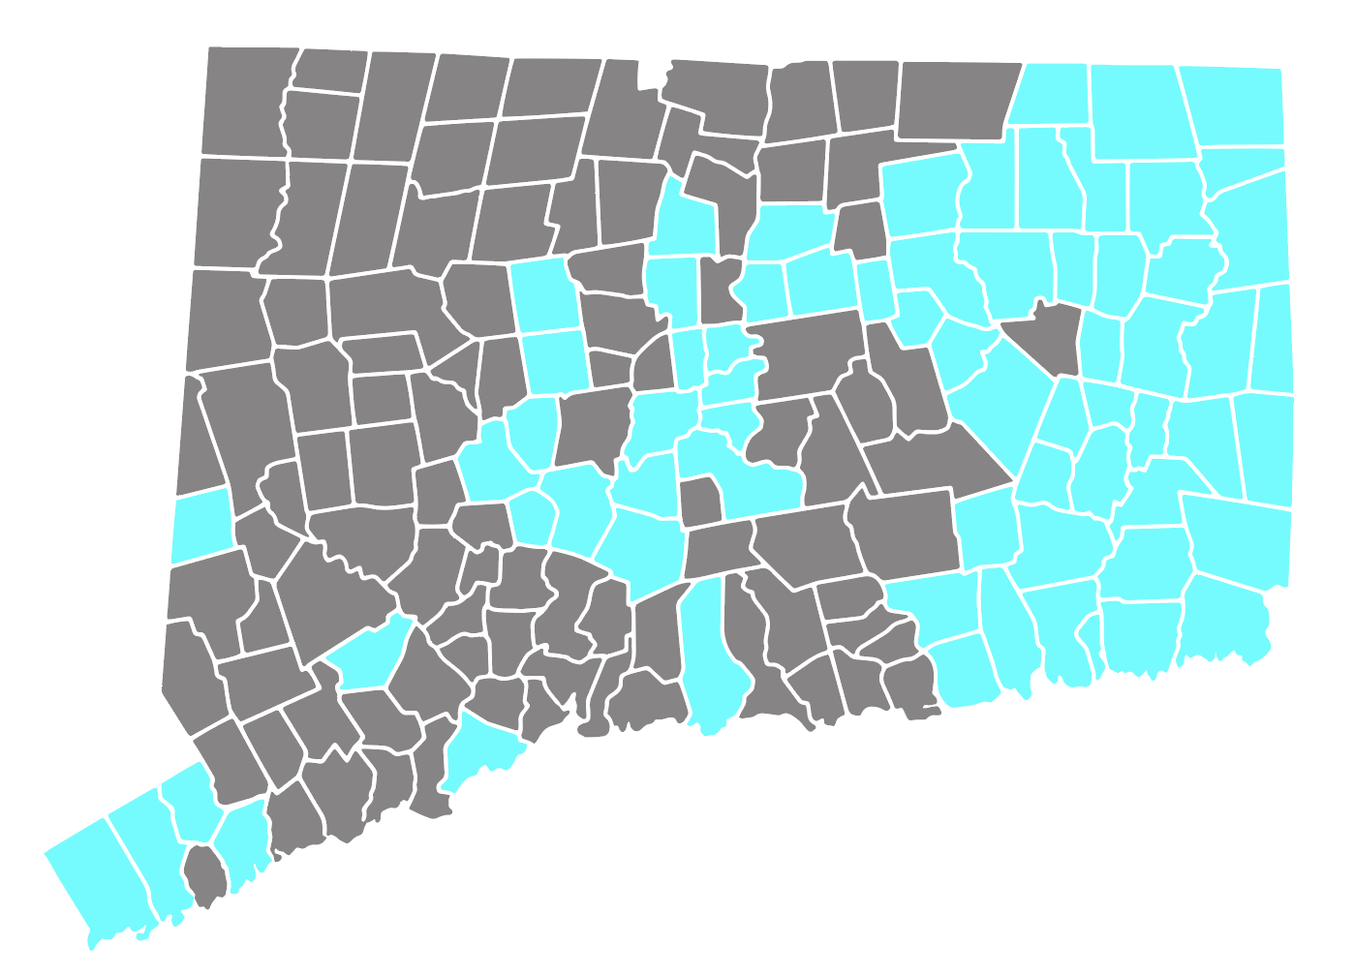
Data Collection
In December of 2023, a survey was sent to all 59 health departments in Connecticut with questions pertaining to climate health and equity
24 health departments responded
Participating Municipalities
Bristol Burlington
Notes:
Anne

Slide 9
Survey Results
Notes:
Cooper

Slide 10
Survey Results
Notes:
Cooper

Slide 11
Survey Results
Notes:
Anne

Slide 12
Survey Results
When asked which climate-related impacts these health districts believe are most concerning to their community, respondents answered:
  Extreme heat and heat waves – 18
  Extreme cold – 11
  Extreme precipitation and flooding – 20
  Increased storm severity and storm surges – 12
  Drought and the quality and/or quantity of fresh water – 11
  Water and food borne diseases – 7
  Food safety and security – 8
  Reduced air quality – 14
  Increase in diseases associated with mosquitos and ticks (vector-borne) – 19
  Inadequate wastewater treatment and sewage operations – 4
  Mental health exacerbations – 13
Notes:
Cooper

Slide 13
Curriculum Breakdown

Slide 14
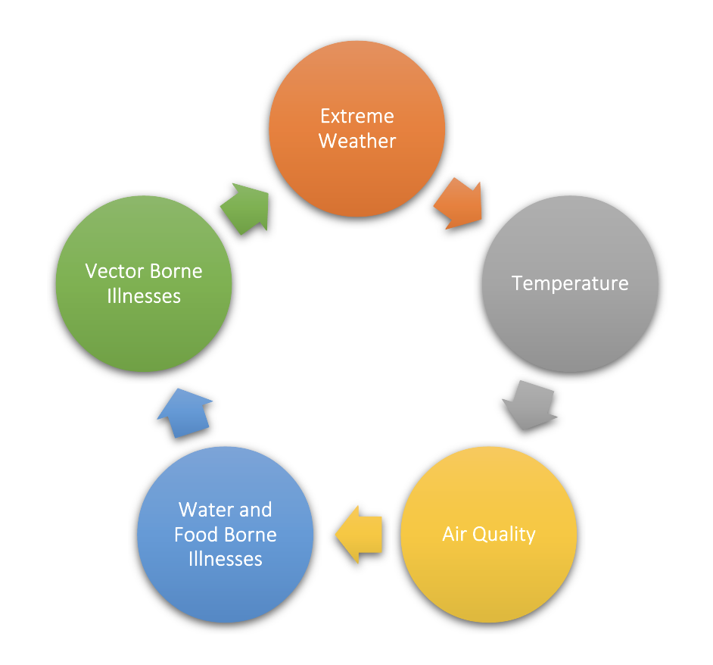
Curriculum Breakdown
This course will entail five modules:
  Extreme Weather
  Temperature
  Air Quality
  Food and Waterborne Illnesses
  Vector Borne Diseases
The overarching five modules were selected based on the survey results
Each module will entail various submodules based on relatable content
Each will include information pertaining to:
  Environmental hazard intersections
  Physical health implications
  Mental health considerations
  Social disparities and health equity
  Future implications and resilience strategies
At the culmination of each module and/or submodule, there will be a concept check the participant must complete
  To continue in the course, the participant must achieve a score of 80% or higher
Notes:
Anne

Slide 15
Extreme Weather
This module is broken into four parts (submodules)
  Flooding
  Hurricanes and Storms
  Sea Level Rise and Saltwater Intrusion
  Drought
These topics were chosen based on the following survey results
  Extreme precipitation and flooding – 20
  Increased storm severity and storm surges – 12
  Drought and the quality and/or quantity of fresh water – 11
  Inadequate wastewater treatment and sewage operations – 4
  Mental health exacerbations – 13
Notes:
Cooper

Slide 16
Temperature
This module is broken into two parts (submodules)
  Hot
  Cold
These topics were chosen based on the following survey results
  Extreme heat and heat waves – 18
  Extreme cold – 11
  Mental health exacerbations – 13
Notes:
Anne

Slide 17
Air Quality
This module is broken into three parts (submodules)
  Ground Level Ozone
  Particulate Matter
  Mold
  Pollen
These topics were chosen based on the following survey results
  Reduced air quality – 14
  Mental health exacerbations – 13
Notes:
Cooper

Slide 18
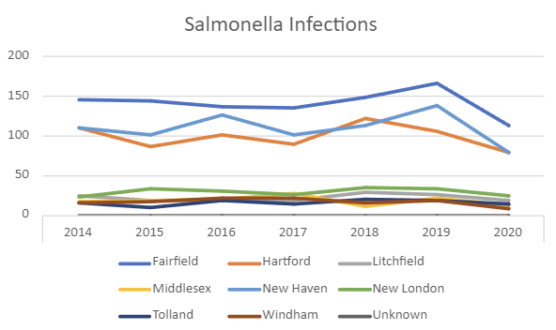
Food and Waterborne Illnesses
This module pertains to information regarding the following food- and waterborne illnesses:
  Campylobacter
  Cholera
  Cryptosporidiosis
  Cyclosporiasis
  Giardiasis
  Legionellosis
  Salmonella
  STEC (Shiga toxin-producing E. coli)
  Typhoid
  Vibrio
These topics were chosen based on the following survey results
  Water and food borne diseases – 7
  Food safety and security – 8
  Inadequate wastewater treatment and sewage operations – 4
  Mental health exacerbations – 13
Notes:
Anne

Slide 19
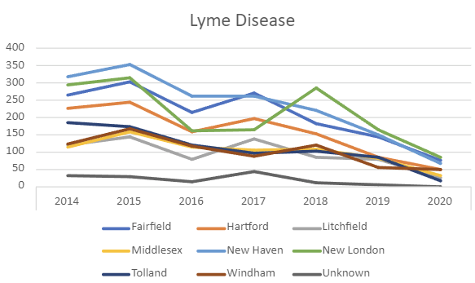
Vector-Borne Illnesses
This module is broken into two parts (submodules)
These topics were chosen based on the following survey results
  Increase in diseases associated with mosquitos and ticks (vector-borne) – 19
  Mental health exacerbations – 13
  Mosquitos
    California Serogroup Viruses
    Chikungunya Virus
    Dengue Virus
    Eastern Equine Encephalitis (EEE) Virus
    Malaria
    St Louis Encephalitis Virus
    West Nile Virus (WNV)
    Yellow Fever Virus
    Zika Virus
  Ticks
    Anaplasmosis
    Babesiosis
    Borrelia Miyamotoi disease
    Ehrlichiosis
    Lyme Disease
    Powassan Virus
    Rocky Mountain Spotted Fever
    Tularemia
Notes:
Cooper

Slide 20
Example Module
Module Template.docx

Slide 21
Discussion

Slide 22
Evaluation Update
AA1 (Curriculum) evaluation:
  Evaluation plan to be reviewed/revised with CDC team
AA1 (Local Heat and Air Quality Plans) evaluation:
  Evaluation plan to be reviewed/revised with CDC team
  Discussion at July 1-2 CDC Site Visit with CDC Evaluation staff and Local Health Departments

Slide 23
Evaluation purpose
The purpose of this evaluation is to provide formative evaluation during the development of the adaptation action, as well as process evaluation during the action’s initial implementation.
We expect to use the evaluation results to improve program design and effectiveness, to inform and engage program participants and stakeholders, and to add to the evidence base for effective climate and health adaptation actions.

Slide 24
Evaluation questions
How did the Adaptation Action support local health departments to develop their LHAQP, and how could the strategy be improved to better support them?
How engaged were stakeholders and how can we engage them more effectively?
In the participating municipalities, how did extreme heat and air quality preparedness and response change as a result of the adaptation action?

Slide 25
Evaluation question 1
How did the Adaptation Action support local health departments to develop their LHAQP, and how could the strategy be improved to better support them?
Indicators:
Policy or document creation
  Creation of finalized LHAQP in participating municipalities
Process change
  Participating LHD and municipal staff report that templates and technical assistance helped them develop the LHAQP

Slide 26
Evaluation question 2
How engaged were stakeholders and how can we engage them more effectively?
Indicators:
Stakeholder participation in meetings
  50% of stakeholders attend each meeting and among those >50% are involved
Adaptation action plan or evaluation plan modification
  Changes made to adaptation action plan as a result of stakeholder review and discussion.

Slide 27
Evaluation question 3
In the participating municipalities, how did extreme heat and air quality preparedness and response change as a result of the adaptation action?
Indicators:
Behavior change by municipal officials regarding their heat and air quality response activities
  Statistically significant difference between pre- to post- intervention survey
Document analysis: Municipal public communications (social media, emails, other?) that align with the plan
  Increase in public communications before/during/after extreme heat or air quality events.
Notes:
What are the key activities, facilitators, challenges, lessons learned, and recommendations that emerged from developing the LHAQ plans?

Slide 28
Challenges of evaluating plans
Any sort of health outcomes rely on the plan being implemented.
Right now, the goal is plan creation and development, so focus should be on a formative evaluation of the plan-creation process.
  First “step”: understanding details about plan development, what worked or didn’t
  Second “step”: did X happen when thresholds were met (why/why not)
  Third “step”: what was learned from IMPLEMENTING the plan
  Fourth “step”: what happened from implementing the plan (/did we see what we wanted to happen; outcomes that can be pulled from the logic model)

Slide 29

LHAQ plan development evaluation question(s)
What are the key activities, facilitators, challenges, lessons learned, and recommendations that emerged from developing the LHAQ plans?
(a) How were community assets leveraged?
(b) How were challenges overcome?
(c) What considerations were made during the planning stage to accommodate the needs of vulnerable populations?
We can play with these sub questions – just suggestions/starting points.
Notes:
https://doi.org/10.1007/s00484-022-02326-x

Slide 30
Eventually, once the plan is put in place, could shift to something like…
Did the things we want to happen when thresholds were met happen? Why/why not?
Notes:
https://doi.org/10.1007/s00484-022-02326-x

Slide 31
Then to…
What are the key activities, facilitators, challenges, lessons learned, and recommendations that emerged from implementing the LHAQ plans?
In the participating municipalities, how did extreme heat and air quality preparedness and response change as a result of the adaptation action?
Notes:
https://doi.org/10.1007/s00484-022-02326-x

Slide 32
Wrap Up and Next Steps
Final updates:
  Capacity
  Legislative Proposals
Important dates:
  Next Coalition meeting: October 17th
  CDC Reverse Site Visit: January 29-31 (DPH and YCCCH reps)
  Symposium: TBD, possibly Mid March

