Slide 1
Climate and Health Equity Coalition
1/15/2025

Slide 2
Welcome + Icebreaker (10 minutes)
Announcements (10 minutes)
AAEP Update (15 minutes)
Curriculum Update (10 minutes)
Symposium Agenda Feedback (15 minutes)
Wrap up (10 mins)

Slide 3
Intros + Icebreaker
Please feel free to share any resolutions or intentions you intend to keep for 2025.
Notes:
Climate and Health Equity Coalition (ct.gov)
Public meeting – agendas and materials will be posted online, and members of the public can attend

Slide 4
Announcements
LHD contracts for Round 1 of pilot grants
Two more LHDs selected for Round 2
Health Program Associate start date 2/7
Notes:
Conducted an application and interview process and scored applicants based on specific criteria, one of which was demonstrated need or climate vulnerability related to air quality; 2nd round has not been formally announce and won’t until contracts are executed
Our new hire, Madhu joins us with previous experience as a physician, in consulting, and with significant data and research skills. Her most recent research has been in surveillance indicators and climate impacts, but she also led a study in WA state on LGBTQ policies and equity and she helped redesign WHO guidelines on gender-affirming care

Slide 5
Evaluation update
Currently revising evaluation plans, with guidance from CDC staff to evaluate the two adaptation actions in our grant.
First step: revise evaluation questions. Here are the current drafts for AA1 and AA2:
AA1 (Curriculum/training) | AA2 (Local heat and air quality planning)
How engaged were stakeholders and how can we engage them more effectively? How did the curriculum impact individual knowledge, attitudes, and beliefs related to the health risks of climate change? How did the training impact the behaviors of local health departments regarding willingness/interest to plan and implement climate and health activities in their communities? | Questions to evaluate efforts of DPH/YCCCH statewide: How did the Adaptation Action support local health departments to develop their LHAQP, and how could the strategy be improved to better support them? How engaged were stakeholders, and how can we engage them more effectively? Questions to evaluate efforts of 4 pilot grantees in their local/regional jurisdictions: What are the key activities, facilitators, challenges, lessons learned, and recommendations that emerged from developing the Local Heat and Air Quality Preparedness and Response Plan (LHAQP)? How were community assets leveraged and key stakeholders engaged? How were challenges overcome? What considerations were made to identify and address the needs of vulnerable populations?

Slide 6
Evaluation next steps
Revise data collection methods to reflect updated evaluation questions
Share with coalition, with feedback requested from M&E Subcommittee members (will give ~1 month)
Incorporate feedback from coalition and CDC team
Finalize and submit to CDC

Slide 7
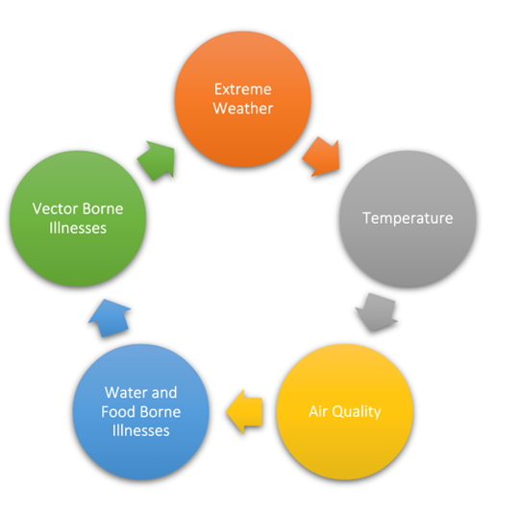
Curriculum Update
This course will include five modules, with corresponding submodules
  Ex. Temperature includes Extreme Heat and Extreme Cold
Each will include information pertaining to:
  Environmental hazard intersections
  Physical health implications
  Mental health considerations
  Social disparities and health equity
  Future implications and resilience strategies
Notes:
As a reminder: the curriculum is broken into five modules, which were determined by a survey completed by Local Health Directors who reported on their climate concerns, what they are seeing in their community, and what they would like to learn more about
Each module will contain the following information, but we see our value add as having Connecticut specific data and resilience strategies

Slide 8
Curriculum Update
Revised Resilience Strategies
1) Extreme Weather | Flooding Hurricanes and Storms Sea Level Rise Drought | COMPLETE
2) Temperature | Extreme Heat Extreme Cold | COMPLETE
3) Air Quality | Ground Level Ozone PM Mold Pollen | NOT STARTED - MARCH
4) Food and Water Borne | 11 Pathogens, e.g., vibrio | IN PROGRESS
5) Vector Borne | Ticks Mosquitoes | NOT STARTED - MARCH
Notes:
We have completed content for each of the modules, but the resilience strategy inclusion was an addition based on feedback from our first round of submission.
The resilience strategy sections take some time, but again, this is where the value is, so we’re continuing on with drafting all of these – extreme weather and temperature have been drafted – air quality and vector borne disease are slated to be completed by the end of March, and food and water borne illness are in progress currently.

Slide 9
Curriculum Update
Resilience Strategy Framework:
  Heat Related Concerns Policy Framework.docx
Notes:
Here is an example of a resilience strategy that has been drafted and what that may include. This one still has comments and edits, but is fairly robust.

Slide 10
Curriculum: Next Steps
February and March:
Complete resilience strategy frameworks and finalize content; plan focus groups; seek feedback from SMEs
April:
Hold focus groups; develop launch plan, including communication plan
May:
Implement focus group feedback; seek approvals
June:
Launch
Notes:
We’ve been playing catch up with all of the BRACE work and have more or less gotten everything back on track. The exception really is the curriculum work. We have a solid foundation and our graduate interns have worked really hard on this, but we have a lot of ground to make up in the first half of this year to get ready to launch
This timeline is firm because we want to be able to collect about a year of evaluation data while this grant is still active, so it’s going to be challenging, but it will be Madhu’s primary task as she joins us

Slide 11
2025 Connecticut Symposium on Climate Change and Health:
Confirmed for Tuesday 3/25/25, 8:30am-2:30pm at Southern CT State University, Adanti Student Center
Objective: Build awareness, engagement, and community in CT around the health impacts of climate change, and solutions to protect health.
Target audiences:
  People working in public health; health care; emergency management; social services; education; and planning and development
  People from communities affected by climate/environmental injustice
  Members of Climate and Health Equity Coalition; Connecticut Equity and Environmental Justice Advisory Council (CEEJAC) and its subcommittees; and other interested groups
  Researchers, journalists, and advocates interested in climate change and health
  Students from Connecticut and nearby colleges, public health schools, medical schools, etc.
Notes:
Will send save-the-date to Coalition ASAP / share widely.
Share speaker suggestions
Professionals could be from state and local government, regional planning agencies, etc.

Slide 12
Symposium Agenda Outline (updated)
Time | Agenda item | Speaker / Notes
8:30 – 9:00 | Breakfast & registration
9:00 – 9:15 | Welcome and opening remarks | DPH Commissioner Juthani
9:15 – 10:30 | Climate hazards, health risks, and health equity in Connecticut (Format: Brief presentations followed by panel discussion/Q&A) Introduction to Climate & Health in CT Connecticut’s changing climate and implications for public health Perspectives on populations at risk, e.g.: EJ communities; people with severe mental illness; rural communities? | Hannah and/or Jen Subject matter experts re: heat, AQ, extreme weather, vector-borne dz, water quality/quantity Community leader; representative from CMHC research team; TBD
10:30 – 10:45 | Break
10:45 – 12:15 | Opportunities to promote a healthy, resilient Connecticut (Format: Brief presentations followed by interactive session) DEEP Air Monitoring & Sensor Loan Program Toolkit for Local Heat & Air Quality Planning Connecticut Health Professionals for Climate Action | Interactive session: at each table, participants reflect on presentations throughout the morning and share their own work/ideas (document with flip chart and/or notes doc). Each group will report back (time permitting).
12:15 – 12:30 | Closing remarks | Hannah & Jen
12:30 – 1:30 | Lunch & networking
1:30 – 2:30 | Coalition meet & greet
Notes:
Open to additional speaker suggestions
Informal Coalition meeting – open for others to join
Because of objective to build community and interactive component, want to do this fully in-person, but will look into recording for broader reach/access.

Slide 13
Wrap Up
Next coalition meeting: April 16th, 2025
Symposium: March 25th, 2025

