Slide 1

Bullying and Harassment:
What School Districts Need to Know to Protect Their
Students and Themselves
October and November – Area Cooperative Educational Services
Maree Sneed, Partner
Hogan Lovells
202-637-6416
maree.sneed@hoganlovells.com

Slide 2

True
or
False

Slide 3

True or False
A school can be liable for harassment even if its administrators did not actually know it occurred.

Slide 4
True or False
Districts are not legally obligated to address anti-transgender harassment under federal law in light of the recent repeal of the transgender-focused Dear Colleague Letter.

Slide 5
True or False
Schools are required to investigate off-campus, peer-on-peer sexual violence even after a police report has been filed.

Slide 6
True or False
Districts are only legally responsible for the actions or inactions of their employees in response to bullying or harassment, not for the harassment itself.

Slide 7
True or False
Although religion and sexual orientation are not explicitly named as federally protected characteristics, districts are sometimes legally obligated to address bullying on those topics.

Slide 8
Background
State of the Law
  Overview of Bullying & Harassment Legal Framework
    Legal Elements of School Bullying & Harassment Claims
    Life Cycle of a School Bullying or Harassment Claim
  Bullying & Harassment Based On Federally Protected Characteristics
    Race, Color, National Origin
    Sex
    Disability
  Cyberbullying
  State Anti-Bullying Laws
Protecting Your Students and Yourselves

Slide 9
Background
State of the Law
  Overview of Bullying & Harassment Legal Framework
    Legal Elements of School Bullying & Harassment Claims
    Life Cycle of a School Bullying or Harassment Claim
  Bullying & Harassment Based On Federally Protected Characteristics
    Race, Color, National Origin
    Sex
    Disability
  Cyberbullying
  State Anti-Bullying Laws
Protecting Your Students and Yourselves

Slide 10
Background
What are bullying and harassment?

Slide 11
What are bullying and harassment?
Bullying is unwanted, aggressive behavior among school-age children that involves a real or perceived power imbalance. The behavior is repeated, or has the potential to be repeated, over time.
  Bullying can be verbal, social, or physical
  Examples:
    Verbal: teasing, name-calling
    Social: exclusion, public embarrassment
    Physical: hitting, damaging personal belongings
                Source: stopbullying.gov
Notes:
33% of students who are bullied report it happening in classrooms, according to the National Center for Education Statistics.

Slide 12
What are bullying and harassment?
Harassment may be verbal, written, or other conduct that is threatening or harmful
  Does not have to include intent to harm, be directed at a specific target, or involve repeated incidents
  Only a small part of the larger universe of bullying or cyberbullying activity
    Source: OCR DCL: Harassment and Bullying

Slide 13
Background
Why are bullying and harassment such “hot” topics?

Slide 14
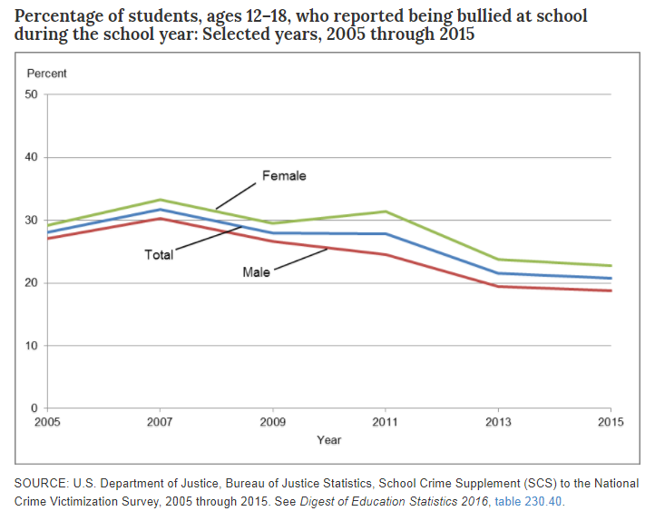
Why are bullying and harassment such “hot” topics? Statistics
According to the National Center for Education Statistics, student-reported bullying has slightly decreased since 10 years ago but plateaued since 2013. About 1 in 5 students report being bullied at school.
Source: NCES Blog
Notes:
https://nces.ed.gov/blogs/nces/post/bullying-down-from-a-decade-ago-but-unchanged-since-2013

Slide 15
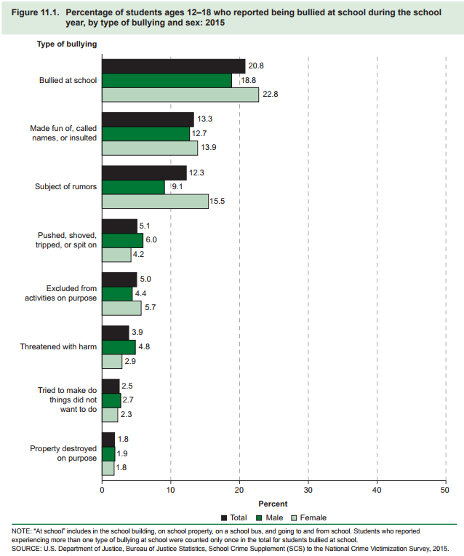
Why are bullying and harassment such “hot” topics? Statistics
Percentage of students who reported being bullied at school in 2015, by type:
Bullied (total) – 20.8%
Made fun of, called names, or insulted – 13.3%
Subject of rumors – 12.3%
Pushed, shoved, tripped, or spat on – 5.1%
Excluded on purpose – 5.0%
Threatened with harm –3.9%
Attempted coercion to do something they did not want to do – 2.5%
Property destroyed – 1.8%
Source: Indicators of School Crime and Safety, 2016

Slide 16

Why are bullying and harassment such “hot” topics? Statistics
Higher percentage of female than male reported being bullied at school in 2015 (23 vs.19%)
Reports of being bullied by grade level:
  Grade 6 – 31%
  Grade 8 – 22%
  Grade 12 – 15%
Source: Indicators of School Crime and Safety, 2016
Notes:
https://nces.ed.gov/pubs2017/2017064.pdf

Slide 17
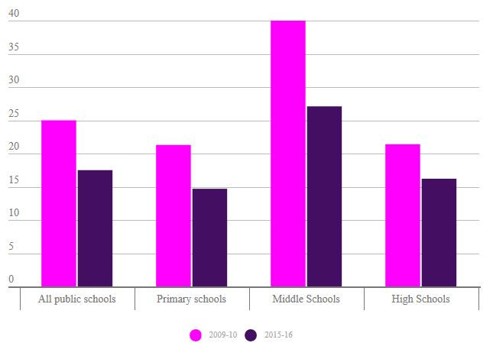
Reports of bullying and violence have declined since 2009–10
Of the public schools that participated in the surveys, 11.9 percent reported a bullying incident at school daily or at least once a week in 2015–16, a decline from 23.1 percent in 2009–10. The department’s two surveys showed a similar decline in violent incidents, from 25 per 1,000 students in 2009–10 to 17.5 in 2015-16.
Source: National Center for Education Statistics
Rate of violent incidents at public schools, per 1,000 students

Slide 18
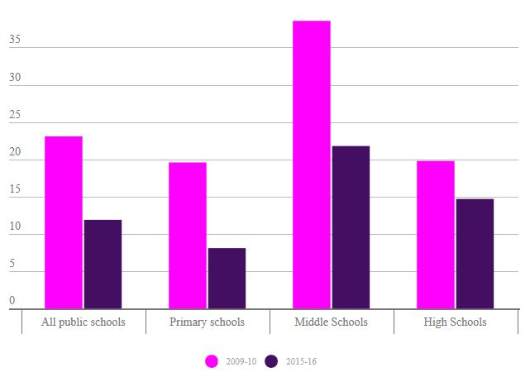
Reports of bullying and violence have declined since 2009–10
Of the public schools that participated in the surveys, 11.9 percent reported a bullying incident at school daily or at least once a week in 2015–16, a decline from 23.1 percent in 2009–10. The department’s two surveys showed a similar decline in violent incidents, from 25 per 1,000 students in 2009–10 to 17.5 in 2015-16.
Source: National Center for Education Statistics
Percent of schools reporting bullying daily or at least once a week

Slide 19
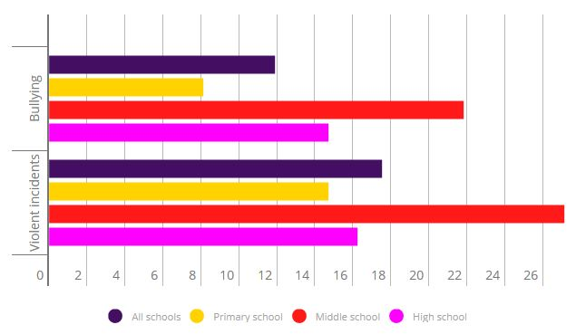
Bullying and violence are most prevalent in middle schools
Let’s face it: We’d all like to forget our middle school years and all that acne, catty drama, and bullying. That last one, at least, is backed by data. According to the latest NCES figures, reports of bullying and violence in middle school far exceed those in elementary and high schools. Across all public schools, 11.9 percent reported bullying issues daily or at least once a week. Among middle schools, 21.8 percent reported similar bullying rates, while high schools came in second, at 14.7 percent.
Source: National Center for Education Statistics
Percent of schools reporting bullying incidents daily or at least once a week, and the rate per 1,000 students of all recorded violent incidents that occurred at school

Slide 20
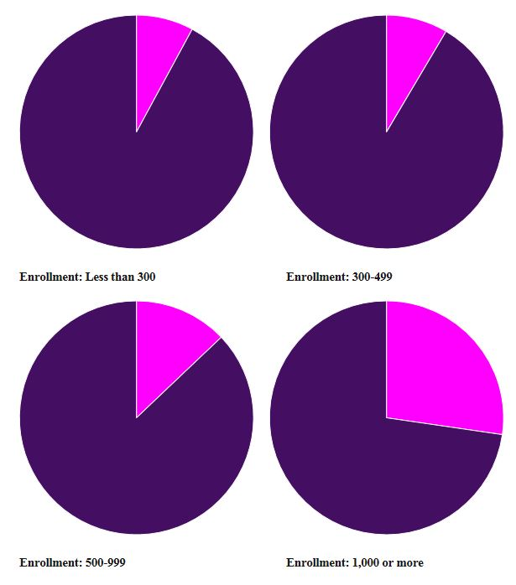
Cyberbullying, which has become more prevalent across the country, appears most common in large schools
Of schools with more than 1,000 students, 27 percent reported cyberbullying daily or at least once a week. In schools that enroll fewer than 300 students, however, 8 percent reported daily or weekly incidents.
Although 12 percent of public schools reported cyberbullying incidents daily or at least once a week, the issue is most prevalent among middle and high schools. In the 2009–10 school year — the last time the Education Department administered the survey — 7.9 percent of schools reported cyberbullying daily or at least weekly. Schools in cities, suburbs, towns, and rural communities experienced cyberbullying at similar rates.
Source: National Center for Education Statistics
Percent of public schools reporting cyberbullying daily or at least once a week in the 2015-16 school year

Slide 21
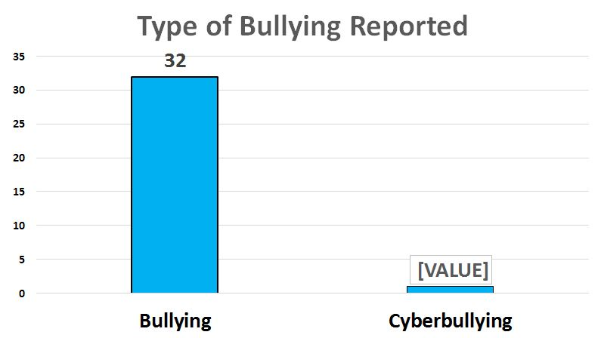
ABC District 2017-18 Data

Slide 22
ABC District 2017-18 Data

Slide 23
2016-17 Data
Initiated Investigation v Substantiated Incident of Bullying

Slide 24
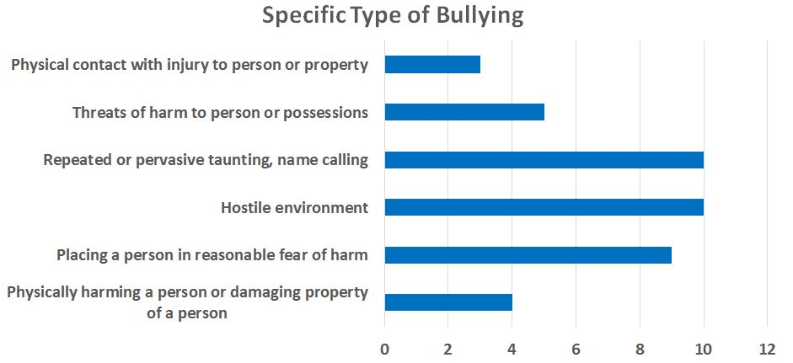
ABC District 2017-18 Data

Slide 25
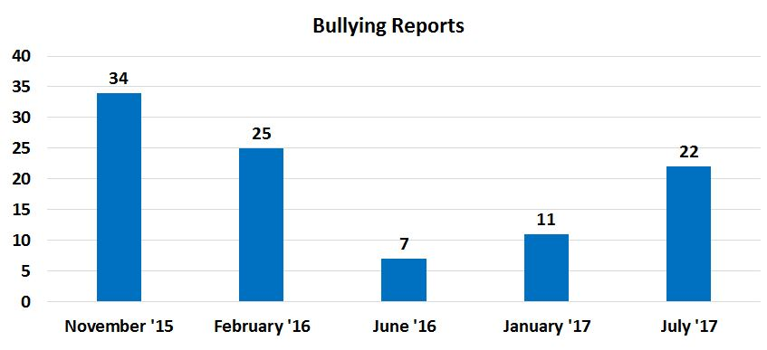
ABC District 2017-18 Data

Slide 26
Recommendations Based on 2017-18 Data
What do you recommend that ABC District do to address any issues identified by 2017-18 data?

Slide 27
Why are bullying and harassment such “hot” topics? Impacts of Bullying
Victims of bullying are at increased risk of…
  Psychological and emotional problems:
    Low self-esteem, high anxiety, depression
    Suicide ideation and attempts
  Physical health problems:
    Headache, backache, sleeping problems, bedwetting
Perpetrators of bullying are at increased risk of…
  Substance use, academic problems, and violence later in adolescence and adulthood
  Source: CDC Understanding Bullying Factsheet 2016
Notes:
https://www.cdc.gov/violenceprevention/pdf/bullying_factsheet.pdf

Slide 28
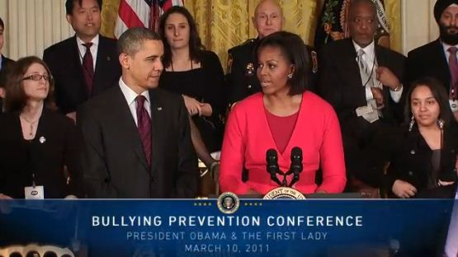
Why are bullying and harassment such “hot” topics? Headlines
“Obituary of 15-year-old who killed self cites school bullies”
--The Washington Post (June 23, 2017)
“Muslim Schoolchildren Bullied By Fellow Students And Teachers”
-NPR (March 29, 2017)
“After years of alleged bullying, an Ohio teen killed herself. Is her school district responsible?”
-The Washington Post (May 23, 2016)
“If there’s one goal … it’s to dispel the myth that bullying is just a harmless rite of passage or an inevitable part of growing up. It’s not.”
- President Obama (March 10, 2011)
Notes:
Updated all headlineshttp://www.usatoday.com/story/news/nation/2015/05/12/everett-washington-bullying-suicide/27160975/

Slide 29
Why are bullying and harassment such “hot” topics? Headlines
“Even popular kids are bullied in high school, researchers find’”
“ . . . Researchers say that the more popular teens are – except for those at the very apex of the fragile high school hierarchy – the more likely they are to be bullied, perhaps a surprise to people who presumed outcasts were the exclusive targets. . . .”
-LA Times (April 2, 2014)
“Bullying by peers has effects later in life”
--CNN (May 8, 2015)
“UT-Austin study: Student bullying costs districts millions”
“…[S]chool districts [in California] missed out on about $275 million annually when students stayed home from school because they felt unsafe in class. When a student misses school, the local district often receives less funding, depending on the state.”
--Houston Chronicle (June 27, 2017)
29
Notes:
http://articles.latimes.com/2014/apr/
http://wnep.com/2015/03/20/app-raises-concerns-about-cyber-bullying/02/science/la-sci-sn-popular-bullied-20140402
http://www.houstonchronicle.com/news/education/amp/UT-Austin-study-Student-bullying-costs-districts-11256936.php

Slide 30
Why are bullying and harassment such “hot” topics?
These headlines are disturbing, worrisome, and only a sampling of the many incidences our nation has faced in recent years.
They also highlight recent developments that compel school districts to take appropriate steps to protect their students and themselves from incidents of bullying and harassment and the consequences thereof.
30

Slide 31
Background
State of the Law
  Overview of Bullying & Harassment Legal Framework
    Legal Elements of School Bullying & Harassment Claims
    Life Cycle of a School Bullying or Harassment Claim
  Bullying & Harassment Based On Federally Protected Characteristics
    Race, Color, National Origin
    Sex
    Disability
  Cyberbullying
  State Anti-Bullying Laws
Protecting Your Students and Yourselves

Slide 32
Background
State of the Law
  Overview of Bullying & Harassment Legal Framework
    Legal Elements of School Bullying & Harassment Claims
    Life Cycle of a School Bullying or Harassment Claim
  Bullying & Harassment Based On Federally Protected Characteristics
    Race, Color, National Origin
    Sex
    Disability
  Cyberbullying
  State Anti-Bullying Laws
Protecting Your Students and Yourselves

Slide 33
Elements of School Bullying & Harassment Claims
What types of bullying and harassment claims are schools and districts legally obligated to address?
Under federal law, schools must address harassment if it is discriminatory against a federally protected characteristic.
State laws greatly vary and can be more expansive than federal law.
Schools districts may have bullying policies that are even broader.

Slide 34

What is harassment?
Harassment may be verbal, written, or other conduct that is threatening or harmful.
  Does not have to include intent to harm, be directed at a specific target, or involve repeated incidents
  Only a small part of the larger universe of bullying or cyberbullying activity

Slide 35
What is sexual harassment?
OCR has defined sexual harassment as “unwelcome conduct of a sexual nature.”
What could that mean?
  unwelcome sexual advances
  requests for sexual favors
  verbal, nonverbal, or physical conduct of a sexual nature
  name-calling
  graphic and written statements, which may include use of cell phones or the Internet
  conduct that may be physically threatening, harmful, or humiliating
Notes:
http://www2.ed.gov/about/offices/list/ocr/letters/colleague-201104.pdf

Slide 36
Connecticut Law: Bullying
Connecticut Legislature took action in 2002 (Public Act 02-119) to address bullying in public schools, and amended the law a number of times since 2002.

Slide 37
Connecticut Law: Bullying
How does Connecticut law define bullying?
  The repeated use by one or more students of a written, oral, or electronic communication, such as cyberbullying, directed at or referring to another student attending school in the same school district; OR
  A physical act or gesture by one or more students repeatedly directed at another student attending school in the same school district, that:
    Causes physical or emotional harm or damage to the student's property;
    Places the student in reasonable fear of harm to himself or herself, or of damage to his or her property;
    Creates a hostile environment at school for the student;
    Infringes on the rights of such student at school; or
    Substantially disrupts the education process or the orderly operation of a school.
Notes:
Confirmed as of October 18, 2015

Slide 38
Connecticut Law: Bullying
“‘Bullying’ shall include, but not be limited to, a written, oral or electronic communication or physical act or gesture based on any actual or perceived differentiating characteristic, such as race, color, religion, ancestry, national origin, gender, sexual orientation, gender identity or expression, socioeconomic status, academic status, physical appearance, or mental, physical, developmental or sensory disability, or by association with an individual or group who has or is perceived to have one or more of such characteristics”
-- Conn. Gen. Stat. § § 10-222d
Notes:
Confirmed as of October 18, 2015
Connecticut General Statutes § 10-222d.

Slide 39
Connecticut Law: Bullying
How does Connecticut law define cyberbullying?
  “[A]ny act of bullying through the use of the Internet, interactive and digital technologies, cellular mobile telephone or other mobile electronic devices or any electronic communications.”
    “Mobile electronic device” means any hand-held or other portable electronic equipment capable of providing data communication between two or more individuals, including, but not limited to, a text messaging device, a paging device, a personal digital assistant, a laptop computer, equipment that is capable of playing a video game or a digital video disk, or equipment on which digital images are taken or transmitted.
    “Electronic communication” means any transfer of signs, signals, writing, images, sounds, data or intelligence of any nature transmitted in whole or in part by a wire, radio, electromagnetic, photoelectronic or photo-optical system.
Is one action enough to qualify as bullying or cyberbullying?
  NO – under Connecticut law, bullying requires “repeated” written, oral or electronic communication.
Notes:
Confirmed on October 18, 2015: Conn. Gen. Stat. § § 10-222d

Slide 40
The Universe of Bullying & Harassment
Total universe of misconduct
Bullying prohibited by school policy
Bullying prohibited by state law
Harassment prohibited by Title IX, Title VI, Section 504 and Title II
Notes:
Added this slide from another presentation

Slide 41
Selected OCR Policy Guidance
Dear Colleague Letter (“DCL”) on Title IX, and Q&A on Campus Sexual Misconduct (Sept. 22, 2017)
DCL on Title IX and Transgender Students (May 13, 2016) (withdrawn and rescinded, Feb. 22, 2017)
DCL on Obligation of Schools to Designate a Title IX Coordinator (April 24, 2015)
Questions and Answers on Title IX and Single-Sex Elementary and Secondary Classes and Extracurricular Activities (December 1, 2014)
DCL on Supporting the Academic Success of Pregnant and Parenting Students (June 25, 2014)
Questions and Answers about Title IX and Sexual Violence (April 29, 2014) (withdrawn, Sept. 22, 2017)

Slide 42
Selected OCR Policy Guidance (cont’d)
DCL on the prohibition against retaliation under Federal civil rights laws (April 24, 2013)
DCL on Addressing Sexual Harassment/Sexual Violence (April 4, 2011) (withdrawn, Sept. 22, 2017)
DCL on Schools’ Obligations to Protect Students from Student-on-Student Harassment on the Basis of Sex; Race, Color and National Origin; and Disability (October 26, 2010)
DCL on Accommodating Students’ Athletic Interests and Abilities: Standards for Part Three of the “Three-Part Test“ (April 20, 2010)
DCL on Sexual Harassment (Jan. 25, 2006)
Revised Sexual Harassment Guidance (Jan. 19, 2001)

Slide 43
A Quick Caveat regarding Dept. of Education Regulations
President Trump’s Regulatory Reform Executive Orders
  Series of EOs issued in January and February
  Requiring agencies to review all existing regulations focusing on whether the regulations:
    Eliminate jobs
    Are outdated
    Costs > Benefits
ED appointed a Regulatory Reform Task Force at the end of April that will:
  Canvas ED’s regulations and policy-oriented guidance, including Dear Colleague Letters
  Seek input from the public on existing regulations
  Make recommendations about what regulations should be repealed, replaced, or modified

Slide 44
A Quick Caveat regarding ED Regulations and Guidance
In September 2017, OCR withdrew the statements of policy and guidance reflected in:
  2011 Dear Colleague Letter on Addressing Sexual Harassment/Sexual Violence (April 4, 2011)
  Questions and Answers on Title IX and Single-Sex Elementary and Secondary Classes and Extracurricular Activities (December 1, 2014)
ED announced that it intends to engage in a rulemaking process to develop new regulations related to Title IX
In the interim, ED issued a new Q&A on Campus Sexual Misconduct (Sept. 22, 2017) and said that it would continue to rely on previous guidance (2006 DCL, 2001 Revised Sexual Harassment Guidance)

Slide 45
Elements of School Bullying & Harassment Claims
OCR Letter: Bullying and Harassment (2010)
OCR’s October 26, 2010 DCL gave schools and districts guidance about what harassment they must address and how they must address it:
  School districts that fail to appropriately identify, thwart, and remedy bullying and harassment risk violating federal civil rights laws and losing federal funds.
  “[S]ome student misconduct that falls under a school’s anti-bullying policy also may trigger responsibilities under one or more of the federal antidiscrimination laws enforced by [OCR].”

Slide 46
Elements of School Bullying & Harassment Claims
OCR Letter: Bullying and Harassment (2010)
What constitutes “harassment” for which schools are legally responsible under these civil rights laws?
The misconduct must:
  (1) Have a nexus to school;
  (2) Be based on a protected category;
  (3) Be sufficiently severe or pervasive to create a hostile
  environment; and
  (4) Be known or reasonably should be known to school administrators

Slide 47
Elements of School Bullying & Harassment Claims
OCR Letter: Bullying and Harassment (2010)
What are federally protected categories?
Race
Color
National Origin
Sex
Disability
All are rooted in federal civil rights laws, which we will discuss later in the presentation

Slide 48
Elements of School Bullying & Harassment Claims
OCR Letter: Bullying and Harassment (2010)
When is harassment sufficiently severe or pervasive to create a hostile environment?
“Harassment creates a hostile environment when the conduct is sufficiently severe, pervasive, or persistent so as to interfere with or limit a student’s ability to participate in or benefit from the services, activities, or opportunities offered by a school.”

Slide 49

Elements of School Bullying & Harassment Claims
OCR Letter: Bullying and Harassment (2010)
“A school is responsible for addressing harassment incidents about which it knows or reasonably should have known.”
49

Slide 50
Elements of School Bullying & Harassment Claims
Standards of Liability
OCR DCL 2010
Standard: Knows or reasonably should have known (Negligence)
Application: Administrative enforcement for Department of Education
Davis v. Monroe County Board of Education
Standard: Deliberate Indifference
Application: Private lawsuits for damages
Requires: Actual knowledge by a school official, conscious disregard of risk
Requires: A showing that a reasonable person would have known about harassment/civil rights violations

Slide 51
Background
State of the Law
  Overview of Bullying & Harassment Legal Framework
    Legal Elements of School Bullying & Harassment Claims
    Life Cycle of a School Bullying or Harassment Claim
  Bullying & Harassment Based On Federally Protected Characteristics
    Race, Color, National Origin
    Sex
    Disability
  Cyberbullying
  State Anti-Bullying Laws
Protecting Your Students and Yourselves

Slide 52
Life Cycle of a Bullying or Harassment Claim
OCR Monitoring
OCR Investigations
Remedies
If OCR monitoring yields a suspicious result or a complaint is received, OCR will investigate.
If an OCR investigation shows noncompliance with federal law, OCR will need to remedy that.
OCR usually enters into an agreement with the school or district, but sometimes refers the case to the DOJ.
When the problem is remedied, the school will continue to be monitored by OCR.
52

Slide 53
Life Cycle of a Bullying or Harassment Claim
OCR Monitoring of Bullying & Harassment
OCR monitors school districts’ responses to bullying and harassment.
Monitoring tool: Civil Rights Data Collection (“CRDC”)
Mandatory survey through which OCR collects data directly from school districts
  All districts now participate in the CRDC
  Data is collected for one school year at a time
School districts must collect and report new data bullying and harassment allegations, policies, and disciplinary measures
Tracks harassment and bullying on the basis of disability, race, color, national origin, sex, sexual orientation, and religion
53
Notes:
https://www2.ed.gov/about/offices/list/ocr/docs/2013-14-first-look.pdf

Slide 54
Life Cycle of a Bullying or Harassment Claim
OCR Monitoring of Bullying & Harassment
CRDC data goes into a database used by OCR in compliance reviews and investigations of bullying and harassment.
The CRDC website allows the public to view data for specific schools and districts, and compare data across multiple schools or districts.

Slide 55
Life Cycle of a Bullying or Harassment Claim Investigating Bullying & Harassment
(2) OCR will investigate a district’s response to
bullying and harassment.
Investigations can be initiated by complaints or compliance reviews
  Complaint process: filed with OCR by impacted citizens
    OCR evaluates thousands of complaints received to determine whether it has the authority to investigate.
      OCR received 16,720 complaints in 2016.
  Compliance reviews: initiated by OCR
    OCR has authority to proactively initiate compliance reviews.
    According to its FY 2015 Report to the President and Secretary of Education, OCR initiated 13 compliance reviews in 2016.
During an investigation, OCR acts as a “neutral” fact finder.
At the close of an investigation, OCR determines whether a school district has complied with its obligations under federal civil rights laws.
Notes:
FY 2016 Report from OCR - https://www2.ed.gov/about/reports/annual/ocr/report-to-president-and-secretary-of-education-2016.pdf
https://www2.ed.gov/about/offices/list/ocr/docs/2015-16-crdc-data-elements.pdf

Slide 56
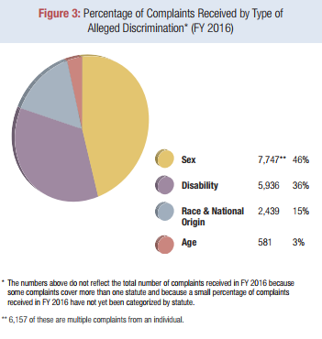
Life Cycle of a Bullying or Harassment Claim Investigating Bullying & Harassment
Complaints received by OCR in FY 2016
-- OCR FY 2016 Report
56
Notes:
http://www2.ed.gov/about/reports/annual/ocr/report-to-president-and-secretary-of-education-2015.pdf
Only harassment relevant figure was the one with racial harassment claims.

Slide 57
Life Cycle of a Bullying or Harassment Claim Investigating Bullying & Harassment
Recent Changes in Requirements for OCR Investigations

Slide 58
Investigating Bullying & Harassment
OCR Instructions to the Field re Scope of Complaints
Circulated to OCR staff on June 8, 2017
Decisions about whether to expand the scope of investigations are now made on a case-by-case basis rather than determined by the category of complaint
This eliminates specialized treatment of certain types of complaints – including certain sexual violence and Title VI complaints – that automatically triggered institution-wide investigations
  Requirements included multi-year reviews of similar claims aimed at detecting patterns of discrimination and increased oversight from OCR headquarters

Slide 59
Investigating Bullying & Harassment
OCR Instructions to the Field re Scope of Complaints
Current OCR leadership says this change will make investigations more efficient and responses more timely
Administrative backlog and slow response time were given as the main reasons for the change in policy

Slide 60
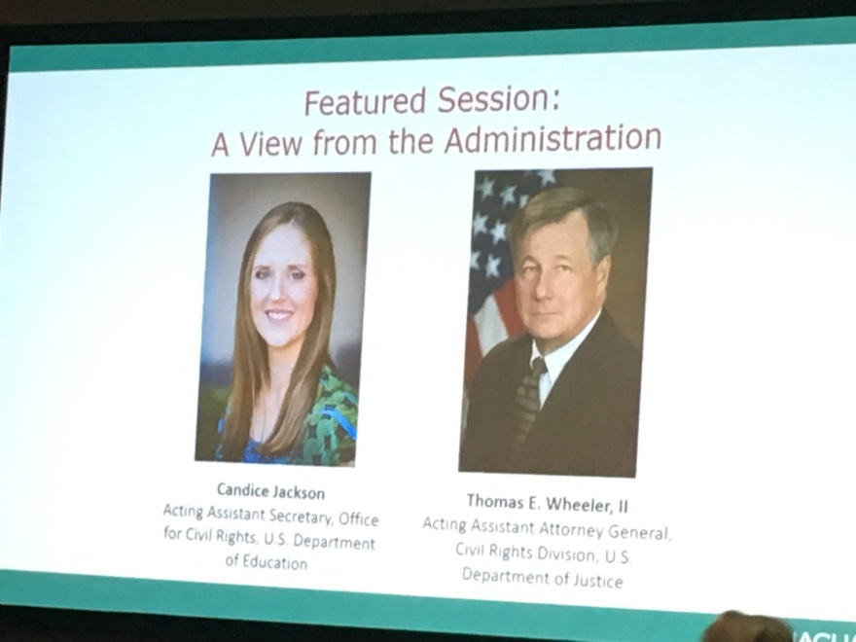
Investigating Bullying & Harassment
OCR Leadership Clarified New Approach at NACUA
Candice Jackson, head of OCR and Acting Assistant Secretary of Education, and Thomas Wheeler, Acting Assistant Attorney General in the Civil Rights Division of the DOJ, spoke on June 27, 2017 at National Association of College and University Attorneys (NACUA) to help clarify the new administration’s approach to civil rights in education
Source: Inside Higher Ed
Notes:
https://www.insidehighered.com/news/2017/06/28/trump-administration-civil-rights-officials-promise-colleges-fairer-regulatory

Slide 61
Investigating Bullying & Harassment
OCR Leadership Clarified New Approach at NACUA
Emphasized that the role of OCR has not changed, still “to enforce the civil rights guaranteed to our nation’s students by certain civil rights laws”
Argued that civil rights enforcement is not being scaled back
  Critics have voiced concerns over the combination of the withdrawal of OCR’s Dear Colleague Letter on transgender students with these investigative changes
Aims to be less confrontational and more cooperative during investigations
Source: Inside Higher Ed

Slide 62
Investigating Bullying & Harassment
OCR Leadership Clarified New Approach at NACUA
Methods of policymaking – moving away from DCLs
  The new administration will not regulate via Dear Colleague Letters, but will use notice and comment procedures for new regulations
  Previously issued Dear Colleague Letters may be opened up to negotiated rulemaking
Source: Inside Higher Ed

Slide 63
Recent Changes in Requirements for OCR Investigations: Take-Aways
There are many blanks still to be filled in about the new administration’s approach to investigations
  What types of investigations will be prioritized?
  What policies will be developed in unsettled areas of the law, such as rights of transgender students?
Schools that are investigated will likely not experience the expansive, drawn out investigations that became more common in recent years
OCR will aim to resolve complaints quickly

Slide 64

Life Cycle of a Bullying or Harassment Claim
Outcomes of Findings of Noncompliance
Districts that fail to respond appropriately to bullying and harassment risk may face:
  OCR enforcement;
  Rarely, lawsuits by DOJ; or
  Private litigation.

Slide 65
Life Cycle of a Bullying or Harassment Claim
Outcomes of Findings of Noncompliance
OCR Enforcement Mechanisms
OCR will usually enforce compliance through one of the following mechanisms:
  Entering into a voluntary agreement;
  Seeking to terminate federal funds; or
  Referral to the DOJ for investigation for possible enforcement.
65

Slide 66
Life Cycle of a Bullying or Harassment Claim
Outcomes of Findings of Noncompliance
DOJ Lawsuits
If OCR determines that a violation has occurred and the district refuses to resolve the violation, OCR may refer the case to DOJ.
  DOJ will investigate and determine whether to initiate litigation against the district.
OCR may initiate an investigation without a referral from OCR.

Slide 67
Life Cycle of a Bullying or Harassment Claim
Outcomes of Findings of Noncompliance
Private Litigation
Students (and parents on behalf of their children) may also sue districts and may seek money damages when districts fail to adequately address harassment in violation of federal civil rights laws or state bullying laws.
With increasing frequency, parents are pursuing lawsuits when bullies target their children and – in the parents’ opinion – the district fails to respond appropriately.
Davis v. Monroe County Board of Education, 526 U.S. 629 (1999) controls private lawsuits against schools. Schools are only liable for damages in cases of student on student harassment when they display deliberate indifference with regards to the bullying.

Slide 68

Remedies for Failure to Address Harassment:
Case Studies
Consent Decree
  Anoka-Hennepin School District (MN)
Resolution Agreement
  Pasadena Unified School District (CA)
Private Litigation
  Fenner v. Freeburg Comm. High School District (IL)
  Sawyer Rosenstein (NJ)
Notes:
http://www2.ed.gov/about/offices/list/ocr/docs/investigations/more/15131083-b.pdf

Slide 69
Consent Decree
Anoka-Hennepin School District
Complaint submitted to DOJ that a female student was being “harassed by peers” for being “too manly.” Other female students reported similar teasing. Some male students were being called “gay boys” and “girly.”
DOJ opened an investigation (Nov. 2010).
Dept. of Ed. Office of Civil Rights (OCR) joined investigation (Jan. 2011).
  DOJ used authority under Title IX, Title IV, and ED regulations which prohibit discrimination on the basis of sex. (Remember: OCR will consider harassment based on not conforming to gender stereotypes as harassment on the basis of sex.)

Slide 70
Consent Decree
Anoka-Hennepin School District
DOJ and OCR visited the district multiple times
  Conducted interviews with students, parents, teachers, staff, and administrators
  Reviewed more than 7,000 pages of documents
In July 2011, six students filed federal lawsuits against the school district, school board, and several school administrators.
In August 2011, OCR and DOJ joined settlement discussions with the District, SPLC, and NCLR.

Slide 71
Consent Decree
Anoka-Hennepin School District
All Parties entered into Consent Decree, filed in U.S. District Court for the District of Minnesota.
  When fully implemented, investigation resolved.
  District agreed to:
    Review and improve its policies and procedures concerning sex-based harassment by working with an Equity Consultant;
    Hire or appoint a Title IX and Equity Coordinator;
    Conduct training for all faculty, staff, and students; clarify policies for reporting and responding to harassment;
    Hire a Mental Health Consultant to assist students subject to harassment;
    Create an Anti-bullying/ Anti-harassment Task Force.

Slide 72
Consent Decree
Anoka-Hennepin School District
  Consent Decree (cont’d)
    Administer an anti-bullying survey each year;
    Identify harassment “hot spots” and monitor these trouble areas;
    Ensure that all middle and high schools have a peer leadership program addressing harassment;
    Hold annual meetings between Superintendent and students at each middle and high school; and
    Provide compliance reports to DOJ and OCR each trimester.
Consent Decree was for five years with DOJ and OCR to monitor and to provide technical assistance as needed.
  This could include additional visits, interviews, reports, or training.

Slide 73

Resolution Agreement
Pasadena Unified School District (2016)
Complaint filed with OCR by parent.
  Daughter has autism and receives 1:1 special education assistance.
  Complaint cited multiple instances of verbal and physical harassment based on sex, race, and disability.
Subjects of OCR investigation included:
  District policies prohibiting discrimination and
  District investigation procedures.
Findings:
  District’s investigation was prompt and thorough (interviewed witnesses, students, complainant), but notification of parties, recordkeeping, and responsiveness to multiple instances of harassment were insufficient.
Notes:
https://www2.ed.gov/about/offices/list/ocr/docs/investigations/more/09141226-a.pdf

Slide 74
Resolution Agreement
Pasadena Unified School District (2016)
Pasadena and OCR entered into a Resolution Agreement.
  Within 5 months of the agreement, District was to
    Provide all district educators and students with education on preventing bullying and harassment;
    Provide OCR with an overview of its bullying/harassment plan; and
    Provide OCR with a copy of most recent annual climate survey results.
  Within 30 days of the agreement, District required to:
    Disseminate guidance to administrators on reporting findings to complainants any time it conducts an internal harassment investigation.
Notes:
https://www2.ed.gov/about/offices/list/ocr/docs/investigations/more/09141226-b.pdf

Slide 75
Private Litigation – Federal Civil Rights Claim
Fenner v. Freeburg Comm. High School District (S.D. Ill. 2016)
Parties: Katrina Fenner, on behalf of her son, filed suit against Freeburg Community High School District 77.
Allegation: Fenner alleged that her son was hazed by senior members of the men’s soccer team and was harassed over social media continuously.
  Plaintiff claimed that this was harassment on the basis of sex because the girl’s soccer team did not have similar hazing rituals. Furthermore, she alleged that the administration knew about the hazing rituals but did nothing to prevent them.
Outcome: These claims survived a motion to dismiss in federal court.

Slide 76
Private Litigation – State Bullying Claim
Rosenstein (NJ 2012) (Case settled)
Parties: Family of Sawyer Rosenstein, a New Jersey middle school student who became paralyzed from the waist down after a school bully punched him in the abdomen sued the district.
Allegation: Sawyer’s school knew or should have known that the boy’s attacker had violent tendencies and violated the state’s anti-bullying law.
  Rosenstein had previously notified the school that he was being bullied by the same student but the school failed to take any disciplinary action.
Outcome: The district settled with the family for $4.2 million.
Notes:
Updated this slide based on new information

Slide 77
Background
State of the Law
  Overview of Bullying & Harassment Legal Framework
    Legal Elements of School Bullying & Harassment Claims
    Life Cycle of a School Bullying or Harassment Claim
  Bullying & Harassment Based On Federally Protected Characteristics
    Race, Color, National Origin
    Sex
    Disability
  Cyberbullying
  State Anti-Bullying Laws
Protecting Your Students and Yourselves

Slide 78
Background
State of the Law
  Overview of Bullying & Harassment Legal Framework
    Legal Elements of School Bullying & Harassment Claims
    Life Cycle of a School Bullying or Harassment Claim
  Bullying & Harassment Based On Federally Protected Characteristics
    Race, Color, National Origin
    Sex
    Disability
  Cyberbullying
  State Anti-Bullying Laws
Protecting Your Students and Yourselves

Slide 79

Bullying and Harassment Based on Race
OCR’s jurisdiction over bullying based on race, color, and national origin is derived from Title VI of the Civil Rights Act of 1964:
“No person in the United States shall, on the ground of race, color, or national origin, be excluded from participation in, be denied benefits of, or be subjected to discrimination under any program or activity receiving Federal financial assistance.”
42 U.S.C. §2000d.

Slide 80
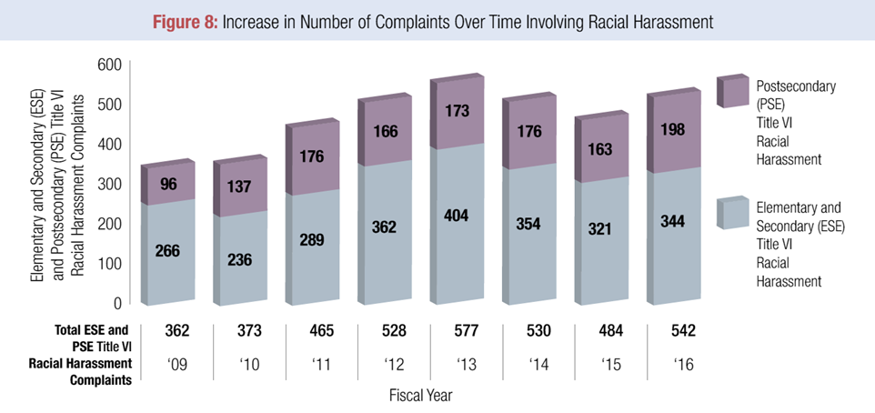
Bullying and Harassment Based on Race
-- OCR FY 2016 Report

Slide 81
Bullying and Harassment Based on Race
Schools should follow the guidance provided in the Bullying and Harassment DCL to deal with claims based on race, color, or national origin.
Schools must address race-based harassment that:
  Has a nexus to school;
  Creates a hostile environment; and
  Is known or should be known to school administrators.

Slide 82
Hypothetical
Maria, a fifth grader, is overheard by some of her classmates speaking Spanish to her mother in the carpool line. That day at recess, one of the classmates approaches her and announces that Maria’s family should to be deported. As Maria starts to argue with the classmate, a circle of students forms around them and they start to chant “Maria is a bad hombre.” Maria stomps on one child’s foot and pushes another to break escape the circle. Both Maria and the instigator are punished for their physical altercation, but no action is taken about the cause of the encounter.

Slide 83
Hypothetical
Is this harassment?
If so, what type of harassment?
Was the school deliberately indifferent?
What, if anything, should the school have done differently?

Slide 84
Bullying and Harassment Based on Race
What About Religion?
Religion is not a protected trait under federal civil rights laws, but it can sometimes be linked to protected traits.
  Title VI covers only race, color, and national origin.
  Language and actual or perceived shared ancestry or ethnic characteristics are considered part of race and national origin.
OCR has a broad view of Title VI’s protections:
  “…[G]roups that face discrimination on the basis of actual or perceived shared ancestry or ethnic characteristics may not be denied protection under Title VI on the ground that they also share a common faith…thus, harassment against students who are members of any religious group triggers a school’s Title VI responsibilities when the harassment is based on the group’s actual or perceived shared ancestry or ethnic characteristics, rather than solely on its members’ religious practices.”

Slide 85
Hypothetical
Mark’s mother posted pictures of his confirmation at church on social media, which his classmates’ parents saw and shared with their children. At school, Mark’s classmates start to call him “Little Altar Boy.” Mark’s teacher tells him this is a learning experience and a time to develop mental toughness, and does not intervene.

Slide 86
Hypothetical
Is this harassment?
If so, what type of harassment?
Was the school deliberately indifferent?
What, if anything, should the school have done differently?

Slide 87
Hypothetical
A high school junior chooses to start wearing a hijab. She has always practiced her religion at home but has never discussed her faith at school. During a US history lecture on the military action in the Middle East in the year following 9/11, students throw paper airplanes at her back with notes written on them, including, “Go back to Afghanistan” and, “You’re a terrorist.” The instructor gives the perpetrators detention and meets with the student after class to debrief. For the rest of the semester, the student has trouble focusing and does not speak in that class.

Slide 88
Hypothetical
Is this harassment?
If so, what type of harassment?
Was the school deliberately indifferent?
What, if anything, should the school have done differently?

Slide 89
Background
State of the Law
  Overview of Bullying & Harassment Legal Framework
    Legal Elements of School Bullying & Harassment Claims
    Life Cycle of a School Bullying or Harassment Claim
  Bullying & Harassment Based On Federally Protected Characteristics
    Race, Color, National Origin
    Sex
    Disability
  Cyberbullying
  State Anti-Bullying Laws
Protecting Your Students and Yourselves

Slide 90
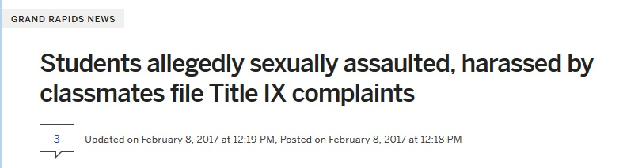
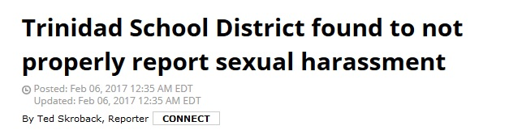
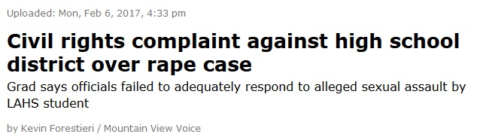
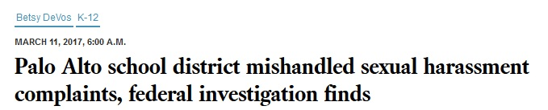
Bullying and Harassment Based on Sex
Headlines

Slide 91

Bullying and Harassment Based on Sex
OCR’s jurisdiction over sex-based bullying is derived from Title IX of the Education Amendments of 1972:
“No person in the United States shall, on the basis of sex, be excluded from participation in, be denied the benefits of, or be subjected to discrimination under any education program or activity receiving Federal financial assistance…”
20 U.S.C. §1681(a)

Slide 92
Bullying and Harassment Based on Sex
Many forms of bullying and harassment can potentially fall under the category of “on the basis of sex.”
  Male vs. female
  Sexual violence
    Sexual violence is considered a type of sexual harassment
  Sexual orientation (in certain cases)
  Transgender (in certain cases)

Slide 93
Bullying and Harassment Based on Sex
Bullying and harassment based on failure to conform to stereotypes associated with the sex one was assigned at birth is considered sexual harassment.
Examples:
  Bullying a girl for preferring to play football at recess
  Teasing a boy for wearing a pink shirt
  Harassing a girl for having a deep voice

Slide 94
Hypothetical
A male middle school student is verbally mocked daily due to his physique. He is short and portly, carrying most of his weight in his stomach and chest areas. Occasionally students on his school bus pin him down and squeeze his chest. At school, they ask when he will get a training bra. A teacher takes note of this teasing but is told that the school is not obligated to intervene because the bullying is about the student’s weight, which is not a legally protected trait.
Notes:
Based on Reed v. Kerens Independent School District (N.D. TX 2017) WL 2463275 where a similar claim just survived summary judgment for sex-based discriminatory harassment.

Slide 95
Hypothetical
Is this harassment?
If so, what type of harassment?
Was the school deliberately indifferent?
What, if anything, should the school have done differently?

Slide 96
Bullying and Harassment Based on Sex
Sexual Orientation

Slide 97
Bullying and Harassment Based on Sex
Sexual Orientation
Title IX does not explicitly prohibit discrimination on the basis of sexual orientation.
But Title IX does protect all students – regardless of actual or perceived sexual orientation – from sex-based discrimination and harassment.
  Title IX prohibits harassment of students for exhibiting stereotypical characteristic for their sex or for failing to conform to such stereotypes.
  Title IX prohibits sexual harassment regardless of whether the harasser and the victim share the same gender
Notes:
Hively v. Ivy Tech Community College of Indiana, 2017 WL 1230393 (7th Cir. April 4, 2017) (en banc)

Slide 98
Hypothetical
The star point guard of the basketball team comes out as gay to a close group of friends at the beginning of his senior year. Although he is the captain of the team, the other players refuse to give him high fives or make any voluntary bodily contact with him. Once the center of the team’s social circle, he is now the only player not invited to post-game dinners and parties. The coach notices the player’s isolation but does not feel he can force the other players to give high fives or involve him socially. The coach resorts to giving pep talks about team unity and brotherhood.

Slide 99
Hypothetical
Is this harassment?
If so, what type of harassment?
Was the school deliberately indifferent?
What, anything, should the school have done differently?

Slide 100
Bullying and Harassment Based on Sex
Sexual Violence

Slide 101
Bullying and Harassment Based on Sex
Sexual Violence
What constitutes sexual violence?
Physical sexual acts perpetrated against a person’s will or where a person is incapable of giving consent
  It includes rape, sexual assault, sexual battery, sexual abuse, and sexual coercion.
  It can be carried out by students, school employees, or third parties.

Slide 102
Bullying and Harassment Based on Sex
Sexual Violence
Title IX protects all students from sexual violence, including:
Elementary through professional school;
Male and female;
Straight, gay, lesbian, bisexual, and transgender students;
American citizens, undocumented students, and international students;
Students with and without disabilities and
Students of different races and national origins.

Slide 103
OCR sexual violence enforcement
In FY 2016, OCR:
  Received 260 complaints related to sexual violence, including 83 against K-12 schools.
In FY 2015, OCR:
  Received 229 complaints related to sexual violence, including 65 against K-12 schools;
  Resolved 83 complaints related to sexual violence; and
  Began 2 compliance reviews and resolved 1 investigation related to sexual violence.
Notes:
http://www2.ed.gov/about/offices/list/ocr/docs/qa-201404-title-ix.pdf

Slide 104
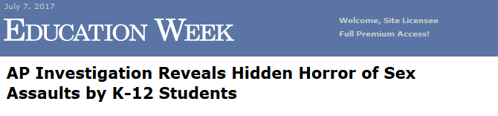

Bullying and Harassment Based on Sex
Sexual Violence
According to an AP Investigation released in May 2017…
17,000 reports of K-12 student-on-student sexual violence were filed between 2011 and 2015
  Such attacks are “greatly under-reported”
  For every adult-on-student incident that was reported, seven student-on-student assaults were reported
Schools are the second-most common place for children to be assaulted
Source: Education Week, Associated Press
Notes:
http://www.edweek.org/ew/articles/2017/05/01/ap-reveals-hidden-horror-of-sex_ap.html?cmp=eml-enl-eu-news1
Full AP series: https://www.ap.org/explore/schoolhouse-sex-assault/index.html

Slide 105
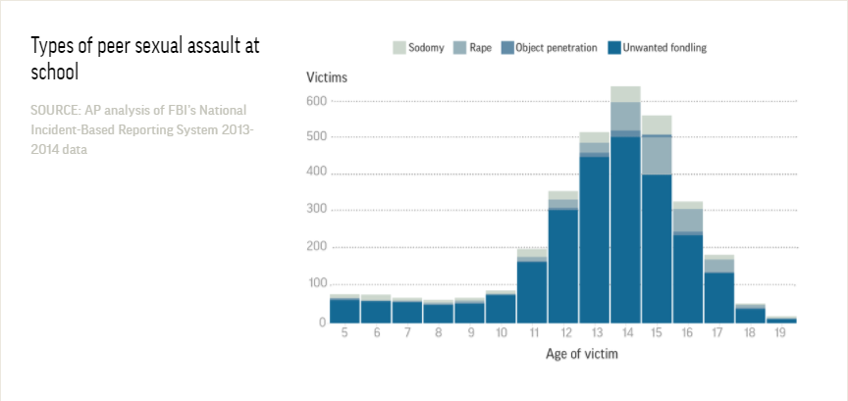
Bullying and Harassment Based on Sex
Sexual Violence
80% of assaults at school were unwanted fondling.
Source: Associated Press
Notes:
https://www.ap.org/explore/schoolhouse-sex-assault/stats-revealed-by-ap-investigation-of-student-sex-assaults.html

Slide 106
Bullying and Harassment Based on Sex
Sexual Violence
OCR has issued 2 guidance documents on sexual violence:
  Dear Colleague Letter (2011) and
  OCR Q&A (2014).
Even though these focus on colleges and universities, they explicitly apply to school districts as well.

Slide 107
Sexual violence as sexual harassment
On April 4, 2011, OCR issued a Dear Colleague Letter addressing sexual violence in schools.
The Dear Colleague Letter:
  Clarified that Title IX, which prohibits discrimination on the basis of sex, covers sexual violence; and
  Provided detailed guidance on districts’ obligations to take “immediate and effective steps” to address incidents of peer-on-peer sexual violence.
Like the OCR letter on bullying and harassment, the Dear Colleague Letter warned that districts that fail to take prompt and effective steps to address incidents of sexual violence risk losing federal funds or being referred to DOJ for litigation.
The 2011 DCL was withdrawn on September 22, 2017. OCR said it will continue to rely on its 2001 Revised Sexual Harassment Guidance and 2006 DCL on Sexual Harassment.
Notes:
http://www2.ed.gov/about/offices/list/ocr/docs/qa-201404-title-ix.pdf

Slide 108
Sexual violence as sexual harassment
On April 29, 2014, OCR issued additional guidance in a Q&A letter concerning obligations to address sexual violence as a form of sexual harassment under Title IX.
The Q&A letter:
  Further clarified the legal requirements and guidance in the 2011 DCL;
  Provided examples of proactive efforts schools can take to prevent sexual violence; and
  Provided remedies schools may use to end sexual violence, prevent its recurrence, and address its effects
The 2014 Q&A was withdrawn on September 22, 2017. OCR said it will continue to rely on its 2001 Revised Sexual Harassment Guidance and 2006 DCL on Sexual Harassment.
Notes:
http://www2.ed.gov/about/offices/list/ocr/docs/qa-201404-title-ix.pdf

Slide 109
District Obligations Concerning Sexual Violence
Training
For employees:
  Schools must ensure that responsible employees know how to respond appropriately to reports of sexual violence and
  Training for employees should include: practical information about preventing sexual violence, including same-sex sexual violence; behaviors that could lead to sexual violence; and proper methods for responding to a student who has experienced sexual violence.
For students:
  Provide age-appropriate training regarding Title IX and sexual violence;
  Encourage students to report incidents of sexual violence; and
  Ensure that incidents are properly report to a responsible employee.
For parents:
  At both the elementary and secondary school level, schools should consider offering training on the school’s process for handling complaints of sexual violence.

Slide 110
District Obligations Concerning Sexual Violence
Areas of salience
Particular areas of salience for sexual violence at the secondary level include:
  Field Trips
    In Doe v. Neshannock Township School District (W.D. Penn. 2016), a parent sued a school district after an alleged sexual assault that occurred during a field trip to New York City.
  Hazing
    In Richardson v. Huber Heights City School Board of Education (6th Cir. 2016), a father sued a school district claiming that the school displayed deliberate indifference to the hazing practices of the high school baseball team. These practices included sexual violence against younger students. The claim survived a motion to dismiss, but eventually failed due to lack of evidence that school officials were actually aware of these practices.

Slide 111
District Obligations Concerning Sexual Violence
Employees Obligated to Report Incidents
“Responsible employees” of a school are obligated to report sexual violence to the Title IX Coordinator.
According to OCR, a responsible employee includes an employee:
  “[W]ho has the authority to take action to redress sexual violence.”
  “[W]ho has been given the duty of reporting sexual violence or other misconduct by students to the Title IX coordinator,” or
  “[W]hom a student could reasonably believe has this authority or duty.”

Slide 112
Title IX Coordinators
112

Slide 113
What are the responsibilities of Title IX Coordinators?
A Title IX coordinator’s responsibilities include:
  Overseeing a school’s response to Title IX reports and complaints;
  Identifying and addressing any patterns or systemic problems revealed by the reports or complaints;
  Staying informed of all complaints raising Title IX issues; and
  Having no other responsibilities that may pose a conflict with Title IX responsibilities.
Title IX gives coordinators broad protection from retaliation, including:
  Investigations cannot be impeded and
  Adverse actions cannot be taken because of investigation.

Slide 114
What are the responsibilities of Title IX Coordinators?
Title IX coordinators should be prepared to:
  Stay abreast of developments related to Title IX, its implementing regulations, and guidance from federal agencies;
  Investigate complaints;
  Educate colleagues, students, and your community about Title IX;
  Revise policies and procedures, as appropriate;
  Resolve complaints promptly.

Slide 115
What are the responsibilities of Title IX Coordinators?
On April 25, 2015, OCR published a resource guide for Title IX coordinators.
The resource guide includes:
  an overview of the scope of Title IX;
  a discussion about Title IX’s administrative requirements;
  a discussion of key Title IX issues (such as athletics and discipline);
  references to federal resources; and
  recommended best practices.

Slide 116
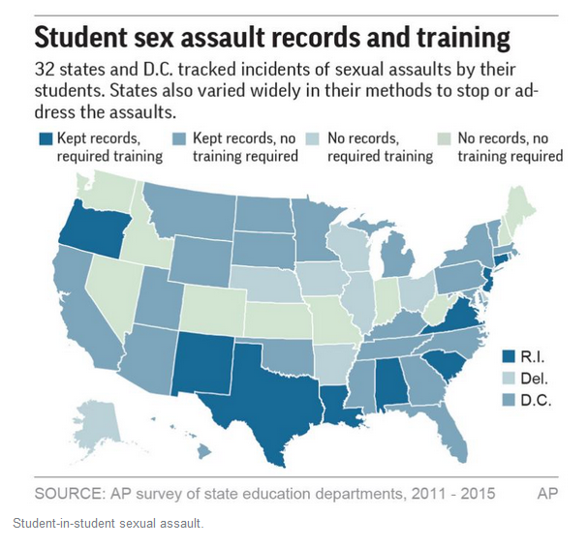
District Obligations Concerning Sexual Violence
Records and Training
Source: AP
Notes:
https://www.yahoo.com/news/student-sex-assault-reports-state-state-042423694.html
There are wide variations in recordkeeping and training on sexual violence state-to-state

Slide 117

District Obligations Concerning Sexual Violence
Case Study: Palo Alto Unified School District
Palo Alto Unified School District was determined to be noncompliant with Title IX, including:
  Multiple instances of sexual harassment and sexual assault of students, both in and out of school.
Resolution Agreement signed March 2017.
The following examples are excerpted complaints from the Palo Alto investigation and the District’s response to each. Consider what they did well and what they should have done differently.

Slide 118
District Obligations Concerning Sexual Violence
Case Study: Palo Alto Unified School District
Reported Conduct
Off-campus sexual assault of female student by a male student
Female student’s parent gave Palo Alto High School oral notice of the assault
After assault was reported, female student harassed at school and on social media by classmates
District Response
Referred student to on-campus and off-campus counseling
Assisted student in filing police report
Gave student an exam waiver so she would not have to return to campus
Interviewed alleged perpetrator, other witnesses
Attempted to find source of retaliatory harassment
Did not provide outcome of either investigation to complainant

Slide 119
District Obligations Concerning Sexual Violence
Case Study: Palo Alto Unified School District
What did Palo Alto do right in this instance?
What should Palo Alto have done differently?
Notes:
What did Palo Alto do right? All of the referrals (on-campus counseling, off-campus rape counseling), assistance with police report, wavier of exams, and initial attempt to investigate social media harassers.
What did OCR find Palo Alto should have done differently? No evidence of an investigation of the assault was actually documented by the district, no notifications were given to the complainant about either investigation (into the assault or the social media harassment). Major take-away: filing a police report does not eliminate a district’s duty to investigate.

Slide 120
District Obligations Concerning Sexual Violence
Case Study: Palo Alto Unified School District
Reported Conduct
Male student allegedly locked a female student in a bathroom at an off-campus party and told her he would not let her out unless she performed sex acts on him.
2 students reported the incident to an Assistant Principal.
District Response
Assistant Principal relayed report to Title IX coordinator.
Female student’s counselor met with her and
  Informed of counseling resources;
  Informed of right to file UCP complaint or police report; and
  Encouraged her to report any subsequent harassment.
Assistant Principal met with accused student,
  Warned not to harass other student and
  Notified his parent of the allegation, made parent aware of counseling resources.
Assistant Principal followed up with female student’s parent, who notified school of police report filing.
School monitored parties but did not provide notice of an outcome to either party.

Slide 121
District Obligations Concerning Sexual Violence
Case Study: Palo Alto Unified School District
What did Palo Alto do right in this instance?
What should Palo Alto have done differently?
Notes:
What did Palo Alto do right? Meeting with both parties and their parents, offering counseling services, informing of reporting options
What did OCR find Palo Alto should have done differently? Palo Alto did not document any of its findings from its investigations and did not notify either party if it made findings or completed the investigation. Also, no evidence that Palo Alto assessed whether this created a hostile learning environment.

Slide 122
District Obligations Concerning Sexual Violence
Case Study: Palo Alto Unified School District
Reported Conduct
Student A reported being stalked by Student B.
Student A had recently broken up with B because of B’s possessive tendencies.
Student B knew A’s class schedule and routes home, allegedly harassed A both on- and off-campus.
Student A alleged B’s conduct caused A to be tardy and could not focus on school work when B was visible outside A’s classroom.
Student B once followed A as A walked home and physically assaulted A, resulting in B’s arrest.
  School was notified.
Student A received an Emergency Protective Order requiring B to stay 300 yards away.
  School was notified.
District Response
Assistant Principal offered counseling for Student A.
Administrators suggested having a campus security supervisor monitor Student A between classes to ensure Student B did not approach.
School eventually suspended Student B in order to comply with the Protective Order.
Student A’s parents say they were not provided information on sexual harassment complaint procedures.

Slide 123
District Obligations Concerning Sexual Violence
Case Study: Palo Alto Unified School District
What did Palo Alto do right in this instance?
What should Palo Alto have done differently?
Notes:
What did Palo Alto do right?
What should Palo Alto have done differently?
Failed to take immediate interim measures to protect Student A
Failed to assess and address the hostile environment created by Student B’s actions
Failed to provide notice of the outcome of its investigation

Slide 124
Bullying and Harassment Based on Sex
Transgender Students

Slide 125
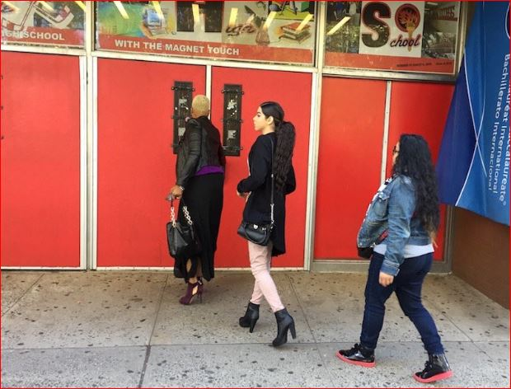
7 suspended in wake of attack on transgender student
NEWARK -- The 14-year-old who was beaten in the hallway of her school is planning to speak to classmates during a string of assemblies this month about her experience as a transgender student.

Slide 126
Bullying and Harassment Based on Sex
Transgender Students
The legal obligations of schools for accommodating and protecting transgender students is in flux.
Timeline of federal transgender policy developments over the last 2.5 years:
January 2015
OCR Public Letter to Private Citizen
Instructed school to follow students’ gender identity, not sex assigned at birth
May 2016
OCR DCL
Detailed obligations rooted in deference to gender identity (accommodations, no requirement of diagnosis, how to address discrimination)
February 2017
OCR DCL
Previous OCR Letter and OCR DCL repealed
June 2017
OCR Internal Memo
OCR issues internal memo explaining that discrimination, bullying, and harassment of transgender students are still covered by Title IX

Slide 127
OCR Internal Memo on Transgender Students
OCR Instructions to the Field re Complaints Involving Transgender Students
Date: June 6, 2017
Summary:
  OCR should rely on Title IX and its implementing regulations in evaluating complaints of sex discrimination.
  OCR said that it may assert subject matter jurisdiction over:
    Failure to promptly and equitably resolve a complaint of sex discrimination;
    Failure to assess whether sexual or gender-based harassment (including not using preferred pronouns);
    Retaliation against a transgender student after discrimination concerns raised; and
    Different treatment based on sex stereotyping.

Slide 128
Legal events following revocation of OCR DCL (Feb. 2017)
March 3, 2017: 13 states dropped their suit against the 2016 DCL.
  States were arguing that it improperly redefined sex discrimination under Titles VII and IX.
  Suit dismissed 9 days after revocation of OCR letters
March 6, 2017: Supreme Court vacated and remanded Gloucester Cty. School Bd. v. G.G.
  Supreme Court sent transgender bathroom case back to 4th Circuit for reconsideration in light of withdrawal of DCL; the 4th Circuit in turn remanded the case to the federal district court.
May 2017: Whitaker v. Kenosha Unified School District
  7th Circuit upheld a preliminary injunction that will prevent school district from forcing the plaintiff, a transgender student, to use the bathroom of his sex assigned at birth rather than his gender identity.
  Court found plaintiff could suffer irreparable harm if forced to use other bathroom and that his chances to succeed on the merits are “better than negligible.”
  Case was argued and decided after the revocation of the Obama administration transgender guidance.
Notes:
https://www.washingtonpost.com/local/education/education-dept-closes-transgender-student-cases-as-it-pushes-to-scale-back-civil-rights-investigations/2017/06/17/08e10de2-5367-11e7-91eb-9611861a988f_story.html?utm_term=.94ccfa42cb7f
http://www.ca4.uscourts.gov/Opinions/Published/161733R1.P.pdf

Slide 129
Legal events following revocation of OCR DCL (Feb. 2017)
June 2017: OCR’s Sparta, Ohio OCR investigation closed.
  Elementary school case involved transgender student’s access to the bathroom of their gender identity.
  Case closed because the student settled with the district.
  Earlier OCR findings that a student had suffered discrimination at school were withdrawn, citing revocation of the 2016 DCL.
August 25, 2017: Doe v. Boyertown Area School District
  School district implemented a policy to allow transgender students to use facilities consistent with their gender identities.
  Parents of transgender students objected to having to share facilities with transgender students.
  Third Circuit rejected the families’ request for a preliminary injunction, finding no violation of Title IX.
Notes:
https://www.washingtonpost.com/local/education/education-dept-closes-transgender-student-cases-as-it-pushes-to-scale-back-civil-rights-investigations/2017/06/17/08e10de2-5367-11e7-91eb-9611861a988f_story.html?utm_term=.94ccfa42cb7f
http://www.ca4.uscourts.gov/Opinions/Published/161733R1.P.pdf

Slide 130

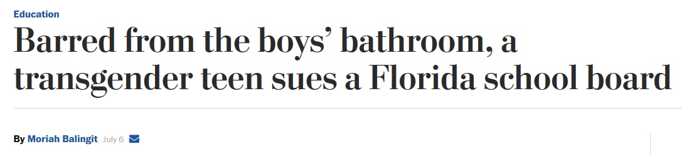
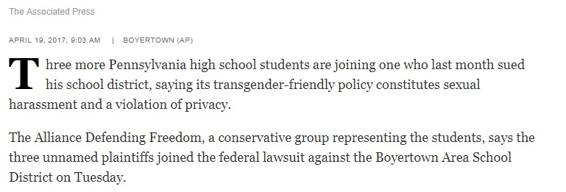

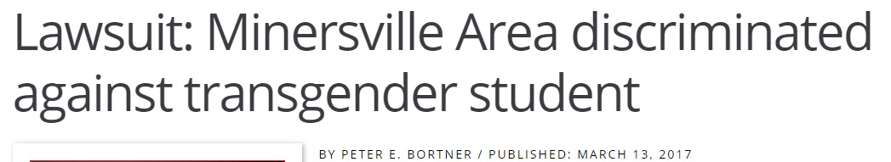
Legal events following revocation of OCR Transgender Guidance (February 2017)
Despite the confusion surrounding transgender rights under federal law, lawsuits continue to be filed against school districts.

Slide 131
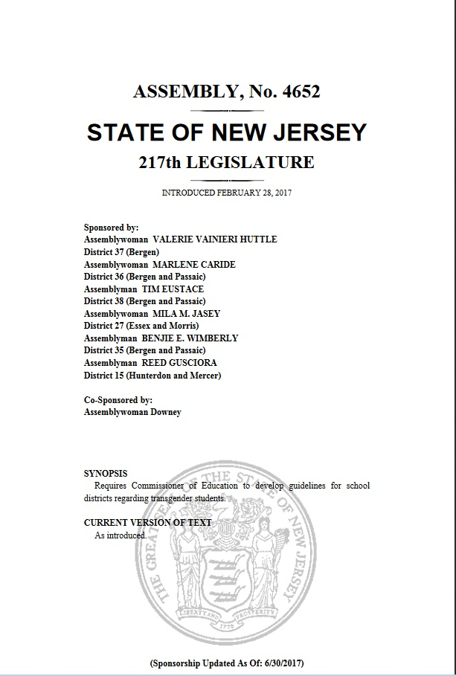
Legal events following revocation of OCR Transgender Guidance (February 2017)
Many state legislatures are proposing, debating, and enacting laws governing transgender rights, including in schools.
On Thursday, July 6, the New Jersey legislature passed a law protecting transgender students in public schools, and it will now be considered by the governor.

Slide 132
Legal events following revocation of OCR Transgender Guidance (February 2017)
On June of 2017, Connecticut State Department of Education issued guidance on civil rights protections for transgender students.
Guidance addresses a range of topics and states that “issues that arise often must be resolved in context of local communities, and school district leaders should consult their legal counsel regarding how the applicable laws and regulations may affect the policy decisions they are making for their schools.”

Slide 133
Legal events following revocation of OCR Transgender Guidance (February 2017)
Connecticut Guidance states that “students and parents/guardians have the right to enforce Title IX directly by filing a lawsuit in court and/or seeking enforcement by appropriate state authorities. . . [s]tudents and parents/guardians also have the right to enforce protections against gender identity discrimination established by Connecticut law.”

Slide 134
Legal events following revocation of OCR Transgender Guidance (February 2017)
Connecticut Guidance states that “[b]ecause of uncertainty concerning how OCR will handle complaints of gender identity discrimination during the Trump administration, CSDE recommends that students, parents and guardians, file complaints with OCR and CHRO if they are unable to resolve issues directly with the school district.”

Slide 135
Legal events following revocation of OCR Transgender Guidance (February 2017)
An Example of Topic in Connecticut Guidance
  “Students are not required to produce documents that reflect gender identity in order to have the right to be treated consistent with their gender identity . . .schools are expected to treat students consistent with the student’s state gender identity even if the education records or identification documents indicate a different sex. Similarly the school’s obligation to treat a student consistent with the student’s gender identity or expression does not require notice from parent or guardian.”

Slide 136
Legal events following revocation of OCR Transgender Guidance (February 2017)
Another Example in Connecticut Guidance
  “Under federal and state laws, CSDE policies and procedures and Executive Order No. 56, schools are required to provide access to the restroom that corresponds to a student’s gender identity at school, even when this differs from their sex assigned at birth. . . In communicating with students, families and staff about this requirement, schools may find it helpful to note that a private restroom option will be made available to any student.”

Slide 137
Background
State of the Law
  Overview of Bullying & Harassment Legal Framework
    Legal Elements of School Bullying & Harassment Claims
    Life Cycle of a School Bullying or Harassment Claim
  Bullying & Harassment Based On Federally Protected Characteristics
    Race, Color, National Origin
    Sex
    Disability
  Cyberbullying
  State Anti-Bullying Laws
Protecting Your Students and Yourselves

Slide 138

Bullying and Harassment of Students with Disabilities
OCR’s jurisdiction over disability-based bullying is derived from Section 540 of the Rehabilitation Act of 1973 and Title II of the Americans with Disabilities Act of 1990:
“No qualified handicapped person shall, on the basis of handicap, be excluded from participation in, be denied the benefits of, or otherwise be subjected to discrimination under any program or activity which receives Federal financial assistance.”
34 C.F.R. § 104.4(a)

Slide 139
Bullying and Harassment of Students with Disabilities
Statistics
Students with disabilities are more likely than peers without disabilities to be bullied:
  24.5% of elementary students with disabilities
  34.1% of middle school students with disabilities
  Source: Blake, Lund, Zhou, Kwok, and Benz (2012)
These higher rates of victimization of students with disabilities are associated with more physical and emotional harm and psychological distress compared to peers without disabilities.
  Source: Hartley, Bauman, Nixon, & Davis (2015)
Notes:
Blake, J. J., Lund, E. M., Zhou, Q., Kwok, O., & Benz, M. R. (2012). National prevalence rates of bully victimization among students with disabilities in the United States. School Psychology Quarterly, 27, 210–222.
Hartley, M. T., Bauman, S., Nixon, C. L., & Davis, S. (2015). Comparative study of bullying victimization among students in general and special education. Exceptional Children, 8, 176–193. doi:10.1177/0014402914551741

Slide 140
Bullying and Harassment of Students with Disabilities
Guidance to schools on how to handle bullying and harassment of students with disabilities comes from:
  Letter from ED-OSERS (2013) and
  OCR Dear Colleague Letter (2014).
In general, when a student with a disability is involved in bullying, schools must ensure the student’s educational plan is still appropriate in light of the bullying or harassment that has occurred.

Slide 141
Bullying of Students with Disabilities
OSERS Letter (2013)
Letter from ED’s Office of Special Education and Rehabilitative Services (OSERS)
Date: August 20, 2013
Take-aways:
  Districts that fail to appropriately identify and remedy the bullying of a student with disabilities risk violating federal civil rights laws and losing federal funds.
  Letter clarified responsibilities of school districts to prevent bullying of students with disabilities
  Letter provided districts with specific strategies to prevent bullying of students with disabilities

Slide 142
Bullying of Students with Disabilities
OSERS Letter (2013)
“[B]ullying of a student with a disability that results in the student not receiving meaningful educational benefit constitutes a denial of a free appropriate public education (FAPE) under the IDEA [Individuals with Disabilities Education Act] that must be remedied.”
  This applies to bullying of students with disabilities on any basis, the harassment does not have to be because of the disability.
“In circumstances involving a student who has not previously been identified as a child with a disability under IDEA, bullying may also trigger a school’s find obligation under IDEA.”

Slide 143
Bullying of Students with Disabilities
OSERS Letter (2013): Best Practices
To appropriately respond to the bullying of a student with disabilities, a school should convene the IEP team to determine:
  whether the student’s needs have changed such that the IEP is no longer designed to provide a meaningful educational benefit and
  to what extent additional or different special education or related services are needed to address the student’s individual needs and revise the IEP accordingly.
“The [IEP Team] should exercise caution when considering a change in placement or the location of services provided to the student with a disability who was the target of bullying behavior . . . [T]he [IEP] team should be aware that certain changes to the education program of a student with a disability may constitute a denial of the IDEA’s requirement that the school provide FAPE in LRE.”

Slide 144
Bullying of Students with Disabilities
OSERS Letter (2013): Best Practices
If the student who engaged in bullying behavior is a student with a disability, the school should convene the IEP team to:
  review the student’s IEP to determine if additional supports or services are needed to address the inappropriate behavior and
  consider examining the environment in which bullying occurred to determine if changes to the environment are warranted.

Slide 145
Bullying of Students with Disabilities
OCR Dear Colleague Letter (2014)
Date: October 21, 2014
Take-aways:
  DCL builds on OSERS’s 2013 guidance.
  Bullying of a student with a disability on any basis can similarly result in a denial of FAPE under Section 504 that must be remedied.
  DCL reiterates schools’ obligations to address conduct that may constitute a disability-based harassment violation and explains that a school must also remedy the denial of FAPE resulting from disability-based harassment.
Notes:
http://www2.ed.gov/about/offices/list/ocr/letters/colleague-bullying-201410.pdf

Slide 146
Hypothetical
At the start of the school year, a sixteen-year-old student with PTSD, Sammy, has been assigned a 504 plan to accommodate anxiety. Sammy also has a speech impediment causing him to stutter. A requirement of his English class is to recite a Shakespearean sonnet. Sammy requests to do his recitation with the teacher privately, but the teacher insists public speaking is an integral part of the assignment. Sammy struggles through his presentation, as anxiety makes his stutter worse. After this, other students in his English class start referring to him as “Suh-suh-Sammy.” To get him out of this environment, the school switches Sammy into a different English class, causing him to change his entire class schedule halfway through the semester, prompting many questions from his classmates.
Notes:
Inspired by OCR Resolution Agreement with Chicago Public Schools: http://www2.ed.gov/about/offices/list/ocr/docs/investigations/more/05131379-a.pdf

Slide 147
Hypothetical
Is this harassment?
If so, what type of harassment?
Was the school deliberately indifferent?
What, if anything, should the school have done differently?

Slide 148
Background
State of the Law
  Overview of Bullying & Harassment Legal Framework
    Legal Elements of School Bullying & Harassment Claims
    Life Cycle of a School Bullying or Harassment Claim
  Bullying & Harassment Based On Federally Protected Characteristics
    Race, Color, National Origin
    Sex
    Disability
  Cyberbullying
  State Anti-Bullying Laws
Protecting Your Students and Yourselves

Slide 149

Cyberbullying
Background
The growth of the Internet has provided and will continue to provide many educational benefits for students.
However, the Internet, cell phones, and social media have also provided students with new, harder-to-monitor ways to bully and harass each other.
Notes:
149

Slide 150

Cyberbullying
Cyberbullying is defined by Stopbullying.gov as “bullying that takes place using electronic technology. Examples of cyberbullying include mean text messages or emails, rumors sent by email or posted on social networking sites, and embarrassing pictures, videos, websites, or fake profiles.”
  Many instances of cyberbullying occur through social networking sites, such as Facebook, Twitter, YikYak, Snapchat, Instagram, and YouTube.
  Cyberbullying can occur 24 hours a day, 7 days a week. No matter where or when it occurs, its effects can impact a child’s educational experience.
Notes:
150

Slide 151

Sexting and Cyberbullying
“Sexting” is the sending or receiving of text messages with sexual content, such as pictures or videos that contain nudity.
Teens in several states – some as young as 14 – have been charged with the creation and distribution of child pornography and sexual exploitation of a minor.
When there is a harassing aspect to sexting, and that harassment is “sufficiently serious that it creates a hostile environment,” a school district’s failure to adequately address that harassment could violate Title IX.
Notes:
151

Slide 152
Sexting and Cyberbullying in the News
“Snapchat bullying triggers suicide.”
WLIX (Lansing, Michigan) (June 9, 2016)
“Snapchat murder, rape threat spurs 100 to attend anti-bullying rally; student charged”
PennLive.com (February 22, 2017)
“Sexting Case Rocks Colorado Town”
- Wall Street Journal (November 8, 2015)
“Cyberbullying Is a Bigger Problem Than Screen Time Addiction”
The New York Times (July 16, 2015)
Notes:
152

Slide 153


Sexting and Cyberbullying
“Queens girl, 12, hangs herself after being cyberbullied ”
NY Post (May 23, 2013)
“Jumping off the gw bridge sorry”
Facebook Post by Tyler Clementi (September 22, 2010)
Notes:
Updated this slide

Slide 154

State Legislation: Pennsylvania
Law creates the offense of "cyberharassment," which would include making seriously disparaging statements about a child's physical characteristics, sexuality, sexual activity or mental or physical health. It would also include threats to inflict harm.
The law allows intervention by law enforcement and juvenile probation officers who would initially review the case if it involved a juvenile offender.
Las was signed into law July 10, 2015 by Gov. Tom Wolf.
Notes:
http://www.ydr.com/local/ci_28477001/cyberbullying-children-becomes-punishable-offense-pa

Slide 155
State Legislation: North Carolina
On June 10, 2016, the Supreme Court of North Carolina reversed a unanimous panel of the Court of Appeals and struck down the state’s cyberbullying statute, N.C.G.S. § 14-458.1 as unconstitutional. State v. Bishop.
  Facts: A student posted a screenshot of a sexually themed text message on Facebook. Defendant Bishop posted derogatory comments on the picture. Police arrested Bishop and charged him with cyberbullying.
  Holding: NC’s cyberbullying statute was an unconstitutional restriction of speech in violation of the First Amendment.

Slide 156
State Legislation: Texas
On June 9, 2017, Texas Governor Greg Abbott signed amendments to the state bullying statute into law to provide more protection from cyberbullying.
  Legal remedies for bullying and cyberbullying include:
    Injunctions to shut down social media accounts of bullies and
    Class A Misdemeanor if bullying attempted to induce the victim to commit suicide or otherwise cause serious self-harm.
  Guidance and requirements for schools and districts include:
    Redefining cyberbullying to include outside-of-school events that negatively impact a victim’s learning environment;
    Enabling schools to expel, suspend, or otherwise discipline bullies; and
    Requiring districts to create anti-bullying policies with fast notification of parents, availability of mental health services.
Notes:
http://www.legis.state.tx.us/billlookup/text.aspx?LegSess=85R&Bill=SB179
http://news4sanantonio.com/news/make-it-stop/gov-greg-abbott-signs-anti-cyberbullying-legislation-dubbed-davids-law

Slide 157

Emerging Issues in Cyberbullying
Several victims of cyberbullying and their families have sued students and school districts for libel, defamation and other similar torts.
Some schools have attempted to charge students with cyberbullying when they comments online that are disparaging to school staff.

Slide 158
Sexting and Cyberbullying
Hypothetical
A high school student sends topless photos of herself to her boyfriend via Snapchat throughout their 3-month relationship, expecting the photos will automatically delete after 10 seconds. The boyfriend takes a screenshot of one of the photos. Following their break-up some weeks later, he texts the screenshot to some teammates, who in turn post suggestive comments on the girl’s social media pages. When she consults her guidance counselor, the counselor hesitates to act because the photos were taken voluntarily outside of school, have not been shown on campus, and the bullying has not explicitly mentioned the photos.

Slide 159
Hypothetical
Is this harassment?
If so, what type of harassment?
Was the school deliberately indifferent?
What, if anything, should the school have done differently?

Slide 160
Background
State of the Law
  Overview of Bullying & Harassment Legal Framework
    Legal Elements of School Bullying & Harassment Claims
    Life Cycle of a School Bullying or Harassment Claim
  Bullying & Harassment Based On Federally Protected Characteristics
    Race, Color, National Origin
    Sex
    Disability
  Cyberbullying
  State Anti-Bullying Laws
Protecting Your Students and Yourselves

Slide 161
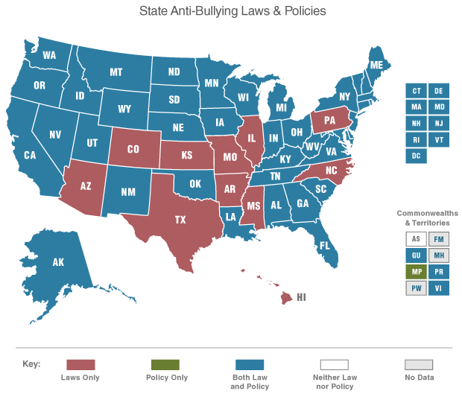
Headlines
“Anti-bullying laws appear to be working”
-CNN (October 2015)
“All 50 States Now Have a Bullying Law. Now What?”
-Huffington Post (April 2015)
Notes:
Updated headlines
http://www.cnn.com/2015/10/08/health/anti-bullying-laws-work/
http://www.huffingtonpost.com/deborah-temkin/all-50-states-now-have-a_b_7153114.html

Slide 162
New, Tougher State Anti-bullying Laws
Federal policing of bullying must be tied to federal civil rights law, state legislation can be more expansive
A growing number of states are developing new or strengthening existing anti-bullying and anti-harassment laws.
  These laws are rapidly changing – Texas and Virginia have revised their bullying laws since the beginning of May 2017.
162

Slide 163
State Variation in Anti-Harassment Policies
Example: Oklahoma Law
  Requires each district to adopt policies, including policies:
    Providing for the investigation of harassment, intimidation and/or bullying;
    Prohibiting harassment, intimidation and/or bullying by students at school and by electronic means if directed at students or school personnel;
    Establishing procedures for the recommendation of community mental health care for students implicated in incidents of harassment, intimidation and/or bullying;
    Requiring the state Board of Education to promulgate rules for monitoring school districts for compliance; and
    Requiring establishment of a “Safe School Committee” to study and make recommendations.
See 70 O.S. §§ 24-100.2, et seq.

Slide 164
Background
State of the Law
  Overview of Bullying & Harassment Legal Framework
    Legal Elements of School Bullying & Harassment Claims
    Life Cycle of a School Bullying or Harassment Claim
  Bullying & Harassment Based On Federally Protected Characteristics
    Race, Color, National Origin
    Sex
    Disability
  Cyberbullying
  State Anti-Bullying Laws
Protecting Your Students and Yourselves

Slide 165
Protecting Your Students and Yourselves
General Tips
In Dec. 2011, DOJ published a Juvenile Justice Bulletin on Bullying in Schools.
  It summarized the National Center for School Engagement study.
  Findings and Recommendations:
    School engagement protects victims of bullying.
    Schools can mitigate the effects of bullying.
      Good: engage victims in academics or extracurricular activities, surround with caring adults that model behavior
      Bad: changing the school structure to less engaging environments for the victim
    Address the transition from elementary to middle school.
    Start prevention programs early.
Notes:
Added this slide based on new information

Slide 166
(1) Written Anti-bullying and
Anti-harassment Policies

Slide 167
Protecting Your Students and Yourselves
Written Policies and Procedures
Districts should ensure that they have
well-publicized, written anti-bullying and
anti-harassment policies and procedures that:
Prohibit bullying and harassment;
Establish procedures for identifying bullying and harassment;
Establish procedures for reporting incidents of bullying and harassment; and
Establish procedures for the investigation and remediation of incidents of harassment.
167

Slide 168

(2) Investigate Allegations
of Harassment
Sources:
Nicholas Fiorenza, Investigating Harassment, Printing Impressions (Mar. 2007).
Melani Kastl et al., How to Assess Credibility in Workplace Investigations, Nonprofit World (Jan./Feb. 2005).
E. Jason Tremblay, Properly Investigating Complaints of Harassment: How to Limit a Company’s Exposure,
Business Law Today (Sept./Oct. 2008).

Slide 169
You receive an allegation of harassment: Now what?
Investigations are important
It is the right thing to do!
  Investigations are necessary to ensure equal access to education.
Legal reasons:
  A school district must be able to demonstrate to a complaining student or parent, OCR, and/or DOJ that it has appropriately investigated and responded to all allegations of harassment.
  If a school district knows about harassment but does not do anything, its failure to act may create liability.

Slide 170
Protecting Your Students and Yourselves
Investigate Allegations of Harassment
Before a complaint is made, districts should:
  Regularly train all school personnel to identify harassment that they observe or that is reported to them;
  Regularly train all school personnel on district anti-harassment policies, procedures, and complaint processes;
  Identify one school-level and one district-level staff member to whom reports of harassment may be made;
  Identify staff members to serve as investigators when complaints of harassment are received;
  Ensure that all staff who investigate are trained and know the district’s anti-harassment policies and procedures and civil rights laws enforced by OCR; and
  Regularly train students on the district’s anti-harassment policies and procedures, including how to identify and report harassment.
  Review policy and procedures to ensure consistent with federal and state law.

Slide 171
You receive an allegation of harassment: Now what?
Preliminary issues
Is there a particular timeframe within which an investigation must be completed?
  OCR has opined that schools have “a responsibility to respond promptly and effectively.”
If a school doesn’t know about harassment, then does it have an obligation to end it?
  “[I]f the school knows or reasonably should know about the harassment, the school is responsible for taking immediate effective action to eliminate the hostile environment and prevent its recurrence.”
Notes:
http://www2.ed.gov/about/offices/list/ocr/docs/title-ix-rights-201104.pdf

Slide 172
You receive an allegation of harassment: Now what?
Preliminary issues, continued
The student and parent do not want to file a formal complaint. Is the school’s responsibility over?
  No. “Regardless of whether the student who was harassed, or his or her parent, decides to file a formal complaint or otherwise request action on the student's behalf (including in cases involving direct observation by a responsible employee), the school must promptly investigate to determine what occurred and then take appropriate steps to resolve the situation.”
The police have started investigating. Is the school’s responsibility over?
  No. “[B]ecause legal standards for criminal investigations are different, police investigations or reports may not be determinative of whether harassment occurred under Title IX and do not relieve the school of its duty to respond promptly and effectively.”
After the school resolves the complaint, it has no further obligations, right?
  No. It must ensure there is no retaliation and that the harassment is not recurring.
Notes:
http://www2.ed.gov/about/offices/list/ocr/docs/title-ix-rights-201104.pdf

Slide 173
You receive an allegation of harassment: Now what?
Does the school need to protect the student’s or complainant’s confidentiality?
  Protect confidentiality to the extent possible.
“In all cases, a school should discuss confidentiality standards and concerns with the complainant initially. The school should inform the student that a confidentiality request may limit the school's ability to respond. The school also should tell the student that Title IX prohibits retaliation and that, if he or she is afraid of reprisals from the alleged harasser, the school will take steps to prevent retaliation and will take strong responsive actions if retaliation occurs. If the student continues to ask that his or her name not be revealed, the school should take all reasonable steps to investigate and respond to the complaint consistent with the student's request as long as doing so does not prevent the school from responding effectively to the harassment and preventing harassment of other students.” (2001 Guidance)

Slide 174
You receive an allegation of harassment: Now what?
Continued…
“OCR enforces Title IX consistent with the federally protected due process rights of public school students and employees. Thus, for example, if a student, who was the only student harassed, insists that his or her name not be revealed, and the alleged harasser could not respond to the charges of sexual harassment without that information, in evaluating the school's response, OCR would not expect disciplinary action against an alleged harasser.
At the same time, a school should evaluate the confidentiality request in the context of its responsibility to provide a safe and nondiscriminatory environment for all students. The factors that a school may consider in this regard include the seriousness of the alleged harassment, the age of the student harassed, whether there have been other complaints or reports of harassment against the alleged harasser, and the rights of the accused individual to receive information about the accuser and the allegations if a formal proceeding with sanctions may result.”

Slide 175
You receive an allegation of harassment: Now what?
Act immediately to end harassment
Acting immediately sends a message that the harassment is not acceptable.
It may be appropriate to provide “interim measures,” individualized services offered as appropriate to either or both the reporting and responding parties involved in an alleged incident of sexual misconduct, prior to an investigation or while an investigation is pending.
  For example: Counseling, extensions of time, modifications of class schedules, restrictions on contact, etc.
Inform complainants about their Title IX rights, any available resources (such as counseling, health, and mental health services), and their right to file a complaint with local law enforcement.

Slide 176
How to Investigate Allegations of Harassment
  **Family Educational Rights and Privacy Act**
  Federal law that protects the privacy of student education records
  An “education record” is:
    Directly related to a student and
    Maintained by an educational agency.
    Note: “Education record” does not include “[r]ecords that are kept in the sole possession of the maker, are used only as a personal memory aid, and are not accessible or revealed to any other person except a temporary substitute for the maker of the record.” See 34 C.F.R. § 99.3.
    See generally 20 U.S.C. § 1232g; 34 C.F.R. Part 99.
Notes:
No changes to 34 C.F.R. 99.3 between last review and October 18, 2015.

Slide 177
How to Investigate Allegations of Harassment
  **Family Educational Rights and Privacy Act**
  A parent has the right to inspect his/her child’s education record within a reasonable time after his/her request, but no later than 45 days after the request.
    “If circumstances effectively prevent the parent or eligible student from exercising the right to inspect and review the student's education records, the educational agency or institution, or SEA or its component, shall--(1) Provide the parent or eligible student with a copy of the records requested; or (2) Make other arrangements for the parent or eligible student to inspect and review the requested records.” 34 C.F.R. § 99.10.
    District may charge for copies of record (unless the imposition of a fee effectively prevents a parent or eligible student from exercising the right to inspect and review).
Notes:
No changes to 34 C.F.R. 99.10 between last review and October 18, 2015.

Slide 178
How to Investigate Allegations of Harassment
  **Family Educational Rights and Privacy Act**
  “If the education records of a student contain information on more than one student, the parent or eligible student may inspect and review or be informed of only the specific information about that student.” 34 C.F.R. § 99.12
  If parent believes education record contains inaccurate or misleading information, he or she can ask school to amend record and request a hearing if school declines to amend the record. See 34 C.F.R. §§ 99.20 and 99.21.
  School officials should obtain access to only those education records in which they have legitimate educational interests. See 34 C.F.R. § 99.31.
Notes:
No changes to 34 C.F.R. Sections 99.12, 99.20, 99.21, 99.31 between last review and October 18, 2015.

Slide 179
How to Investigate Allegations of Harassment
  **Family Educational Rights and Privacy Act**
  Examples of circumstances when disclosure without consent is needed:
    Disclosure “to a victim of an alleged perpetrator of a crime of violence or a non-forcible sex offense. The disclosure may only include the final results of the disciplinary proceeding conducted by the institution of postsecondary education with respect to that alleged crime or offense. The institution may disclose the final results of the disciplinary proceeding, regardless of whether the institution concluded a violation was committed.”
    Disclosure is in connection with a health or safety emergency
  See 34 C.F.R. § 99.31.
  A school should maintain a record of each request for access to and each disclosure of personally identifiable information from the education records of each student. See 34 C.F.R. § 99.32.

Slide 180
Protecting Your Students and Yourselves
Investigate Allegations of Harassment
  **Connecticut’s Freedom of Information Act**
  “Except as otherwise provided by any federal law or state statute, all records maintained or kept on file by any public agency, whether or not such records are required by any law or by any rule or regulation, shall be public records and every person shall have the right to
  (1) inspect such records promptly during regular office or business hours,
  (2) copy such records . . ., or
  (3) receive a copy of such records.”
  --Conn. Gen. Stat. § 1-210.
Notes:
Conn. Gen. Stat. § 1-210 (updated in 2015)
(b) Nothing in the Freedom of Information Act 1 shall be construed to require disclosure of: ***
(11) Names or addresses of students enrolled in any public school or college without the consent of each student whose name or
address is to be disclosed who is eighteen years of age or older and a parent or guardian of each such student who is younger than
eighteen years of age, provided this subdivision shall not be construed as prohibiting the disclosure of the names or addresses
of students enrolled in any public school in a regional school district to the board of selectmen or town board of finance, as the
case may be, of the town wherein the student resides for the purpose of verifying tuition payments made to such school;
***
(17) Educational records which are not subject to disclosure under the Family Educational Rights and Privacy Act, 20 USC
1232g;

Slide 181
Protecting Your Students and Yourselves
Investigate Allegations of Harassment
  **Connecticut’s Freedom of Information Act**
“Nothing in the Freedom of Information Act 1 shall be construed to require disclosure of:
***
(11) Names or addresses of students enrolled in any public school or college without the consent of each student whose name or address is to be disclosed who is eighteen years of age or older and a parent or guardian of each such student who is younger than eighteen years of age, provided this subdivision shall not be construed as prohibiting the disclosure of the names or addresses of students enrolled in any public school in a regional school district to the board of selectmen or town board of finance, as the case may be, of the town wherein the student resides for the purpose of verifying tuition payments made to such school;
***
(17) Educational records which are not subject to disclosure under the Family Educational Rights and Privacy Act, 20 USC 1232g.”
  --Conn. Gen. Stat. § 1-210.
Notes:
Conn. Gen. Stat. § 1-210 (updated in 2015)
(b) Nothing in the Freedom of Information Act 1 shall be construed to require disclosure of: ***
(11) Names or addresses of students enrolled in any public school or college without the consent of each student whose name or
address is to be disclosed who is eighteen years of age or older and a parent or guardian of each such student who is younger than
eighteen years of age, provided this subdivision shall not be construed as prohibiting the disclosure of the names or addresses
of students enrolled in any public school in a regional school district to the board of selectmen or town board of finance, as the
case may be, of the town wherein the student resides for the purpose of verifying tuition payments made to such school;
***
(17) Educational records which are not subject to disclosure under the Family Educational Rights and Privacy Act, 20 USC
1232g;

Slide 182
Protecting Your Students and Yourselves
Investigate Allegations of Harassment
  **Connecticut’s Freedom of Information Act**
Important: In general, respond within four business days to a request, otherwise you will be considered to have denied the request.
See Conn. Gen. Stat. § 1-206.
      Note: Fees should not exceed what it costs to the public agency to provide the copy. Detailed fee instructions appear in the statute.
Notes:
As of October 18, 2015, there are no changes to Connecticut General Statute 1-206 since 2011.

Slide 183
Protecting Your Students and Yourselves
Investigate Allegations of Harassment
Once a complaint is made:
  Immediately take steps to ensure that the alleged victim and the alleged harasser are kept separate during the investigation.
  Investigate the alleged harassment fully and promptly. A full investigation includes the following steps:
Note: Please keep in mind that the steps described below should be adjusted according to the particular facts of the alleged harassment, including the age, disabilities, or other sensitivities of the alleged victim, the alleged harasser, and the witnesses.
183

Slide 184
Protecting Your Students and Yourselves
Investigate Allegations of Harassment
Review applicable statutes, regulations, and school district policies and procedures. Follow all applicable policies and procedures throughout the investigation.
2. Ask the complaining student or staff member for a full narrative of the facts.
    Written complaint forms are very helpful.
3. Review the student/staff files of individuals allegedly involved in the incident.
    Reviewing the files will provide the investigator with key background facts that can inform his or her questioning of the victim, the alleged harasser, and witnesses.
4. Interview all alleged victims (which may or may not include the complainant).
    Consider asking: how the alleged harassment has affected the victim and whether the victim has any notes, emails, text messages, documentation, or other physical evidence.

Slide 185
Protecting Your Students and Yourselves
Investigate Allegations of Harassment
  5. Interview the alleged harasser(s).
  Interview other witnesses.
  Review the notes from the interviews.
    Follow up on any factual inconsistencies. Re-interview as necessary.
Note: Provide interviewees – whether they are the victim, a witness, or the alleged harasser – with appropriate translation services if the interviewee is an English Language Learner.

Slide 186
How to Investigate Allegations of Harassment
If only a school official is conducting an interview and:
  No school resource officer is present
  No police officer is present
If a school official is not acting at the behest of the police
If a school resource officer or police officer joins a school official for an interview but does not ask questions
  Parental consent and/or presence is not required
186

Slide 187
How to Investigate Allegations of Harassment
If a police officer is present and directing the questioning, the age of the student becomes significant:
  Category 1: Students under 16 years old
  Category 2: Students 16 and 17 years old
187

Slide 188
How to Investigate Allegations of Harassment
Category 1: If a police officer is present and directing the questioning, any admission, confession or statement, written or oral, made by a child under the age of 16:
  Needs to be in the presence of a child's parent or guardian
  Must be given after the child and his/her parent or guardian have been advised:
    of the child’s right to retain counsel, or if unable to afford counsel, to have counsel appointed on the child's behalf,
    of the child’s right to refuse to make any statements, and
    that any statements the child makes may be introduced into evidence against the child.
    Any admission or confession will be inadmissible in court unless the requirements above are met. See Conn. Gen. Stat. § 46B-137(a).
188
Notes:
No changes to 46B-137(a) since 2012 (confirmed October 20, 2015)

Slide 189
How to Investigate Allegations of Harassment
Category 2: If a police officer is present and directing the questioning, any admission, confession or statement, written or oral, made by a child 16 or 17 years old:
  reasonable efforts must be made to contact the child’s parent or guardian and
  the child must be advised:
    of the right to contact a parent or guardian and to have a parent or guardian present during any interview,
    of the right to retain counsel or, if unable to afford counsel, to have counsel appointed,
    of the right to refuse to make any statement, and
    of the fact that any statement made may be introduced into evidence against him or her.
    Any admission or confession will be inadmissible in court unless the requirements above are met. See Conn. Gen. Stat. § 46B-137(b).
189

Slide 190

Investigation Steps Applied:
  Review applicable statutes, regulations, and school district policies and procedures. Follow all applicable policies and procedures throughout the investigation.
  Suzy Sawit has reported that she saw racial slurs written in graffiti on several lockers in the main hallway of Happy High School. Suzy also says she knows that Harold Hurt wrote the slurs.
      First Step: As investigator, your first step is to review your school district’s anti-harassment policies and procedures. Follow those procedures throughout your investigation!
Notes:
Changed the names in the next few slides to erase the implications they suggested

Slide 191
Investigation Steps Applied:
  2. Ask the complaining student or staff member for a full narrative of the facts.
    Written complaint forms are very helpful. A written form ensures that the investigator collects all relevant information, including:
      Who, what, when, where;
      Race, ethnicity, and gender of victim;
      Students, teachers, and other staff involved;
      Witnesses to the incident; and
      The specific nature of the alleged harassment.
  As soon as possible, provide Suzy Sawit with a written complaint form. Check to ensure that she provides all the information above. Review her responses carefully before conducting any further interviews.

Slide 192
Investigation Steps Applied:
  3. Review the student/staff files of every individual allegedly involved in the incident.
    Reviewing the files will provide the investigator with key background facts that can inform his or her questioning of the victim, the alleged harasser, and witnesses.
  Questions to consider when reviewing the files:
    Has Suzy Sawit ever reported a similar incident in the past?
    Does Suzy have a history of telling the truth?
    What are the races, genders, and disability statuses of the students whose lockers were defaced? What are the disciplinary backgrounds of those students?
    What is the race and disciplinary background of Harold Hurt?

Slide 193
Investigation Steps Applied:
  4. Interview all alleged victims (which may or may not include the complainant).
    In addition to the standard factual information listed in #2 above, the investigator should consider asking the victim(s) the following questions:
      How did you react to the harassment?
      How has the alleged harassment affected you and your experience at school?
      Are there any other students, teachers, or staff that might have relevant information?
      Do you have any notes, emails, text messages, documentation, or other physical evidence related to the incident?
      How would you like to see this situation resolved?
Be sure to interview each student whose locker was defaced.

Slide 194
Investigation Steps Applied:
  5. Interview the alleged harasser(s).
    The investigator should ask the alleged harasser about the basic facts surrounding the incident and give the alleged harasser an opportunity to explain the reasons for his or her actions.

Slide 195
Investigation Steps Applied:
  6. Interview other witnesses.
    A full investigation includes interviews with all potential witnesses, even if the first few witnesses interviewed have provided identical information.
    First, the investigator should explain briefly the reasons for the interview and ask whether the witness has any relevant information about the alleged incident.
    Next, the investigator should consider asking the following questions:
      Describe the alleged harasser’s general behavior toward the victim.
      What, if anything, did the victim tell you about the incident?
      Do you know of anyone else who might have relevant information?
      Are you aware whether the alleged harasser has ever engaged in similar conduct in the past?
Be sure that you have captured all potential witnesses by encouraging your interviewees to list any other students or school personnel who could possibly have information about the incident.

Slide 196
Investigation Steps Applied:
  7. Review the notes from the interviews.
    Follow up on any factual inconsistencies. Re-interview witnesses as necessary.
If Harold Hurt says something that directly contradicts what Suzy Sawit reported to you, you must circle back with Suzy to clarify her version of the events.

Slide 197
How to Investigate Allegations of Harassment
  Eight Tips for an
  Effective Investigation
197

Slide 198
How to Investigate Allegations of Harassment
Be strategic. Use your review of the relevant law and policies as a guide to what you need to find out.
Be consistent! Follow the same investigative processes for each harassment complaint.
Develop a checklist of questions before each interview.
Interview questions should illicit the facts but be open-ended so as to allow the interviewees to tell their side of the story.
198

Slide 199
How to Investigate Allegations of Harassment
Take notes either during the interviews or immediately following the interviews. The notes should state the facts, not the investigator’s opinions.
Provide interviewees – whether they are the victim, a witness, or the alleged harasser – with appropriate translation services if the interviewee is an English Language Learner.
199

Slide 200
How to Investigate Allegations of Harassment
One of the most difficult aspects of an investigation is determining witness credibility. When confronted with conflicting stories, consider the witnesses’:
    Character;
    Prior inconsistent statements;
    Bias or motive;
    Demeanor;
    Opportunity or capacity to observe the events; and/or
    Cooperation with the investigation (or lack thereof).
200

Slide 201
How to Investigate Allegations of Harassment
Ask follow-up questions if needed (“Is there anything else you think we should know?”).
    Sources:
        Nicholas Fiorenza, Investigating Harassment, Printing Impressions (Mar. 2007).
        Melani Kastl et al., How to Assess Credibility in Workplace Investigations, Nonprofit World (Jan./Feb. 2005).
        E. Jason Tremblay, Properly Investigating Complaints of Harassment: How to Limit a Company’s Exposure, Business Law Today (Sept./Oct. 2008).
201

Slide 202
After an investigation
Provide written notice of the outcome of disciplinary proceedings to both parties concurrently.
The content of the notice may vary depending on the underlying allegations and the age of the students.
Inform the reporting party’s parents (or directly to the student, if the student is 18):
  Whether the school found that the alleged conduct occurred;
  Any individual remedies offered to the reporting party or any sanctions imposed on the responding party that directly relate to the reporting party; and
  Other steps the school has taken to eliminate the hostile environment, if applicable

Slide 203
Investigation Reports
203

Slide 204

Investigation Reports
  Importance of Reports
  Report Components
  Tips for Writing Effective Investigation Reports
204

Slide 205
Investigation Reports
The Story of Veronica Volleyball
Veronica Volleyball tells her homeroom teacher, Tessa Teacher, that her 8th grade classmate, Bobby Baseball, made sexually suggestive comments to her. Veronica explains that even after she asked him to stop, he kept making suggestive statements to her. Veronica gives Ms. Teacher an email that Bobby sent to her that includes several suggestive statements. Veronica states that she has pretended to be sick sometimes just to avoid her seventh period class with Bobby. Ms. Teacher reports the information to you.
You investigate and learn additional facts. Bobby tells you initially that he didn’t say anything to Veronica, but then says he “might” have made some comments but was “joking.” You know that Bobby has received two in-school suspensions for making sexually suggestive remarks to girls at school, and has lied to school officials twice in the past. In a meeting with Principal Patterson, Harry Highschool confirms that Bobby made suggestive comments to Veronica. Tessa Teacher reports that she heard Bobby make suggestive comments to Veronica also. Bobby’s Facebook page contains suggestive comments about Veronica.

Slide 206
Investigation Reports
Importance of Reports
Investigation reports provide evidence of investigations. In particular, reports:
  Detail the processes of the investigation;
  Organize and present the factual information collected; and
  Provide specific factual support for conclusions and remedies.
206
Notes:
206

Slide 207
Investigation Reports
Reports help ensure that all participants in the investigation – including the victim, alleged harasser, and other witnesses – receive a fair process by:
  Encouraging thorough investigations;
  Giving district officials an opportunity to analyze the information collected to determine whether facts support the allegations; and
  Providing rationale for district decisions.
207
Notes:
207

Slide 208
Investigation Reports
Report Components
Introduction / Origin of Complaint
Scope of Investigation
Facts
Conclusions
Recommendations
Note: Each of the components above should be a separate section in the report.
208

Slide 209
Investigation Reports
Introduction / Origin of Complaint
Describe each allegation in detail.
  State each as succinctly and clearly as possible.
Veronica Volleyball claims that during a seventh period class on November 1, 2010, Bobby Baseball made the following sexually suggestive comments to her: " [insert comments]." Veronica claims that she asked him to stop but that he continued to repeat the statements.
209

Slide 210
Investigation Reports
For each allegation, cite the statutory or regulatory claim and grounds upon which the allegation is based.
Title IX prohibits sexual harassment in any public school. In addition, Policy 99.101 of the Main Street Middle School Student Handbook prohibits a student from making statements to another student of a sexually suggestive nature. Policy 99.102 requires . . .
210

Slide 211
Investigation Reports
Describe actions the school has taken prior to your involvement.
Prior to the investigation, Assistant Principal John Smith met with Veronica Volleyball and questioned her about the alleged incident. In addition, Mr. Smith instructed Bobby Baseball that he was not to have any conversations with Veronica until further notice.
211

Slide 212
Investigation Reports
Scope of Investigation
Explain how you conducted the investigation
I began the investigation by reviewing the relevant statute, policies, etc. that address the conduct that allegedly took place. Next, I interviewed the complainant, Veronica Volleyball. Based upon information provided by Veronica, I reviewed the relevant student files, then interviewed Sam Student, Harry Highschool, and Franny Friend. Based upon the relevant policies, documents and interviews, I presented recommendations to Principal Patricia Patterson.
212

Slide 213
Investigation Reports
Identify the documents you reviewed, including:
  written complaints,
  emails,
  interview notes,
  school policies and regulations,
  incident reports,
  online photos and posts, and
  other documentary or physical evidence.
213

Slide 214
Investigation Reports
Attach key documents to the end of the report.
I reviewed the following written materials:
  1. Student Handbook policy no. ____.
  2. Email, dated May 1, 2016, from Bobby Baseball to Veronica Volleyball.
  3. Student files of _____, _____, and _____.
  4. Facebook page of Bobby Baseball printed May 5, 2014.
  5. Incident report, dated November 2, 2015, prepared by Assistant Principal Karen Johnson.
214

Slide 215
Investigation Reports
Identify the witnesses you interviewed
The following witnesses were interviewed during the investigation:
1. Veronica Volleyball
2. Bobby Baseball
3. Assistant Principal Karen Johnson
4. etc.
215

Slide 216

Investigation Reports
Facts
Should rely upon clear, accurate, factual evidence.
216

Slide 217
Investigation Reports
Describe facts relevant to the analysis, conclusions, and recommendations, including:
  Who, what, where, when, why, how;
  Specific actions / incidents that occurred;
  Dates;
  Locations of incidents;
  Specific quotations of words used (evidence of motivation, but not statements about motivation);
  Ages of students;
  Specific actions the district has already taken to investigate (but not conclusions the district has drawn);
  Impact of incident on complainant, others, and school;
  Students’ prior relationships and interactions;
  Students’ prior incidents; and
  Position of actors (e.g. student, principal).
217

Slide 218
Investigation Reports
Present the facts in a logical sequence.
  Often, it is best to use the chronological order of events.
  But, sometimes, you may want to organize the facts according to complaint or subject matter.
218

Slide 219
Investigation Reports
If some fact is disputed, use the relevant documents and testimony – as well as the strategies described in Section II – to include sufficient factual material to resolve the dispute.
Although Bobby Baseball denies making any improper statements to Veronica Volleyball, Bobby has lied to school officials on two occasions in the past, and the email dated May 1, 2010 supports Veronica’s allegations that Bobby made comments of a sexually suggestive nature.
219

Slide 220
Investigation Reports
Be objective; do not use subjective characterizations.
Prior to the incident at issue, Bobby Baseball had twice received in-school suspensions for making sexually suggestive remarks to female students.
NOT
Bobby Baseball is a crude and unlikable student who constantly gets into trouble.
220

Slide 221
Investigation Reports
Cite to specific evidence for support.
Statement of Harry Highschool during a meeting with Principal Patterson on November 8, 2015.
221

Slide 222
Investigation Reports
Do not analyze the facts or draw conclusions in the Finding of Facts section.
  This section is intended only to establish the factual and logical basis for the analysis and conclusions.
If available, use police investigations / reports as you would any other piece of information – they are not necessarily determinative.
222

Slide 223
Investigation Reports
For example:
Facts:
1. Veronica Volleyball and Bobby Baseball are 8th grade students at Main Street Middle School.
2. Main Street Middle School is a public school located at 123 Main Street.
3. On November 1, 2010, Veronica Volleyball complained to her homeroom teacher, Tessa Teacher, that Bobby Baseball had made sexually suggestive comments to her during their seventh period class.
223

Slide 224
Investigation Reports
Conclusions
Analyze the facts presented, restating the critical facts and resolving factual disputes.
Apply the correct standard – preponderance of the evidence under the federal civil rights laws.
The comments allegedly made by Bobby Baseball are sexual in nature. If the comments were made, they violate the Main Street Student Handbook. Section XX.XXX of the Student Handbook states as follows: [insert].
224

Slide 225
Investigation Reports
Include reasons for accepting or rejecting the allegations.
  Apply the preponderance of the evidence standard!
I credit Veronica Volleyball’s version of events. Her allegations are supported by two witnesses, Harry Highschool and Tessa Teacher. Moreover, while Bobby Baseball initially denied the allegations, he later conceded that he "might" have made the comments but stated that he was "joking."
225

Slide 226
Investigation Reports
Draw conclusions
  Use the facts!
  All conclusions must be logical and reasonable reflections of the facts.
  The purpose is to determine if the alleged acts occurred and why the alleged acts occurred (i.e. motivations).
Do NOT make legal conclusions
226

Slide 227
Investigation Reports
Recommendations
Recommend a resolution of the complaint.
  Describe actions required to make the complainant whole.
  Describe actions required to eliminate the discriminatory practice.
Main Street's Student Handbook clearly states that there is "zero tolerance" for sexually suggestive remarks by, or directed to, students. Consistent enforcement of the policy requires prompt and decisive discipline, both to correct Bobby Baseball’s behavior and to reiterate to others that such conduct is not tolerated.
227

Slide 228
Investigation Reports
Recommend interventions, such as:
  Remedial relief for identified victims;
  Prospective relief for the school (e.g. changes in policies, training for staff); and/or
  Progressive discipline for the harasser (which depends on severity, intent, whether a repeat offender, etc.).
228

Slide 229
Investigation Reports
For example:
I recommend the following:
1. Bobby Baseball should be instructed to apologize to Veronica Volleyball in a meeting supervised by Principal Patricia Patterson.
2. Bobby Baseball should be suspended from school for a period of two days.
3. Bobby Baseball should be cautioned not to retaliate in any manner against Veronica Volleyball.
4. Main Street Middle School should conduct a school assembly to review the school's anti- harassment policies.
229

Slide 230
Investigation Reports
10 Tips for Writing an
Effective Investigation Report
230

Slide 231
Investigation Reports
1) Be impartial.
  Do not use biased language.
  Beware of language that downplays, has certain connotations, etc.
  If available, use the specific language of the actors.
2) Do not mischaracterize facts.
231

Slide 232
Investigation Reports
3) Be thorough.
  Do not leave out facts that appear damaging to the school district. This undermines both the credibility of the report and your credibility as an investigator.
  Sometimes, you might need to explain that the district made a mistake.
4) Be specific.
  Do not be vague. If you do not know a particular fact, find it out.
  When possible, do not allow witnesses to be vague.
232

Slide 233
Investigation Reports
5) Confirm that the investigation was done appropriately.
  Interview appropriate witnesses.
  Substantiate claims, investigate credibility, and do not accept statements at face value.
  Use supporting documents and corroborating evidence.
  Follow up on all leads.
6) Be prompt.
  Follow your district’s policy with regard to deadlines.
233

Slide 234
Investigation Reports
7) Comply with legal requirements.
  Comply with state and federal privacy laws.
  Comply with union contracts.
8) Give yourself enough time!
  Allow an appropriate amount of time to conduct a thorough investigation and write an effective report.
234

Slide 235
Investigation Reports
9) Write effectively.
  Use short sentences, active voice, and words that convey full and appropriate meaning.
  Proofread.
10) Attach key documents to the end of the report.
*Form documents can help keep the process organized*
235

Slide 236
Putting Theory into Practice
236

Slide 237
Putting Theory into Practice: Role Play
You hear rumors that a group of male tenth graders led by Bobby Baseball created an elaborate online “fantasy league” involving a quarter of the female students in the tenth grade. You receive an email from Jane Doe, a tenth grader, attaching a scanned copy of the “scoring page” and her “profile page.” The scoring page assigns points to each boy by pseudonym based on the girl’s profile score and how “far” the boy got, including points for so-called “grabs.” Jane’s profile says she is an “ugly slut,” worth only 1 point. Jane’s email says she found a paper copy of the pages printed and stuffed in her locker.
You call Jane to your office, and commence the interview . . .

Slide 238
Putting Theory into Practice: Role Play
Ripped from the headlines. . .
In October 2012, Piedmont High School in Piedmont, California launched an investigation into a “fantasy” league that may have been operating for five years.
--ABC News
School officials plan to meet with parent clubs to reassure parents, “establish coaching alliance training” for all athletes, and hold an assembly in December 2012.
--Oakland Tribune

Slide 239
Remediation

Slide 240
Remediate
Once a district has determined that
harassment has occurred, the district must
take appropriate steps to end harassment.
The nature of those steps will depend on a number of factors, including the ages of the victim(s) and the harasser(s), the nature of harassment, and the pervasiveness of harassment.

Slide 241
Remediate
Generally, school districts should consider taking some or all of the following steps:
Discipline the harasser appropriately.
2. If appropriate, engage in conflict resolution procedures involving the harasser and his or her victim.
3. If necessary, provide services to the victim to address the effects of the harassment.
4. Prevent retaliation.

Slide 242
Remediate
5. Take reasonable steps to prevent the harassment from recurring.
  Examples of steps or strategies are:
    Providing training or other interventions for harassers and/or the larger
    school community;
    Informing parents and students about the harassment incident and the
    school district’s response;
    Distributing anti-harassment materials to students and parents;
    Ensuring that the victim and his or her family know how to report
    subsequent problems with harassment; and
    Conducting follow-up inquiries to confirm that there have not been any
    new instances of harassment or instances of retaliation.

Slide 243
You receive an allegation of harassment: Now what?
It may be appropriate for a school to take interim measures during the investigation of a complaint.
Rearrange schedules
Provide counseling, medical services, and academic support (tutoring)
Remove negative grades or evaluations that resulted from the harassment from the student’s record, or allow a student to retake a test or class
Note: In 2017, ED said that “[i]n fairly assessing the need for a party to receive interim measures, a school may not rely on fixed rules or operating assumptions that favor one party over another, nor may a school make such measures available only to one party. Interim measures should be individualized and appropriate based on the information gathered by the Title IX Coordinator, making every effort to avoid depriving any student of her or his education. The measures needed by each student may change over time, and the Title IX Coordinator should communicate with each student throughout the investigation to ensure that any interim measures are necessary and effective based on the students’ evolving needs.”

Slide 244
True
or
False

Slide 245
True or False
A school can be liable for harassment even if its administrators did not actually know it occurred.

Slide 246
True or False
Districts are not legally obligated to address anti-transgender harassment under federal law in light of the recent repeal of the transgender-focused Dear Colleague Letter.

Slide 247
True or False
Schools are required to investigate off-campus, peer-on-peer sexual violence even after a police report has been filed.

Slide 248
True or False
Districts are only legally responsible for the actions or inactions of their employees in response to bullying or harassment, not for the harassment itself.

Slide 249
True or False
Although religion and sexual orientation are not explicitly named as federally protected characteristics, districts are sometimes legally obligated to address bullying on those topics.

Slide 250

Maree Sneed
maree.sneed@hoganlovells.com
(202) 637-6416
Hogan Lovells US LLP
Columbia Square
555 Thirteenth Street, N.W.
Washington, D.C. 20004
www.hoganlovells.com
Hogan Lovells has offices in:
Abu Dhabi
Alicante
Amsterdam
Baltimore
Beijing
Berlin
Brussels
Budapest*
Caracas
Colorado Springs
Denver
Dubai
Dusseldorf
Frankfurt
Hamburg
Hanoi
Ho Chi Minh City
Hong Kong
Houston
Jeddah*
London
Los Angeles
Madrid
Miami
Milan
Moscow
Munich
New York
Northern Virginia
Paris
Philadelphia
Prague
Riyadh*
Rome
San Francisco
Shanghai
Silicon Valley
Singapore
Tokyo
Ulaanbaatar*
Warsaw
Washington DC
Zagreb*
"Hogan Lovells" or the "firm" refers to the international legal practice comprising Hogan Lovells International LLP, Hogan Lovells US LLP, Hogan Lovells Worldwide Group (a Swiss Verein), and their affiliated businesses, each of which is a separate legal entity. Hogan Lovells International LLP is a limited liability partnership registered in England and Wales with registered number OC323639. Registered office and principal place of business: Atlantic House, Holborn Viaduct, London EC1A 2FG. Hogan Lovells US LLP is a limited liability partnership registered in the District of Columbia.
The word "partner" is used to refer to a member of Hogan Lovells International LLP or a partner of Hogan Lovells US LLP, or an employee or consultant with equivalent standing and qualifications, and to a partner, member, employee or consultant in any of their affiliated businesses who has equivalent standing. Rankings and quotes from legal directories and other sources may refer to the former firms of Hogan & Hartson LLP and Lovells LLP. Where case studies are included, results achieved do not guarantee similar outcomes for other clients. New York State Notice: Attorney Advertising.
© Hogan Lovells 2011. All rights reserved.
* Associated offices

