Slide 1
CONNECTICUT STATE DEPARTMENT OF EDUCATION
Adult Education Policy Forum
January 13, 2017

Slide 2
Agenda
Welcome/Introductions
Energize CT Center Welcome
Connecticut State Department of Education Updates
Connecticut Association for Adult and Continuing Education (CAACE)
ATDN Professional Development Updates
College and Career Readiness Standards
CT Adult Virtual High School (CTAVHS)
CARS Updates

Slide 3
Agenda continued
Disability Documentation Form
National External Diploma Program (NEDP) Update
GED Updates
CCS Updates
State Grant Update
Career Pathways
Technology
Federal Grant Update/PIP Reviews/RFP

Slide 4
CSDE Updates
Adult Education is moving!
New Address:
State of Connecticut
Department of Education
Bureau of Health/Nutrition, Support Services and Adult Education
450 Columbus Blvd., Suite 504
Hartford, CT 06103

Slide 5
CAACE

Slide 6
ATDN Professional Development
The 25th Annual Disabilities Conference will be held on April 27, 2017 at Water’s Edge
Keynote speaker will be Patrick Corrigan
Contrasting Perspectives on Erasing the Stigma of Mental Illness
Register at: www.educationconnection.org/disabilities
College and Career Readiness Standards
Approximately 400 AE teachers received ELA certificates of completion and 50 AE teachers will have Math certificates of completion
More than 200 teachers have received partial math training
Career Pathways
The Task Force has facilitated two forums on Nov. 18 and Jan. 6, with the third forum scheduled for February 24, 2017
CONNECTICUT STATE DEPARTMENT OF EDUCATION

Slide 7
ATDN Professional Development
Teacher Evaluation
37 Adult Ed Programs completed the Teacher Evaluation Training required sessions
60 participants received Certificates for attending a Teacher Evaluation training session
A condensed webinar for the Adult Education Professional Evaluation will be posted on the EdAdvance ATDN website in February (not a substitute for the required sessions)
GED, Technology
11 workshops were offered in GED, Technology and Teacher Evaluation with all of them posted as webinars and/or workshop presentations
NEDP
An implementation training for new NEDP Advisor/Assessors and a new training for the updated College and Career Competency instrument was delivered
Portfolio review and technical support continue, and an evaluation workshop for those who are eligible is planned for the spring
CONNECTICUT STATE DEPARTMENT OF EDUCATION

Slide 8
Adult Education Teacher Evaluation Plan Highlights
The adult education evaluation plan is designed to provide a basic and consistent framework for all adult education programs
The guiding principles of the plan are aligned to the Connecticut Guidelines for Educator Evaluation and Connecticut’s System for Education Evaluation and Development (SEED)
format, terminology, differentiated rubrics for teachers and service delivery
The evaluation instrument is designed to:
provide sufficient flexibility to accommodate different site configurations
prioritize teacher performance indicators:
Learning Environment
Instruction for Active Learning
The observation process is streamlined to realistic for the adult educational setting
Evaluation training workshops planned for the Spring 2016

Slide 9
College and Career Readiness Standards (CCRS)

Slide 10
College and Career Readiness Standards (CCRS)
CCRS ELA 101 & 102
-over 400 teachers have attended
-next session scheduled at Energize CT on 3/7 and 3/15
CCRS ELA 201 Resource Alignment –February 7th at Coltsville 9:30- 3:30
Participants will use the tools provided to evaluate resources and revise resource lessons
and then train other staff members in their program in resource alignment and lesson revision.

Slide 11
College and Career Readiness Standards (CCRS) continued..
CCRS Math 201: Resource Alignment Workshop
Purpose:
Deepen understanding of CCRS
Build capacity to evaluate instructional resources
Analyze alignment between common resources and CCRS
Renovate resources to improve quality
CONNECTICUT STATE DEPARTMENT OF EDUCATION
Notes:
CCRS Math 201: Resource Alignment Workshop
Programs should support participants with the $55 materials fee and selectively choose 1-2 adult educators who:
· Have received a certificate of completion for CCRS Math 101 and 102
· Will utilize the tools provided in this session to train other staff members in resource alignment and lesson renovation
· Will facilitate the identification of aligned resources (i.e., a resource library, a list of evaluated resources)
· Will bring a resource (currently in use in the program) to practice alignment protocol and a laptop with Wi-Fi capability.
Description: Providing our students with high-quality resources and instruction aides their development of deep understanding and transferable knowledge. During our session, we will build our capacity to evaluate the degree of alignment of instructional materials to the College and Career Readiness Standards (CCRS) in Mathematics. A resource currently in use in participants’ programs, as well the resource provided for a materials fee, will be used. After determining alignment of the resource, we will renovate a lesson from the resource to improve its quality. Please bring a resource currently in use in your program and a laptop with Wi-Fi capability. Materials fee: $55.00
Completion Task: A lesson renovation using Mathematics Lesson Plan template
Purpose:
· Deepen understanding of the College and Career Readiness Standards (CCRS)
· Build capacity to evaluate instructional resources
· Analyze the degree of alignment between common instructional resources and CCRS
· Renovate instructional resources to improve quality

Slide 12
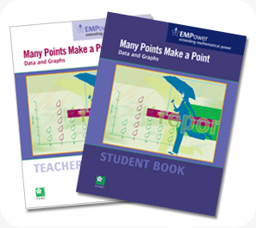
College and Career Readiness Standards (CCRS) continued…
CCRS Math 201: Resource Alignment Workshop
February 22nd 12 – 6pm
Prerequisite: CCRS Math 100s
$55 materials fee
Completion task: Lesson renovation
CONNECTICUT STATE DEPARTMENT OF EDUCATION
Notes:
Location: CREC Hartford area. Snow date February 27th.
Prerequisite: Certificate from CCRS Math 100 level courses (so assignments must be done)
Materials fee: Per teacher if sending more than one. Payment will be processed with registration through Protraxx. They can use a credit card, PO number, or be invoiced. Materials fee covers teacher choice of: Many Points Make a Point: Data and Graphs; Seeking Patterns, Building Rules: Algebraic Thinking; Using Benchmarks Plus: Fractions and Operations
Completion task: turned in after the workshop

Slide 13
Update
AVHS Flex Catalog continues to expand as Chemistry and Physics join Biology as Flexible Enrollment courses.
The new Math courses (Foundations of Real World Math & College Algebra) are now offered in a Flex format.
Still working towards an Introduction to Manufacturing course for late Spring/Summer
Still plenty of GED Prep/Test seats available
2 presentations for CAACE – One will be a GED Prep overview and the other a round-table for OLCs and mentors – similar to last year.
The Counselor/OLC orientation course is (still) available.
Reminder! The next AVHS Directors meeting will be Feb 9th

Slide 14
CARS Updates
CARS data entry deadline for the first semester is Friday, January 24, 2017
semester data include the completion of attendance, achievements, credits earned and assessments
all data are to be error free
contact the CARS helpdesk at ewhelpdesk@ca.com if you have questions or issues
data entry timelines are found in the CARS Policies and Guidelines manual that may be accessed through CARS home page or at
http://www.sde.ct.gov/sde/cwp/view.asp?a=2620&Q=320698&sdePNavCtr=|45471|#45549
Providers are reminded that the ethnicity and race section of page one of the Student Information Form must be completed
remember, this data is critical for federal reporting requirements

Slide 15
CARS Updates continued
CARS data administrators are reminded to:
review the user list and the access levels users have within CARS;
check “not active” for any users who are no longer with the program; and
enter CDP transfer credits individually and NOT by one summarized/combined entry.
Please validate the unique ten-digit Educator Identification Number (EIN) on the staff screen and ensure the years of teaching experience in adult education for your staff is current and correct.
Please count only the years of teaching experience in adult education and select one of three choices from the drop-down list:
Less than 1 year
1-3 years
More than 3 years

Slide 16
CARS Updates continued
Merge requests are done weekly by Angela
Please refer to pages 32 and 33 of the CARS Policies and Guidelines manual for instructions pertaining to a merge request and to obtain the business rules that apply to any merge request
FY 2016 State and Local Program Profiles for all state and federal adult education providers will be available on the CSDE Web site by February 2017
All CARS reports have been moved to the new SQL Server reporting format
FY 2016 Provider Performance Summary (PPS)

Slide 17
Adult Education Disability Documentation Form
Adult Education Disability Documentation Form (DRAFT)
Student Name:
Student’s Disability:
Functional Limitations Resulting from Disability in Adult Education Environment:
Suggested Accommodations to be utilized in the Adult Education Environment:
Typed name, Credential and Specialty of Practitioner:
Signature and Date
Accommodations Granted [please list]:
Signature of Disability Contact Person
Date Accommodations granted:
Signature of Adult Education Director

Slide 18
NEDP Update
College and Career Competency Instrument and Manual CASAS has released the long-awaited instrument which replaces the Individualized Competency tool. Training was done via webinar by CASAS and also a face to face training was presented by Astrid Robitaille. Another one will be scheduled for the spring.
NEDPC Conference! February 1st to 3rd in Arlington, VA
For more information, contact Amy Shea at
amy.shea@aded.Naugatuck.k12.ct.us
NEDP Refresher Training will be held on Friday, February 5, 2016, at CREC/Coltsville. Please register using Protraxx http://www.crec.org/events/index.php

Slide 19
GED Update continued
National Student Clearinghouse
40,000 GED® graduates submitted for National Student Clearinghouse match
Result: 35% of GED® graduates went on the post-secondary institutions within a year of passing the GED® test
75% in 2-year program
25% in 4 year program
93% continue to be enrolled
The mean scaled score of students going on to PSE is ~158-160

Slide 20
Currently working with four major employers and thousands of students
The GEDWorks™ program includes the tools a student needs to successfully prepare for and pass the GED® test. Students are provided access to a GED Advisor™, online and/or print GED® study materials, and connections to local adult education programs, practice tests, GED® test attempts, and more.

Slide 21
GEDWorks™ and Adult Ed continued
For the past year, Walmart employees were able to participate in GEDWorks™. Now, even more adults will be eligible through this program.
If you have a current student who is a benefits-eligible family member of a Walmart employee, they must:
register on GED.com (or update their existing account);
select Walmart as their employer; and
provide the store location and employee ID of their family member who works at Walmart.

Slide 22
GEDPrep Connect™
GEDPrep Connect™ helps GED® candidates find Adult Education Providers in their local area when they create their account on GED.com. Furthermore, lists of GED® candidates who express interest in a program will be shared with adult educators.
Adult Education Providers will have access to data about active students and students interested in your program and will be able to connect more easily with testers and manage their progression through the GED® program. GEDPrep Connect™ is able to identify additional information such as candidate testing results, GED Ready scores, if potential candidates would like to be contacted, etc.
Due to the confidentiality of this material, the CSDE is requesting all programs to identify a maximum of 2 contact people to receive access to GED Manager.

Slide 23
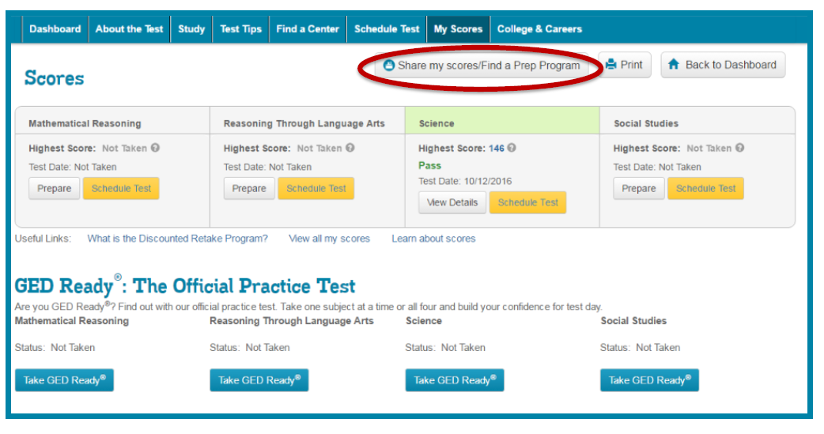

Slide 25
CCS Updates
The CSDE requires a signed Confidentiality Statement Form for anyone with access to CARS or GED Manager (e.g. Data Entry personnel, GED Registrars)
Signed statements are to be maintained by the provider and available for review by the CSDE
If you need a copy of the Confidentiality Statement Form of if you any questions or concern regarding the form or who should sign it, please contact Sabrina Mancini at sabrina.mancini@ct.gov

Slide 26
CCS Updates
CASAS e-test units cost $1.10 for 2016-2017
Although you may not currently use CASAS eTests, you are eligible to purchase computer test administrations at the discounted price per the current MOU between CASAS and the Connecticut State Department of Education. The agreement also covers license and support to access the TOPSpro Enterprise data management application (online or locally installed versions) through June 30, 2017.

Slide 27
CCS Update
Reading Appraisal:
All programs should be using CASAS Reading Appraisal Form 80.
Reading Appraisal Form 50 will be “retired” at the end of FY 2018. You may continue to use it this year and there is no need to retest those who may have already taken Reading Appraisal Form 50.
Math Apprasial:
All programs may begin using CASAS Math Appraisal Form 80 effective immediately or Math Appraisal Form 50.
Programs may continue to use Math Appraisal Form 50 this year and there is no need to retest those who may have already taken Math Appraisal Form 50.

Slide 28
Advantages of Using
Access anywhere with Internet connection
Streamline assessment and placement
Replace Appraisal with short computer-adaptive locator
Administer locator + pretest in one sitting
Automatically assigns next test
Reports available immediately after test administration
Eliminates time spent hand scoring, data-entry, creating class profiles

Slide 29
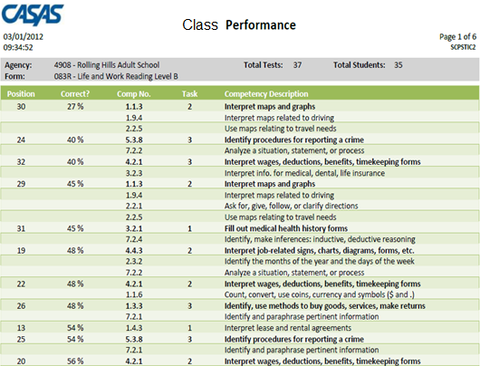
Sample report displays the competency number per test item and student item responses sorted by percentage correct.
per form
per class
Class
Bold Competency Descriptions give details about the Competency Number
Test Question Number
Percentage of students who answered this question correctly
Non-bold Competency Descriptions and Numbers give additional details about the test item.
The Competency Number on which this question is based
Task Area
Notes:
PRESENTER/TRAINER NOTES:
This slide shows a Class Performance report sorted by percentage correct.
This report is a popular alternative to the Class Profile report from the previous slide.
Teachers can readily identify areas of greatest need to develop lessons that address those needs and prepare students for post/progress-testing.
Sample report available on the CASAS website at: www.casas.org > Product Overviews > Software > TOPSpro Enterprise > Sample Reports
Ask if anyone has questions.

Slide 30
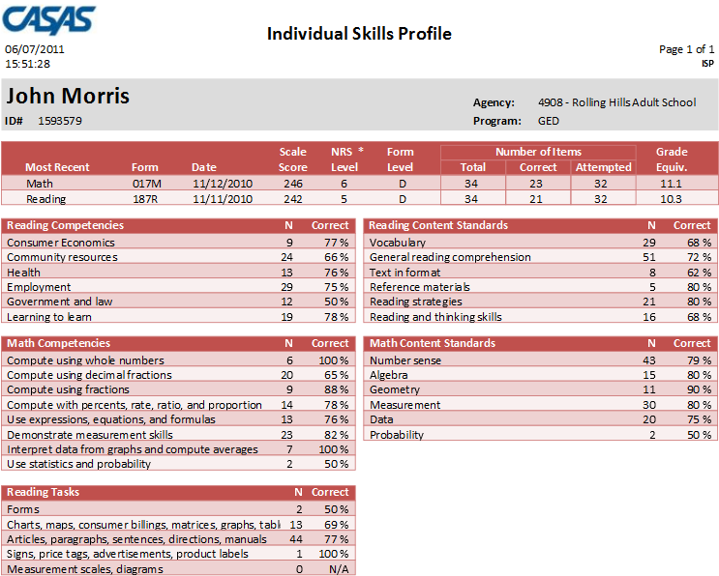
Sample report displays competencies assessed in math and reading.
per student
Notes:
PRESENTER/TRAINER NOTES:
This slide shows an example of an Individual Skills Profile report.
This sample displays competencies assessed in reading and math and includes a predictor for the likelihood of passing different GED subsections.
Sample report available on the CASAS website at: www.casas.org > Product Overviews > Software > TOPSpro Enterprise > Sample Reports

Slide 31
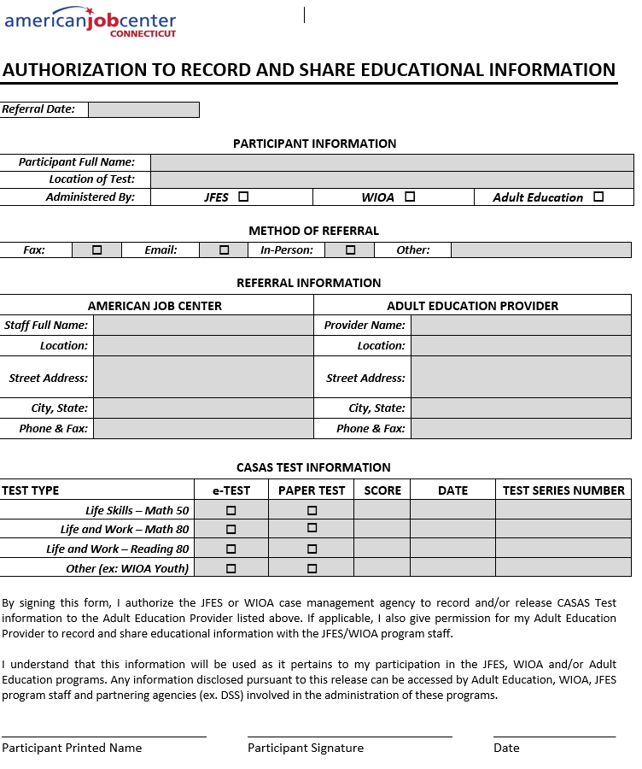

Slide 32
Adult Education State Grant Update FY 2016-17
FY 2017 State Grant Revision Application: ED-245 and ED-245A are available on the CSDE Web site.
ED-245 and ED-245A revision application forms must include the completed Excel Budget Templates. http://www.sde.ct.gov/sde/cwp/view.asp?a=2620&Q=320684&sdePNavCtr=|45472|#45554.
Due to the Bureau on or before March 15, 2017.
In addition to Excel Sheets, changes > $100 need explanation in the Budget Narrative section.
Due to space constraints in the new Hartford Office:
One original copy with superintendent signature
Electronic copy – e-mail to Marcy.Reed@ct.gov
MAKE SURE TO USE THE NEW ADDRESS: 450 Columbus Blvd. – see details on grant instructions

Slide 33
Adult Education State Grant Update FY 2017-18
The FY 2018 State Grant Application, forms ED-244 and ED-244A for adult education providers and CEE agency heads will be available on the CSDE Web site in February and may be accessed at:
http://www.sde.ct.gov/sde/cwp/view.asp?a=2620&Q=320684&sdePNavCtr=|45472|#45554
Due to the Bureau on or before Monday, April 17, 2017.
ED-244 and ED-244A application forms must also include the completed Excel Budget Templates.
Due to space constraints in the new Hartford Office:
One original copy with superintendent signature
Electronic copy – e-mail to Marcy.Reed@ct.gov
MAKE SURE TO USE THE NEW ADDRESS: 450 Columbus Blvd. – see details on grant instructions

Slide 34
Career Pathways Update
There were 3 Career Pathways Forums scheduled this year:
November 18 – Department of Labor and Bureau of Rehabilitative Services
January 6 – Workforce Boards
One remaining Forum:
Friday, February 24, CSDE, SERC Classroom, Middletown Office
Will feature examples of Career Pathways from Adult Education Programs
Will provide access to the materials we have been archiving

Slide 35
Technology
How Technology Literate are your teachers?
According to ISTE Standards teachers should:
1. Facilitate and inspire student learning and creativity
2. Design and develop digital age learning experiences and assessments
3. Model digital age work and learning
4. Promote and model digital citizenship and responsibility
5. Engage in professional growth and leadership

Slide 36
Technology
How would you talk to your classes about:
Effective Searching?
Authenticating Websites?
Authenticating Information?
How would you advise a student to authenticate information if it was on his/her Facebook page?

Slide 37
Federal Grant Update
The FY 2017 PIP Mid-Year Report and budget revisions are due to the Department on Friday, February 17, 2017 no later than 3:00 pm. Documents may be accessed from the CSDE Web site http://www.sde.ct.gov/sde/cwp/view.asp?a=2620&Q=320696&sdePNavCtr=|45472|#45552
NEW! One complete packet of original materials with original signatures delivered/mailed to CSDE and complete packet emailed to susan.pierson@ct.gov
New Address: CSDE, Bureau of Health/Nutrition, Family Services and Adult Education, 540 Columbus Blvd, Suite 504, Hartford, CT 06103
Do NOT send anything to 25 Industrial Park Rd, Middletown.
Only send materials to the Hartford building after January 23rd

Slide 38
New RFP Update
Adult Education new Request for Proposal will be issued in February with return date of mid-April
Priority Areas are similar with new requirements within the areas
Notifications will be sent via email, newspapers and core partners’ web sites
Bidders Conference will be held in late February.

Slide 39
Thank you for coming
Next Policy Forum:
Friday, June 9, 2017

