Slide 1
Health Impact of IPV, Human Trafficking and Sexual Assault
Notes:
Notes to Trainer: Share with the audience that you will now review the known health consequences of Intimate Partner Violence and Human Trafficking.

Slide 2
Trainer
Marlene Moranino, RN BSN
Senior Director of Clinical Programs
Community Health Center Association of CT
Notes:
Notes to Trainer: Trainers briefly introduce themselves and summarize the agenda, giving participants a quick sense of the flow and what to expect. Thank health center key staff or local DV advocacy key staff for hosting and arranging the room/food/etc. and helping to coordinate training details or logistics. Recognize any key leaders who were instrumental in making the training happen. Announce where attendees can find the restrooms, and any information about lunch, water/beverages, or other meals being provided.
Add in the names/titles/org for primary trainers.
Consider adding in organizational logos (of trainers) to the bottom of this slide

Slide 3
Why do we address IPV/HT/SA in Health Care?
An essential part of safety planning and wellness:
Understanding that IPV/HT /SA have serious health impacts
Advocates and clinicians are in a unique position to intervene
Improves client access to support services and medical care
Notes:
Notes to Trainer:
As you already know – IPV has serious health impacts. Advocates are in a unique position to intervene and reduce health consequences related to experiencing violence.
Many survivors have not received health care in a long time or are primarily concerned about their children’s health. Taking care of health needs is an important part of healing.
Builds relationships and rapport – Advocates are focusing on the whole person, not just crises and experiences of violence.
Builds communities and allies. Advocates have the opportunity to partner with community health centers and other health programs (public health departments, hospitals, clinics, home visitation programs, etc.) to provide additional education and resources.
Supports advocate and addresses burnout. When health needs are being addressed, survivors can be more present and engaged in advocacy services.
Criminal justice system is not always a primary resource for clients. Health referrals may be more impactful.

Slide 4
Health Impacts of IPV
Notes:
Notes to Trainer: Share with the audience that you will now review the known health consequences of Intimate Partner Violence and Human Trafficking.

Slide 5
Primary Care
Notes:
Note to Trainer: Ask one person from this group to report back and remind them not to cover mental health, or reproductive/sexual/perinatal health as those will be covered by other groups. Use the next slides to address any points missed in the report back (try not to repeat the spoken points). We are aiming for the audience to get a sense of how IPV is connected to almost any aspect of poor health.

Slide 6
More Than Broken Bones and Black Eyes
Examples of health conditions associated with IPV include:
Asthma
Bladder and kidney infections
Circulatory conditions
Cardiovascular disease
Fibromyalgia
IBS
Chronic pain syndromes
Central nervous system disorders
Gastrointestinal disorders
Joint disease
Migraines and headaches
(Black/CDC, 2011)
Notes:
Notes to Trainer: There are many long-lasting health consequences for IPV in addition to the immediate bruises and physical injuries. These health consequences can persist even after an abusive relationship has ended.
For more information on Intimate Partner Violence: Consequences:, visit the Centers for Disease Control and Prevention website: http://www.cdc.gov/violenceprevention/intimatepartnerviolence/consequences.html\
Black MC. 2011. Intimate partner violence and adverse health consequences: implications for clinicians. Am J Lifestyle Med 5(5):428-439.Breiding MJ, Black MC, Ryan GW. Chronic disease and health risk behaviors associated with intimate partner violence—18 U.S. states/territories, 2005. Ann Epidemiol . 2008; 18:538–544.
Crofford LJ. Violence, stress, and somatic syndromes. Trauma Violence Abuse. 2007; 8:299–313.
Also see: www.IPVHealthPartners.org

Slide 7
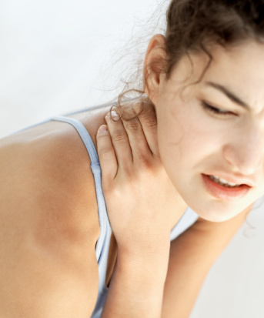
Traumatic Brain Injury and Strangulation
Studies show a range of 40%-91% of women experiencing IPV have incurred a traumatic brain injury (TBI) due to a physical assault (Campbell, 2018)
More than
two-thirds
of IPV victims are strangled at least once
{ the average is 5.3 times per victim }
(Chrisler & Ferguson, 2006 Abbott, 1995; Coker, 2002; Frye, 2001; Goldberg, 1984; Golding, 1999; McLeer, 1989; Stark, 1979; Stark, 1995)
Notes:
Notes to Trainer: Read the slide aloud. Share with the audience that the most common and persistent symptoms of TBI are headaches, fatigue, loss of memory, depression, and communication difficulty. TBI is often missed and it’s recommended that assessment for TBI be done with the HELPS brain injury screening tool which also addresses strangulation (see below for tool link). Strangulation is one of the most common forms of traumatic brain injury (TBI) that survivors experience. Other common forms of TBI that survivors experience are blunt force blows to the head that can cause concussions, such as being slammed against a wall, or being shaken so hard that the brain hits the wall of the skull. Non-fatal strangulation is an important risk factor for homicide of women, underscoring the need to screen for non-fatal strangulation when assessing abused women in emergency department settings. (Glass, 2008)
Background Information:
Nancy Glass, PhD, MPH, RN, Kathryn Laughon, PhD, RN, Jacquelyn Campbell, PhD, RN, Carolyn Rebecca Block, PhD, Ginger Hanson, MS, Phyllis W. Sharps, PhD, RN, and Ellen Taliaferro, MD, FACEP, J Emerg Med. 2008 Oct; 35(3): 329–335. Published online 2007 Oct 25. Non-fatal strangulation is an important risk factor for homicide of women
Jacquelyn C. Campbell, PhD, RN, FAAN,1 Jocelyn C. Anderson, PhD, RN,1,2 Akosoa McFadgion, PhD, MSW, Jessica Gill, PhD, RN,4 Elizabeth Zink, MS, RN,Michelle Patch, MSN, APRN-CNS, ACNS-BC,Gloria Callwood, PhD, RN, FAAN,5 and Doris Campbell, PhD, ARNP, FAAN, The Effects of IPV and Probable Traumatic Injury on Central Nervous Symptoms. Journal of Women’s Health (In press—due out 2018) https://www.liebertpub.com/doi/abs/10.1089/jwh.2016.6311?src=recsys&
Picard M, Scarisbrick D, Paluck R. HELPS brain injury screening tool. New York: International Center for the Disabled, TBI-NET, US Department of Education, Rehabilitation Services Administration, 1991. To download this tool: http://www.rcpaconference.org/wp-content/uploads/2015/09/W56_Nagele_HELPSScreeningTool.pdf
It is crucial that providers are aware of the physical and mental effects that strangulation and other TBIs can have on survivors.
Decreased concentration, reduced attention span difficulties with executive functioning (goal setting, self monitoring, initiating, modifying, and/or bringing to completion, making plans, setting goals, and organizing tasks), including adhering to health plans
Short-term and/or long-term memory loss
Difficulty in learning new information, including health information
Increased aggression and/or anxiety and quickly agitated or saddened, increased irritability or impatience
Changes in emotional expression (flat, non-emotional, inappropriate or overreactions)
Difficulty sleeping
Strangulation is :
A common form of physical violence, one that is particularly controlling, in abusive relationships, that is often repeated.
Normalized because it is so common and because there are not always immediate physical repercussions. (In a National Family Justice Center study in which 300 victims reported a strangulation assault, only three victims sought any medical help at the time of the assault.)
Not always painful, leave marks, make voice raspy, or break blood vessels in eyes, so it may not be thought of as very serious, but is still cutting off oxygen to the brain.
Folks can die from strangulation hours or days after the assault.
Sources:
Chrisler JC, Ferguson S. Violence Against Women as a Public Health Issue. Annals of New York Academy of Sciences. 2006;1087:235-249.
Abbott J, Johnson R, Koxiol-McLain J, Lowenstein SR. Domestic Violence Against Women: Incidence and Prevalence in an Emergency Department Population. JAMA. 1995;273(22):1763-1767.
Coker AL, Davis KE, Arias I, Desai S, Sanderson M, Brandt HM, et al. Physical and mental health effects of intimate partner violence for men and women. Am J Prev Med. 2002;23(4):260–268.
Frye V. Examining Homicide’s Contribution to Pregnancy-Associated Deaths. JAMA. 2001;285(11):1510-1511.
Goldberg WG, Tomlanovich MC. Domestic Violence Victims in the Emergency Department. JAMA. 1984;251:3259-3264.
Golding JM. Intimate Partner Violence as a Risk Factor for Mental Disorders: A Meta-Analysis. Journal of Family Violence. 1999;14(2):99-132.
McLeer SV, Anwar RA, Herman S, Maquiling K. Education is not Enough: A Systems Failure in Protecting Battered Women. Annals of Emergency Medicine. 1989;18:651-653.
Stark E, Flitcraft A, Frazier RJ. Medicine and Patriarchal Violence: The Social Construction of a “Private” Event. International Journal of Health Services. 1979;9(3):461-493.
Stark E, Flitcraft A. Killing the Beast Within: Woman Battering and Female Suicidality. International Journal of Health Services. 1995;25(1):43-64.

Slide 8
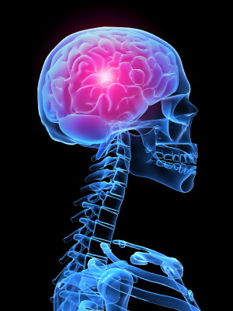
Understanding Strangulation and Traumatic Brain Injuries
Common form of physical violence that is often repeated
Not always immediate physical repercussions
Even if it is not painful, can leave marks, make voice raspy, or break blood vessels in eyes, it is still cutting off oxygen to the brain.
Victims can die from TBI hours or days after the assault
Pointer - Google “HELPS screening tool for traumatic brain injury”
(Training Institute on Strangulation Prevention, 2017)
Notes:
Notes to Trainer: IPV victims are at risk of another type of brain injury and that is anoxic injury due to strangulation which also occurs at a surprisingly high frequency among IPV victims.
Why should DV advocates talk about strangulation and other TBIs:
It is an extremely common form of physical violence – one that is particularly controlling – in abusive relationships, that is often repeated.
It is normalized because it is so common and because there are not always immediate physical repercussions. (In a National Family Justice Center study in which 300 victims reported a strangulation assault, only three victims sought any medical help at the time of the assault.)
Not always painful, leave marks, make voice raspy, or break blood vessels in eyes, so it may not be thought of as very serious, but is still cutting off oxygen to the brain.
Strangulation is a indicator for DV homicide or serious re-assault.
Takes only 4 pounds of pressure for 10 seconds to make someone unconscious and leave potentially permanent brain damage.
Background Info:
Training Institute on Strangulation Prevention. (2017). Health Issues Result from Strangulation - Training Institute on Strangulation Prevention. [online] Available at: http://www.strangulationtraininginstitute.com/health-issues-result-from-strangulation
The “HELPS” Screening Tool for Traumatic Brain Injury: http://www.doj.state.or.us/wp-content/uploads/2017/08/traumatic_brain_injury_and_domestic_violence.pdf
Traumatic Brain Injury As a Result of Domestic Violence: Information, Screening and Model Practices Participant’s Guide by the National Coalition Against Domestic Violence (2011) http://www.ncdsv.org/images/PCADV_TBIasaResultOfDVParticipant'sGuide_2011.pdf

Slide 9
Behavioral Health
Including mental health and substance abuse
Notes:
Note to Trainer: Ask one person from this group to report back. Use the next slides to address any points missed in the report back (try not to repeat the spoken points).

Slide 10
IPV and Behavioral Health Co-Morbidities
Anxiety and/or depression
Post-traumatic stress disorder (PTSD)
Antisocial behavior
Suicidal behavior
Low self-esteem
Emotional detachment
Sleep disturbances
Substance dependency
(Tjaden P, 2000; Coker AL, 2002)
Research suggests that women may also be more likely than men to use prescription opioids to self-medicate for other problems including anxiety or stress. (McHugh 2013)
Notes:
Notes to Trainer: Share with the audience “As with physical health, experiencing IPV can have a significant negative impact on mental health and substance use coercion. Some of the patients that we consider the most “difficult” or non-compliant may also be experiencing violence.”
If you’d like to add an example here, share:
Smoking: In one study conducted with 2,043 women aged 18 to 59, across Massachusetts, approximately one-half of women who reported IPV in the past year were current smokers. By comparison, only 23.5% of women who did not disclose abuse were current smokers.
Hathaway JE, Mucci LA, Silverman JG, Brooks DR, Mathews R, Pavlos CA. Health Status and Health Care Use of Massachusetts Women Reporting Partner Abuse. American Journal of Preventive Medicine. 2000; 19 (4): 302-307.
Sources:
Tjaden P, Thoennes N. Extent, nature, and consequences of intimate partner violence: findings from the National Violence Against Women Survey. Washington (DC): Department of Justice (US); 2000. Publication No. NCJ 181867.
Coker AL, Davis KE, Arias I, Desai S, Sanderson M, Brandt HM, et al. Physical and mental health effects of intimate partner violence for men and women. Am J Prev Med. 2002;23(4):260–268.
McHugh RK, DeVito EE, Dodd D, et al. Gender differences in a clinical trial for prescription opioid dependence. J Subst Abuse Treat. 2013;45(1):38-43. doi: 10.1016/j.jsat.2012.12.007
For more information, see
Final Report: Opioid Use, Misuse, and Overdose in Women July 19, 2017 https://www.womenshealth.gov/files/documents/final-report-opioid-508.pdf
Opioids, Domestic Violence, and Mental Health by Nisa Hussain, Dr. Carole Warshaw, Posted on June 7, 2017.
http://www.nationalcenterdvtraumamh.org/2017/06/opioids-domestic-violence-and-mental-health/
Substance Use/Abuse in the Context of Domestic Violence, Sexual Assault, and Trauma, Patricia J. Bland, M.A. CDP & Debi Edmund, LPC CADC (Dec 2014). http://nationalcenterdvtraumamh.org/wp-content/uploads/2015/10/NCDVTMH_PatriciaBland_DebiEdmund_SubstanceUseDVSATraumaCurriculum.pdf

Slide 11
Mental Health and Substance Use Coercion
Abusers rely on stigma related to mental health and substance abuse to undermine and control their partners.
(Warshaw, 2014)
Notes:
Notes to Trainer: Share that asking directly if a patient’s partner is forcing them to use drugs or preventing them from seeking help or treatment can be an important intervention. Abusers use mental health status to control their partners or manipulate their use of substances to further control them.
Learn more about responding to mental health and substance use coercion:
http://www.nationalcenterdvtraumamh.org/wp-content/uploads/2012/01/Tipsheet_Asking-Responding-to-Abuse-and-MH_Sept2012_FINAL.pdf
Substance Use/Abuse in the Context of Domestic Violence, Sexual Assault, and Trauma, Patricia J. Bland, M.A. CDP & Debi Edmund, LPC CADC (Dec 2014). http://nationalcenterdvtraumamh.org/wp-content/uploads/2015/10/NCDVTMH_PatriciaBland_DebiEdmund_SubstanceUseDVSATraumaCurriculum.pdf
Carole Warshaw, MD; Eleanor Lyon, PhD; Patricia J. Bland MA, CDP; Heather Phillips, MA; Mikisha Hooper, BA Mental Health and Substance Use Coercion Surveys, A Report from the National Center on Domestic Violence, Trauma & Mental Health and the National Domestic Violence Hotline, March (2014). http://www.nationalcenterdvtraumamh.org/wp-content/uploads/2014/10/NCDVTMH_NDVH_MHSUCoercionSurveyReport_2014-2.pdf

Slide 12
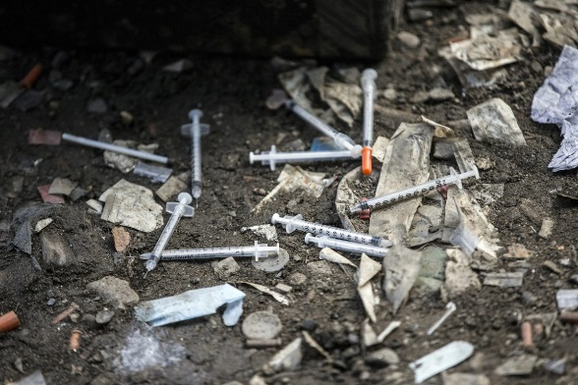
Women, Opioids and Violence
Opioid use disorders are associated with IPV victimization particularly among women
Women also may be particularly susceptible to such violence when under the influence of opioids.
(Smith, 2012)
Notes:
Notes to Trainer: Read the slide aloud. Also share this: “A survey of 5,989 adult women who called a DV hotline showed mental health and substance use coercion were common among hotline callers. Particularly salient for MCH providers is that over 50% of those who sought help for their mental health and over 60% of those who sought help for substance use said their partners tried to interfere with their treatment”. (Warshaw, 2014) These points underscore how important it is for providers to ask their patients if anyone is interfering with their treatment for mental health or substance use.
Smith PH, Homish GG, Leonard KE, Cornelius JR. Intimate partner violence and specific substance use disorders: Findings from the National Epidemiologic Survey on Alcohol and Related Conditions. Psychol Addict Behav. 2012 Jun; 26(2). Retrieved from: https://www.ncbi.nlm.nih.gov/pmc/articles/PMC3883081/
Carole Warshaw, MD; Eleanor Lyon, PhD; Patricia J. Bland MA, CDP; Heather Phillips, MA; Mikisha Hooper, BA
Mental Health and Substance Use Coercion Surveys, A Report from the National Center on Domestic Violence, Trauma & Mental Health and the National Domestic Violence Hotline, March (2014). http://www.nationalcenterdvtraumamh.org/wp-content/uploads/2014/10/NCDVTMH_NDVH_MHSUCoercionSurveyReport_2014-2.pdf
For more information, see Final Report: Opioid Use, Misuse, and Overdose in Women July 19, 2017 https://www.womenshealth.gov/files/documents/final-report-opioid-508.pdf

Slide 13
Adolescent Health
Notes:
Note to Trainer: only highlight missing data rather than repeating what was already said.

Slide 14
Adolescent Relationship Abuse (ARA)
Young women who have experienced abuse have higher rates of:
Depression and anxiety
Disordered eating
Suicidality
Substance abuse
And are more likely to initiate sex before age 15.
(Kim-Godwin, 2009; Howard, 2008; Brossarte, 2008; Ackard & Neumark-Sztainer, 2002)
(Silverman, 2001)
Notes:
Notes to Trainer: Share with the audience: “The presence of mental health issues such as depression, thoughts of suicide, substance abuse and disordered eating may be something that survivors of ARA are experiencing”.
Additional Info:
Teens experiencing teen dating violence are more likely to suffer long-term negative behavioral and health consequences, including suicide attempts, depression, cigarette smoking and marijuana use.
Teen victims of physical dating violence are more likely than their non-abused peers to engage in unhealthy diet behaviors (taking diet pills or laxatives or vomiting to lose weight).
Definition of Adolescent Relationship Abuse (ARA): a pattern of repeated acts in which a person physically, sexually, or emotionally abuses another person of the same or opposite sex in the context of a dating or similarly defined relationship, in which one or both partners is a minor. While ARA is included in the definition of intimate partner violence, experts in the field have noted that while many aspects of ARA are similar to IPV, there are also distinct characteristics relative to the age of the victim and/or perpetrator and different patterns of abusive behaviors.
• Similar to adult intimate partner violence, the emphasis on repeated controlling and abusive behaviors distinguishes relationship abuse from isolated events (e.g. a single occurrence of sexual assault at a party with two people who did not know each other).
• Sexual and physical assaults often occur in the context of relationship abuse, but the defining characteristic is a repetitive pattern of behaviors aiming to maintain power and control in a relationship. Such behaviors can include monitoring cell phone usage, telling a partner what she/he can wear, controlling whether the partner goes to school that day, and interfering with contraceptive use.
Kim-Godwin YS, Clements C, McCuiston AM, Fox JA. (2009). Dating violence among high school students in southeastern North Carolina. Journal of School Nursing, 25(2):141-151.
Howard DE, Wang MQ, Yan F. (2008). Psychosocial factors associated with reports of physical dating violence victimization among U.S. adolescent males. Adolescence, 43(171):449-460.
Brossard RM, Simon TR, Swahn MH. (2008). Clustering of Adolescent Dating Violence, Peer Violence, and Suicidal Behavior. Journal of Interpersonal Violence, 23(6):815 -833.
Ackard DM & Neumark-Sztainer D. (2002). Date Violence and Date Rape among Adolescents: Associations with Disordered Eating Behaviors and Psychological Health. Child Abuse & Neglect, 26(5):455-473.
Silverman JG, Raj A, Mucci LA, Hathaway JE. (2001). Dating Violence Against Adolescent Girls and Associated Substance Use, Unhealthy Weight Control, Sexual Risk Behavior, Pregnancy, and Sucidality. Journal of the American Medical Association,286(5): 572-579.

Slide 15
Technology as a Tool For Exerting Power and Control
One in four teens in a relationship report having been called names, harassed, or put down by their partner via cell phone/texting.
(Zweig, 2013)
Notes:
Notes to Trainer: Share with the audience: “Electronic relationship abuse is a prevalent form of controlling behavior among youth in romantic relationships. That’s why it’s important to go broad with your conversations and educational materials with adolescents.”
Zweig, J M, Dank, M, Yahner, J, et al. (2013). The Rate of Cyber Dating Abuse Among Teens and How It Relates to Other Forms of Teen Dating Violence. Journal of Youth and Adolescence, 42(7): 1063-1077.

Slide 16
Cyber Relationship Abuse Rarely Happens in Isolation
Technology-based harassment is a red flag for other abuse
84% of the teens who report cyber abuse said they were also psychologically abused by their partners
52% say they were also physically abused
33% say they were also sexually coerced
(Zweig, 2013)
Notes:
Notes to Trainer: Read the slide aloud. As a segue from the previous slide, share with the audience that the recommendation is for providers to consider having conversations with their patients about cyber harassment which may be indicative of abuse.
Source:
Zweig, J M, Dank, M, Yahner, J, et al. (2013). The Rate of Cyber Dating Abuse Among Teens and How It Relates to Other Forms of Teen Dating Violence. Journal of Youth and Adolescence, 42(7): 1063-1077.

Slide 17
Perinatal, Reproductive
and Sexual Health
Notes:
Notes to Trainer: only highlight missing data rather than repeating what was already said.

Slide 18
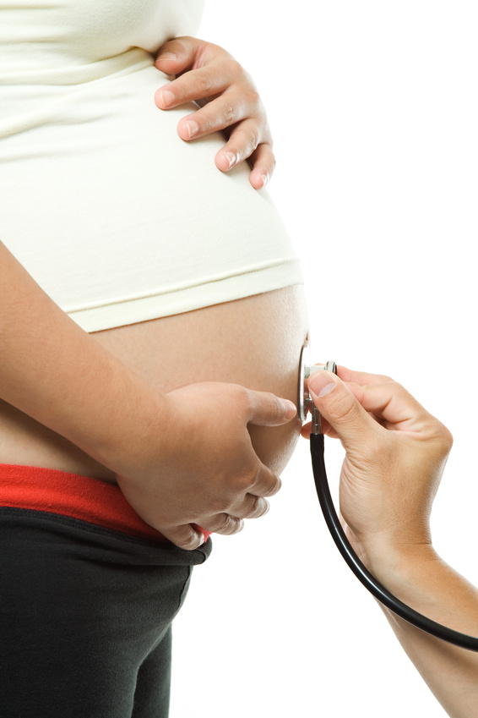
Perinatal Health
Women who disclosed abuse were at an increased risk for rapid repeat and unintended pregnancy
Late entry into prenatal care
Increased incidence of low birth weight babies, preterm birth, and miscarriages
(Sarkar, 2008; Raneri 2007; Alhusen 2015; Lipksy 2009, Morales 2006, Silverman 2006)
Notes:
Notes to Trainer: Highlight the points not already covered in the group discussion.
Sources:
For bullet 1:
The odds of repeat pregnancy was 1.9 times higher among teen mothers who were physically abused by their partner within three months of delivery compared to non-abused teen mothers: Sarkar NN. (2008). The Impact of Intimate Partner Violence on Women’s Reproductive Health and Pregnancy Outcome. Journal of Obstetrics and Gynaecology, 28(3):266-271.
Raneri LG, Wiemann CM. Social Ecological Predictors of Repeat Adolescent Pregnancy. Perspectives on Sexual and Reproductive Health. 2007;39(1):39-47.
For bullet 2:
Jeanne L. Alhusen, PhD, CRNP, RN, Ellen Ray, DNP, CNM, Phyllis Sharps, PhD, RN, FAAN, and Linda Bullock, PhD, RN, FAAN, Intimate Partner Violence During Pregnancy: Maternal and Neonatal Outcomes, J Womens Health (Larchmt). 2015 Jan 1; 24(1): 100–106.
For bullet 3:
Lipsky S, Holt VL, Esterling TR, Critchlow C. Police-Reported Intimate Partner Violence During Pregnancy and Risk of Antenatal Hospitalization. Maternal and Child Health Journal. 2009;8(2):55-63.
Morales CL, Amorim AR, Reichenheim ME. Gestational Weight Gain Differentials in the Presence of Intimate Partner Violence. International Journal of Gynaecology and Obstetrics. 2006;95:254-260.
Silverman JG, Decker MR, Reed E, Raj A. Intimate Partner Violence Victimization Prior to and During Pregnancy Among Women Residing in 26 U.S. States: Associations with Maternal and Neonatal Health. American Journal of Obstetrics and Gynecology. 2006;195:140-148.
In a study by Goodwin et al (2000), women who had unintended pregnancies were 2.5 times more likely to experience physical abuse compared to women whose pregnancies were intended.
Hathaway et al. (2000) analyzed data from a population-based survey (Behavioral Risk Factor Surveillance System) in Massachusetts to examine the association between IPV and unintended pregnancy. Among women experiencing IPV who had been pregnant in the past 5 years, approximately 40% reported that the pregnancy was unwanted, as compared to 8% of other women.
(Late entry into prenatal care stat): Jeanne L. Alhusen, PhD, CRNP, RN, Ellen Ray, DNP, CNM, Phyllis Sharps, PhD, RN, FAAN, and Linda Bullock, PhD, RN, FAAN, Intimate Partner Violence During Pregnancy: Maternal and Neonatal Outcomes, J Womens Health (Larchmt). 2015 Jan 1; 24(1): 100–106.
Sarkar conducted a literature review of publications from 2002 through 2008 on the impact of domestic violence on women’s reproductive health and pregnancy outcomes.
Sexually transmitted infections: Women and adolescents in abusive relationships are often forced or coerced into unwanted sexual activity. This impacts unintended pregnancies and STIs. Women with a history of IPV are more likely to experience pelvic inflammatory disease, invasive cervical cancer, and preinvasive cervical neoplasia. Coker AL, Sanderson M, Fadden MK, Pirisi L. Intimate Partner Violence and Cervical Neoplasia. Journal of Women‚s Health & Gender-Based Medicine. 2000;9(9):1015-1023.
Women with a controlling or threatening partner are 5 times more likely to experience persistent symptoms of postpartum maternal depression. (Blabey 2009).
Sources:
Miller E, Levenson R, Jordan B, Silverman JG. (2010). Reproductive coercion: connecting the dots between partner violence and unintended pregnancy. Contraception, 81(6):457-9.
Sarkar NN. (2008). The Impact of Intimate Partner Violence on Women’s Reproductive Health and Pregnancy Outcome. Journal of Obstetrics and Gynaecology, 28(3):266-271.
Goodwin MM, Gazmararian JA, Johnson CH, Gilbert BC, Saltzman LE. (2000). Pregnancy intendedness and physical abuse around the time of pregnancy: findings from the pregnancy risk assessment monitoring system, 1996-1997. PRAMS Working Group. Pregnancy Risk Assessment Monitoring System. Maternal and Child Health Journal, 4(2):85–92.
Hathaway J, Mucci L, Silverman J, Brooks D, Matthews R, and Pavlos C. (2000). Health status and health care use of Massachusetts women reporting partner abuse. American Journal of Preventive Medicine, 19:302-307.
Coker AL, Smith PH, Bethea L, King MR, McKeown RE. (2000). Physical health consequences of physical and psychological intimate partner violence. Archives of Family Medicine, 9:451-457.
Blabey MH, Locke ER, Goldsmith YW, Perham-Hester KA. Experience of a Controlling or Threatening Partner Among Mothers with Persistent Symptoms of Depression American Journal of Obstetrics & Gynecology. 2009;201:173.e1-9.

Slide 19
Tobacco Cessation and DV
42% of women experiencing some form of IPV could not stop smoking during pregnancy compared to 15% of non-abused women.
(Bullock, 2001)
Notes:
Notes to Trainer: Read aloud: “During a study conducted by FUTURES staff on the impact of IPV on behavioral health one researchers asked a woman who was a 3 pack-a-day smoker if she thought her experiences with domestic violence might be connected to her smoking? She said, ‘You don’t understand. Smoking was the only thing I could control. I didn’t get to use the phone or the car or see my family without permission. I didn’t go to the store or spend any money without permission—smoking was the ONLY thing I controlled.’ A story like this helps us to understand why a referral to smoking cessation program might not be effective for a woman experiencing abuse. This story lends itself to be empathetic for some of the clients we serve who have addiction issues.
Background Info: In this retrospective study by Bullock et al. (2001), rural postpartum women (n=293) were interviewed during their hospital stay about their tobacco use and experiences with DV. DV was measured with the Abuse Assessment Screen which includes questions on physical, sexual, and emotional abuse within the past year and since pregnancy. The rate of smoking among abused women during pregnancy is in agreement with other prospective studies that found between 44% and 60% of abused women continue to smoke during pregnancy.
Bullock LFC, Mears JLC, Woodcock C, Record R. Retrospective Study of the Association of Stress and Smoking During Pregnancy in Rural Women. Addictive Behaviors. 2001;26:405-413.

Slide 20
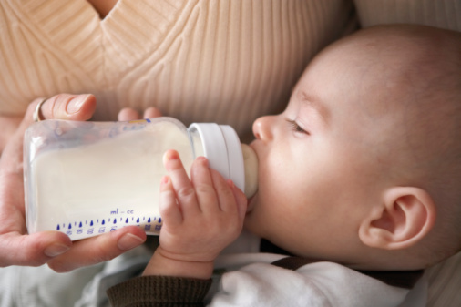
DV and Breastfeeding
Women experiencing physical abuse around the time of pregnancy are:
41%-71% more likely to cease breastfeeding by 4 weeks postpartum
(Silverman, 2006)
Notes:
Notes to Trainer: Read the slide aloud. Share that women who are experiencing DV may have difficulty breastfeeding because of their partner’s control over their body/breasts, or because of jealousy of a mother’s alone time spent with the baby. Additionally, it may be easier for women to move a baby out of harm’s way when they’re attached to a bottle, than when they are attached to a breast. Experiences with PTSD, previous trauma, and maternal depression are other factors which may affect a mom’s decision, or ability to breastfeed.
Silverman JG, Decker MR, Reed E, Raj A, Intimate partner violence around the time of pregnancy: association with breastfeeding behavior, J Womens Health (Larchmt), 2006 Oct;15(8):934-40.
Background Info:
The cells, hormones, and antibodies in breastmilk help protect babies from illness. This protection is unique and changes every day to meet a baby’s growing needs. Research shows that breastfed babies have lower risks of:
Asthma
Leukemia (during childhood)
Obesity (during childhood)
Ear infections
Eczema (atopic dermatitis)
Diarrhea and vomiting
Lower respiratory infections
Necrotizing (NEK-roh-TEYE-zing) enterocolitis (en-TUR-oh-coh-LYT-iss), a disease that affects the gastrointestinal tract in premature babies, or babies born before 37 weeks of pregnancy
Sudden infant death syndrome (SIDS)
Type 2 diabetes
From: https://www.womenshealth.gov/breastfeeding/making-decision-breastfeed
There are also maternal health benefits to breastfeeding such as:
decreased postpartum bleeding and more rapid uterine involution
decreased menstrual blood loss and increased child spacing (lactational amenorrhea)
earlier return to prepregnancy weight
decreased risk of breast and ovarian cancers
From: https://www.aap.org/en-us/advocacy-and-policy/aap-health-initiatives/Breastfeeding/Pages/Benefits-of-Breastfeeding.aspx
Information on maternal breastfeeding support programs: https://www.womenshealth.gov/breastfeeding/learning-breastfeed/finding-breastfeeding-support-and-information and http://www.nursingmothers.org/
“The Benefits of Breastfeeding,” The Atlantic. April 2, 2012 https://www.theatlantic.com/health/archive/2012/04/the-benefits-of-breastfeeding/255206/
American Academy of Pediatrics. (2012). Breastfeeding and the use of human milk. Pediatrics, 129(3), e827–e841. Retrieved April 27, 2012, from http://pediatrics.aappublications.org/content/129/3/e827.full.pdf+html
Feldman-Winter, L., & Goldsmith, J. P.; Committee on Fetus and Newborn, Task Force on Sudden Infant Death Syndrome. (2016). Safe sleep and skin-to-skin care in the neonatal period for healthy term newborns. Pediatrics, 138(3), e20161889. Retrieved December 20, 2016, from http://pediatrics.aappublications.org/content/early/2016/08/18/peds.2016-1889

Slide 21
HIV and STIs and Women’s Experiences with IPV
Women disclosing physical abuse were 3 times more likely to have an STI
(Machtinger, 2012; Black, 2011)
Over half of women living with HIV have experienced domestic or sexual violence —considerably higher than the national prevalence among women overall
(55% vs. 36%)
(Machtinger, 2012; Black, 2011)
Notes:
Notes to Trainer: Share with the audience that women who are living with HIV across the U.S. have reported very high rates of IPV. Women and men who report a history of IPV are more likely to report behaviors known to increase risk for HIV, including drug use, non treatment for an STI, giving or receiving money or drugs for sex, and anal sex without a condom.
Based on time, consider adding in some of the following points—
IPV Increases Risk for HIV Infection in the following ways:
Sexual coercion/forced sex with an infected partner
Limited or compromised negotiation of safer sex practices
Increased sexual risk-taking behaviors, including survival and transactional sex
Increased risk of mother-to-child HIV transmission among abused pregnant women
Increased risk of unsafe injecting practices and coerced drug use
(Maman, 2000)
Maman, S. et al. 2000. The intersections of HIV and violence: Directions for future research and interventions. Social Science & Medicine 50(4):459-478.
Black MC, et al., (2011). The National Intimate Partner and Sexual Violence Survey (NISVS): 2010 Summary Report. Atlanta, GA: National Center for Injury Prevention and Control, Centers for Disease Control and Prevention. Machtinger E, et al. (2012a). Psychological trauma and PTSD in HIV-positive women: A meta-analysis. AIDS and Behavior 16(8), 2091-2100
Black MC, Intimate partner violence and adverse health consequences: implications for clinicians, American Journal of Lifestyle Medicine, 2011, 5(5):428–439.
Coker AL, Does physical intimate partner violence affect sexual health? A systematic review, Trauma, Violence, & Abuse, 2007, 8(2):149–177.
Background Info:
https://www.futureswithoutviolence.org/hiv/

Slide 22
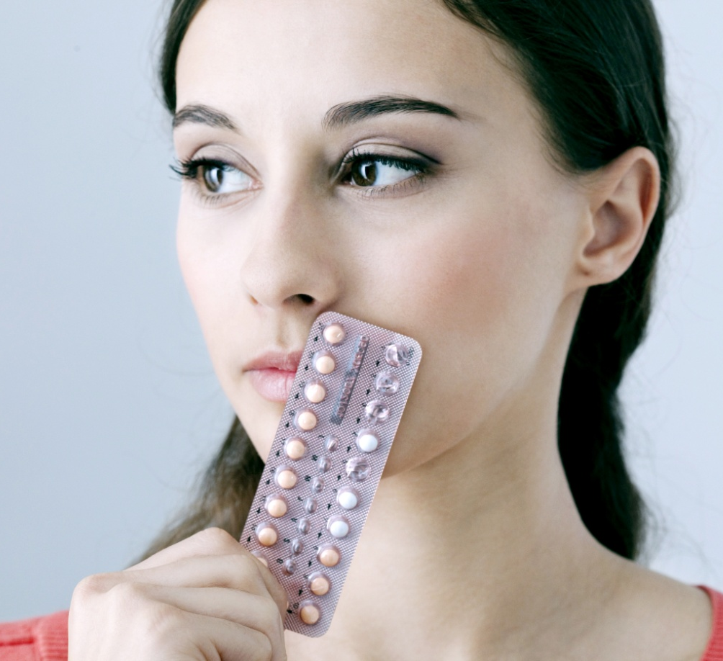
A partner can and will interfere with a female client’s birth control
Notes:
Notes to Trainer: Ask participants to give some examples they have seen in their health centers. Responses may include examples of condom refusal, pregnancy pressure, forced sex, etc. Based on what’s already shared, lift in some additional examples from the list below:
Reproductive and sexual coercion involves behaviors aimed to maintain power and control in a relationship related to reproductive health by someone who is, was, or wishes to be involved in an intimate or dating relationship with an adult or adolescent. Most forms of behavior used to maintain power and control in a relationship impacting reproductive health disproportionately affect females. There are, however, some forms of reproductive and sexual coercion that males experience which are included in the definitions below.
Reproductive Coercion: Reproductive coercion is related to behaviors that interfere with contraception use and/or pregnancy. Two types of reproductive coercion, birth control sabotage and pregnancy pressure and coercion, are described below.
Birth Control Sabotage: Birth control sabotage is active interference with a partner’s contraceptive methods. Examples of birth control sabotage include:
• Hiding, withholding, or destroying a partner’s birth control pills
• Breaking or poking holes in a condom on purpose or removing it during sex in an explicit
attempt to promote pregnancy
• Not withdrawing when that was the agreed upon method of contraception
• Pulling out vaginal rings
• Tearing off contraceptive patches
Pregnancy Pressure and Coercion: Pregnancy pressure involves behaviors that are intended to pressure a female partner to become pregnant when she does not wish to become pregnant. Pregnancy coercion involves coercive behaviors such as threats or acts of violence if she does not comply with her partner’s wishes regarding the decision of whether to terminate or continue a pregnancy. Examples of pregnancy pressure and coercion include:
• Threatening to leave a partner if she does not become pregnant
• Threatening to hurt a partner who does not agree to become pregnant
• Forcing a female partner to carry to term against her wishes through threats or acts of violence
• Forcing a female partner to terminate a pregnancy when she does not want to
• Injuring a female partner in a way that she may have a miscarriage
Sexual Coercion: All experiences of sexual violence, including rape, impact sexual and reproductive health. Over the past twenty years, the healthcare field has made tremendous strides in responding to sexual assault, through such innovative programs as Sexual Assault Response Teams (SARTS), and Sexual Assault Nurse Examiners (SANE). This guide further supports those programs, with interventions to address a specific aspect of sexual violence within the context of a relationship: sexual coercion. Sexual coercion includes a range of behaviors that a partner may use related to sexual decision-making to
pressure or coerce a person to have sex without using physical force. Examples of sexual coercion, which may occur in heterosexual or same sex relationships include:
• Repeatedly pressuring a partner to have sex when they do not want to
• Threatening to end a relationship if a person does not have sex
• Forced non-condom use or not allowing other prophylaxis use
• Intentionally exposing a partner to a STI or HIV
• Retaliation by a partner if notified of a positive STI result
From: Linda Chamberlain, PhD, MPH and Rebecca Levenson, MA (Futures Without Violence) Addressing Intimate Partner Violence Reproductive and Sexual Coercion: A Guide for Obstetric, Gynecologic, Reproductive Health Care Settings Third Edition (2013). https://www.futureswithoutviolence.org/userfiles/file/HealthCare/Reproductive%20Health%20Guidelines.pdf
Background Info:
Fanslow et al. (2008) conducted interviews with a random sample of 2,790 women who have had sexual intercourse. Women who had experienced domestic violence were more likely to have had partners who refused to use condoms or prevented women from using contraception compared to women who had not experienced domestic violence (5.4% vs. 1.3%).
Fanslow J, Whitehead A, Silva M, Robinson E. (2008). Contraceptive Use and Associations with Intimate Partner Among a Population-based Sample of New Zealand Women. Australian & New Zealand Journal of Obstetrics & Gynaecology, 48(1):83-89.
Miller E, Decker MR, Reed E, Raj A, Hathaway JE, Silverman JG. (2007). Male Partner Pregnancy-Promoting Behaviors and Adolescent Partner Violence: Findings From a Qualitative Study with Adolescent Females. Ambulatory Pediatrics, 7(5):360-366.
Lang DL, Salazar LF, Wingood GM, DiClemente RJ, Mikhail I. (2007). Associations Between Recent Gender-based Violence and Pregnancy, Sexually Transmitted Infections, Condom Use Practices, and Negotiation of Sexual Practices Among HIV-Positive Women. Journal of Acquired Immune Deficiency Syndromes, 46(2):216-221.

Slide 23
Key Consideration: Harm Reduction Strategy
If her partner monitors her menstrual cycles, an IUD may be the safest method to offer her.
Especially if we cut the strings in the cervical canal so they can’t be pulled out, or felt by a partner.
The inconvenience of IUD removal with ultrasound may well be worth avoiding an unwanted pregnancy by an abusive partner.
(Chamberlain, 2013)
Notes:
Notes to Trainer: Share these bullets with the audience:
A woman’s period or bleeding pattern isn’t altered with this method as it may be with other methods.
It’s important that this information be included in our patient education.
It is possible to cut the strings in the cervical canal so they can’t be pulled out or felt by a partner (stories from the field).
The Copper T IUD prevents pregnancy by blocking sperm from reaching an egg. It can also be inserted as emergency contraception to prevent pregnancy up to 5 days after unprotected sex.
http://www.arhp.org/Publications-and-Resources/Patient-Resources/Fact-Sheets/Copper-T-IUD
Background Info:
Linda Chamberlain, PhD, MPH and Rebecca Levenson, MA (Futures Without Violence) Addressing Intimate Partner Violence Reproductive and Sexual Coercion: A Guide for Obstetric, Gynecologic, Reproductive Health Care Settings Third Edition (2013). https://www.futureswithoutviolence.org/userfiles/file/HealthCare/Reproductive%20Health%20Guidelines.pdf
Adolescents and Long-Acting Reversible Contraception: Implants and Intrauterine Devices ABSTRACT: Long-acting reversible contraception (LARC)—intrauterine devices and the contraceptive implant—are safe and appropriate contraceptive methods for most women and adolescents. The LARC methods are top-tier contraceptives based on effectiveness, with pregnancy rates of less than 1% per year for perfect use and typical use. These contraceptives have the highest rates of satisfaction and continuation of all reversible contraceptives. Adolescents are at high risk of unintended pregnancy and may benefit from increased access to LARC methods.
Long-acting reversible contraception: implants and intrauterine devices. Practice Bulletin No. 186. American College of Obstetricians and Gynecologists. Obstet Gynecol 2017;130:e251–69. https://www.acog.org/Clinical-Guidance-and-Publications/Practice-Bulletins/Committee-on-Practice-Bulletins-Gynecology/Long-Acting-Reversible-Contraception-Implants-and-Intrauterine-Devices

Slide 24
Human Trafficking Health Impact
Notes:
Notes to Speaker: Share that we will next discuss the health impact of human trafficking.

Slide 25
Health Impact: Human Trafficking Issues
Injuries from physical or sexual violence/ health exposures
unhealthy weight loss due to food deprivation and poor nutrition
HIV/AIDS
cervical cancer
forced abortion
infectious disease
dental or oral problems
respiratory illness
(Baldwin 2011; Mazeda 2010; Zimmerman 2011; WHO, 2012)
Notes:
Notes to Trainer: Share: “The impact of human trafficking mirrors the health impact of IPV. This list represents additional clinical indicators for trafficked victims not included in the review of IPV health impact slides.” For example, people who are labor trafficked may have respiratory or other physical injuries resulting from exposure to unsafe working conditions and chemicals/pesticides, etc. Women who are sex trafficked may have an increased number of sex partners and increased exposures to HPV and other STIs increasing risk for cervical cancer and HIV, as well as unintended pregnancy and forced abortion.
Background Info:
Susie B. Baldwin, David P. Eisenman, Jennifer N. Sayles, Gery Ryan and Kenneth S. Chuang, Identification of human trafficking victims in health care settings Health and Human Rights, Vol. 13, No. 1, Natural Disasters and Humanitarian Emergencies (June 2011), pp. 36-49.
Mazeda Hossain MSc, Cathy Zimmerman PhD, Melanie Abas MD, MSc, Miriam Light MSc, and Charlotte Watts PhD, The Relationship of Trauma to Mental Disorders Among Trafficked and Sexually Exploited Girls and Women, American Journal of Public Health (AJPH) December 2010
Cathy Zimmerman, Mazeda Hossain, Charlotte Watts. Human trafficking and health: A conceptual model to inform policy, intervention and research, Social Science & Medicine, July 2011
Understanding and Addressing Violence Against Women and Human Trafficking, World Health Organization (2012) apps.who.int/iris/bitstream/10665/77394/1/WHO_RHR_12.42_eng.pd

Slide 26
Youth, Substance Abuse and Cumulative Trauma
Traffickers often introduce victims to illicit substances or use existing drug or alcohol addictions to force them into exploitative circumstances
(Litam, 2017)
Drugs and alcohol were commonly used by 28.0% of individual traffickers and 62.6% of gang organized traffickers to control victims
(Roe-Sepowitz, 2017)
Notes:
Notes to Trainer: Share with the audience that the overlay of substance abuse is important to understand relative to youth being recruited into the life by traffickers. Sex traffickers often target runaway and homeless youth, as well as children who have been abused or neglected, or are in the foster care system.
Background Info:
Litam, Stacey Diane A. 2017. “Human Sex Trafficking in America: What Counselors Need to Know.” The Professional Counselor 7 (1): 45–61. doi:10.15241/sdal.7.1.45
Roe-Sepowitz, Dominique, James Gallagher, Kimberly Hogan, Tiana Ward, Nicole Denecour, and Kristen Bracy. 2017. A Six-Year Analysis of Sex Traffickers of Minors. Arizona State University Office of Sex Trafficking Intervention Research and the McCain Institute for International Leadership. http://ag.nv.gov/uploadedFiles/agnvgov/Content/Human_Trafficking/2017_April_AZ_SexTraffickingResearch.pdf
“Safe Harbor” information related to minors:
https://polarisproject.org/sites/default/files/2015%20Safe%20Harbor%20Issue%20Brief.pdf
https://www.ncjw.org/wp-content/uploads/2017/07/Fact-Sheet_Safe-Harbor_Updated-2016.pdf

Slide 27
How Often Do We Miss Trafficked Victims?
Often.
A 2014 study revealed 88% of participants identifying as sex trafficking survivors had some contact with health care while being exploited.
(Lederer, 2014)
Think about how many survivors has your health center identified?
Notes:
Notes to Trainer: Similar to missing clinical opportunities to support human trafficking survivors, remind the audience that one in four women will experience IPV in her lifetime and identification of those survivors is also exceedingly low. You may want to ask the audience to share their own health center-wide positive disclosure rates. Those low rates are an indication that we must shift our approach away from disclosure based screening to help reach more survivors. This will be further discussed in the CUES section coming up.
Laura J. Lederer* and Christopher A. Wetzel, The Health Consequences of Sex Trafficking and Their Implications for Identifying Victims in Healthcare Facilities, Annals of Health Law Volume 23, Issue 1 (Winter, 2014)
https://www.globalcenturion.org/wp-content/uploads/2014/08/The-Health-Consequences-of-Sex-Trafficking.pdf

Slide 28
Sexual Assault Health Impact
Notes:
.

Slide 29
Sexual abuse/assault survivors deserve ongoing access to, and empathic response from, all healthcare systems including medical, dental, and childbirth practitioners.
Patients trust health care providers. Be a role model.
Notes:
Actively model respectful, equitable behavior in your interactions with colleagues and patients.

Slide 30
Long Term Effects Sexual Assault
Adult survivors of child sexual abuse report having:
a heightened prevalence of medical conditions,
increased visits to healthcare providers,
increased surgeries, and hospitalizations
Examples of health conditions associated with SA include:
PTSD
Psychological issues
Interpersonal difficulties
Self injuring
IBS
Chronic pain syndromes
(Romans, Belaise, Martin, Morris & Raffi, 2002).
Notes:
Notes to Trainer: There are many long-lasting health consequences for IPV in addition to the immediate bruises and physical injuries. These health consequences can persist even after an abusive relationship has ended.
For more information on Intimate Partner Violence: Consequences:, visit the Centers for Disease Control and Prevention website: http://www.cdc.gov/violenceprevention/intimatepartnerviolence/consequences.html\
Black MC. 2011. Intimate partner violence and adverse health consequences: implications for clinicians. Am J Lifestyle Med 5(5):428-439.Breiding MJ, Black MC, Ryan GW. Chronic disease and health risk behaviors associated with intimate partner violence—18 U.S. states/territories, 2005. Ann Epidemiol . 2008; 18:538–544.
Crofford LJ. Violence, stress, and somatic syndromes. Trauma Violence Abuse. 2007; 8:299–313.
Also see: www.IPVHealthPartners.org

Slide 31
Sexual Violence Impacts Health
In the year following a rape: The average level of health care use increases 18% more than pre-rape levels;
During the second year: Post-rape service use increases 56%.
The chances that a woman will develop post-traumatic stress disorder (PTSD) after being raped are between 50% and 95%
Heise, Ellsberg, & Gottemoeller, 1999)

Slide 32
MISSED OPPORTUNITY
One study of 27 primary care physicians found that 89% never asked about their patient’s history of sexual abuse or assault
Fewer than 6% of women reported found it to be bothersome or upsetting.
More than 95% of women who received any of the types of information about sexual victimization from a healthcare provider, reported the information was at least potentially helpful

Slide 33
Considerations for Differential Diagnosis
New onset of mental health symptoms/exacerbation of issues
Any/all substance abuse/relapse (pressure by another, coping/fear/hurt)
Lack of medication adherence
Access to care/follow up
Ability to exercise/care for self
(Miller, 2017)
Notes:
Notes to Trainer: : Here we are inviting the audience to re-examine the lens they use when reviewing underlying conditions and diagnosing health issues. How might they broaden their current conversations around access and adherence to treatment plans, substance abuse and referral follow up? And reflecting on trauma-informed care—might we have a different way to think about patients who present with angry or difficult demeanors—what might be behind it? Feel free to paraphrase as needed to make it clear to your audience. “Harm reduction strategies may be the thing that a client needs the most. Helping them identify any obstacles to care or what is getting in the way of managing their health might be the first time they connect their own health behaviors/access to care and their experiences with IPV.”
Background Info:
Elizabeth Miller, Heather L. McCauley, Michele R. Decker, Rebecca Levenson, Sarah Zelazny, Kelley A. Jones, Heather Anderson, and Jay G. Silverman, Implementation of a Family Planning Clinic–Based Partner Violence and Reproductive Coercion Intervention: Provider and Patient Perspectives Respect Sex Reprod Health. 2017 Jun;49(2):85-93
Joanne Klevens, Linda E. Saltzman, The Controversy on Screening for Intimate Partner Violence: A Question of Semantics? Journal of Women's Health VOL. 18, NO. 2 | Report from the CDC https://www.liebertpub.com/doi/abs/10.1089/jwh.2008.1252

Slide 34
Why Medical Settings May be Distressing for People with Trauma Experiences:
Invasive procedures
Removal of clothing
Physical touch
Personal questions that may be embarrassing or distressing
Negative past health care experiences
Assuming gender of patient or their partner
Language barrier
Fear of deportation/ICE
Power dynamics of relationship
Gender of health care provider
Vulnerable physical position
Loss of and lack of privacy
Unfamiliar with provider, or health system
Notes:
Notes to Trainer: The idea here is to help the audience feel a part of the thinking about how trauma/IPV/HT may make if difficult for clients to step foot in the front door of a clinic. Trauma may impact health access, client adherence for treatment and follow-up etc.
If there’s time and sharing an example would benefit the discussion, offer this example of what a provider might share with a patient getting a pelvic exam to promote their trauma-informed care: “I’m going to tell you exactly what I’m going to do next while we do your pelvic exam—what you will feel with each step and check in with you to see if you are comfortable or need me to change something I’m doing. And let me know if you have any questions or things that will help you feel most comfortable before we begin. Ok...so first you are going to feel my hand on your foot...” Use this time to hear from the audience—they should have some ideas about system change/trauma informed practices from the front of their health center to the exam rooms.
The Substance Abuse and Mental Health Services Administration is a branch of the U.S. Department of Health and Human Services. For more on their trauma informed practice analysis see: https://www.samhsa.gov/nctic/trauma-interventions

Slide 35
Provider Barriers in Addressing IPV/HT/SA
Comfort levels with initiating conversations with patients about IPV/HT/SA
Feelings of frustration with patients when they do not follow a plan of care
Not knowing what to do about positive disclosures of abuse
Lack of time
Vicarious trauma or personal trauma
Child protection service involvement (CPS) /Deportation reporting fears
(Sprague, 2012)
Clinicians identified the following barriers:
Notes:
Notes to Trainer: Read the slide.
Background Info:
Sheila Sprague PhD, Kim Madden MSc, Nicole Simunovic MSc, Katelyn Godin BSc, Ngan K. Pham BSc, Mohit Bhandari MD PhD FRCSC & J. C. Goslings MD PhD (2012) Barriers to Screening for Intimate Partner Violence, Women & Health, 52:6, 587-605, DOI: 10.1080/03630242.2012.690840
Results: The authors included a total of 22 studies in this review from all examined sources. Five categories of intimate partner violence screening barriers were identified: personal barriers, resource barriers, perceptions and attitudes, fears, and patient-related barriers. The most frequently reported barriers included personal discomfort with the issue, lack of knowledge, and time constraints. Provider-related barriers were reported more often than patient-related barriers.

Slide 36
Women Who Talked to Their Health Care Provider About Experiencing Abuse Were:
Healthcare Providers Make a Difference
FOUR TIMES more likely
to use an intervention such as:
Advocacy
Counseling
Protection orders
Shelter
or other services
(McCloskey, 2006)
Notes:
Notes to Trainer: Share with the audience that the research has shown that just having the opportunity to talk to a health care provider about domestic violence can increase access to domestic violence support services. In this study by McCloskey et al. (2006), 132 women outpatients who disclosed domestic violence in the preceding year were recruited from multiple hospital departments and community agencies. Abused women who talked with their health care providers about the abuse were more likely to use an intervention and exit the abusive relationship. Women who were no longer with their abuser reported better physical health than women who stayed.
McCloskey LA, Lichter E, Williams C, Gerber M, Wittenberg E, Ganz M. Assessing Intimate Partner Violence in Health Care Settings Leads to Women’s Receipt of Interventions and Improved Health. Public Health Reporter. 2006;121(4):435-444.

Slide 37
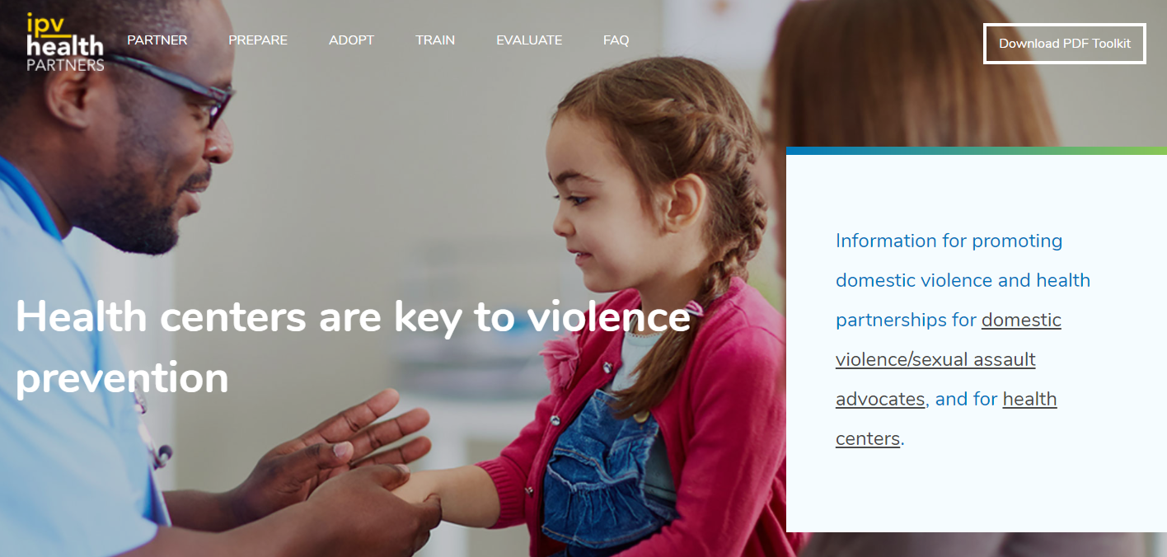
www.ipvhealthpartners.org
Developed by and for community health centers in partnership with domestic violence programs
Notes:
Notes to Trainer: Share that this online toolkit is the go-to resource for the audience to learn more and find related tools and resources related to today’s training. www.ipvhealthpartners.org was developed by Futures Without Violence in an earlier Project Catalyst phase of work informed by twenty participating community health centers and domestic violence advocacy programs.

Slide 38
Health Center Services
Karen Smith, MSW, LCSW
Southwest Community Health Center
Notes:
Notes to Trainer: Trainers briefly introduce themselves and summarize the agenda, giving participants a quick sense of the flow and what to expect. Thank health center key staff or local DV advocacy key staff for hosting and arranging the room/food/etc. and helping to coordinate training details or logistics. Recognize any key leaders who were instrumental in making the training happen. Announce where attendees can find the restrooms, and any information about lunch, water/beverages, or other meals being provided.
Add in the names/titles/org for primary trainers.
Consider adding in organizational logos (of trainers) to the bottom of this slide

Slide 39
Health Center Locations

Slide 40
Connecticut Health Centers
392,000 patients across CT
Provide high-quality medical, dental and behavioral heath to all people of all ages.
On site pharmacy, labs, insurance enrollment, translation, nutrition

