Slide 1
Financing Resources for Multifamily Properties

Slide 2
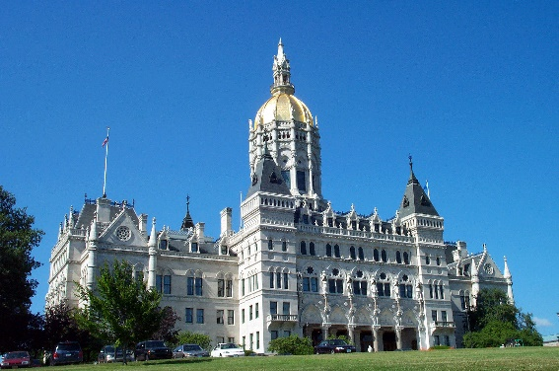
Connecticut Green Bank
Mission Statement and Goals
Confront climate change and provide all of society a healthier and more prosperous future by increasing and accelerating the flow of capital into markets that energize the green economy.
Leverage limited public resources to scale-up and mobilize private capital investment in the green economy of Connecticut.
Strengthen Connecticut’s communities by making the benefits of the green economy inclusive and accessible to all individuals, families, and business.
Pursue investment strategies that advance market transformation in green investing while supporting the organization’s pursuit of financial sustainability.
2
2

Slide 3
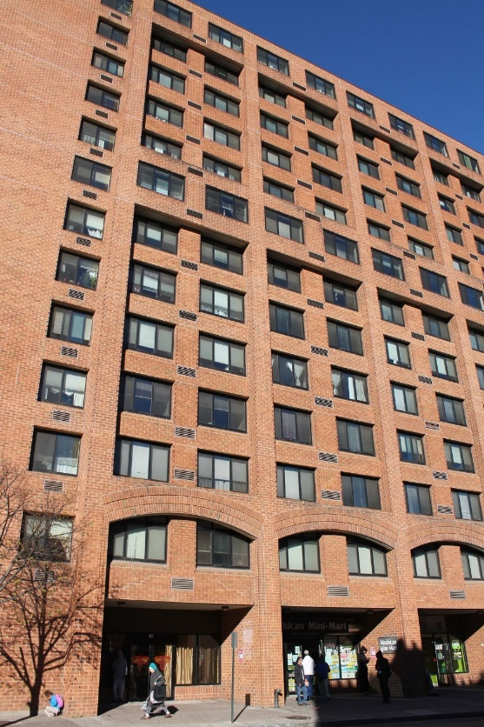
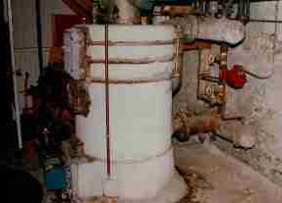
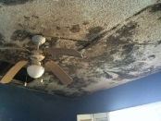
Challenges with CT’s older and aging housing stock
Over 70% of residential units built before 1979 – in need of capital improvements that include health and safety
CT has amongst the highest energy costs and energy burdens in the country, with low income residents the hardest hit
Energy improvements can reduce energy
and other operating costs for owners and residents
H&S issues must often be addressed before energy improvements can be implemented

Slide 4
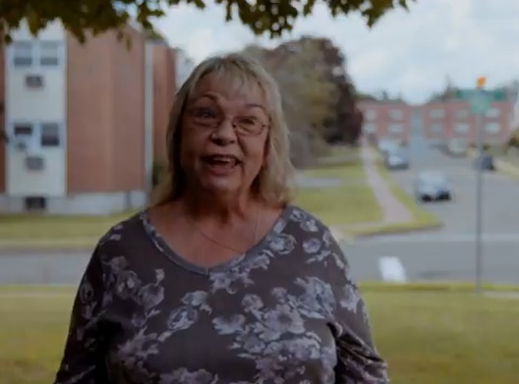
How the numbers work:
Unlocking Cash Flows to Stabilize Property
East Meadow Condo Association, Manchester, CT
Description: | Lighting, boilers, roof replacement, insulation
Total Project Costs: Utility Incentives: Financed: | $654,000 $34,000 $620,000
Est Annual Savings: Annual Debt Service: | $79,000 $53,000, 1.48 DSCR
Est Free Cash Flow: | $26,000
Financing Terms: | 20 years, 6.00%
Payback Period: | 7.8 years
www.ctgreenbank.com/our-stories/#multifamily
Energy improvements yield significant savings, unlocking cashflows that cover debt service – often for additional capital improvements.

Slide 5
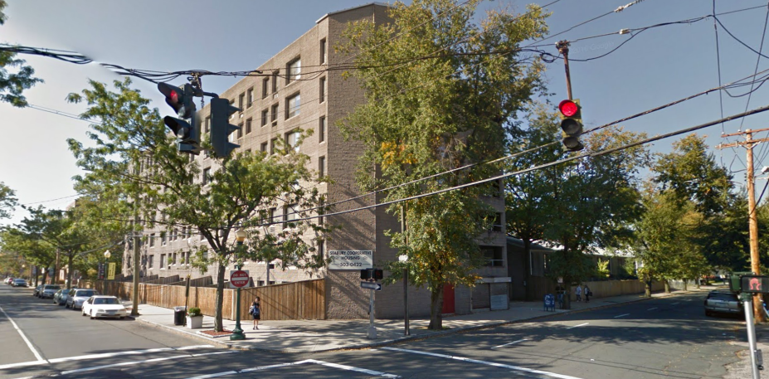
Health & Safety and Pre-Dev Loans
Unlocking Cash Flows to Stabilize Property
Seabury Coop, New Haven, CT
Seabury Coop, New Haven
88 units, adj. to Yale campus
Annual energy costs: over $226K per year (> 200/unit/ month)
Health & Safety Loan: $150K REAC repairs, electrical hazards
Pre-Dev Loan funds: $350K from Green Bank and HDF; $500K UHAB
Energy Upgrades: electric boiler replacement, lighting, windows, roof insulation

Slide 6
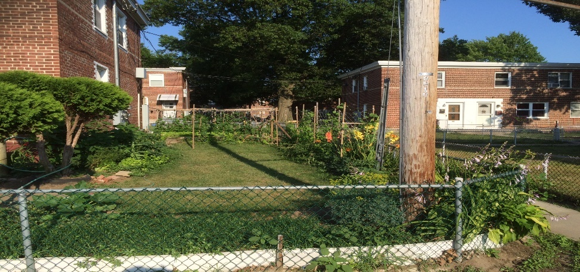
Health & Safety and Pre-Dev Loans
Unlocking Cash Flows to Stabilize Property
Success Village Coop: Bridgeport, CT
964 units, WW2 workers housing, central heating plant circa 1960’s
Annual heating costs: $1.8M (> $155/unit/month)
Health & Safety Loan: $165K for removal of asbestos (pilot phase)
Technical Assistance: Governance support from UHAB, preliminary engineering and development TA from Green Bank team
Pre-Development Loan: $150K for engineering analysis, design, development and funding of new heating systems (pilot phase)
Implementation cost
estimate: $10-15MM

Slide 7
Definitions
“Multifamily”
5+ units
Income eligible and market rate
Private and non-profit owners
Public housing authorities
Senior / assisted living communities
Condominiums
Co-operatives
“Affordable”
>60% of property’s units must offer rents affordable to tenants earning <80% of area media income (AMI)
Affordable rents assume <30% of household income is spent on housing costs
Affordable rent figures include all utility costs
For condos and co-ops, total housing costs are considered, rather than rents
  Mortgage
  Insurance
  Taxes
  Utilities
  Association Fees

Slide 8
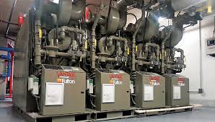
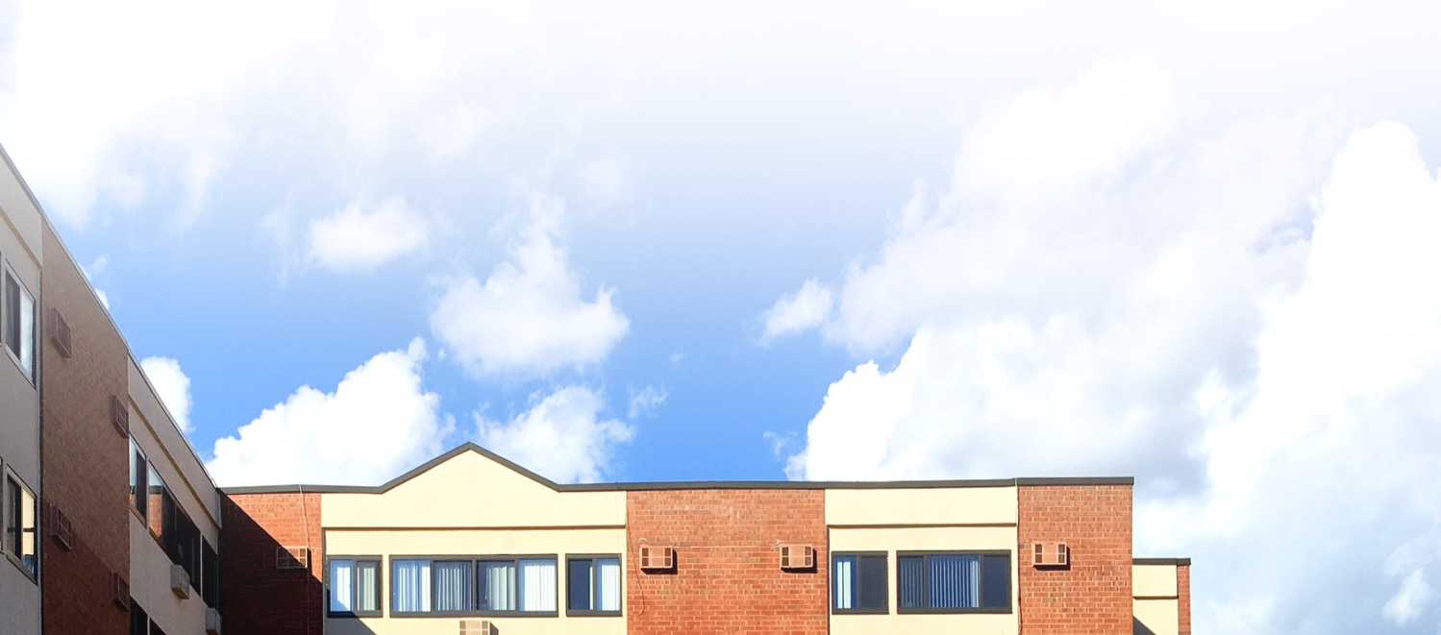
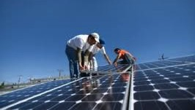

Eligible energy efficiency and renewable energy improvements
Heating and cooling systems
Hot water systems
Building envelope
Lighting and appliances
Water efficiency
Renewable energy systems (solar PV,
solar thermal and others)
Conversion from oil or electric to gas
Qualified health and safety measures

Slide 9

Pre-development Loan Programs
Navigator Loan Program
Type
Rate
Loan Process
Pre-development
Affordable properties 1.99%;
Market-rate properties 3.99%
Client pays 25%; program loans 75%
Owners select their own energy professionals
To fund energy-related assessments, audits, and design.
Passive House → ability to fund more $$$
Type
Rate
Loan Process
Pre-development
Affordable properties 1.99%;
Market-rate properties 3.99%
Client pays 25%; program loans 75%
Funds technical assistance by New Ecology, Inc.

Slide 10



Energy Project Financing
LIME
Type
Rate
Term
Criteria
All MFH
6.00-7.00%
5-20 years
1.1x+ project Energy
Savings Coverage Ratio*
Type
Rate
Term
Criteria
Affordable projects
2.99% + 05% loan fee
Up to 20 years years
Enable energy upgrades
Health &
Safety Loan
Solar PPA
Type
Rate
Term
Criteria
Solar projects
Fixed or escalating price
20 years
10%+ Year 1 Variable
Electric Rate Savings
* For solar projects; efficiency projects must be 1.3x+
Notes:
C-PACE
Market-rate projects
5.00-6.50%
5-25 years
1.0x+ Energy Savings
Coverage Ratio
Type
Rate
Term
Criteria

Slide 11
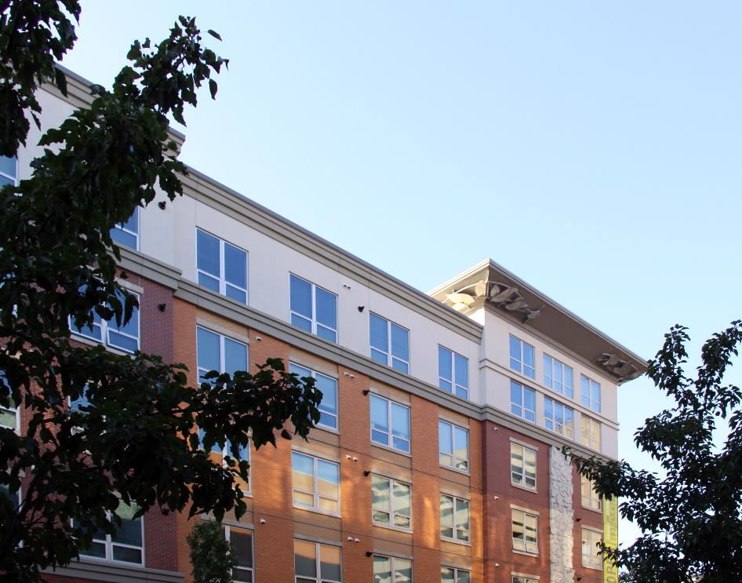
LIME Loan

Slide 12
Loans Improving Multifamily Efficiency (LIME)
Offered through Capital for Change
Eligible costs include:
    Any and all energy efficiency and renewable energy improvements
    Up to 25% of loan proceeds may be used for non-energy efficiency improvements (structural, health/safety, etc.)
Type | Unsecured; underwritten to savings
Rate | 6.00% – 6.99%
Loan term | 5 – 20 years
Origination fee | 2.00%
Underwriting Criteria | 1.30X or greater project energy savings coverage ratio; 1.10X or greater energy savings ratio for solar-only projects

Slide 13
ECT Health & Safety Revolving Loan Fund

Slide 14
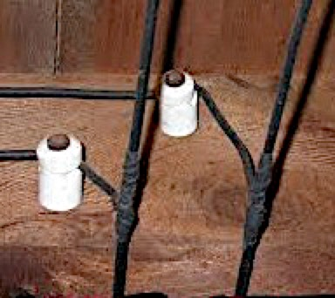
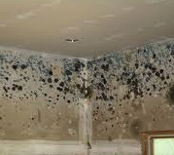
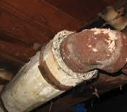
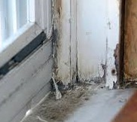
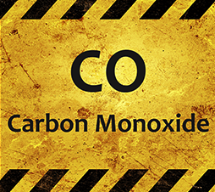
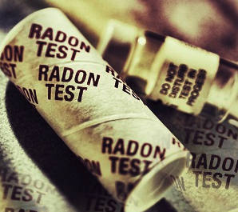
What can the ECT Health &
Safety Loan fund?
Knob & Tube Wiring | Mold/ Water Leaks | Asbestos
Lead Paint | CO Off-Gassing | Radon
Funding to remove health and safety barriers that must be taken care of in order to implement energy improvements.

Slide 15
Solar PPA

Slide 16
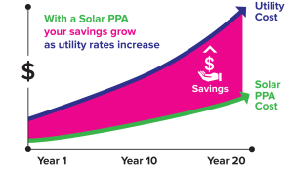
What are the Benefits of a PPA?
No upfront costs (for PV system)
Lock in discounted electricity rate
Positive cash flow
CGB owns operations & maintenance costs
Preserve capital & credit lines
Monetizes value of federal ITC

Slide 17
What are the Benefits of a PPA?
The value of solar PV comes from electricity cost savings!
$10.00
Utility Bill
Savings
$6.25
Solar Electricity via PPA
PPA electricity price: $0.05/kWh
Utility Bill
Retail electricity price: $0.10/kWh
Grid Electricity Only
With Solar PV System
*Representative project for illustrative purposes only

Slide 18

Solar Municipal Assistance Program
Connecticut Green Bank will work with municipalities to develop solar PV projects.
ctgreenbank.com/solarmap/

Slide 19
For more information on pre-development loans, project loans, and technical assistance available through CGB’s multifamily program, please visit:
www.ctgreenbank.com/multifamily

Slide 20

Thank You!
Kim Stevenson
Director, Strategic Initiatives, Inclusive Prosperity Capital
kim.stevenson@ctgreenbank.com

