Slide 1

Health Care Cabinet
May 12, 2015

Slide 2
Agenda
Enrollment Update
Special Enrollment Update
Post OE efforts

Slide 3
Enrollment Update

Slide 4
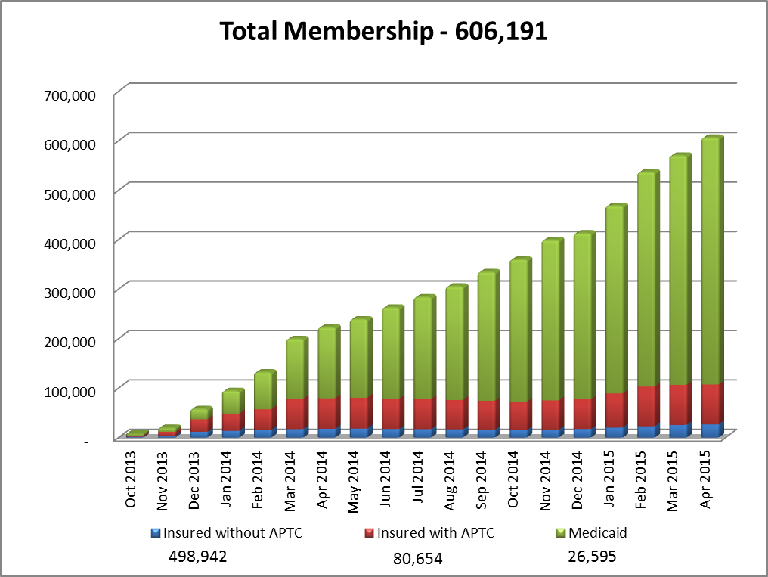
Enrollment
26,595
498,942

Slide 5
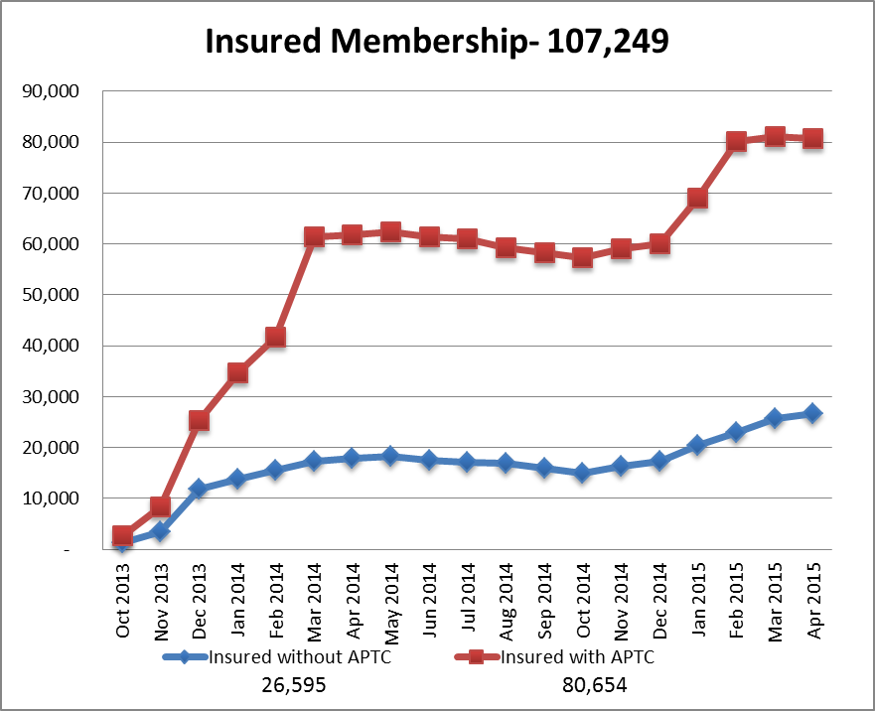
Enrollment

Slide 6
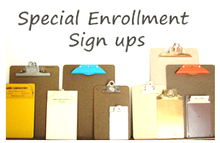
Special Enrollment
AHCT enrolled 1,429 Connecticut residents in private health care plans (QHP) during the Special Open Enrollment Period that ran from April 1, 2015 to April 30, 2015.
The special enrollment period was opened to individuals who did not have health care coverage in 2014 and were subject to a penalty on their 2014 federal taxes.

Slide 7
Open Enrollment Activity Update
Current enrollment volume across all plans and programs stands at 606,191 individuals
Since the start of OE, we have processed more than 107k QHP enrollments and 498k Medicaid enrollments.
  Of these close to 42k were new QHP customers, and over 184k were new Medicaid applicants.
QHP Membership
Medicaid Membership
107,249
41,941
498,942
184, 957
65,308
313,985
Total
Enrollment
New
Enrollment
Repeat
Enrollment
Total
Enrollment
New
Enrollment
Repeat
Enrollment
Note: “New” as anyone who has insurance coverage in CY2015, but did not have coverage in any month in CY2014.
“Repeat” enrollees are individuals who have coverage in both CY 2014 and CY 2015

Slide 8


Additional Membership Information
To date, ConnectiCare continues to see the majority of new enrollments (41.6%)
Anthem is currently taking 1 out of every 3 new enrollments (29.8%)
Healthy CT has seen a dramatic uptick in selection, with nearly a quarter of individuals selecting their plans.
Dental plans and our SHOP program continue to show solid gains
Dental = 1,707
SHOP:
Groups = 186
Members = 1,173

Slide 9
Post Open Enrollment Update
Member census research: 3 main goals
Better understanding of their current enrollee base
Determine at a high level the reasons behind leaving Access Health CT
Make data-driven projections to help answer the question of “Who is left?”
Summer Program Campaign:
Branding, education and retention
Combination of radio, on-site presence (35 locations), digital and online advertising
Partnership with UConn
OE Marketing and Communications campaign platform: Main focuses
Retention
Acquisition

