Slide 1
Radon Overview
CDBG Small Cities
January 28, 2020

Slide 2
Overview
What radon is
How it enters a home
Health effects
Testing and Mitigation

Slide 3
What is Radon?
A naturally-occurring radioactive gas
Colorless, odorless and tasteless
Found all over the U.S. in all types of buildings
  Old or new
  Drafty or well sealed
  With and without basements

Slide 4
Uranium Decay Chart
Radon
Radium
Uranium

Slide 5
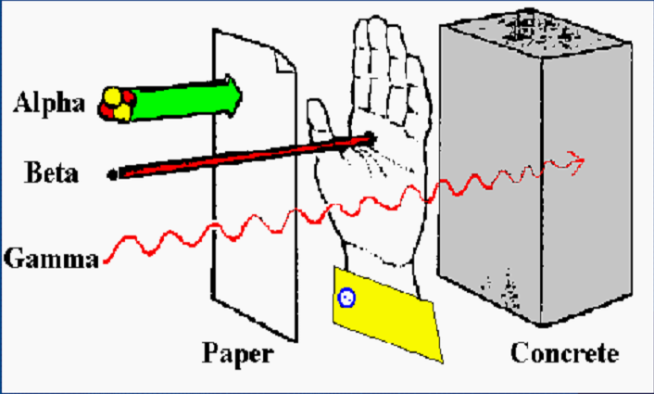
Radiation Types
Radon Penetrating Power

Slide 6
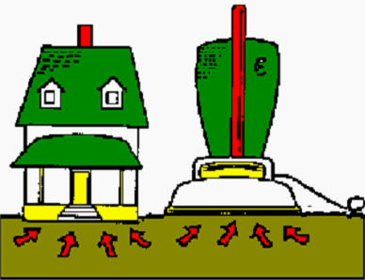
Why It Enters the Home
A home acts like a vacuum drawing gases inside
Driving force is from negative pressure

Slide 7
Radon and Its Health Effects
  Exposure to elevated radon levels increases a person’s risk of developing lung cancer
No immediate health effects
Radon causes no symptoms
The radiation damages lung cells and DNA

Slide 8
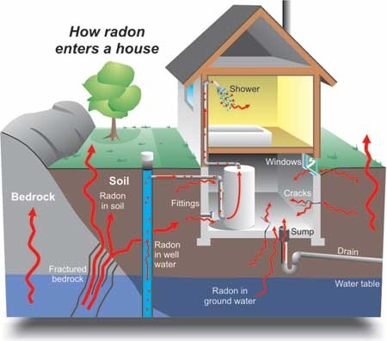
Cracks in solid floors
Construction joints
Cracks in walls
Gaps in suspended floors
Gaps around service pipes
Cavities inside walls
The water supply

Slide 9
EPA Action Level - Air
The EPA recommended action level for radon in air is 4.0 pCi/L
This action level is not a health-based standard
There is no safe level of radon
The EPA recommends that radon levels of >4 pCi/L be reduced to decrease risk of developing lung cancer.
WHO recommendation: 2.7 pCi/L

Slide 10
Testing Is The Only Way To Know

Slide 11
Radon Measurement
DPH recommends using a Nationally Certified Measurement Provider to test for radon
For a single building (single or multi-family), DPH recommends testing the lowest occupied space
A short-term testing device is placed for a minimum of 48 hours to 7 days depending on device used

Slide 12

Radon mitigation systems:
effective
relatively inexpensive
easy to install
Average Cost = $1,200

Slide 13
Radon Mitigation
DPH recommends using a Nationally Certified Mitigation Provider to perform radon mitigation
  Must be nationally certified through NRSB or NRPP
  Must be a home improvement contractor registered with CT’s Department of Consumer Protection

Slide 14
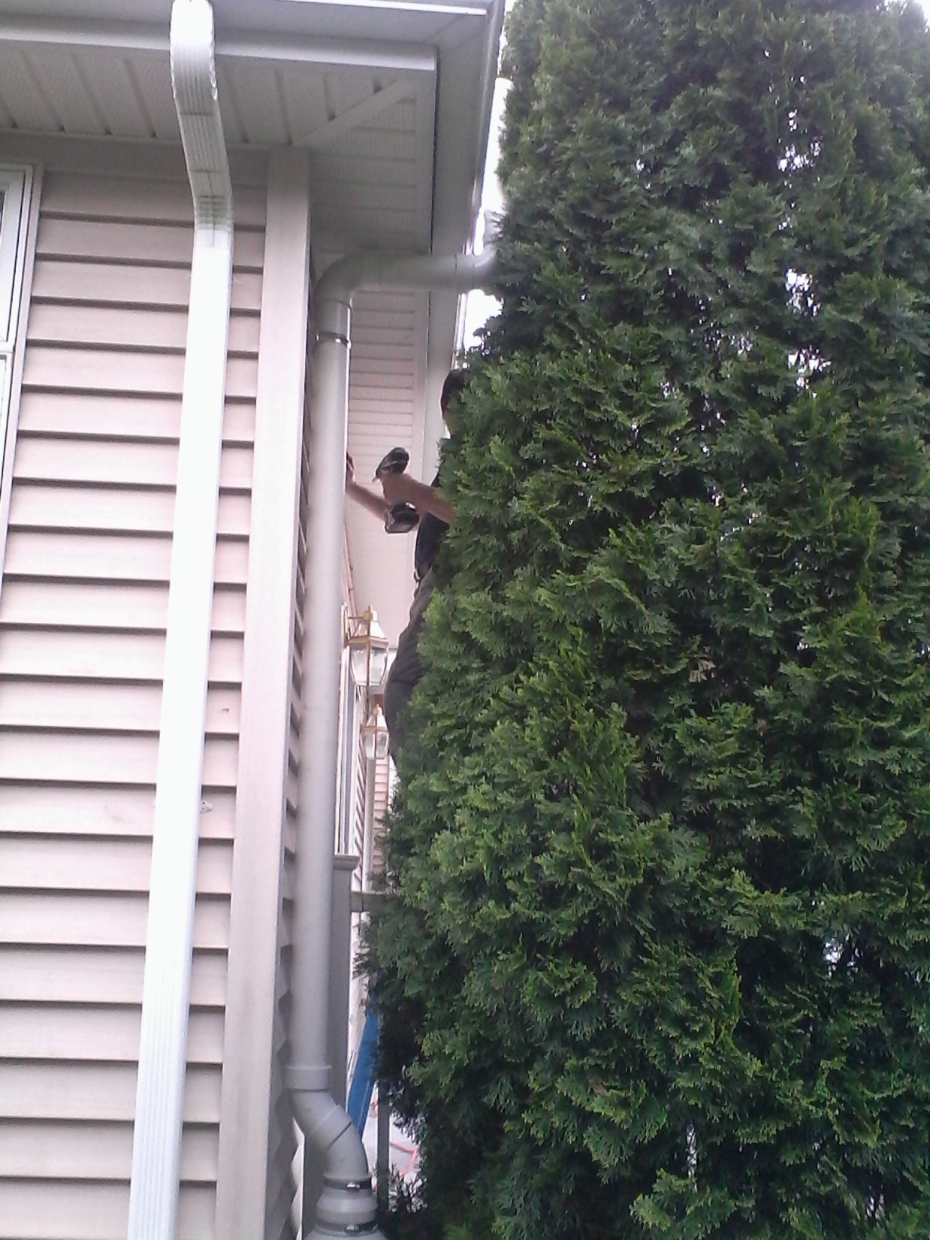

Slide 15
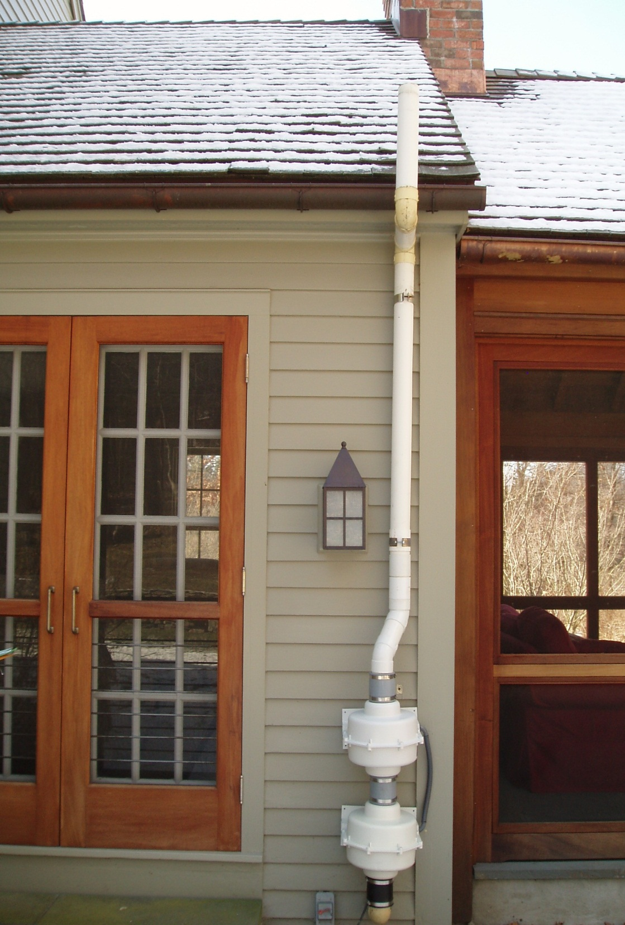

Slide 16
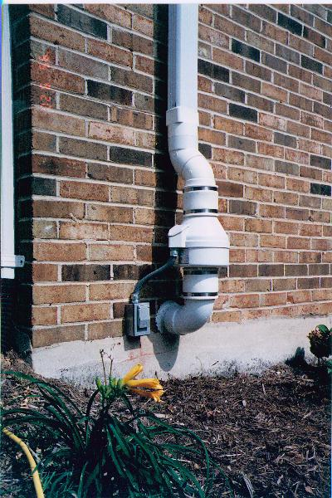
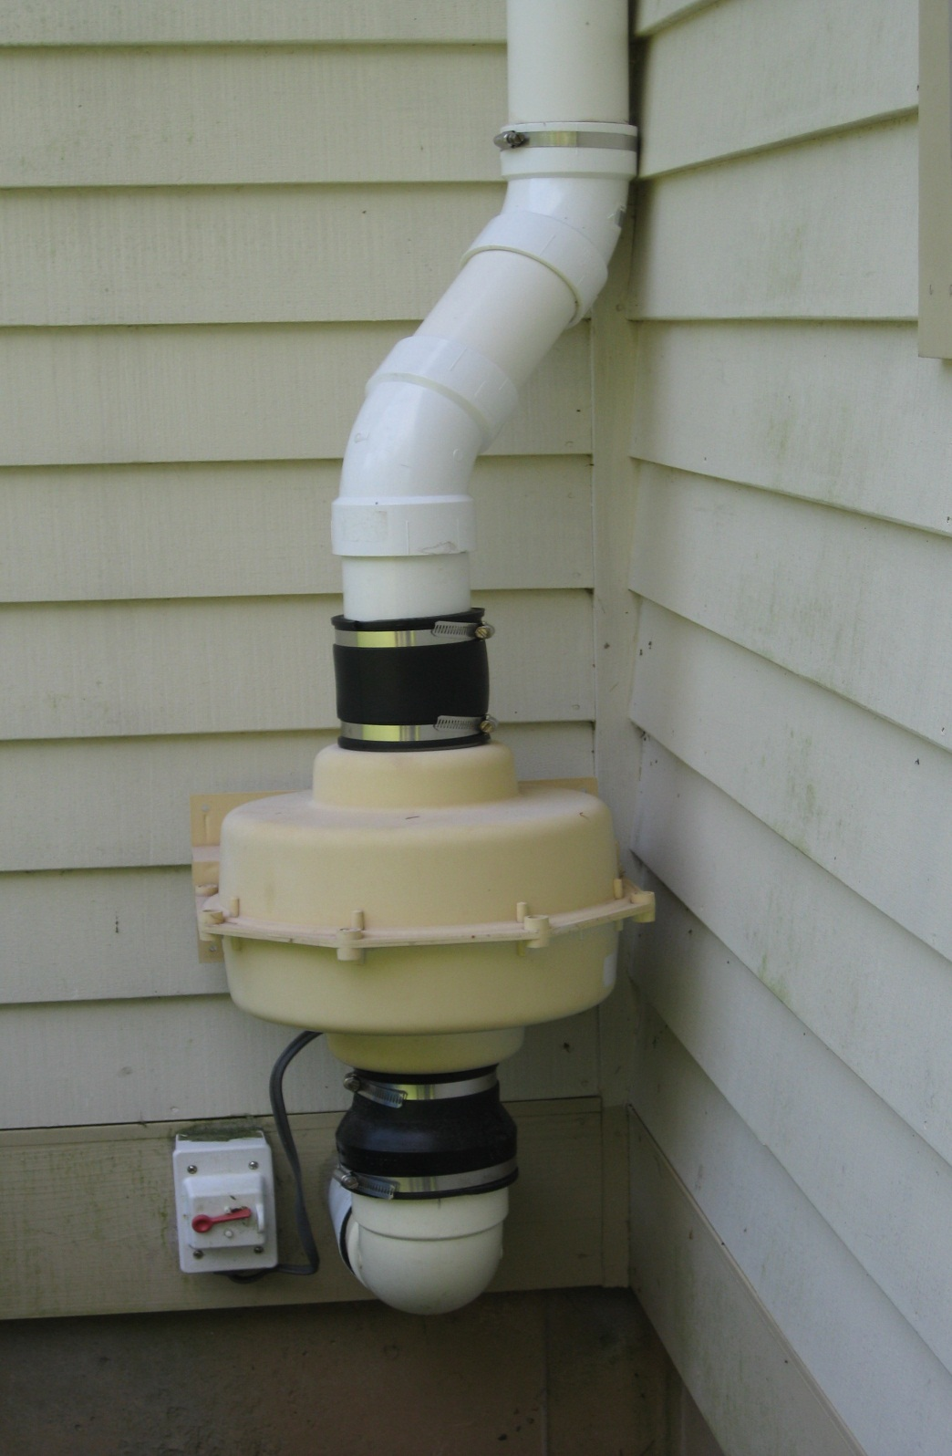

Slide 17
Contact Information:
Allison Sullivan
Environmental Analyst
State of Connecticut
Department of Public Health
(860) 509-8140
allison.sullivan@ct.gov

Slide 18


